Slide 1


Year 5 – Summer Block 2 – Properties of Shape
Step 4: Drawing Lines and Angles Accurately
© Classroom Secrets Limited 2018

Slide 2
Introduction
Match these equivalent millimetres and centimetres and order them from smallest to largest.
5cm
50mm
36mm
10mm
5mm
0.5cm
4.5cm
45mm
3.6cm
1cm
© Classroom Secrets Limited 2018

Slide 3
Introduction
Match these equivalent millimetres and centimetres and order them from smallest to largest.
Smallest
Largest
5mm
10mm
36mm
45mm
50mm
0.5cm
1cm
3.6cm
4.5cm
5cm
© Classroom Secrets Limited 2018

Slide 4
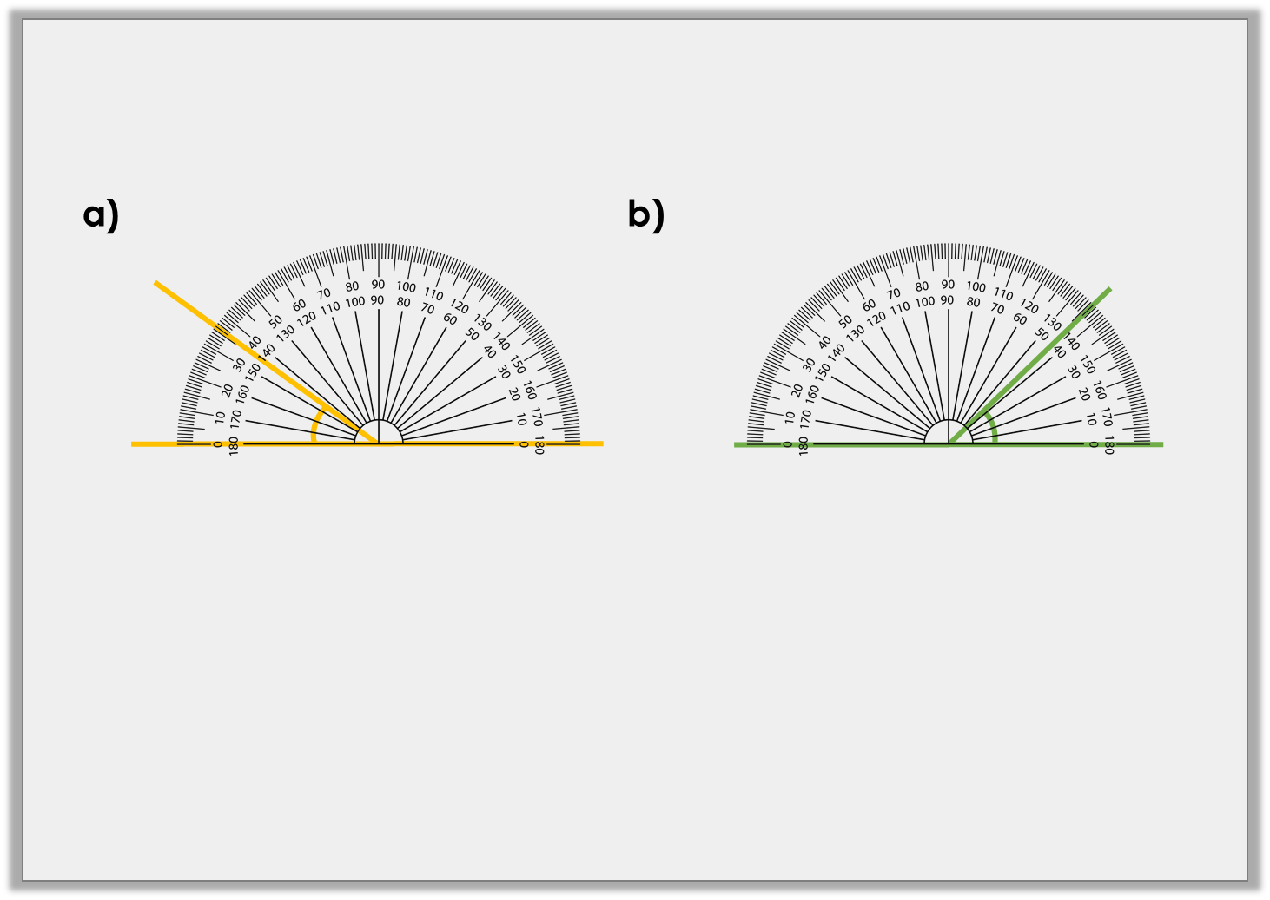
Varied Fluency 1
Draw angles that are 35˚ larger than these:
© Classroom Secrets Limited 2018

Slide 5
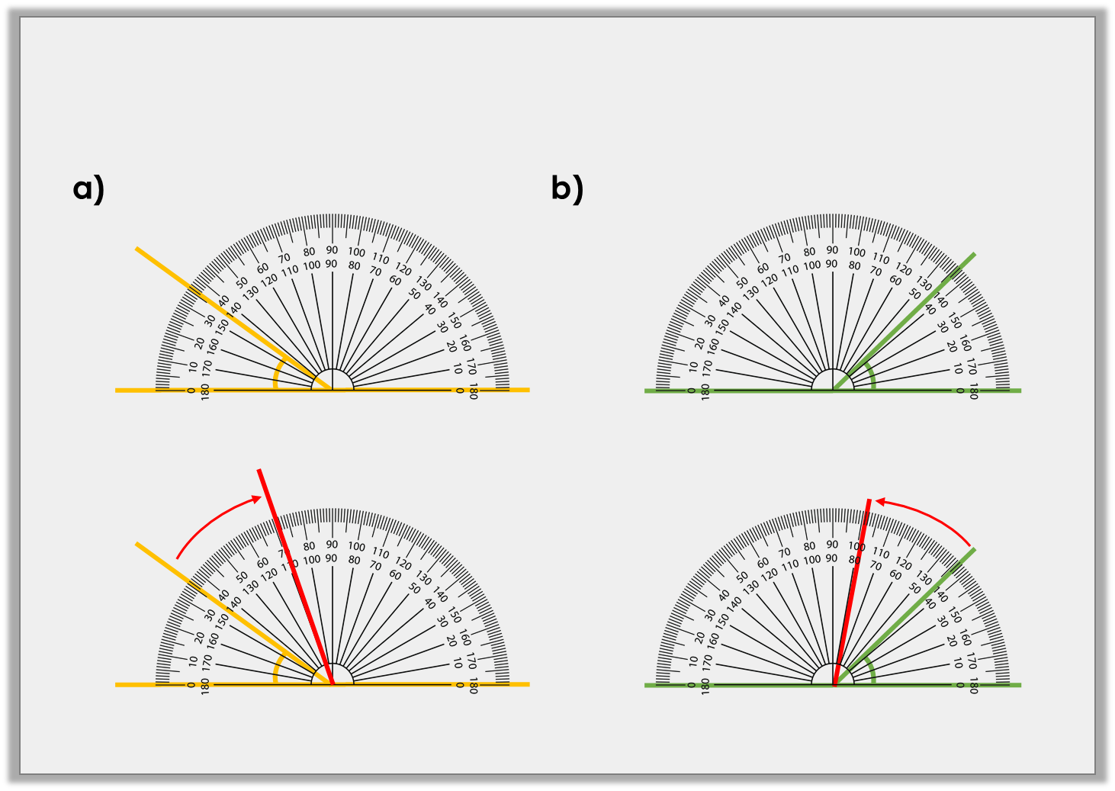
Varied Fluency 1
Draw angles that are 35˚ larger than these:
= 71˚
79˚ =
35˚ +
+ 35˚
36˚
44˚
© Classroom Secrets Limited 2018

Slide 6
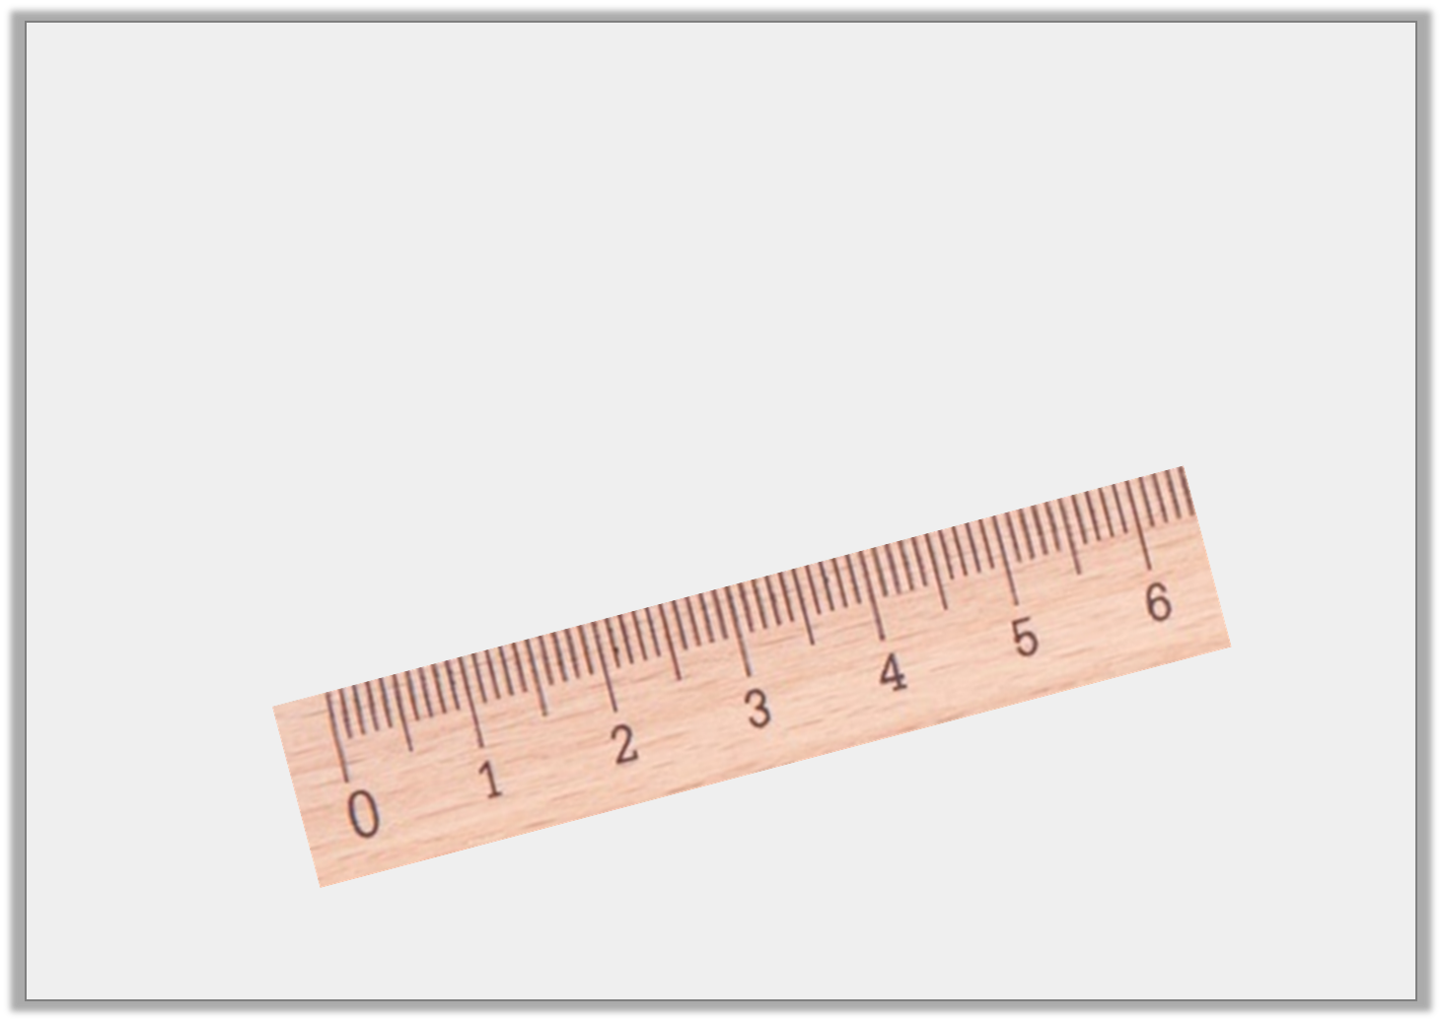
Varied Fluency 2
Draw a line to connect the dots.
Circle the closest length.
5.5cm | 5cm 2mm | 49mm
B
A
(not to scale)
© Classroom Secrets Limited 2018

Slide 7
Varied Fluency 2
Draw a line to connect the dots.
Circle the closest length.
5.5cm | 5cm 2mm | 49mm
B
A
(not to scale)
© Classroom Secrets Limited 2018

Slide 8
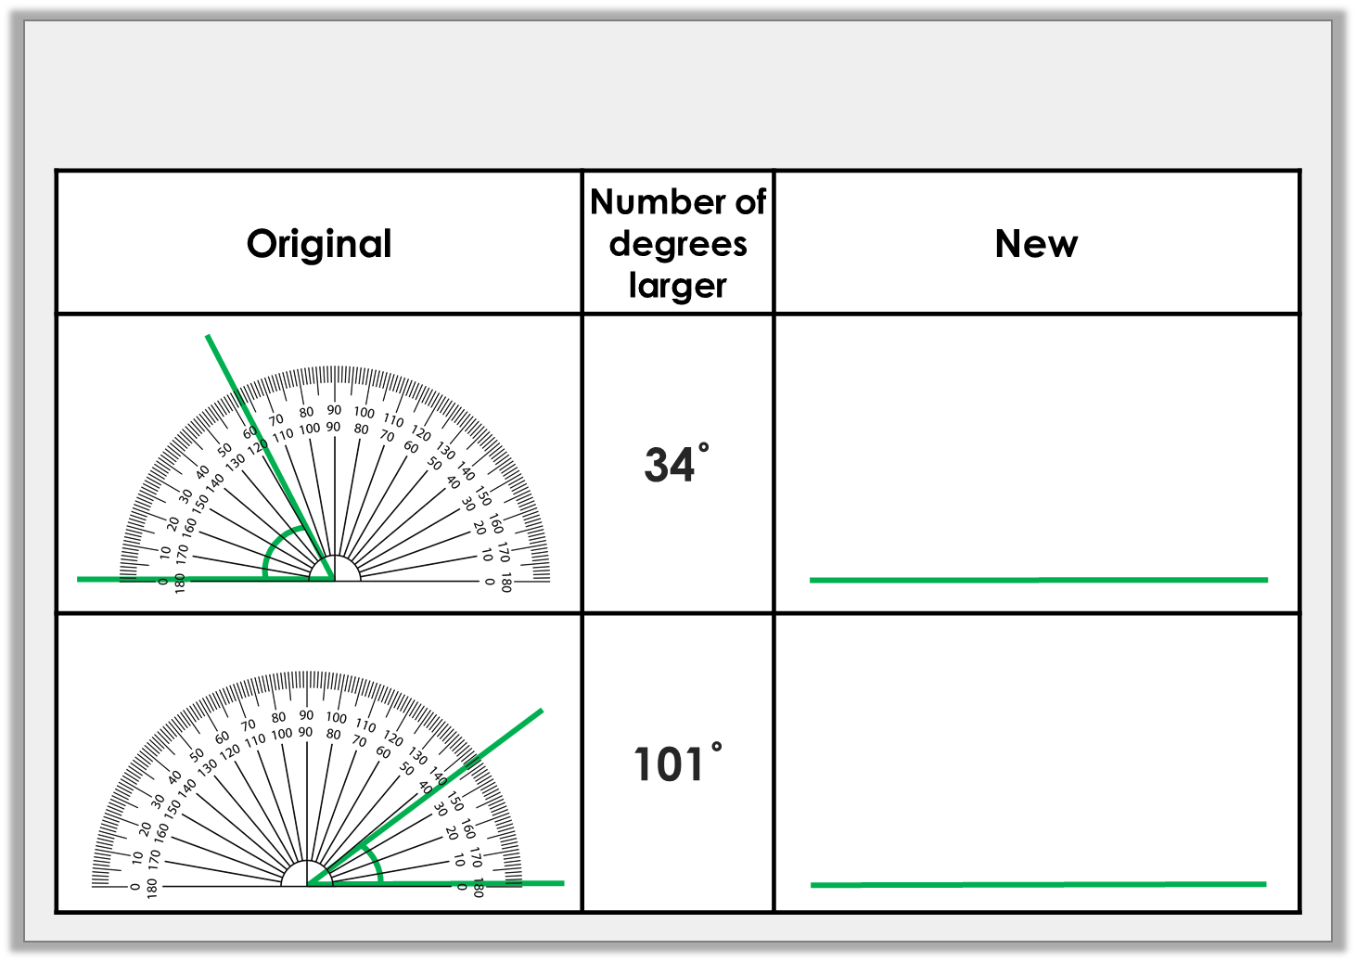
Varied Fluency 3
Complete the table.
© Classroom Secrets Limited 2018

Slide 9
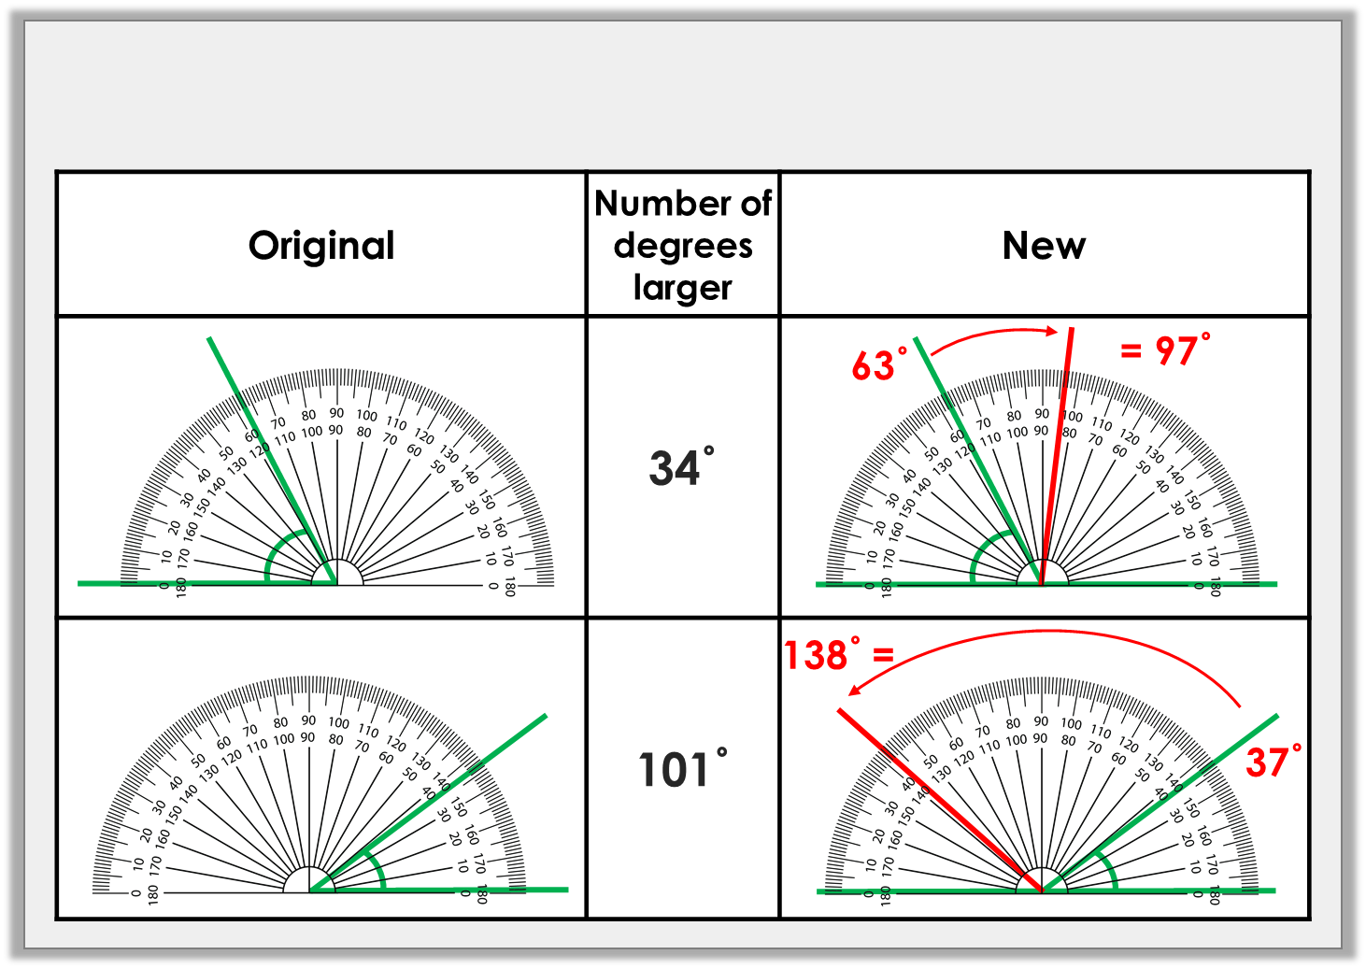
Varied Fluency 3
Complete the table.
© Classroom Secrets Limited 2018

Slide 10
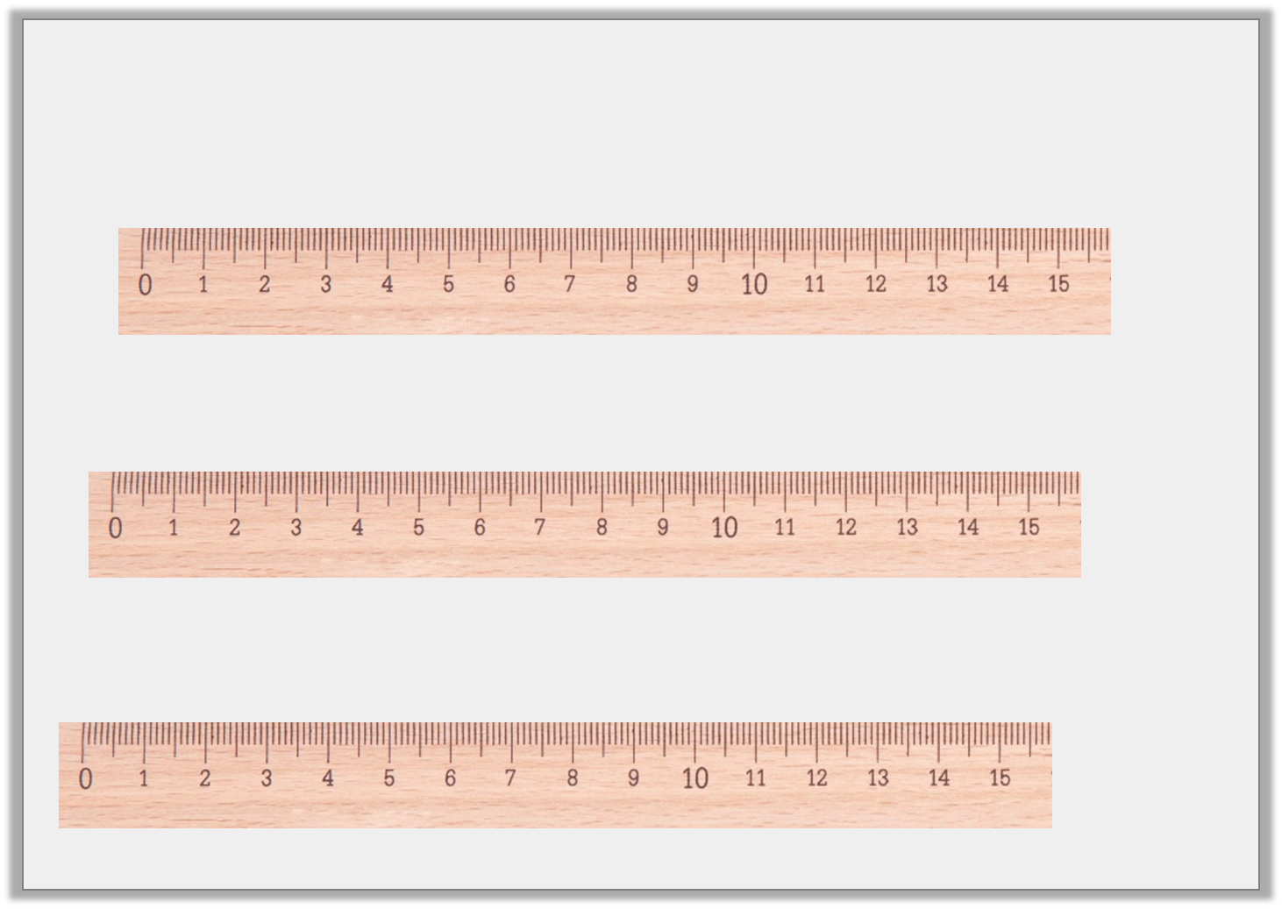
Varied Fluency 4
Draw lines that are 26mm longer than these:
(not to scale)
© Classroom Secrets Limited 2018

Slide 11
Varied Fluency 4
Draw lines that are 26mm longer than these:
71mm + 26mm = 97mm
59mm + 26mm = 85mm
89mm + 26mm =
115mm
(not to scale)
© Classroom Secrets Limited 2018

Slide 12
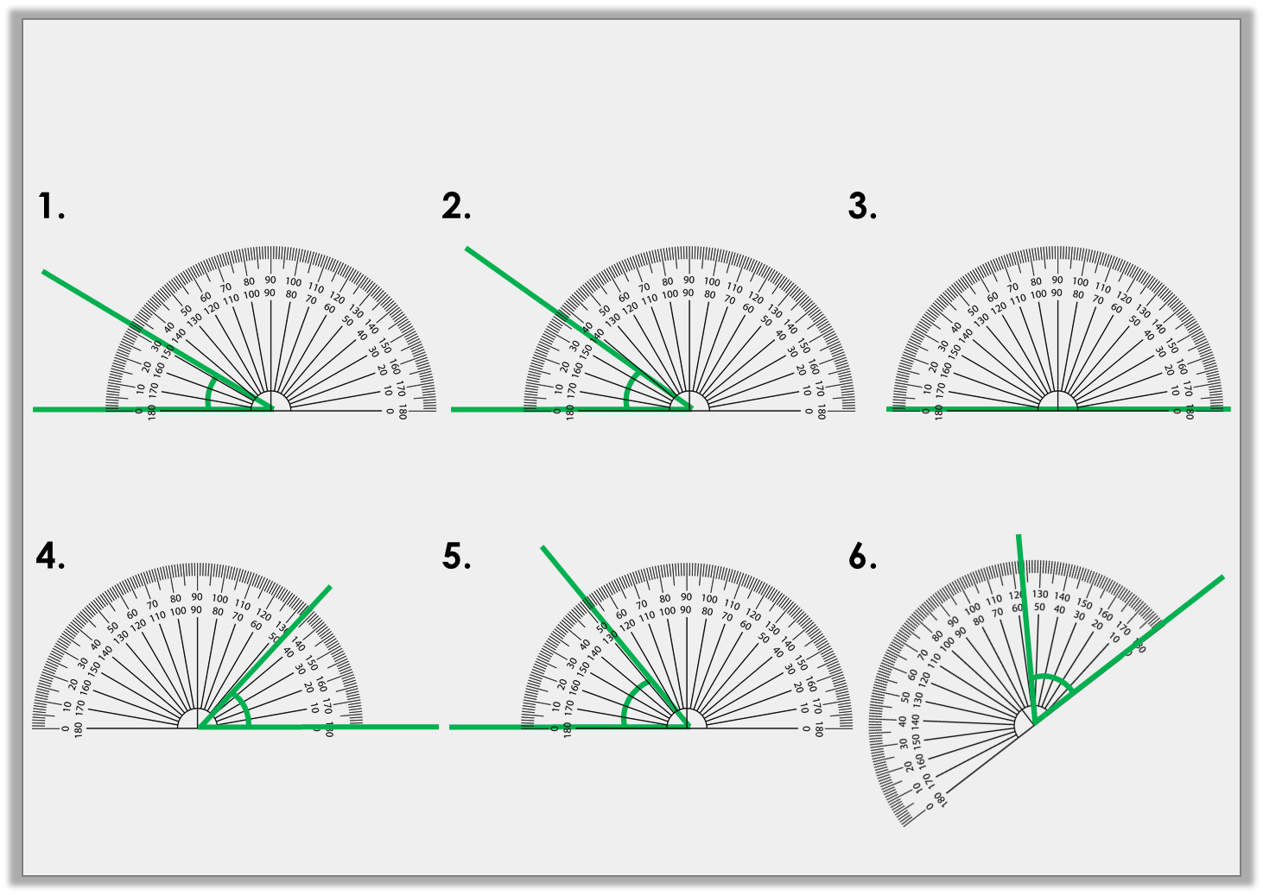
Problem Solving 1
Draw the missing angle in the sequence.
?˚
© Classroom Secrets Limited 2018

Slide 13
Problem Solving 1
Draw the missing angle in the sequence.
42˚
42˚
32˚
37˚
47˚
52˚
© Classroom Secrets Limited 2018

Slide 14
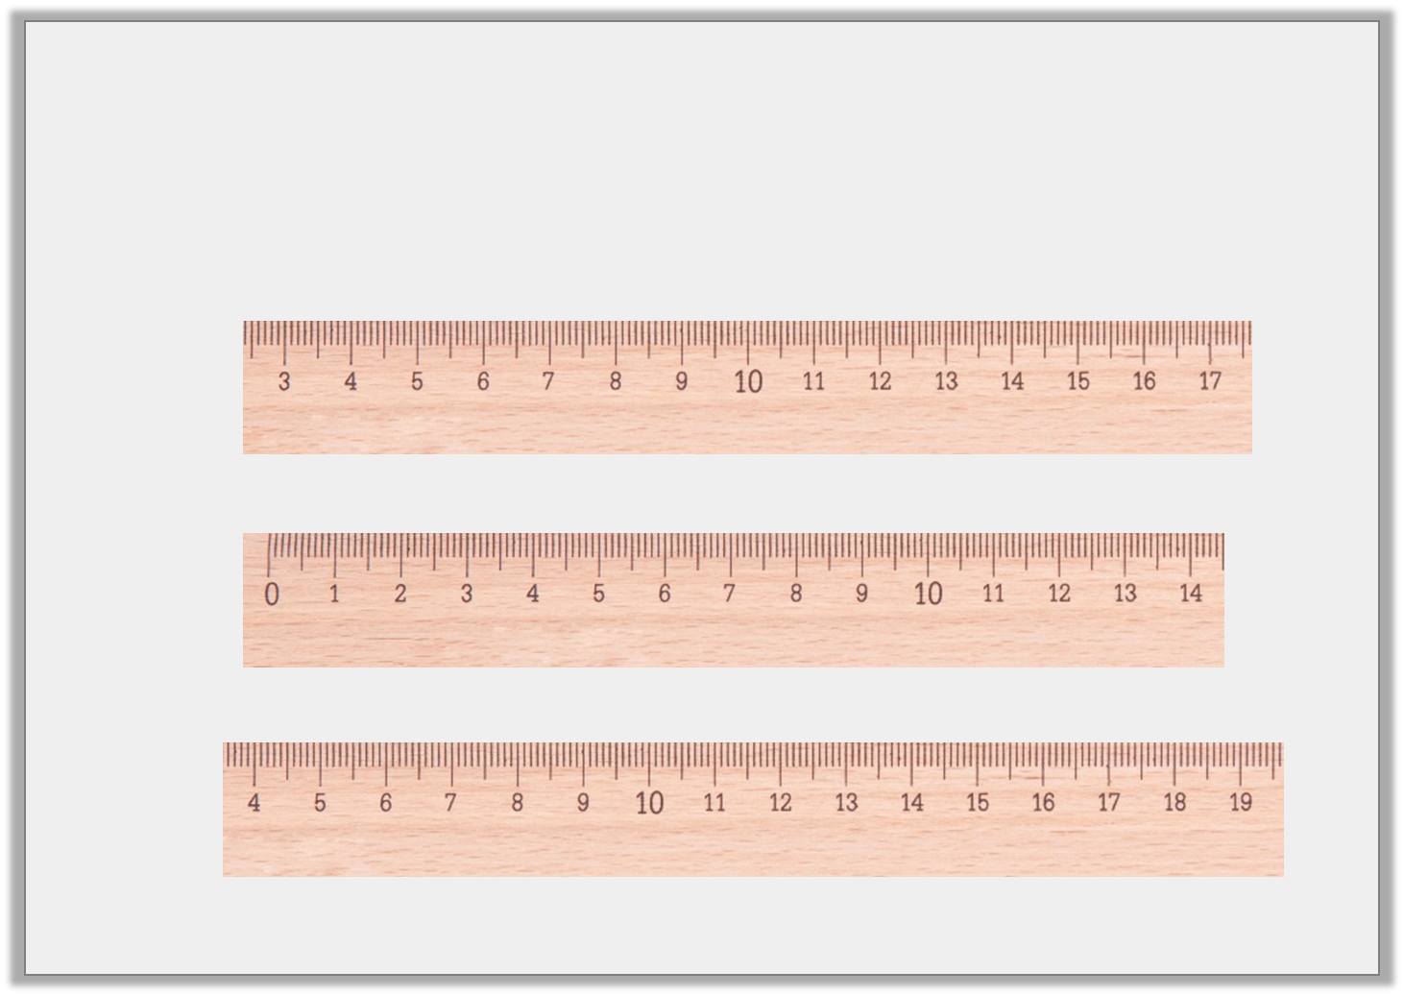
Reasoning 1
Draw lines which are:
Which new line is odd one out? Convince me.
22mm longer than A | 33mm shorter than B | 3cm 1mm longer than C
A
B
C
(not to scale)
© Classroom Secrets Limited 2018

Slide 15
Reasoning 1
Draw lines which are:
Which new line is odd one out? Convince me.
B is the odd one out because …
22mm longer than A | 33mm shorter than B | 3cm 1mm longer than C
A
102mm + 22mm = 124mm
B
124mm – 33mm = 91mm
C
9.3cm + 3.1cm = 12.4cm
(not to scale)
© Classroom Secrets Limited 2018

Slide 16
Reasoning 1
Draw lines which are:
Which new line is odd one out? Convince me.
B is the odd one out because A’ and C’ are both 12.4cm.
22mm longer than A | 33mm shorter than B | 3cm 1mm longer than C
A
102mm + 22mm = 124mm
B
124mm – 33mm = 91mm
C
9.3cm + 3.1cm = 12.4cm
(not to scale)
© Classroom Secrets Limited 2018

Slide 17
Problem Solving 2
Davina has drawn some lines and angles. She is describing one of the lines to her friend.
My line measures 15cm 4mm.
My line intersects another at 155˚.
Which line is she describing?
A
D
B
C
(not to scale)
© Classroom Secrets Limited 2018

Slide 18
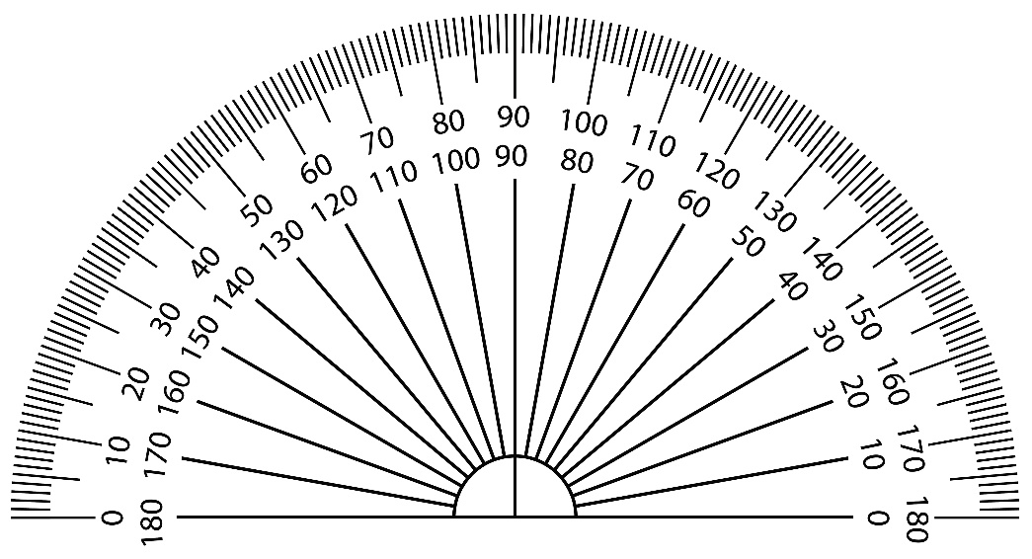
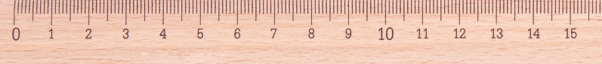
Problem Solving 2
Davina has drawn some lines and angles. She is describing one of the lines to her friend.
My line measures 15cm 4mm.
My line intersects another at 155˚.
Which line is she describing?
B
A
D
B
C
(not to scale)
© Classroom Secrets Limited 2018

