Slide 1
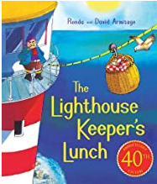
Good morning Year 2 Friday 19th June
English
This week our seaside story is ‘The Lighthouse Keepers Lunch’.
We have been writing a playscript. In class, this would take us a few days because we would practise our words before writing it on paper. You could practise with someone and make your playscript come alive.
The features of a playscript are:
set the scene including who, where, what and sound and lighting
stage direction
character direction
conversation flows
Today we are editing our playscripts. But what does that mean?
Some of you may have ‘The Lighthouse Keepers Lunch’ on your shelf. Read it or listen to a grown up read it to you.
Or, listen to the story using this link:
https://www.youtube.com/watch?v=46wCRq50Wwg

Slide 2
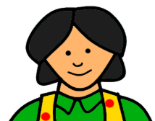
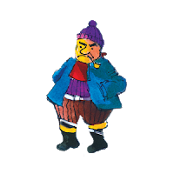
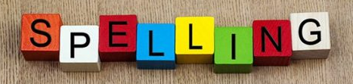
Friday 19th June
English
Editing means that you read your writing and think about:
* word choices
* punctuation
* sense
* spelling
* setting out
Practise editing by reading my play script. Can you find 10 errors?
good morning mr grinling. How are you today
I am going cleen and polish my lite today. What is for lunch
I have maid lighthouse sandwiches peach surprise and iced sea biscuits.
Now check your playscript. Ask someone else to check it too!
Handwriting Use the paper on our Year 2 class page to practise your handwriting. Careful with size and shape.
Spelling Practise your spellings. This week we are adding the suffixes less and ly. Keep practising. Which method of practising suits you best?

Slide 3
Friday 19th June
Maths
Today, have a look at the questions in Measurement Year 2. Some are easy and some are not so easy. Challenge yourself to try them all.
We have not learned how to tell the time yet, so don not worry about those, unless you would like to try them. I have already suggested that you practise o’clock and half past times.
Next week our maths will be telling the time.
The word ‘mass’ is used. When we speak we usually say weight. It is measured in g and kg.

Slide 4
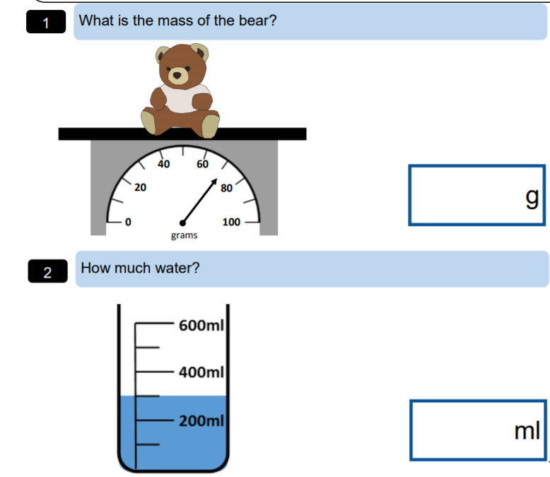
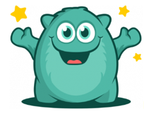
Friday 15th June
Look at the scale. What is it counting in?
Make sure it works before writing your answer.
61 g
62g
65 g
70 g Which one is correct? Yes 70 g.
Look at the scale. What is it counting in?
Make sure it works before writing your answer.
201 ml 250 ml 300 ml
Yes 300 ml is correct
Don’t forget to check in to Prodigy for 20 mins each day. I can see how many questions you try and how many you get right. Great work everyone on Prodigy – keep it going.

Slide 5
Friday 19th June
English
Editing means that you read your writing and think about:
* word choices
* punctuation
* sense
* spelling
* setting out
Practise editing by reading my play script. Did you find all 10 errors?
Good morning Mr Grinling. How are you today?
I am going to clean and polish my light today. What is for lunch?
I have made lighthouse sandwiches, peach surprise and iced sea biscuits.
Did you spot 10 errors?
Look at the last slide to check you found them all.

