Slide 1
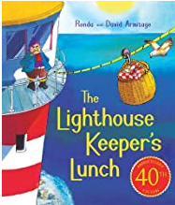
Good morning Year 2 Thursday 18th June
English
Here is the link again so that you can listen to the story.
https://www.youtube.com/watch?v=46wCRq50Wwg
Yesterday, we wrote a simple playscript. Today we are going to make it much more like a real playscript. We are going to:
set the scene including sound and lighting
add character direction
add stage direction
First you will need to cut up your playscript from yesterday into strips, one per speech.

Slide 2


Thursday 18 June
English
When you have cut up your playscript it will look like this.
Set the scene first.
Cut out the yellow strip from the Playscript file. Use it to write 2 or 3 sentences to describe the scene in the present tense. Include: where the action takes place, who is there at the beginning of the scene, think about lighting and sounds.

Slide 3
Thursday 18 June
English
Mrs Grinling is the only person in the kitchen at the start.
Lighting could be
dull, misty morning
bright sunny morning
dull with dark, thundery clouds
Sounds might include:
birds singing noisily outside
Hamish purring by the door
the radio playing lively music or the weather forecast
Have a think and then decide what to write.
Look at mine.
Did I include all of these?
Where?
Who?
Sound?
Lighting?
Present tense?
Now you try.
In the kitchen of the cottage, Mrs Grinling has just finished making Mr Grinling’s lunch. It is a bright sunny morning after a rainy night and the birds are singing loudly in the trees outside.

Slide 4
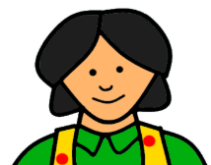
Thursday 18 June
English
Character direction is easy.
How did the characters speak? What kind of mood are they in?
After their picture write in a word or two (very short) to give the actor an idea about how to say the words. Write the words in brackets to show they are not spoken.
(crossly) Now where did I put Hamish’s toy mouse? He’ll need that today.
The actor would say these sentences differently depending on whether they were being cross or cheerful or speaking in a sing songy way.
(cheerfully) Now where did I put Hamish’s toy mouse? He’ll need that today.
(in a sing songy voice) Now where did I put Hamish’s toy mouse? He’ll need that today.
You do not need character direction every time. Choose2 or 3 or 4 strips to add character direction to. Remember the bracket.

Slide 5
Thursday 18 June
English
Finally let’s add stage direction.
Stage direction tells the actors when to move and where to move to on the stage. You will only need 1 or 2 of these.
Use your purple strips of paper for this.
Mrs Grinling is on her own in the kitchen. Who comes in?
Now you try . Read your playscript. Where do you need to tell the actors to move? Write it on purple paper and place it in the correct place in your playscript.
Now can you see why we needed to cut it up into strips?
Mr Grinling walks into the kitchen smiling. He stands by the window.

Slide 6
Thursday 18th June
English
It should look something like this:
In the kitchen of the cottage, Mrs Grinling has just finished making Mr Grinling’s lunch. It is a bright sunny morning after a rainy night and the birds are singing loudly in the garden outside.
Mr Grinling walks into the kitchen smiling. He stands by the window.
Now you can tape them together and perform your playscript. Yours will be longer than this or course. Or you could write it out in your book.

Slide 7
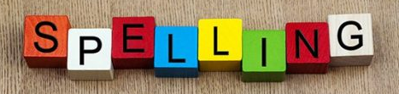
Thursday 18 June
English
I hope that was not too tricky to follow. The main thing is to enjoy making up a conversation and then think about what you would want to tell the actors who would perform your play.
Handwriting Use the paper on our Year 2 class page to practise your handwriting. Careful with size and shape.
Spelling Practise your spellings. This week we are adding suffixes less and ly. Keep practising. Which method of practising suits you best?

Slide 8
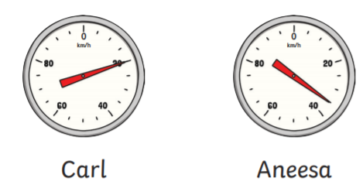
Thursday 18th June
Maths
Look at the Reading Scales file.
For each question look at the scale and check what it is counting in. Ones? Twos? Fives? Tens?
How fast are these people going?
The numbers go up 20, 40, 60, 80.
But look at the lines in between. Start at 0.
Count in ones – no
Count in twos – no
Count in fives – yes that works. I said 20 in the right place.
So how fast are they going?
Carl 20 km/h Aneesa 35 km/h
Check you got the same answer. Print out the questions or answer them in your book. Remember to write the date the maths way 18 – 06 - 2020

Slide 9

Thursday 18th June
Maths
Don’t’ forget Prodigy. It helps keep your all round maths skill sharp while you are at home.
Check in to Prodigy for 20 mins each day. I check in frequently throughout the week.
The Leader Board changes every day. Some times it changes within a day.
Only 3 people can be on the Leader Board, which means that 27 people can not. Work hard for your own progress. How man questions did you do last week? How many ‘Skill Completes’ have you got? Have you moved up a level.

