Slide 1
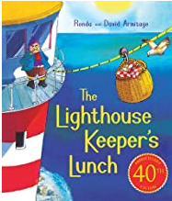
Good morning Year 2 Tuesday 16th June
English
Let’s think about some of words in the story and see if we can think of
some alternatives.
Here is the link again so that you can listen to the story.
https://www.youtube.com/watch?v=46wCRq50Wwg
Read these sentences from the story and see if you can think of
alternative words for the underlined word.
Once there was a lighthouse keeper called Mr Grinling.
I have changed the word to:
Once there was a lighthouse keeper named Mr Grinling.
Once there was a lighthouse keeper whose name was Mr Grinling.

Slide 2
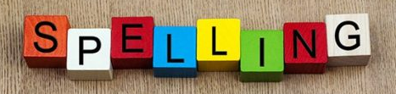
Tuesday 16th June
English
Now you try. Think of different words to use in place of the blue underlined words. The sentence still has to make sense of course. Be adventurous in your word choices. Have you got a thesaurus? Or ‘enable editing’ on this powerpoint and then use the ‘review’ tab and thesaurus to make some unusual but sensible choices.
Mr Grinling was a most industrious lighthouse keeper.
Come rain or shine he tended his light.
Sometimes at night, as Mr Grinling lay sleeping in his warm bed, the ships would toot to tell him that his light was shining brightly and clearly out to sea.
Once she had prepared the lunch she packed it into a special basket and clipped it onto the wire.
Write two versions of each sentence.
Handwriting Use the paper on our Year 2 class page to practise your handwriting. Careful with size and shape.
Spelling Practise your spellings. This week we are adding suffixes less and ly. Keep practising. Which method of practising suits you best?

Slide 3
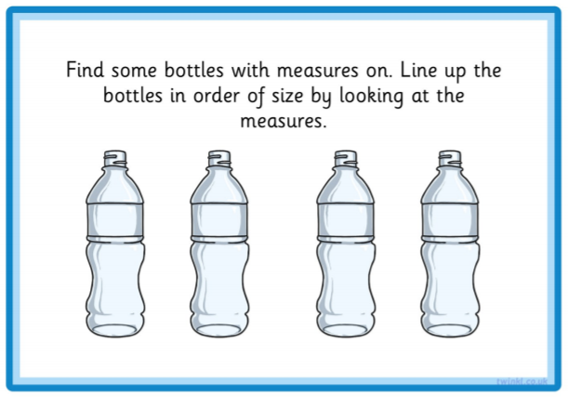
Tuesday 16th June
Maths
Shall we try something more practical? If the sun is shining this will be good fun outdoors. Otherwise, the kitchen sink may have to do.
With a grown up, have a look around your house for some containers holding liquid e.g. shampoo, conditioner, ketchup, mayonnaise, washing up liquid, yoghurt, milk. Try this activity. Read the ml on the bottle carefully.
These bottles all look the same but, your bottles and containers will look different.
Order your bottles from which holds the least to most amount of liquid and then rearrange from holds the largest amount to smallest.

Slide 4
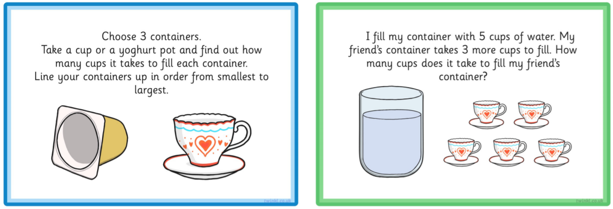
Tuesday 16th June
Here are lots of activity challenges to try. Choose your favourites.

Slide 5
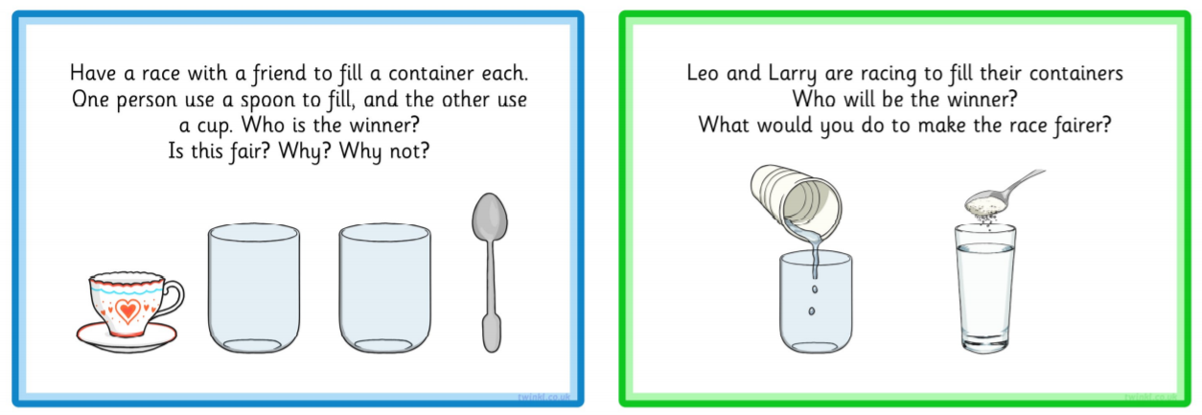
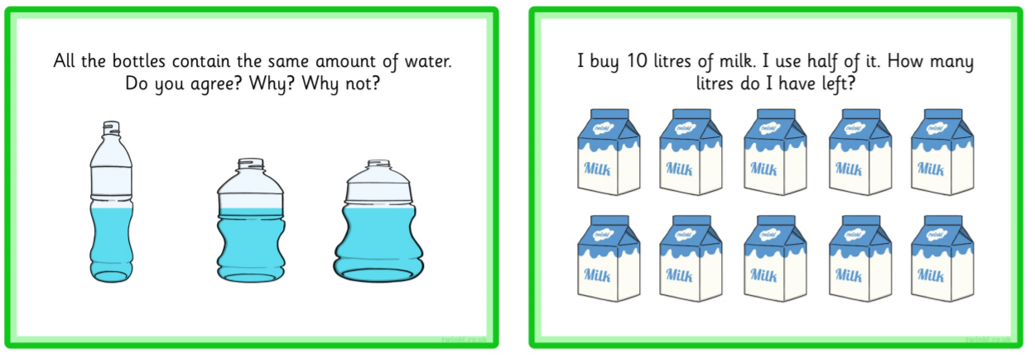

Slide 6
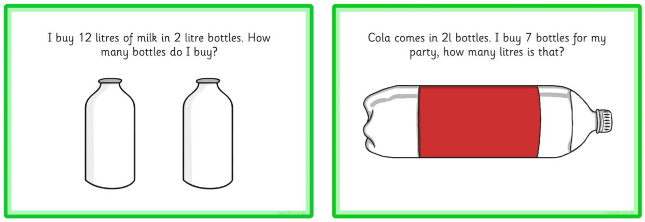
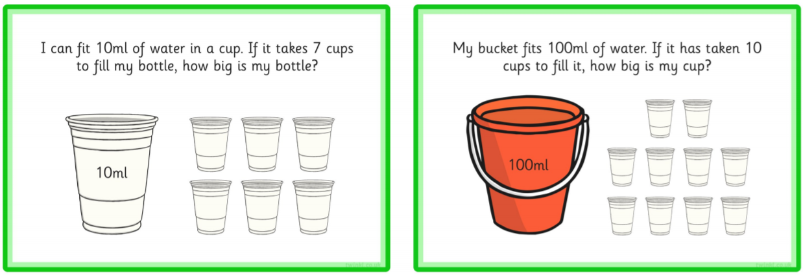

Slide 7

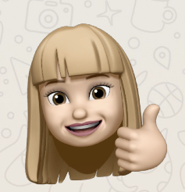
Tuesday 16th June
Maths
Don’t’ forget Prodigy. It helps keep your all round maths skill sharp while you are at home.
Check in to Prodigy for 20 mins each day. I check in frequently throughout the week.
The Leader Board changes every day. Some times it changes within a day.
Only 3 people can be on the Leader Board, which means that 27 people can not. Work hard for your own progress. How man questions did you do last week? How many ‘Skill Completes’ have you got? Have you moved up a level.
Great work everyone on Prodigy – keep it going.

