Slide 1
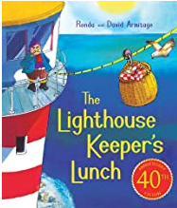
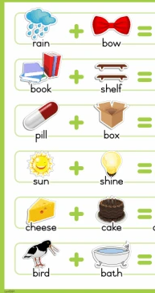
Good morning Year 2 Monday 15th June
English This week our seaside story is ‘The Lighthouse Keepers Lunch’. Today we are going to think about compound words.
The word ‘lighthouse’ is a compound word.
It is made out of two words put together to make a new word.
light + house = lighthouse
Can you work out these compound words?
Write the date in your book the English way.
Write out the word sum.
rain + bow = rainbow
You could draw a picture to show what the new word means.
Some of you may have ‘The Lighthouse Keepers Lunch’ on your shelf. Read it or listen to a grown up read it to you.
Or, listen to the story using this link:
https://www.youtube.com/watch?v=46wCRq50Wwg

Slide 2
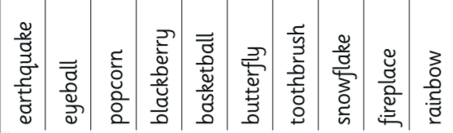
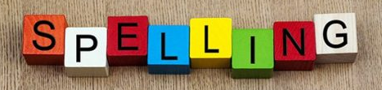
Monday 15th June
English
Let’s practise using compound words in sentences.
Choose 5 or 6 words and use each one in a sentence.
Remember that sentences include:
capital letters
full stops
sense
accurate spelling
E.g. When I go to the cinema I enjoy eating popcorn.
Handwriting Use the paper on our Year 2 class page to practise your handwriting. Careful with size and shape.
Spelling Practise your spellings. This week we are adding suffixes less and ly. Keep practising. Which method of practising suits you best?

Slide 3
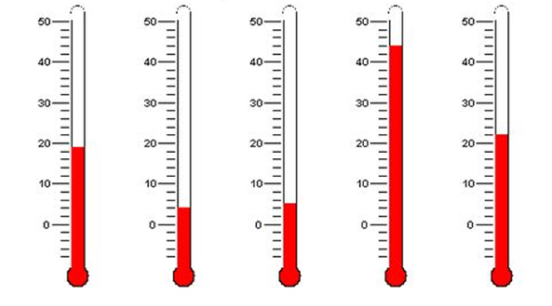
Monday 15th June
Maths
I hope the sun shines because this week you might be able to play with water and call it maths!
We are going to look at reading scales. A ruler is like a scale you read how long an object is.
This sounds easy. It is, if the scale counts in 1s. But what if the scale counts in 2s or 5s or 10s.
Thermometers measure temperature in C.
Find 0. Look at the red column. How far up the thermometer is it?
The first one says 20 C.

Slide 4
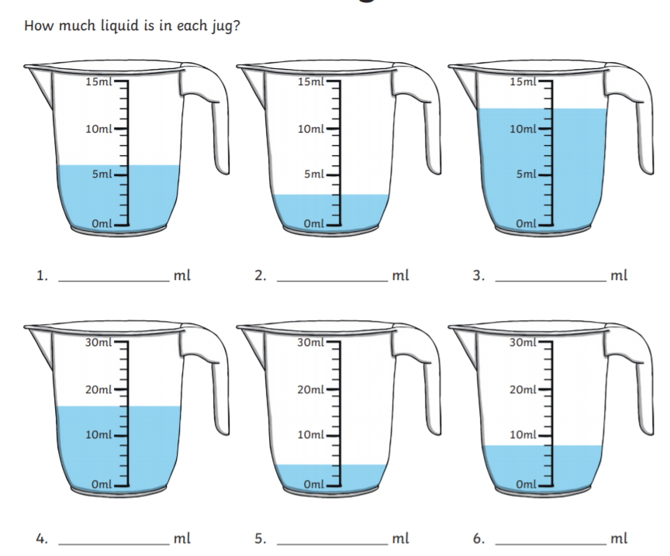
Monday 15th June
We use millilitres and
litres to measure liquid
ml and l.
Start at 0. Check the scale.
Is it counting in ones. Try it.
Does it work?
Write the answers in
your book.
Find 0. Check the scale.
Is it counting in ones?
No? Count in twos.
Does it work?

Slide 5
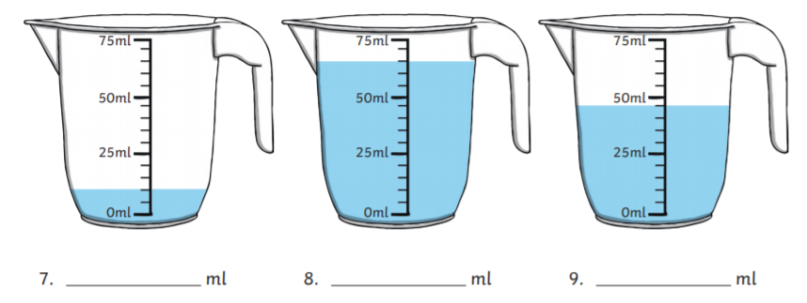
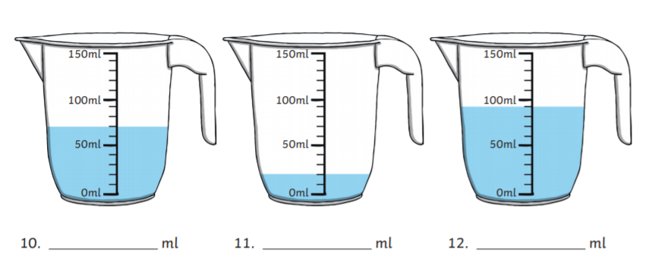
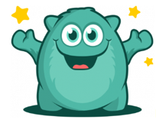
Monday 15th June
Now try these. Find 0. Check the scale. Is it counting in ones, twos, fives or tens?
Write the answers in your book.
Don’t forget to check in to Prodigy for 20 mins each day. I can see how many questions you try and how many you get right. Great work everyone on Prodigy – keep it going.

