Slide 2
Aim
To recognise the features of limerick poetry.
Success Criteria
I know that limericks usually start with set phrases.
I know that a limerick has 5 very rhythmic lines.
I know that certain lines should rhyme.

Slide 3
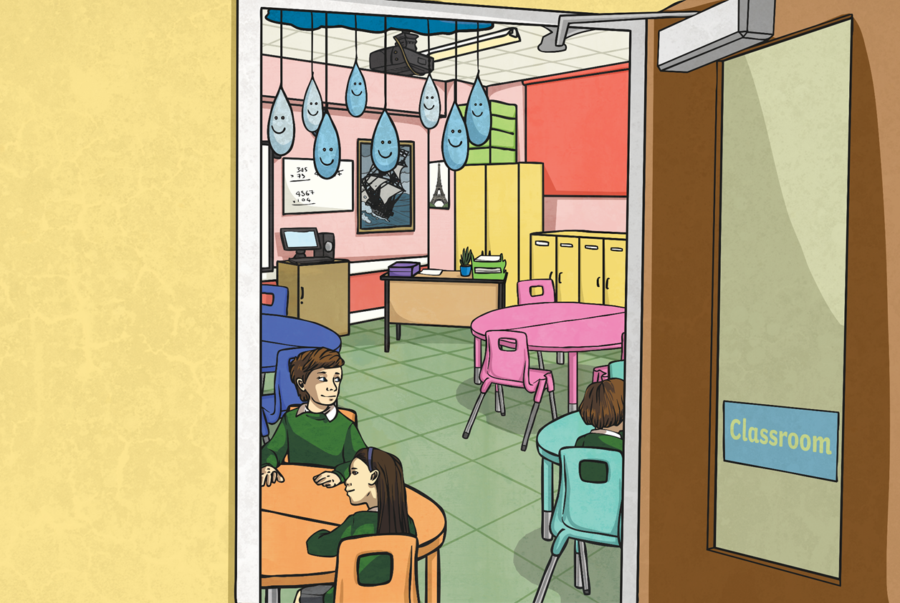
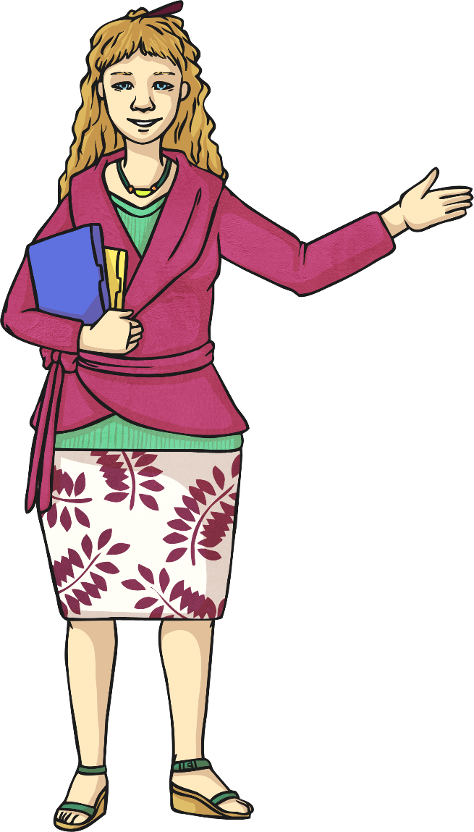
There once was a teacher in school,
Who thought, “I am nobody’s fool.”
She searched lovely Twinkl,
For resources to sprinkle,
And now her classroom looks so cool!

Slide 4
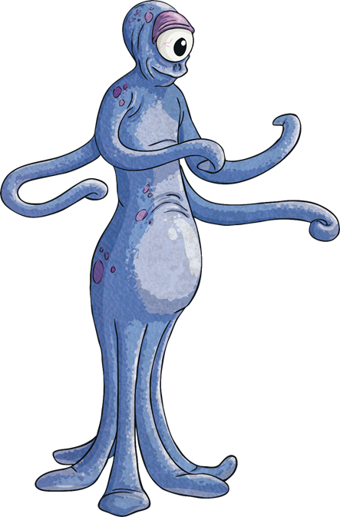
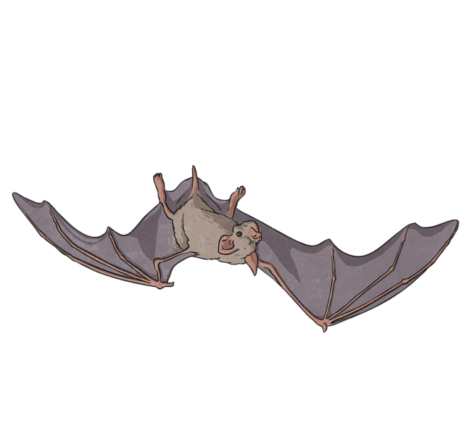
Limerick Examples
Limericks are light-hearted, funny poems with several common features.
Compare these two limericks.
There once was a young man from Ealing,
Who always would hang from the ceiling.
He couldn’t wear a hat,
But could hang like a bat,
And said, “What a wonderful feeling!”
There was an old Martian named Zed
With blue spots all over his head.
He sent out a lot
Of di-di-dash-dot-dot
But nobody knows what he said!

Slide 5
Limerick Features
What did you notice?
Lines 3 and 4 rhyme.
Lines 1, 2 and 5 rhyme.
There once was a young man from Ealing,
Who always would hang from the ceiling.
He couldn’t wear a hat,
But could hang like a bat,
And said, “What a wonderful feeling!”

Slide 6
Limerick Features
What did you notice?
Lines 3 and 4 are
shorter, with the
same number of
syllables (5-6).
There once was a young man from Ealing,
Who always would hang from the ceiling.
He couldn’t wear a hat,
But could hang like a bat,
And said, “What a wonderful feeling!”
Lines 1, 2 and 5 are longer and have approximately the
same number of
syllables (usually
8-10) in each.
Limericks follow a typical rhythm:
di DUM di di DUM di di DUM dum (3 beats)
di DUM di di DUM di di DUM dum (3 beats)
di DUM di di DUM (2 beats)
di DUM di di DUM (2 beats)
di DUM di di DUM di di DUM dum (3 beats)

Slide 7
Limerick Features
What did you notice?
First lines begin with typical phrases, like this one.
The second line gives more details about the subject.
There once was a young man from Ealing,
Who always would hang from the ceiling.
He couldn’t wear a hat,
But could hang like a bat,
And said, “What a wonderful feeling!”
Lines 3 and 4 give us some action about the subject.
The last line is the punchline, usually the consequences of lines 3 and 4.
The first line sets up the subject, so it usually ends with the name of a person or place.

Slide 8

Your Turn
Can you complete this limerick template?
There once was a from ,
Who .
He/she .
And/but/then .
.

Slide 9

Plenary
What have we learned about limericks?
Limericks usually start with set phrases.
They have 5 very rhythmic lines.
Lines 1, 2 and 5 must rhyme.
Lines 3 and 4 must rhyme.
The rhyming pattern is AABBA

