Slide 1
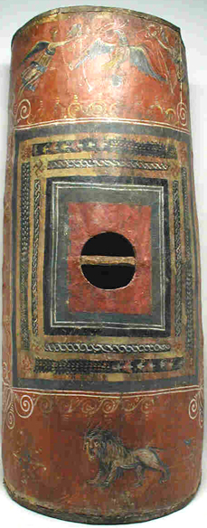
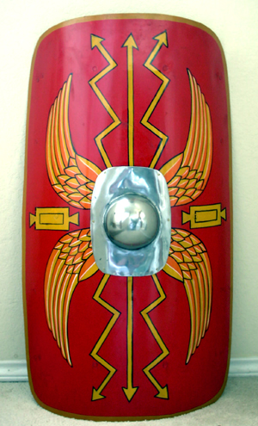
Roman Shields

Slide 2
Have a look at this Roman shield.
What do you think the different parts of the shield symbolise?

Slide 3
The lightening bolts signify Jupiter.
Jupiter was the king of the Roman Gods.
These wings are eagles wings.
The eagle was the symbol of the Roman army.
The colour Red was the symbol of Mars, the Roman God of war.

Slide 4
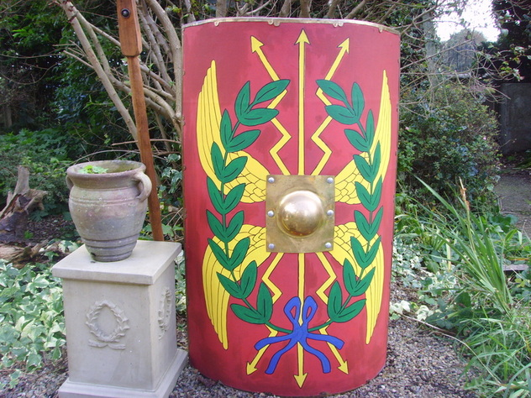
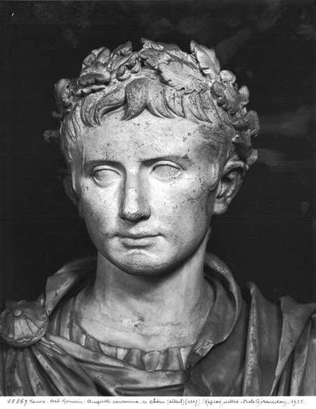
Victory Wreath
Some shields would also come with a wreath. The wreath symbolises Victory. Roman emperors would wear a wreath rather than a crown.

Slide 5
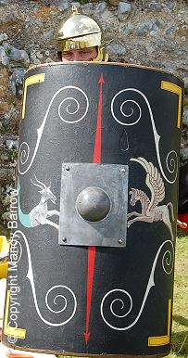
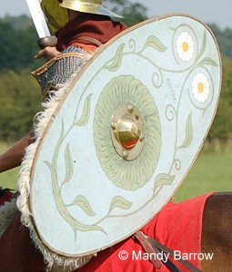
Not all shields were painted the same though…
Senior Roman soldiers would pay a craftsman to paint their shield. It would have often have scenes from myths or from famous battles.

Slide 6
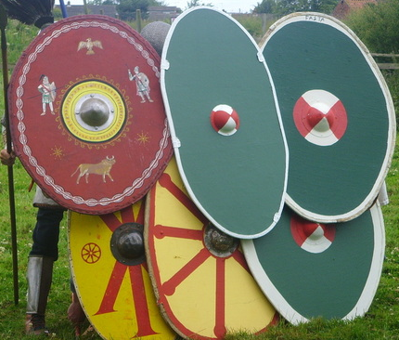
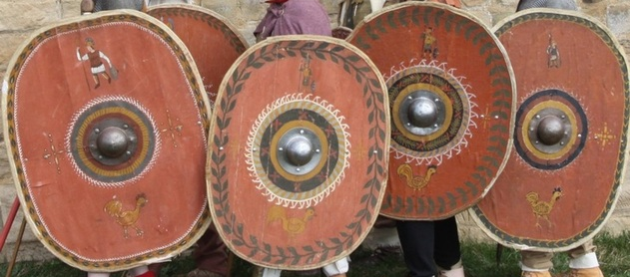
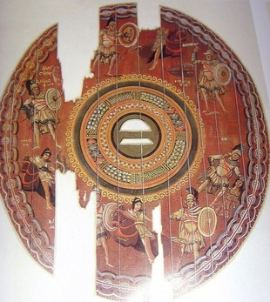
In fact…
There were lots of different
designs of shield.

Slide 7
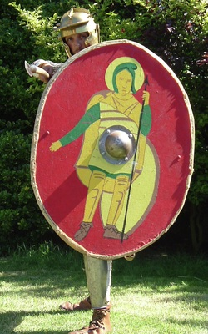
Roman soldiers would paint their shields with something that was important to them, or to their legion.
Remember to keep the design simple and bold. You will want your enemies to be able to see it from far away.

