Slide 1
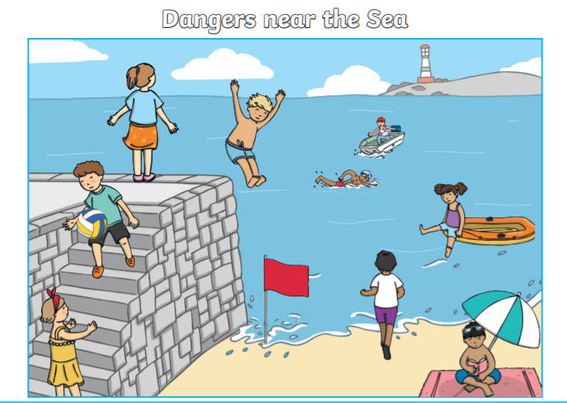
Identify all the dangers in the picture.
Choose 3 dangers.
Insert a text box and write a sentence to explain the danger.
Remember:
* capital letters using ’shift’ not ‘caps lock’.
* Full stops
* Makes sense
Accurate spelling
I have done one for you.
This person is swimming even though there is a red flag which means no swimming.

