Slide 1

Creating Effective Film Reviews Primary

Slide 2

After viewing the film
What did you like about the film?
What didn’t you like about the film?
Which parts will you remember the most and why?
Did it turn out how you expected?
Guide to Creating Effective Film Reviews – Primary
Notes:
What did you like about the film?
What I liked about this film was…
What didn’t you like about the film?
What I didn’t like about this film was…
Which parts will you remember the most and why?
What I remember most is…
Did it turn out how you expected?
However, it turned out…

Slide 3
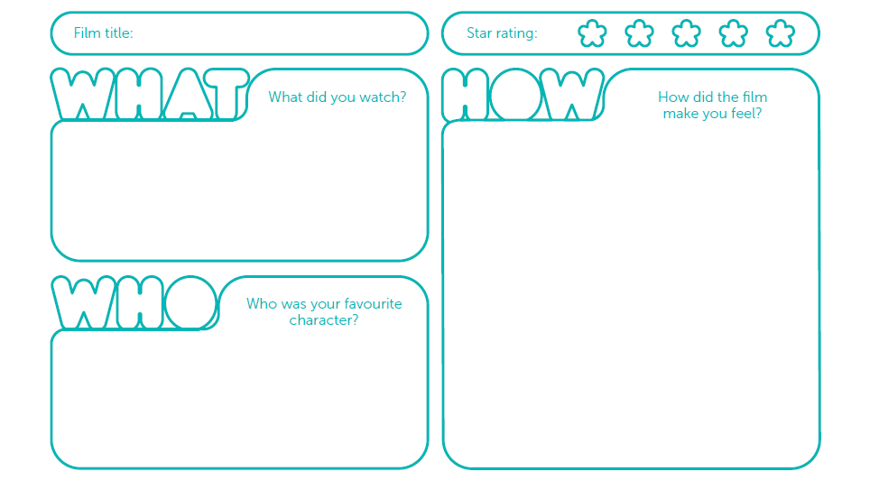
Draw your review
Guide to Creating Effective Film Reviews – Primary

Slide 4




Creative comparisons challenge
Can you compare the film you have just seen to the following things?
Example
If the film Toy Story was an animal it would be a puppy because it is playful and cute.
Guide to Creating Effective Film Reviews – Primary
Notes:
Challenge! Are you able to think of any more creative comparisons for the film?

Slide 5
What is a film review?
A review is an opinion that comments on how good or bad a book, film, play, or other work of art is.
Telling a friend
Film review
Book review
TV programme review
Game review
Music review
Theatre review
Blog review
Website review
How many
did you
think of?
Guide to Creating Effective Film Reviews – Primary
Notes:
Ask the question and then click to reveal a definition and some examples.
See www.intofilm.org/clubs for Into Film reviews of the week by Into Film clubs members

Slide 6
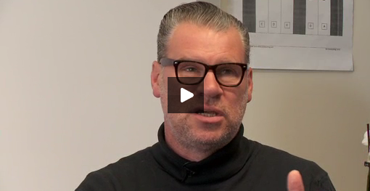
Behind The Scenes with
Mark Kermode
Property of Into Film © (2014) All rights reserved.
Guide to Creating Effective Film Reviews – Primary
Notes:
Give members an insight into being a film critic by watching the ‘Behind The Scenes with Mark Kermode’ clip (also found at www.intofilm.org/review-writing-primary
This interview he gives pupils some insights into the tricks of the trade. If watching the full video online, you may wish to split the clips to break them up and allow for discussion in between.
Appropriate times to pause would be 1:55, 5:02, 6:25 and finish at 7.05.
Can the children identify three top tips for writing reviews? They can write these in the top tips box on page 10 of the Member workbook.

Slide 7
What is a synopsis?
The part of a review that describes the plot is called a ‘synopsis’.
A review should tell the reader a little bit about what happens in the film – but not too much!
Too much detail can be boring for the reader and might even ruin the film.
That’s why giving away the end of the film in a review is called a ‘spoiler’!
Guide to Creating Effective Film Reviews – Primary
Notes:
See www.intofilm.org/clubs for Into Film reviews of the week by Into Film clubs members

Slide 8
Can you guess the film from the synopsis?
The second in a series of fantasy films about the adventures of a young boy and his friends at a magical school. Someone- or something- is terrorising the students, but can the three friends solve the mystery before it’s too late?
Guide to Creating Effective Film Reviews – Primary
Notes:
See www.intofilm.org/clubs for Into Film reviews of the week by Into Film clubs members

Slide 9
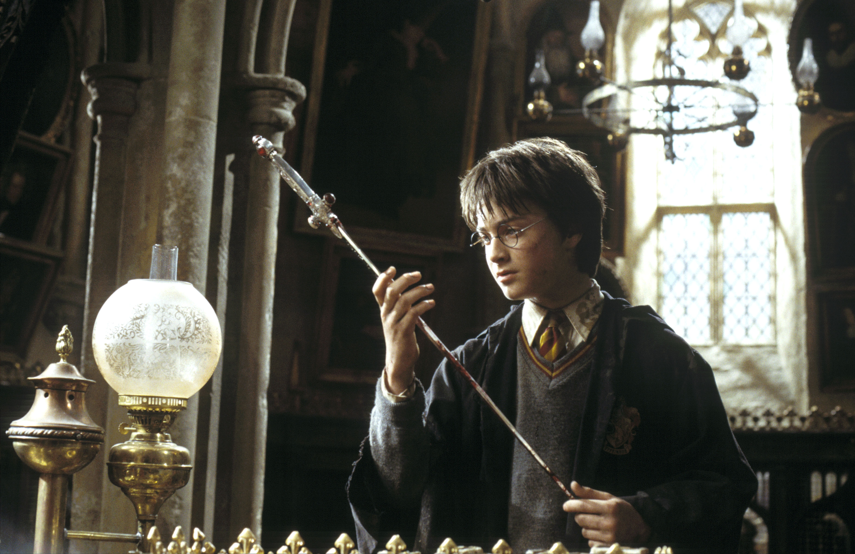
Harry potter AND THE CHAMBER OF SECRETS
The answer is…
Image property of Warner Bros © (2002) All rights reserved

Slide 10
Can you guess the film from the synopsis?
Two young princesses, who were once close, are driven apart by an accident. Soon to become Queen, the elder sister’s worry over her powers has built so much that an emotional outburst causes her to cast the whole kingdom into eternal winter. With the help of a gung-ho mountain man and friendly snowman, the younger Princess must find her sister and save the kingdom.
Guide to Creating Effective Film Reviews – Primary
Notes:
See www.intofilm.org/clubs for Into Film reviews of the week by Into Film clubs members

Slide 11
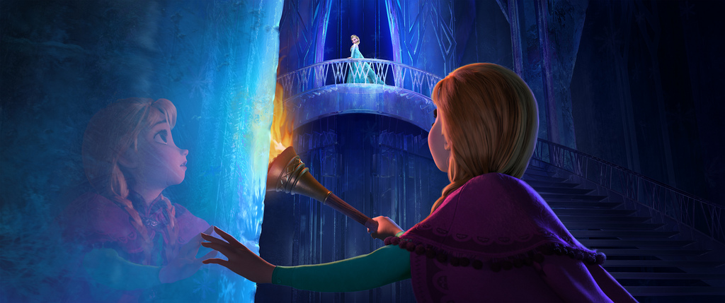
Frozen
The answer is…
Image property of Disney © (2013) All rights reserved

Slide 12
Can you guess the film from the synopsis?
In a world where Vikings hate dragons and have to learn to fight them, young Hiccup takes a different path and befriends a young dragon instead, with the big advantage that they can go flying together. Of course, there are plenty of other Vikings who think this is complete madness. This computer-animated adventure is sweet and funny, with a couple of thrilling battle scenes for action fans.
Guide to Creating Effective Film Reviews – Primary
Notes:
See www.intofilm.org/clubs for Into Film reviews of the week by Into Film clubs members

Slide 13
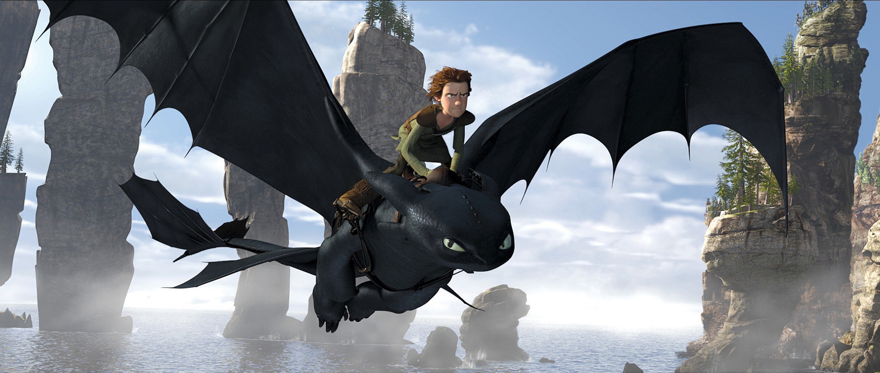
How to train your dragon
The answer is…
Image property of Dreamworks SKG © (2010) All rights reserved

Slide 14
Five things to include
in your review
An introduction that makes your reader want to read on.
A short synopsis (story summary) – with no spoilers!
Interesting information about the film – the genre, audience, cast, crew, funny facts or awards.
What did you like or dislike and why?
Summarise your review.
Guide to Creating Effective Film Reviews – Primary

Slide 15
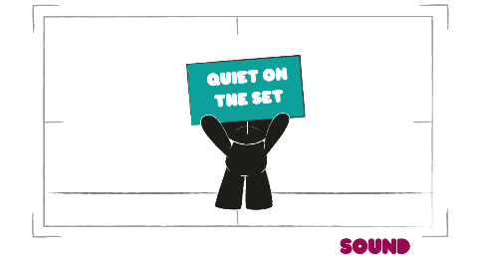
Film your review!
Rehearse by reading your review aloud. Use body language and pauses to emphasise any key points. Get a friend to give you some honest feedback.
Find a quiet, well-lit location to film your review. Do a couple of practice-runs with the camera.
Look back at your practice-runs. Is the camera steady and well framed? Can the audience hear you clearly?
Guide to Creating Effective Film Reviews – Primary

Slide 16
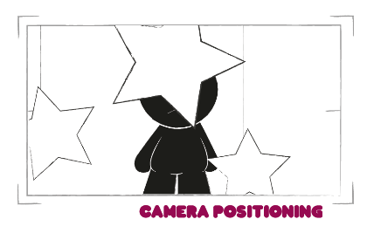
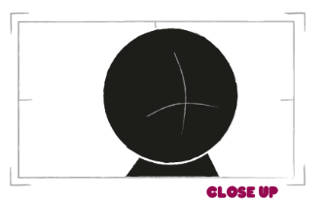
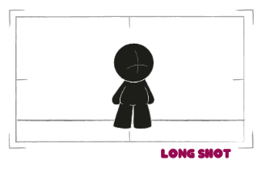
Film your review!
Is it interesting for the audience? Are there any bits you need to take out? How can you improve it?
Experiment! How could you use different camera shots, angles and locations to make it more interesting to watch?
Guide to Creating Effective Film Reviews – Primary

