Slide 1
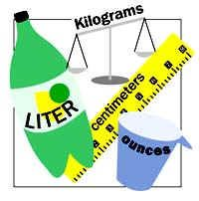
I can convert metric units to imperial units

Slide 2
1 kg ≈ 2.2 pounds
1 ounce ≈ 25 g

Slide 3
5 miles ≈ 8 km
1 foot ≈ 30 cm
1 inch ≈ 2.5 cm

Slide 4
1 litre ≈ 1.75 pints
1 gallon ≈ 4.5 litres

