Slide 2



Diving into Mastery Guidance for Educators
Each activity sheet is split into three sections, diving, deeper and deepest, which are represented by the following icons:
These carefully designed activities take your children through a learning journey, initially ensuring they are fluent with the key concept being taught; then applying this to a range of reasoning and problem-solving activities.
These sheets might not necessarily be used in a linear way. Some children might begin at the ‘Deeper’ section and in fact, others may ‘dive straight in’ to the ‘Deepest’ section if they have already mastered the skill and are applying this to show their depth of understanding.
Diving
Deeper
Deepest

Slide 3
Aim
Estimate, compare and calculate different measures, including money in pounds and pence.

Slide 4

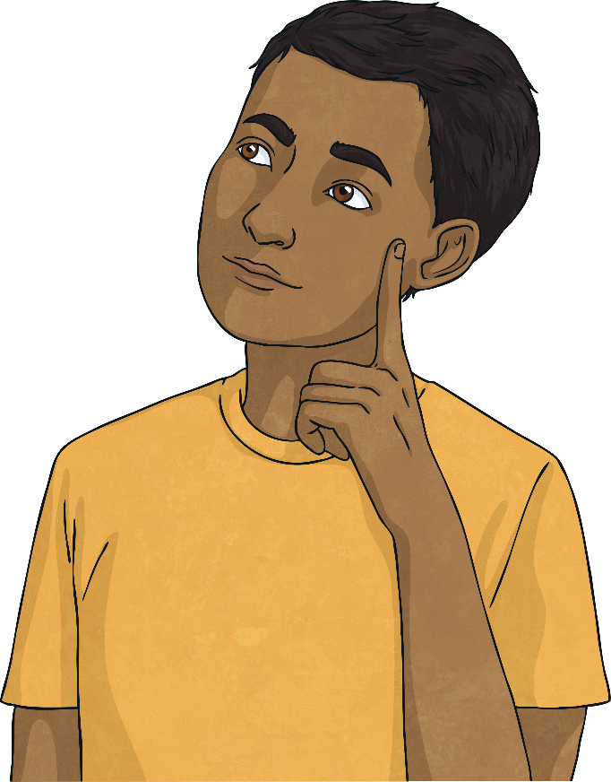
Ordering Money
Diving
Compare these amounts using <, > or =.
<
1256p 1265p
>
£61.65 £61.55
>
£2.63 236p
2400p £24
=

Slide 5
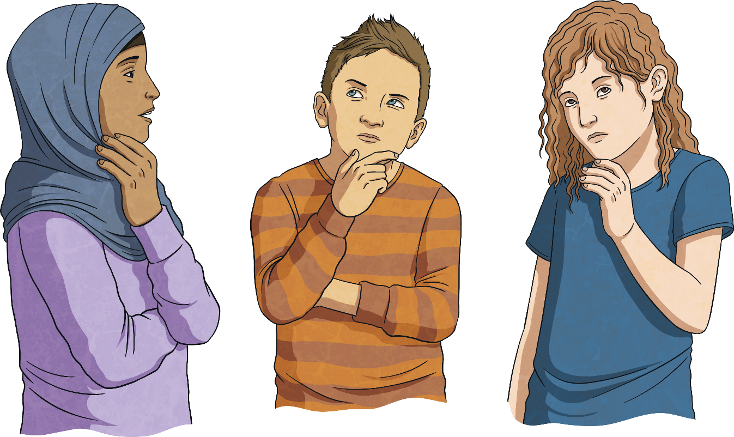
Ordering Money
Diving
Put the amounts in ascending order.
1256p
£21.65
£12.65
2156p
1256p
£12.65
2156p
£21.65

Slide 6

Ordering Money
Deeper
Is each statement true or false? For each false statement, which symbol should be used instead to make it true?
a)
True.
1573p > £13.75
b)
False. £12.90 equals 1290p, which is greater than 1209p. The > sign should be used.
£12.90 < 1209p
c)
False. 560p equals £5.60, so the = sign should be used.
560p > £5.60

Slide 7
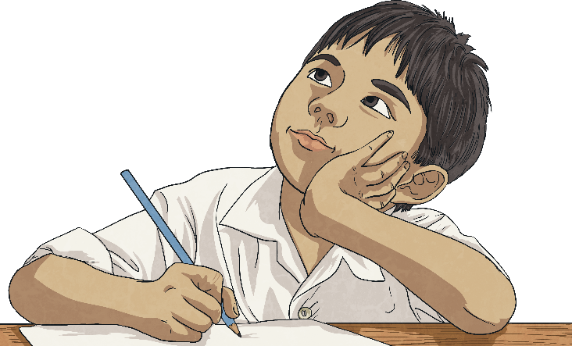
Ordering Money
Deeper
Morris has written these amounts in descending order. He has made a mistake. Explain his mistake and write the amounts in the correct order.
£2.45 | 254p | £4.25 | £4.52 | 524p
Morris has written the numbers in ascending order.
524p | £4.52 | £4.25 | 254p | £2.45

Slide 8
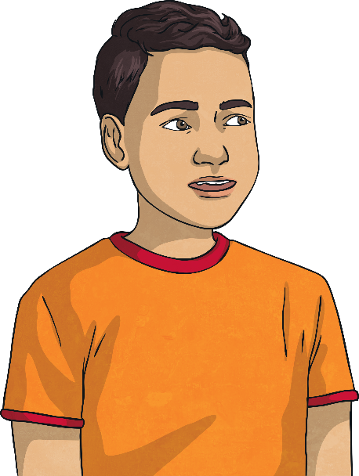
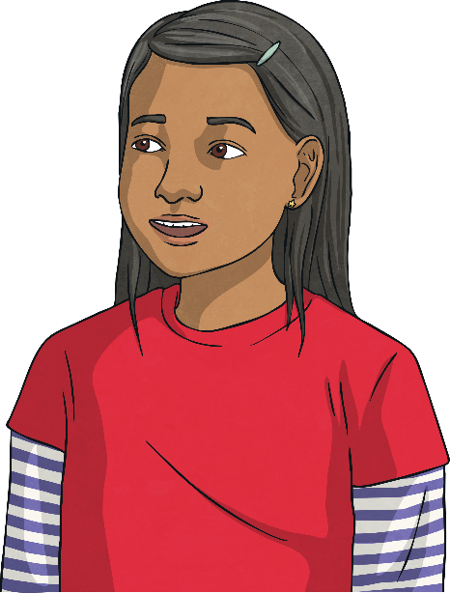
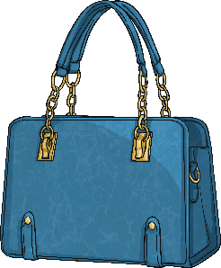
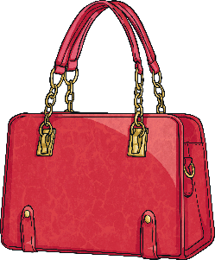
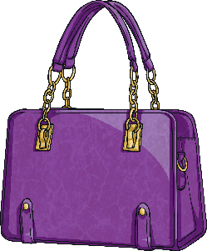
Ordering Money
Deeper
These purses have been lined up in ascending order of value.
The middle purse has £2 in it.
The middle purse has less than £2 in it.
£1.96
203p
Who is correct?
Either of the children could be correct. The purse could have £1.97, £1.98, £1.99, £2.00, £2.01 or £2.02 in it.

Slide 9

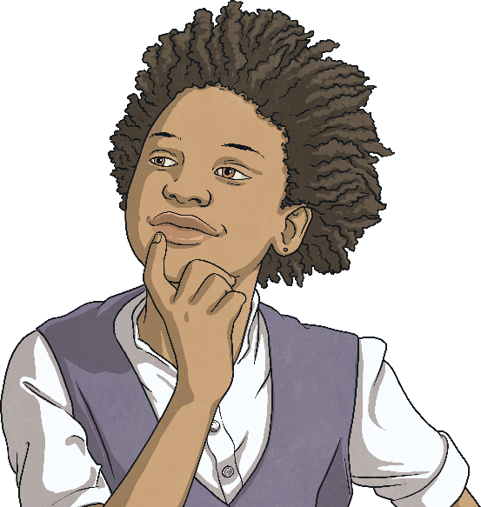

Ordering Money
Deepest
50p
120p
£3
Saffron buys two raffle tickets.
What is the smallest amount of money she could spend altogether?
£1.70 (or 170p)
£1.70, £3.50, £4.20
(or 170p, 350p, 420p)
Find all the different possible amounts she could make. Put them in ascending order.

Slide 10
Ordering Money
Deepest
Find all the different possible prices you can make using these three digits to fill in the price label. You can only use each digit once.
Write the prices in ascending order.
£
.
4
6
8
£4.68, £4.86, £6.48, £6.84, £8.46, £8.64.

Slide 11
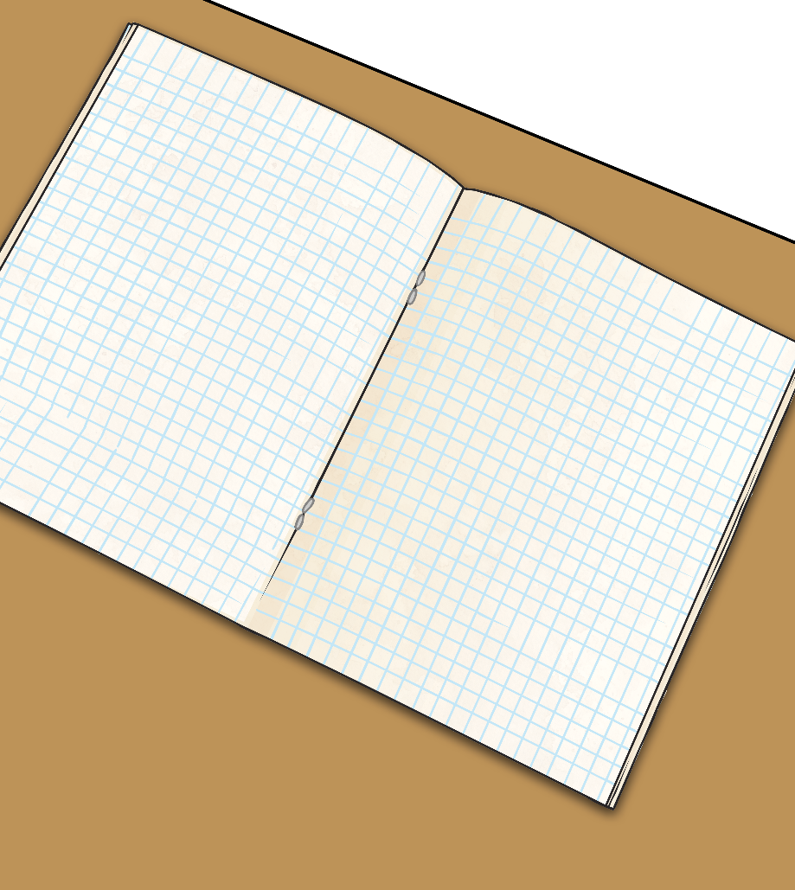
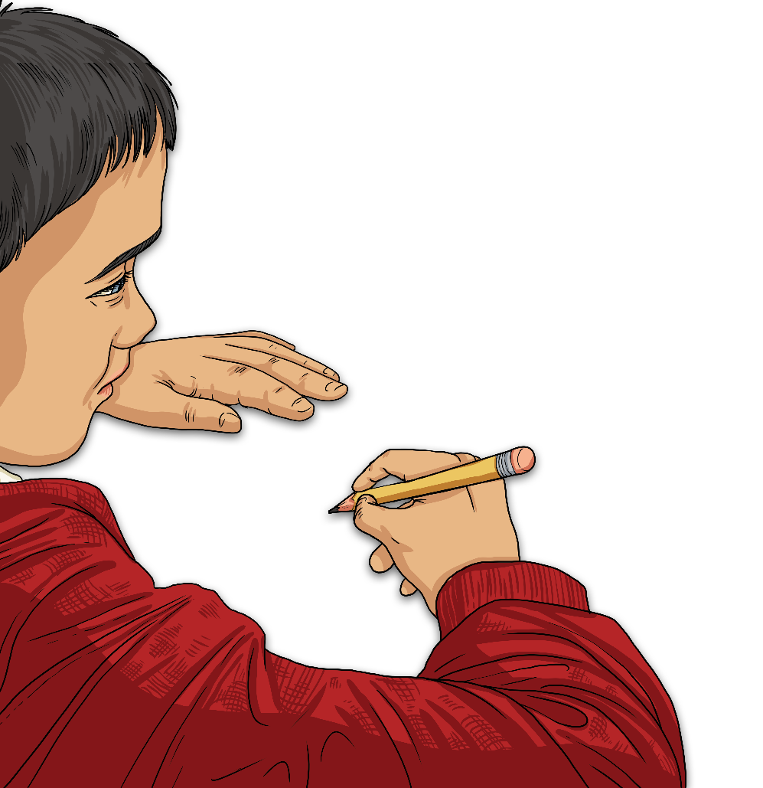
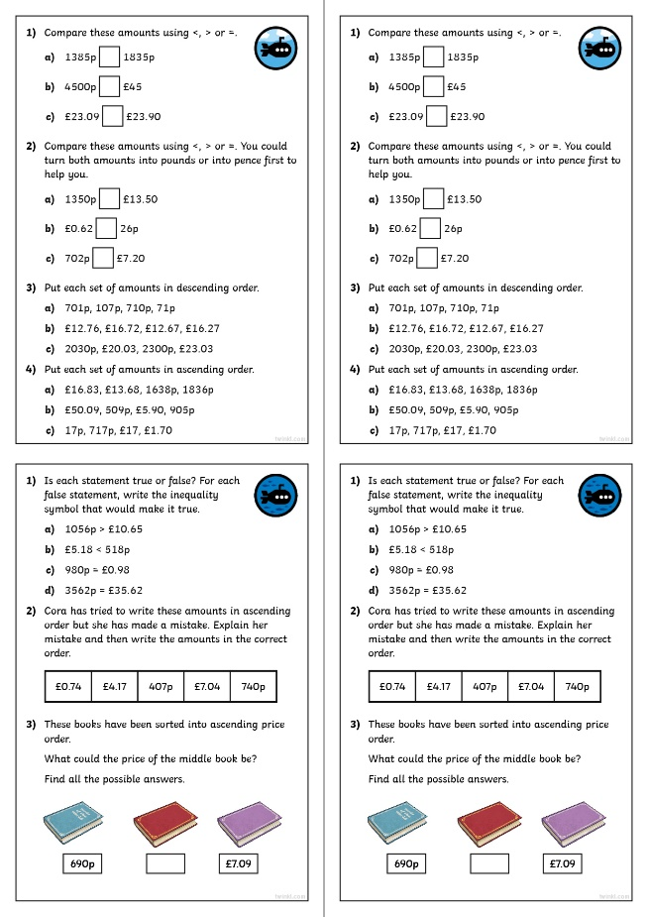
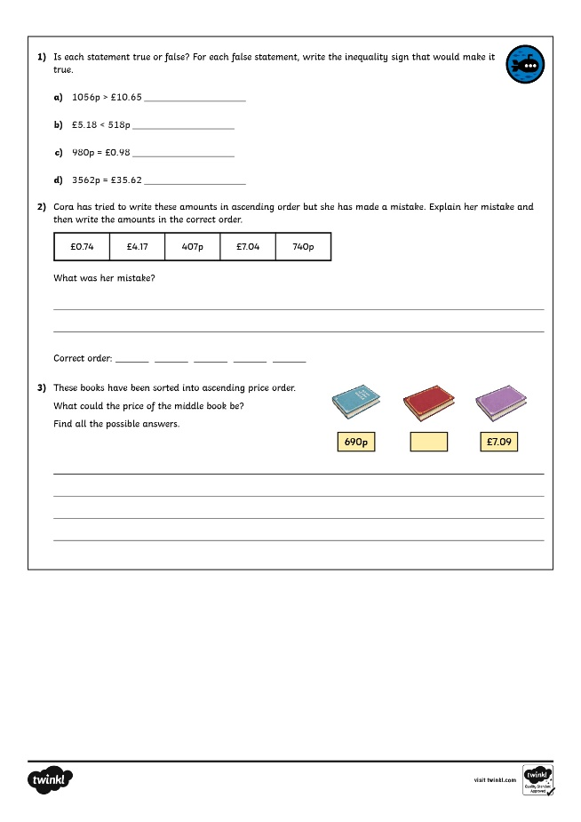
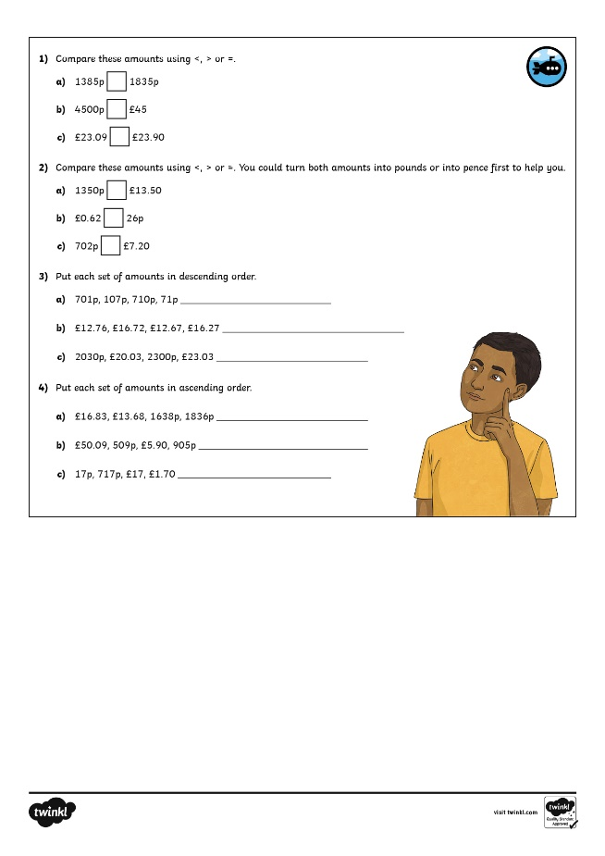
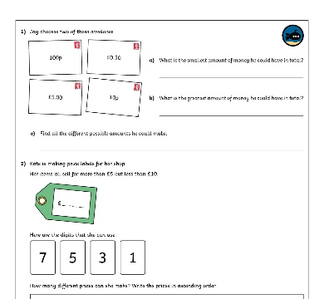
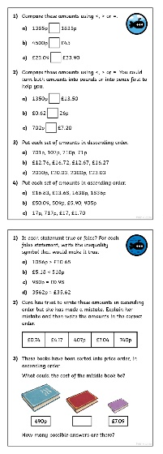
Ordering Money
Dive in by completing your own activity!

Slide 12
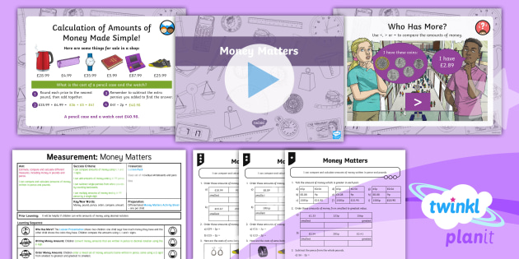
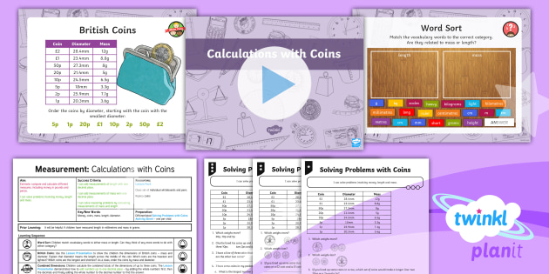

Need Planning to Complement this Resource?
National Curriculum Aim
Estimate, compare and calculate different measures, including money in pounds and pence.
For more planning resources to support this aim, click here.
Twinkl PlanIt is our award-winning scheme of work
with over 4000 resources.

