Slide 1
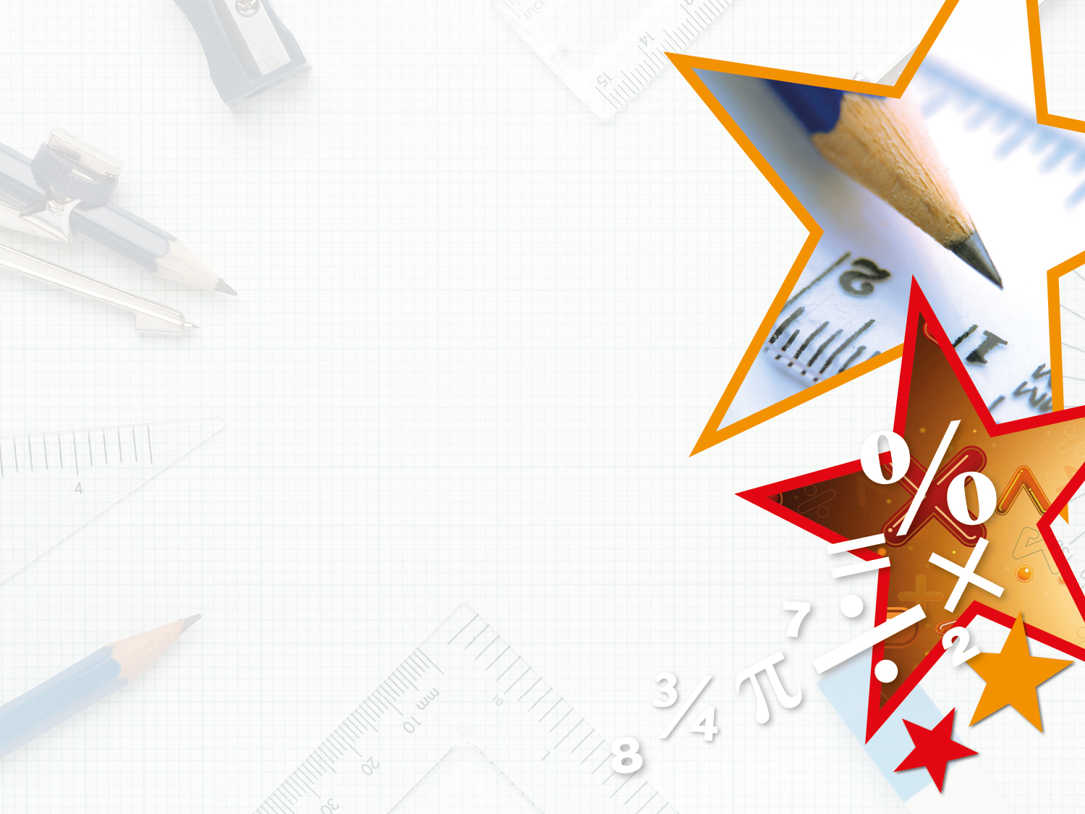

Year 5 – Summer Block 4 – Converting Units
Step 1: Kilograms and Kilometres
© Classroom Secrets Limited 2018

Slide 2
Introduction
Complete the boxes to show what you must do
to convert these units of measure.
km
m
g
kg
© Classroom Secrets Limited 2018

Slide 3
Introduction
Complete the boxes to show what you must do
to convert these units of measure.
x 1,000
÷ 1,000
km
m
g
kg
÷ 1,000
x 1,000
© Classroom Secrets Limited 2018

Slide 4
Varied Fluency 1
Check each of the conversions and correct any that are wrong.
6,500m = 6.5km | 9,600m = 9.6km
7.1km = 7,100m | 4.7kg = 4,070g
50,500g = 50.5kg | 1,500g = 15.0kg
© Classroom Secrets Limited 2018

Slide 5
Varied Fluency 1
Check each of the conversions and correct any that are wrong.
6,500m = 6.5km | 9,600m = 9.6km
7.1km = 7,100m | 4.7kg = 4,070g 4.7kg = 4,700g or 4.07g = 4,070g
50,500g = 50.5kg | 1,500g = 15.0kg 1,500g = 1.5kg or 15,000g = 15.0kg
© Classroom Secrets Limited 2018

Slide 6
Varied Fluency 2
Complete the table:
 | True or false?
4kg > 3,500g
21kg > 210g
7.3km = 7,300m
2,900m > 2.9km
© Classroom Secrets Limited 2018

Slide 7
Varied Fluency 2
Complete the table:
 | True or false?
4kg > 3,500g | True
21kg > 210g | True
7.3km = 7,300m | True
2,900m > 2.9km | False
© Classroom Secrets Limited 2018

Slide 8
Varied Fluency 3
Select a number from the box to make these statements correct.
Include the correct unit of measurement.
5kg < __________ | __________ > 16kg
7.1km > __________ | 3,900m = __________
3.9 | 17,000 | 5,300 | 4,800
© Classroom Secrets Limited 2018

Slide 9
Varied Fluency 3
Select a number from the box to make these statements correct.
Include the correct unit of measurement.
5kg < __________ | __________ > 16kg
7.1km > __________ | 3,900m = __________
5,300g
17,000g
4,800m
3.9km
3.9 | 17,000 | 5,300 | 4,800
© Classroom Secrets Limited 2018

Slide 10
Varied Fluency 4
Answer the question below.
Mike runs of 1km.
How many metres does he run?
9
10
© Classroom Secrets Limited 2018

Slide 11
Varied Fluency 4
Answer the question below.
Mike runs of 1km.
How many metres does he run?
1km = 1,000m
1,000m ÷ 10 = 100m
100m x 9 = 900m
He runs 900m.
9
10
© Classroom Secrets Limited 2018

Slide 12
Problem Solving 1
Complete the circles so that each line adds up to 7,000g in every direction. Give your answer in kilograms.
0.5kg
2,400g
2.7kg
400g
© Classroom Secrets Limited 2018

Slide 13
Problem Solving 1
Complete the circles so that each line adds up to 7,000g in every direction. Give your answer in kilograms.
0.5kg
4.1kg
2,400g
0.2kg
3.9kg
2.7kg
400g
© Classroom Secrets Limited 2018

Slide 14
Problem Solving 2
Using the cards below, create 3 different comparison statements.
5,500m
4.3km
2,300m
<
>
© Classroom Secrets Limited 2018

Slide 15
Problem Solving 2
Using the cards below, create 3 different comparison statements.
Various possible answers, for example:
4.3km < 5,550m 2,300m < 5,500m 4.3km > 2,300m
5,500m
4.3km
2,300m
<
>
© Classroom Secrets Limited 2018

Slide 16
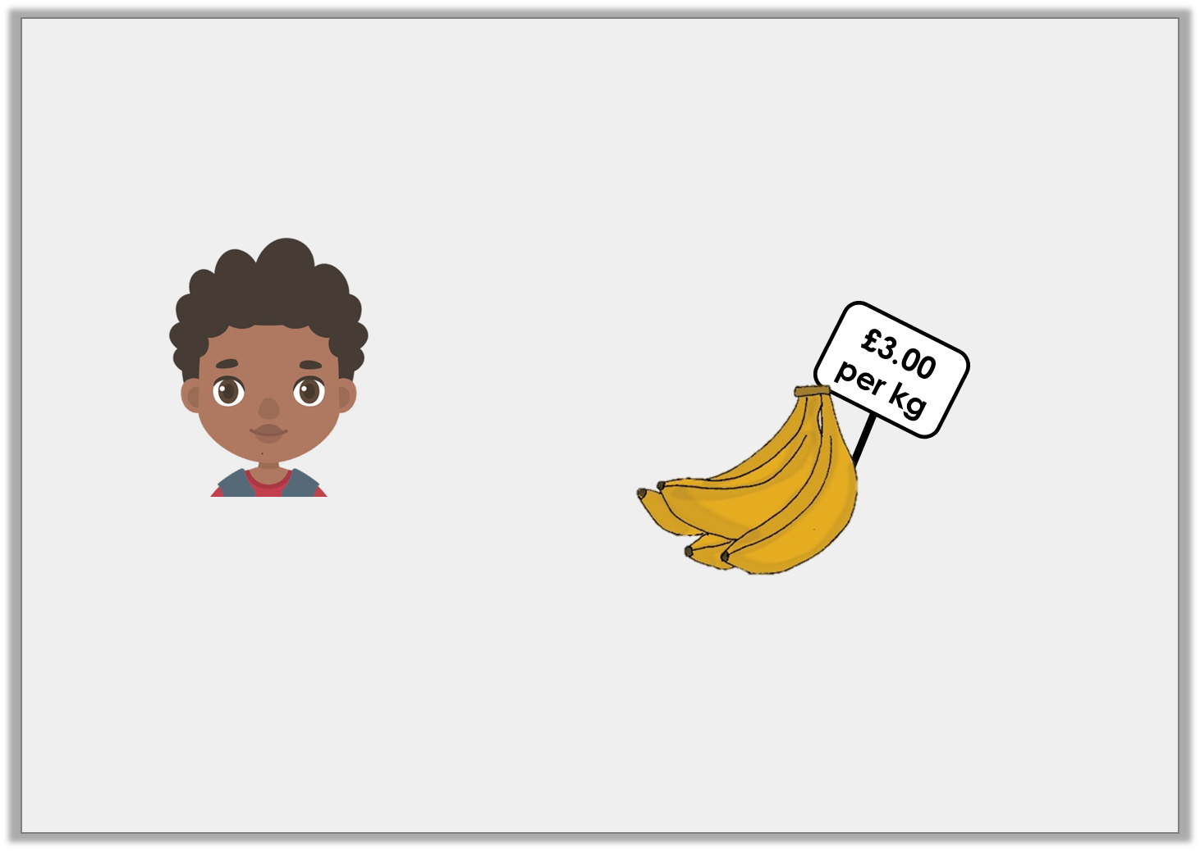
Reasoning 1
A crate of bananas weighs 5,500g.
Is Luke correct?
Explain your answer.
A crate of bananas will cost £15.
© Classroom Secrets Limited 2018

Slide 17
Reasoning 1
A crate of bananas weighs 5,500g.
Is Luke correct?
Explain your answer.
Luke is not correct because . . .
A crate of bananas will cost £15.
© Classroom Secrets Limited 2018

Slide 18
Reasoning 1
A crate of bananas weighs 5,500g.
Is Luke correct?
Explain your answer.
Luke is not correct because 5,500g = 5.5kg. 5.5 x £3.00 = £16.50
A crate of bananas will cost £15.
© Classroom Secrets Limited 2018

