Slide 2

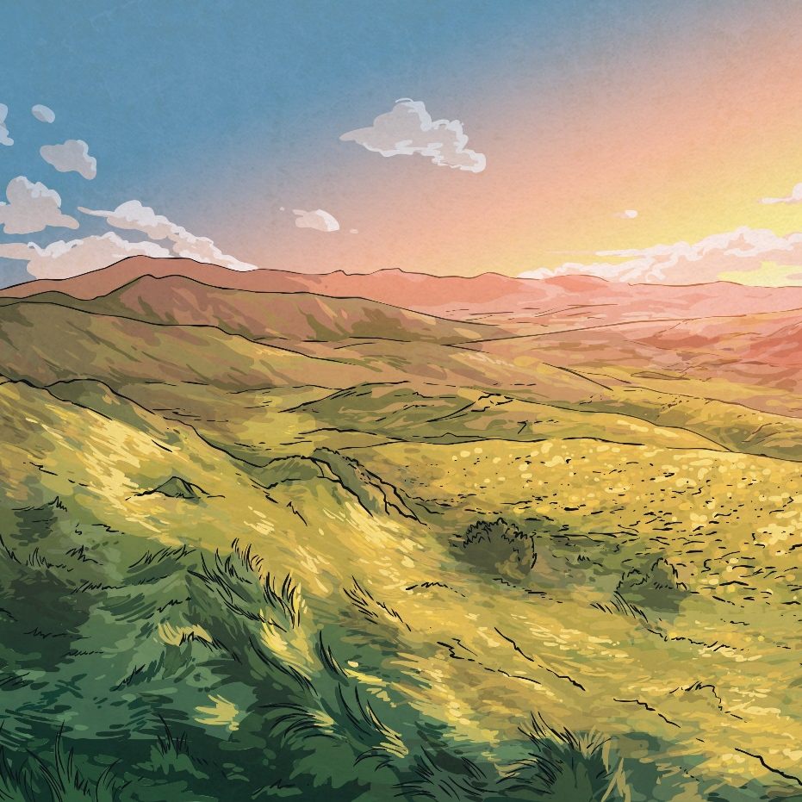
What Do You Know About…
mammals?
amphibians?
insects??
birds?
Tell your partner everything you already
know about these animals.

Slide 3
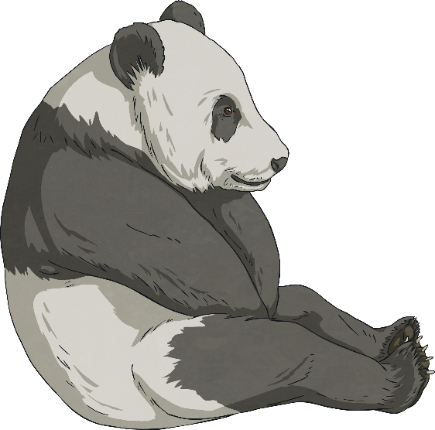
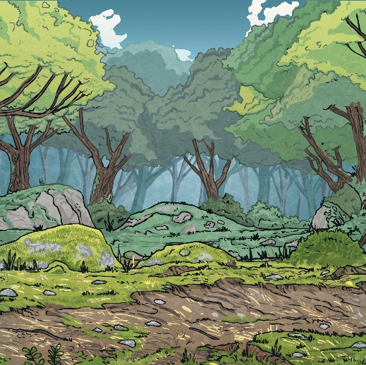
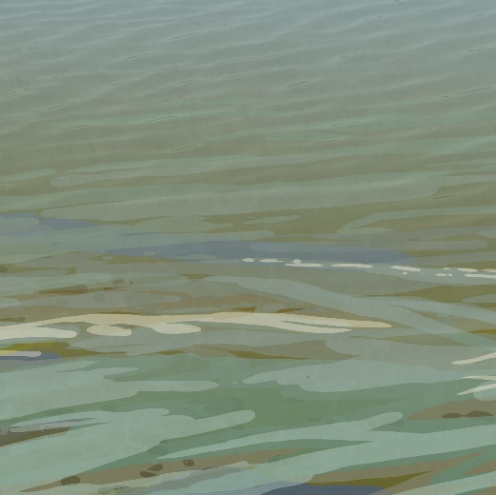
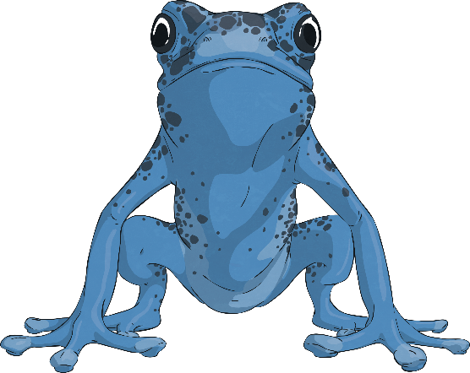
What Is…
a mammal?
A mammal is a warm-blooded creature that gives birth to
live babies. A mammal has fur or hair. The largest
mammal in the world is the blue whale and the smallest
is the bumblebee bat.
an amphibian?
An amphibian is a cold-blooded creature. Amphibians can breathe in and out of water. Frogs and toads are amphibians.
Click on each picture to find out more.

Slide 4

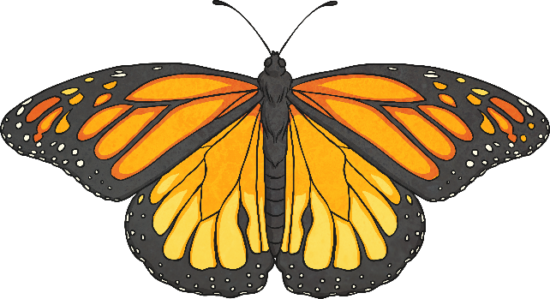

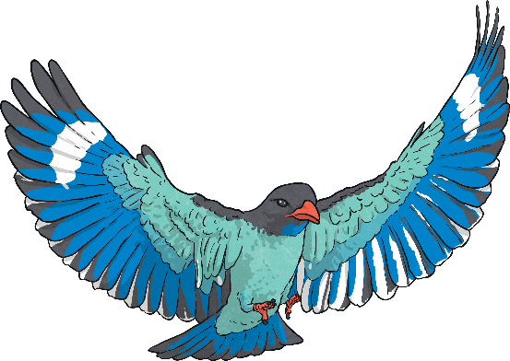
What Is…
an insect?
An insect is a creature whose body is split into three
sections called the head, the thorax and the abdomen.
Insects have an exoskeleton. There are around one million species of insects, including ants, bees and butterflies.
a bird?
A bird is a vertebrate. It has a beak, feathers and wings, although not all birds can fly. Owls, swans and sparrows are all species of birds.
Click on each picture to find out more.

Slide 5
Life Cycles
In one minute, draw a life cycle of any creature.
Include as much detail as possible.
1 Minute
Stop

Slide 6
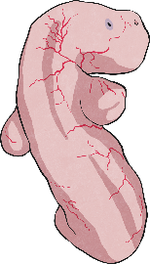
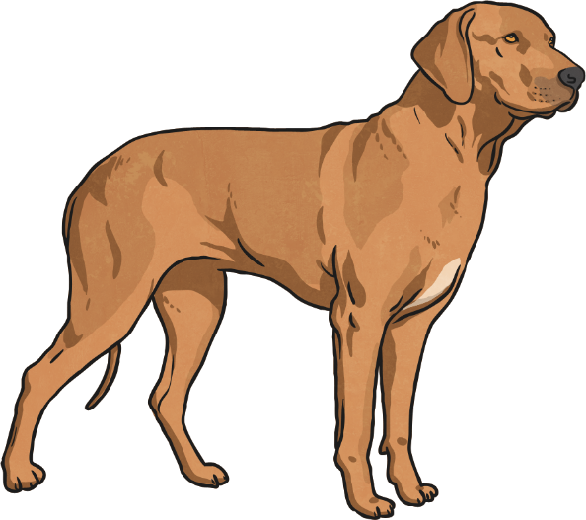
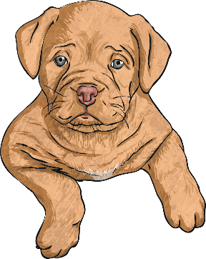
The Life Cycle of a Mammal
Independent adult usually
seeks company from the opposite sex and mates. Adult female nurses their young.
Embryo growing inside the mother, where it is completely reliant upon the mother.
1
Main period of growth and
developing independence
from the parents.
3
2

Slide 7
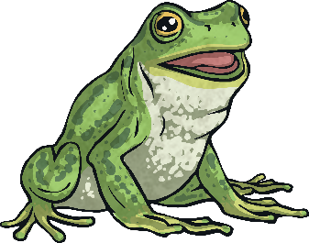
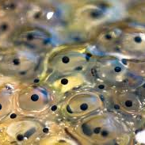
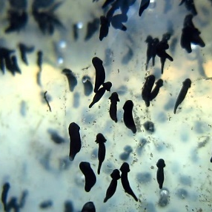
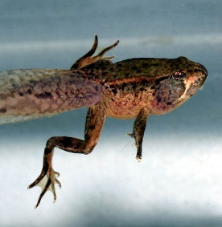

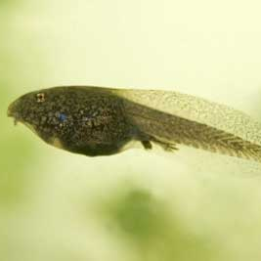
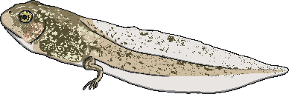
The Life Cycle of an Amphibian
The tail disappears and it starts to eat insects instead of plants. It takes 2-4 years to become an adult, when it can lay eggs.
The female lays a mass of eggs which are fertilized by the male.
6
1
The tadpole grows front legs and its tail shortens. It uses nutrients in its tail as food. It jumps out of the water on to land.
After 2-25 days
the tadpole
hatches from
the egg.
2
5
The tadpole grows fins and a
stronger tail. Then, it develops
lungs and hind legs.
It swims and eats
plants. It breathes
through gills.
4
3

Slide 8
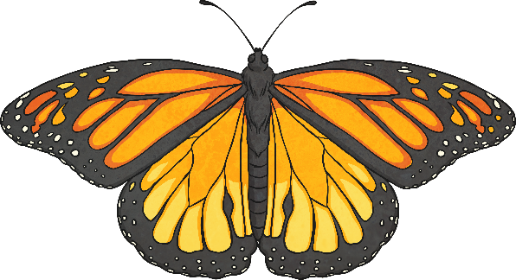
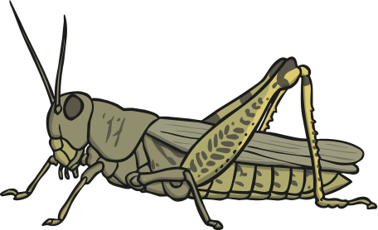
Insects
Insects come under two categories. ‘Metamorphosis’ means ‘to change’. Click on a heading to find out more.
Complete Metamorphosis
Incomplete Metamorphosis
The life cycle of these insects has four stages: egg, larva, pupa and adult. Insects in this category include beetles, butterflies and flies.
The life cycle of these insects has three stages: egg, nymph and adult.
Insects in this category include grasshoppers, crickets and cockroaches.

Slide 9
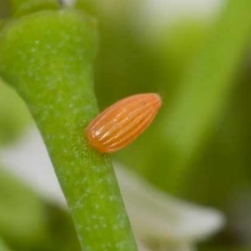
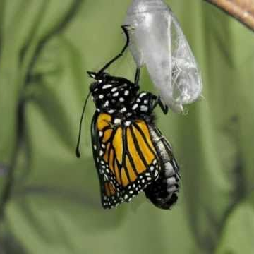
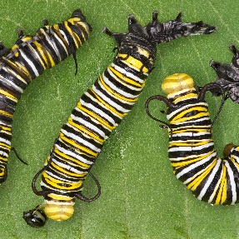
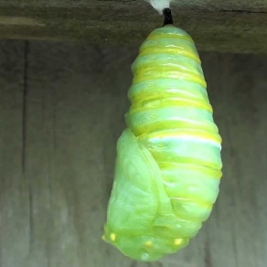
The Life Cycle of an Insect (Complete Metamorphosis)
Eggs are laid by the female insect.
It metamorphoses into
an adult which breaks
out of the pupa, matures
and lays eggs.
1
4
Egg hatches into a larva. This varies depending on
species. Common forms are caterpillars, maggots, grubs.
2
The pupa is usually where a hard case is formed around the larva.
3

Slide 10
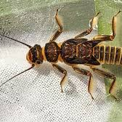
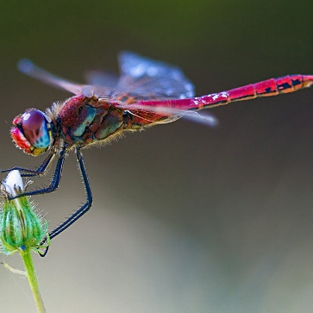
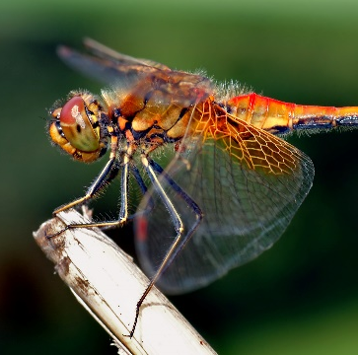
The Life Cycle of an Insect (Incomplete Metamorphosis)
Eggs are laid by the female insect. Sometimes this is in water.
Egg hatches into a nymph. This varies depending on species. Nymph looks like small adult. In some cases, it lives in water.
1
The nymph grows into the adult form, sometimes shedding skin. Adults sometimes fly. Adult females lay eggs.
3
2

Slide 11
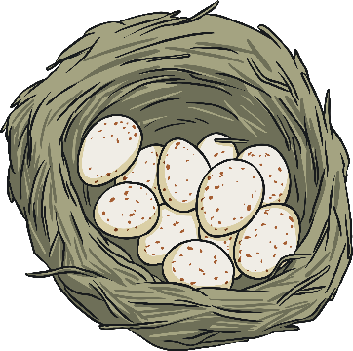
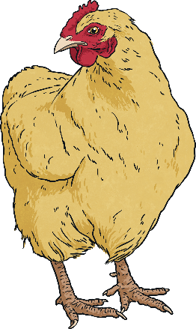
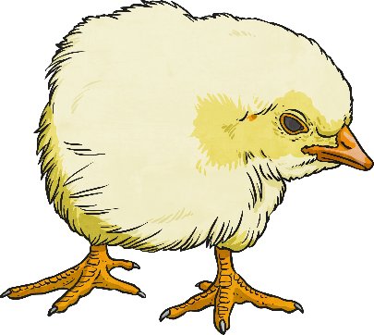
The Life Cycle of a Bird
Independent adult usually
seeks company from the opposite sex and mates.
Eggs are laid by the mother and the mother and father care for the egg until it hatches.
1
Mother and father feed the
young bird until it is old
enough to fly and find its
own food.
3
2

Slide 12
Similarities and Differences
 | Mammal | Amphibian | Insect –Complete Metamorphosis | Insect –Incomplete Metamorphosis | Bird
Starts as an egg | X | ✓ | ✓ | ✓ | ✓
The number of stages in the life cycle | 3 | 6 | 4 | 3 | 3
Does the young look like the adult? | Yes | No | No | Yes | Yes
Can you think of any other differences between the life cycles?

