Slide 1
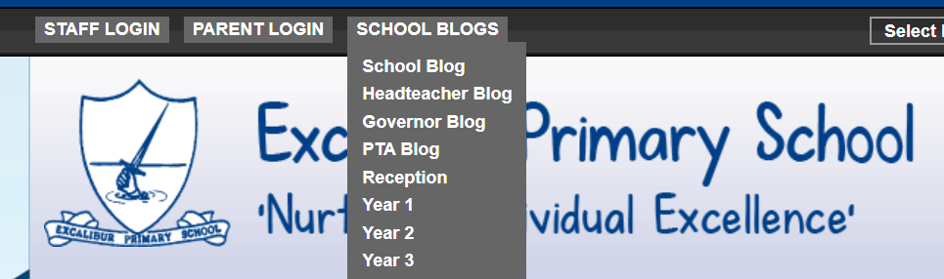
Good morning Year 2 Friday 27th March
9.00 – 9.30 PE with Joe live on youtube – ask first!!!!!!!
English
Read the Tony Ross information. Try to answer some of the questions. We will finish it off next week.
If you would like to write another riddle, I would love to read them on our riddle blog. You don’t have to. Choose an animal or vegetable maybe. Have you found it?
Good riddles will have the 5 features plus:
Use of adjectives
Sentences started in different ways eg I have….. I am……. My ……… Sometimes…….. You eat me with…………
Correct punctuation
Excellent riddles will make use of:
Similes eg as red as…… shaped like a ………….
Comparisons eg longer than …. shorter than ……….
Spelling Remember to practise your y+s=ies spellings. Write them out on paper, on the carpet with your finger, in the air!

Slide 2
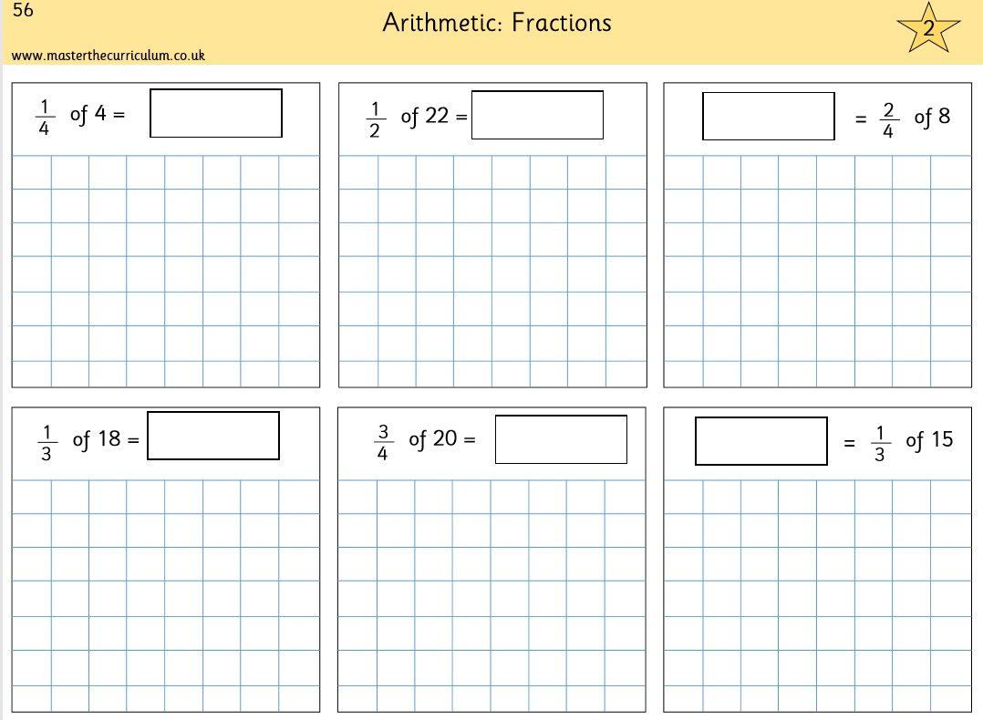

Friday 27th March
Maths
Revising fractions. Understanding ÷. Will really help you. Complete p56 in your pack. It looks like this.
Remember, you can’t just write the answer. Show your working out. Draw the people. ¼ tells you to draw 4 people, ½ tells you to draw 2 people. For ¼ share equally between 4 people. How much does 1 person get? For $\frac{2}{4}$ share equally between 4 people. How much do 2 people have? Just like we did in school.
Answers 1, 11, 4, 6, 15, 5
Use Prodigy for 20 minutes.
Practise your tables – click them and clap them – you know how we do in class. 2x 3x 4x 5x 10x

Slide 3

We survived our first week of online learning!
Well done Year 2
Just a little reminder about Prodigy. You must do it yourself. An adult may read the question but not help you to answer. It really doesn’t matter if you get it wrong Prodigy will adjust to help you improve.
Someone did end up doing Year 6 questions because their parent was helping them!!!

