Slide 1
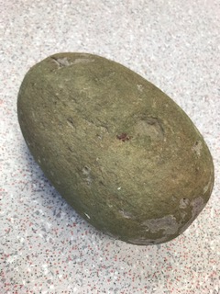
Good morning Year 2 Thursday 26th March
9.00 – 9.30 PE with Joe live on youtube – ask first!!!!!!!
English This week we are writing riddles. These are the features:
1 First person - we know how to do this – I, me, my
2 Present tense - we know how to do this – has, have, is , am
3 Hardest clues first/ Easiest clues near the end
4 Descriptive - we know how to use adjectives, could include similes
5 Finish with a question - What am I? - remember the ?
You have written a fruit riddle. Now take a look at the dragon egg. You held it on Friday. Collect adjectives and similes to describe its colour, size, weight and texture. What is inside? Is it moving? Write your own dragon egg riddle. Remember don’t say it’s a dragon egg. You could test it out on your grown ups.
Good riddles will have the 5 features plus:
Use of adjectives
Sentences started in different ways eg I have….. I am……. My ……… Sometimes…….. You eat me with…………
Correct punctuation
Excellent riddles will make use of:
Similes eg as red as…… shaped like a ………….
Comparisons eg longer than …. shorter than ……….
You can post your riddles on the Year 2 riddles blog (school blogs, Year 2, top of the school home page).
Spelling Remember to practise your y+s=ies spellings. Write them out on paper, on the carpet with your finger, in the air!

Slide 2
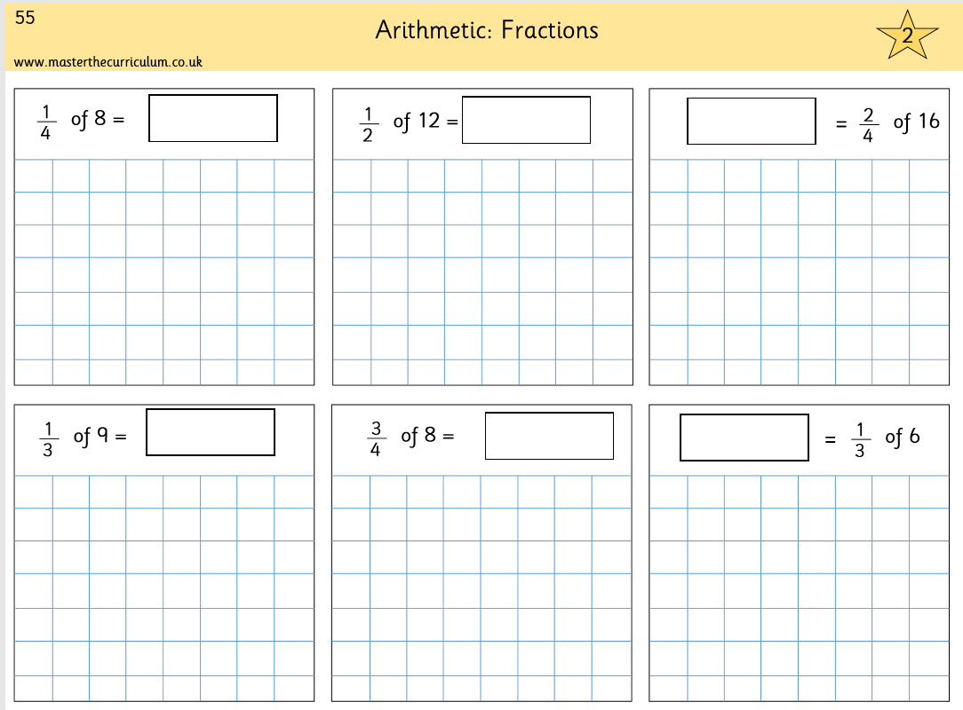

Thursday 26th March
Maths
Revising fractions. Understanding ÷. Will really help you. Complete p55 in your pack. It looks like this.
Remember, you can’t just write the answer. Show your working out. Draw the people. ¼ tells you to draw 4 people, ½ tells you to draw 2 people. For ¼ share equally between 4 people. How much does 1 person get? For $\frac{2}{4}$ share equally between 4 people. How much do 2 people have? Just like we did in school.
Answers 2, 6, 8, 3, 6, 2
Use Prodigy for 20 minutes.
Practise your tables – click them and clap them – you know how we do in class. 2x 3x 4x 5x 10x

