Slide 1
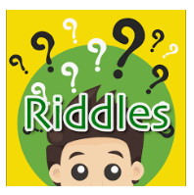
Good morning Year 2 Wednesday 25th March
9.00 – 9.30 PE with Joe live on youtube – ask first!!!!!!!
English This week we are writing riddles. Did you find the features?
1 First person - we know how to do this – I, me, my
2 Present tense - we know how to do this – has, have, is , am
3 Hardest clues first/ Easiest clues near the end
4 Descriptive - we know how to use adjectives, could include similes
5 Finish with a question - What am I? - remember the ?
Read the riddles on Mondays power point. Think about the fruit that you chose. Have a go at writing your own riddle.
Good riddles will have the 5 features plus:
Use of adjectives
Sentences started in different ways eg I have….. I am……. My ……… Sometimes…….. You eat me with…………
Correct punctuation
Excellent riddles will make use of:
Similes eg as red as…… shaped like a ………….
You can post your riddles on the Year 2 riddles blog. (school blogs, Year 2, top of the school home page)
Can you guess each others fruit?
Spelling Remember to practise your y+s=ies spellings. Write them out on paper, on the carpet with your finger, in the air!

Slide 2
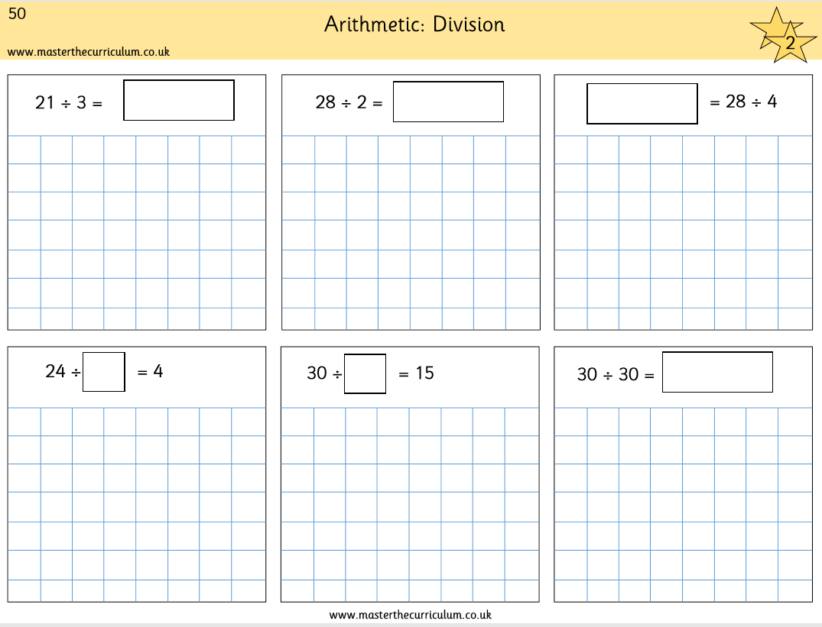
Wednesday 25th March
Maths
We are continuing with division. Complete p50 in your pack. It looks like this.
÷2 ÷3 ÷4 ÷5 Show your working out. Draw the people.
30 ÷ 30 = 1 Think of more ways to use ÷ so that the answer is 1. eg 5 ÷ 5 = 1
Answers 7, 14, 7, 6, 2, 1
https://www.ictgames.com/mobilePage/doggyDivision/index.html to help you practise equal dividing ‘Doggy Division Dinners’
Use Prodigy for 20 minutes.
Practise your tables – click them and clap them – you know how we do in class. 2x 3x 4x 5x 10x

