Slide 1
Good morning Year 2 Tuesday 24th March
9.00 – 9.30 PE with Joe live on youtube – ask first!!!!!!!
English This week we are writing riddles. Did you find the features?
First person - we know how to do this – I, me, my
Present tense - we know how to do this – has, have, is , am
Hardest clues first
Easiest clues near the end
Descriptive - we know how to use adjectives, could include similes
Finish with a question - What am I? - remember the ?
Let’s practise the description. Think of a fruit. Choose adjectives to describe its colour, size, taste, use. Devise similes to describe its colour, size, taste, use (as red as a ruby, as red as a glowing coal, as red as Rudolph’s nose, as small as a marble). Think of comparisons using ----er ideas. (Smaller than a tennis ball but larger than raindrop.)
Spelling Practise your y+s=ies spellings.

Slide 2
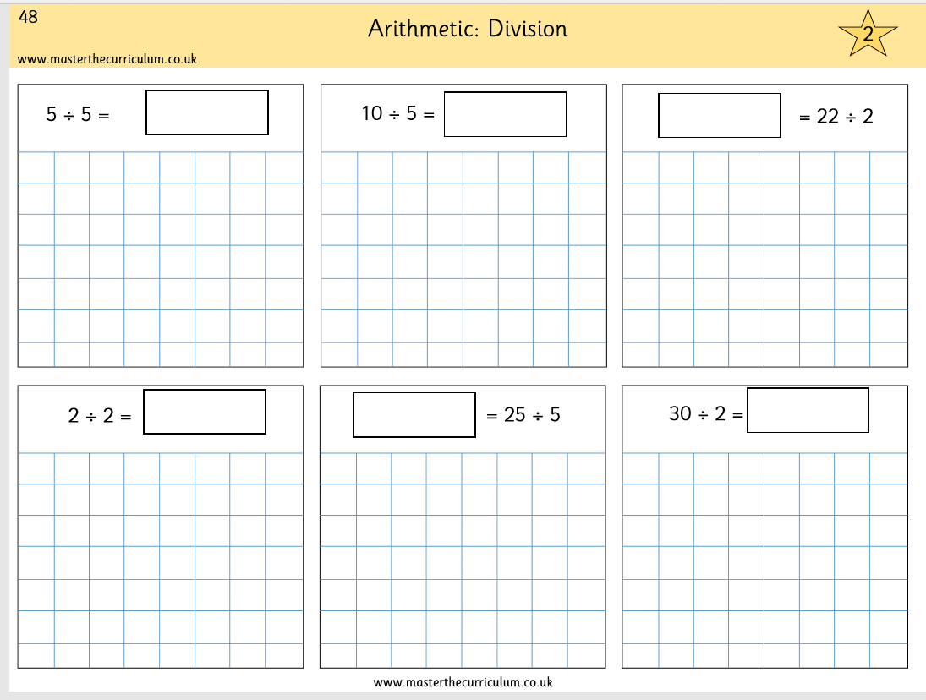
Tuesday 24th March
Maths
We are continuing with division. Complete p48 in your pack. It looks like this.
÷2 ÷3 ÷4 ÷5 Show your working out. Draw the people.
Answers 1, 2, 11, 1, 5, 15
Use Prodigy for 20 minutes.
Practise your tables – click them and clap them – you know how we do in class. 2x 3x 4x 5x 10x

