Slide 1
Good morning Year 2 Monday 23rd March
9.00 – 9.30 PE with Joe live on youtube – ask first!!!!!!!
English This week we are going to write riddles. But what is a riddle? Read some of these to the adults in your house. Can you work them out?
I begin with a ‘d’. I have two webbed feet. I dip under water to find food to eat. What am I? | I am red and white. My light is very bright. I keep ships safe on stormy nights. What am I? |  | I have an eye but I cannot see. I’m very sharp. You can sew with me. What am I?
I am hard. I am shaped like the moon. You can whisk me up in a delicious milkshake. I am longer than your thumb but shorter than a ruler. I grow on trees in long bunches. Sometimes I am yellow but sometimes I am black. I have got slippery skin. What am I? |  | I am soft. I come from a field. I am smaller than a tennis ball and bigger than a two pence coin. I am juicy and sweet. I am heart shaped. My colour is bright red. You can eat me with cream. What am I?
Look carefully. What makes riddle writing different to other writing. Think of at least 3 features. (Not capital letters, full stops, sense, spelling.) We’ll check in tomorrow to look at all 5 features.
Spelling Practise your y+s=ies spellings.

Slide 2
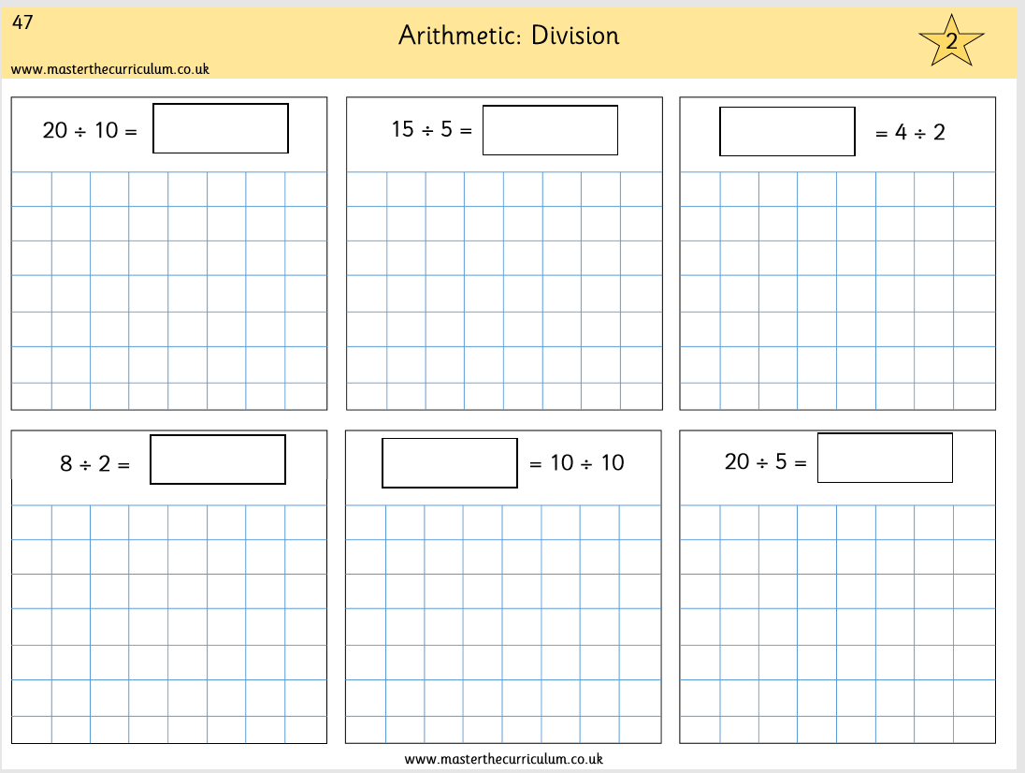
Monday 23rd March
Maths
We are continuing with division. Complete p47 in your pack. It looks like this.
Remember ÷10 we just know! But ÷2 ÷3 ÷4 ÷5 we show our working out draw the people.
Answers 2, 3, 2, 4, 1, 4
Use Prodigy for 20 minutes.
Practise your tables – click them and clap them – you know how we do in class.

