Slide 3
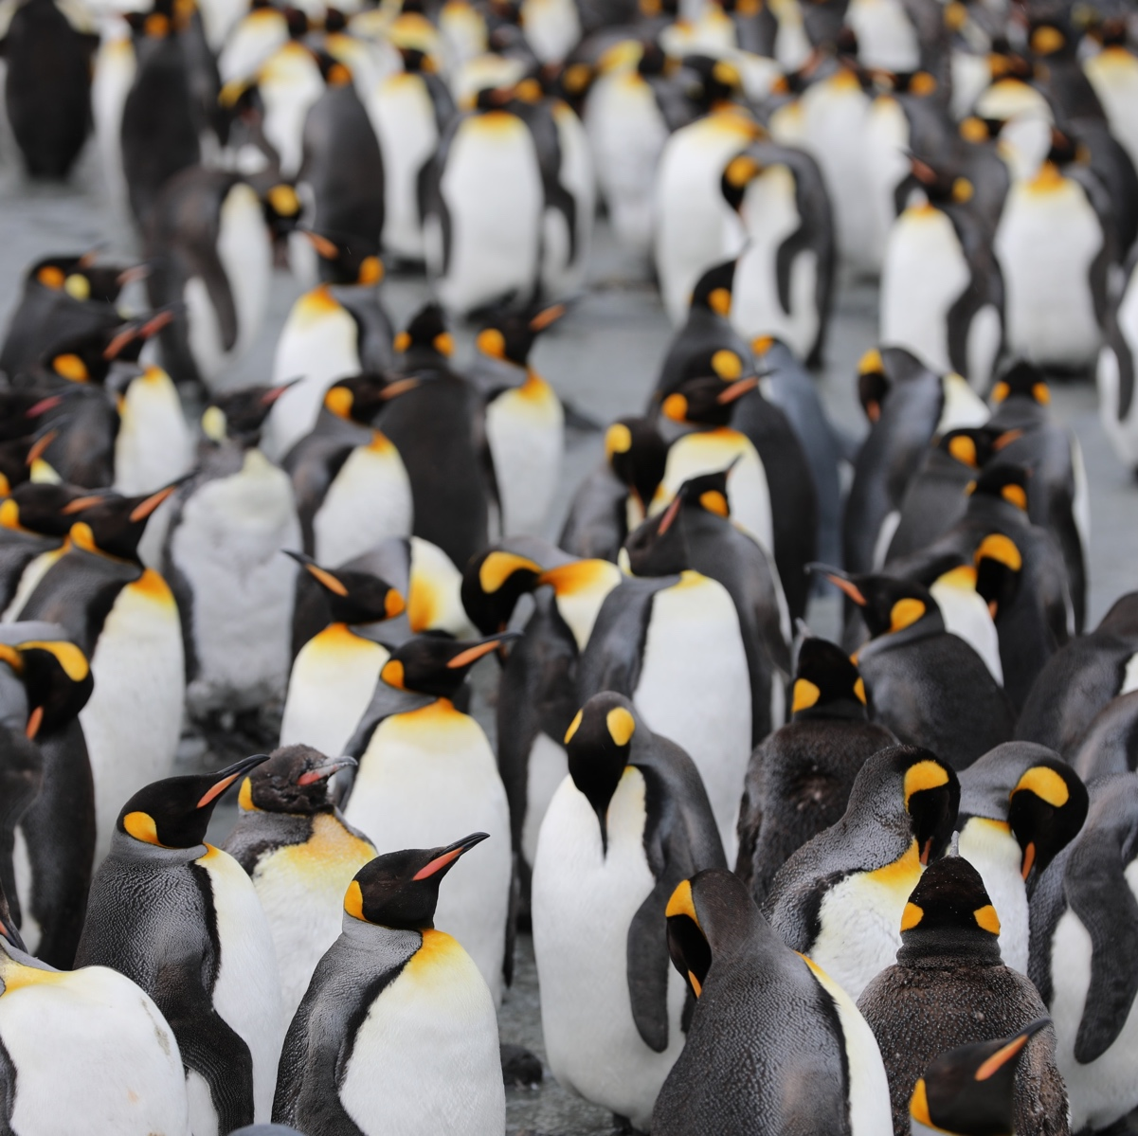
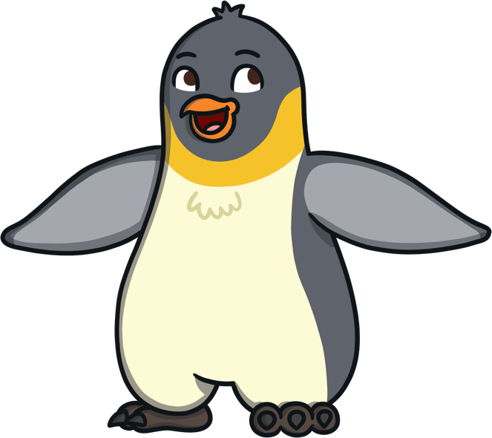
All About
Penguins
What do you know about penguins?
What can you see in this photo?
Do you know any stories or TV
programmes that include penguins?
Do you know any facts about penguins?

Slide 4
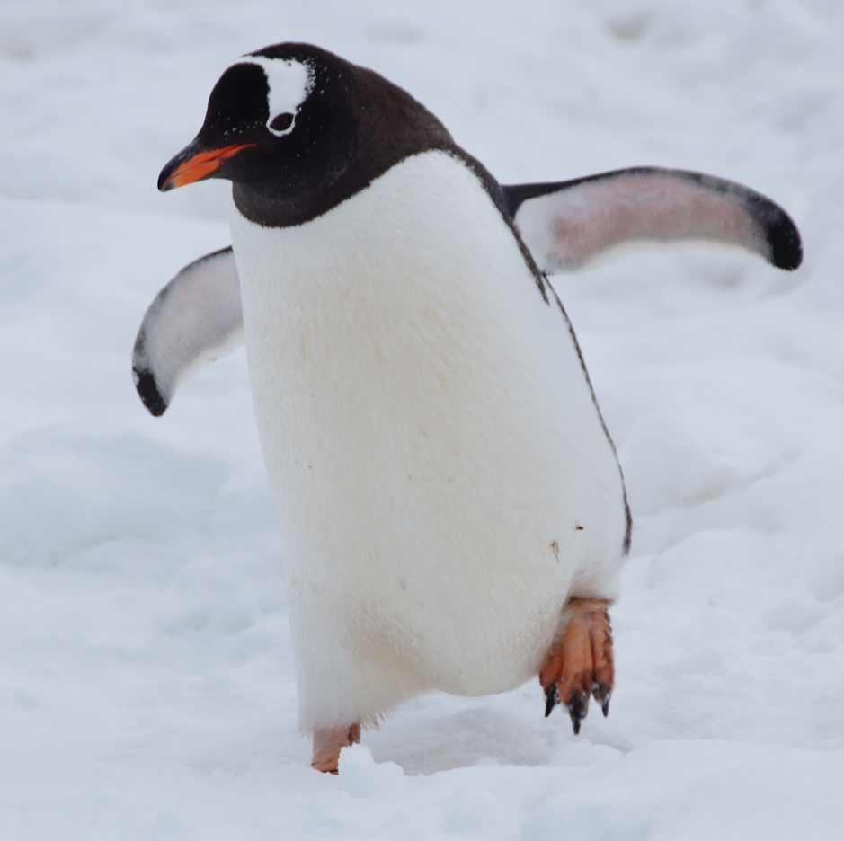
What Is a
Penguin?
Penguins are a type of bird.
They are aquatic birds, meaning they live on
or near water.
  They are mainly black and white.
    Penguins cannot fly but they are very good at swimming.
How am I similar to the penguin in the photo? How am I different?

Slide 5
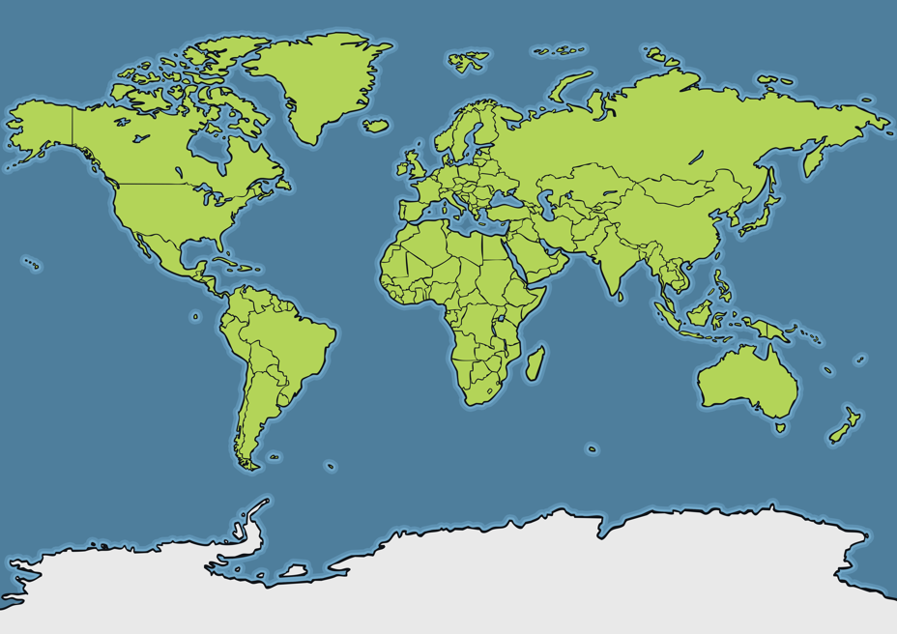
Where Do Penguins Live?
In the wild, penguins mainly live
in the southern hemisphere.
Northern Hemisphere
Galapagos
Islands
Southern Hemisphere
Some live in very cold places like
the Antarctic.
Antarctica
Australia
Some penguins live in warmer places, such as around Australia and the Galapagos Islands.
My friend, a Galapagos penguin, lives in the Galapagos Islands. Can you see where they live on the map?

Slide 6
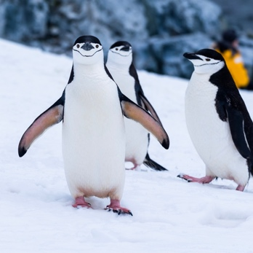
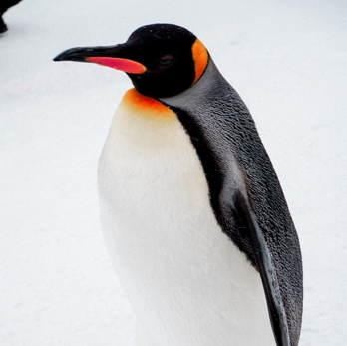
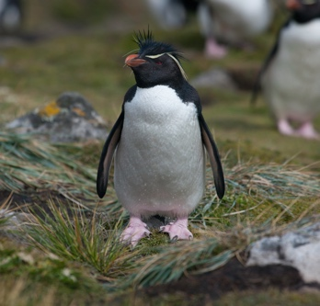
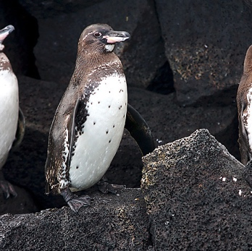
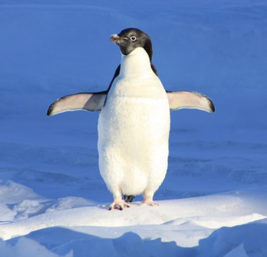
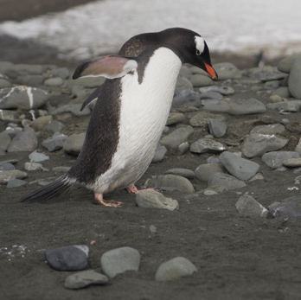
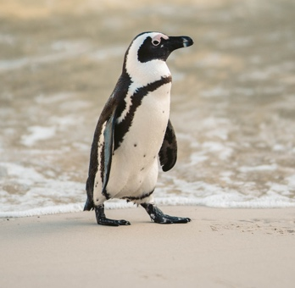
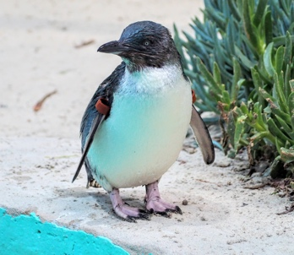
Types of
Penguin
chinstrap
emperor
rockhopper
Galapagos
Adelie
gentoo
Humboldt
little blue
There are many different species of penguin.
What type of penguin do you think I am?
The largest species of penguin is the emperor penguin. They can grow to be around 1 metre tall.
The smallest species of penguin is the little blue penguin which is around 30cm tall.
“Galapagos Penguins” by Aaron Logan is licensed under CC BY 2.0

Slide 7
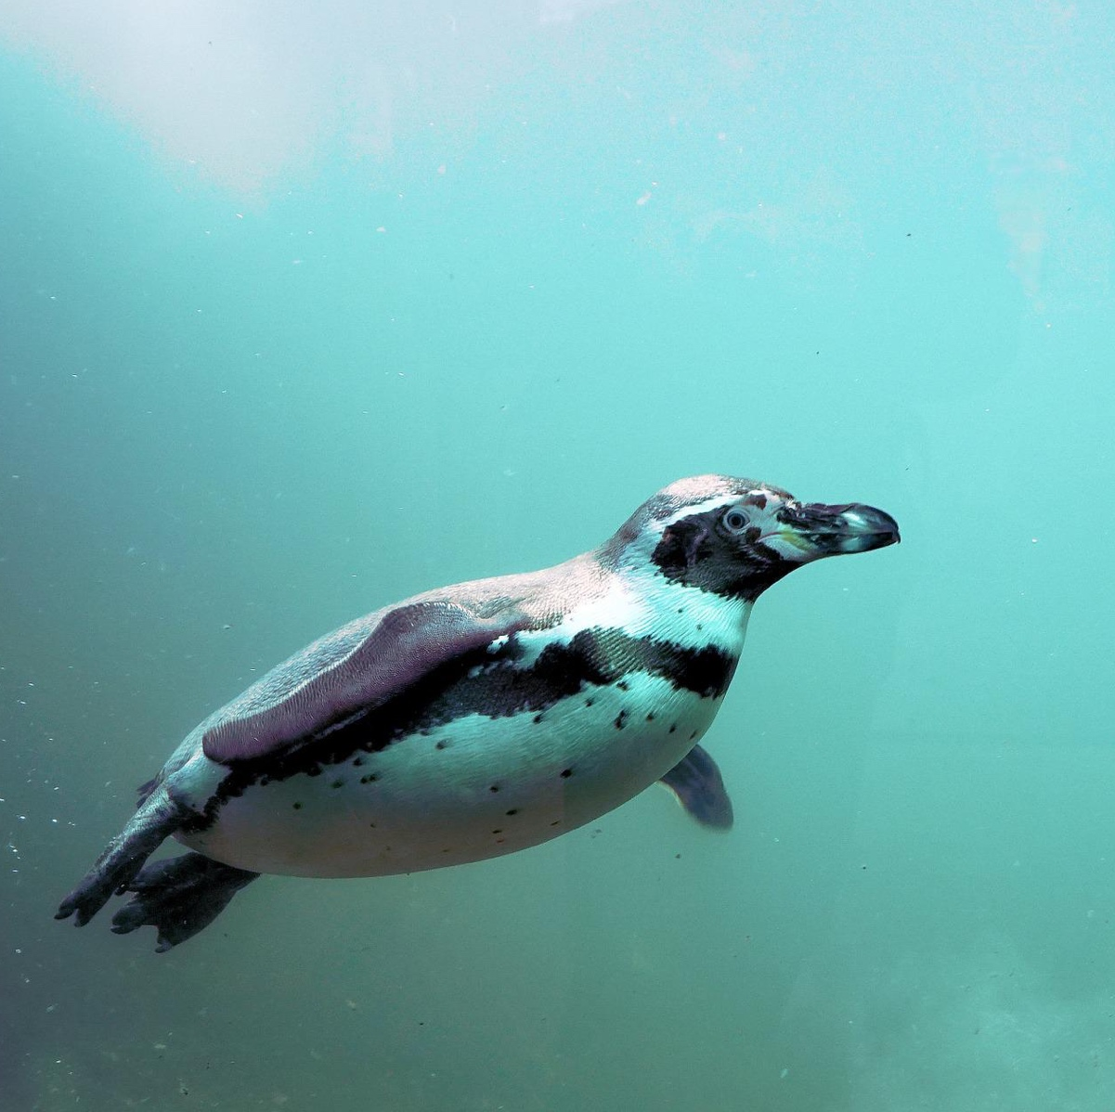
What Do
Penguins Eat?
Penguins hunt for food while they
are swimming under the water.
They mainly eat fish, krill (small
shrimp-like creatures), squid or
other small forms of sea life.
My favourite food is fish! What is your favourite food?

Slide 8
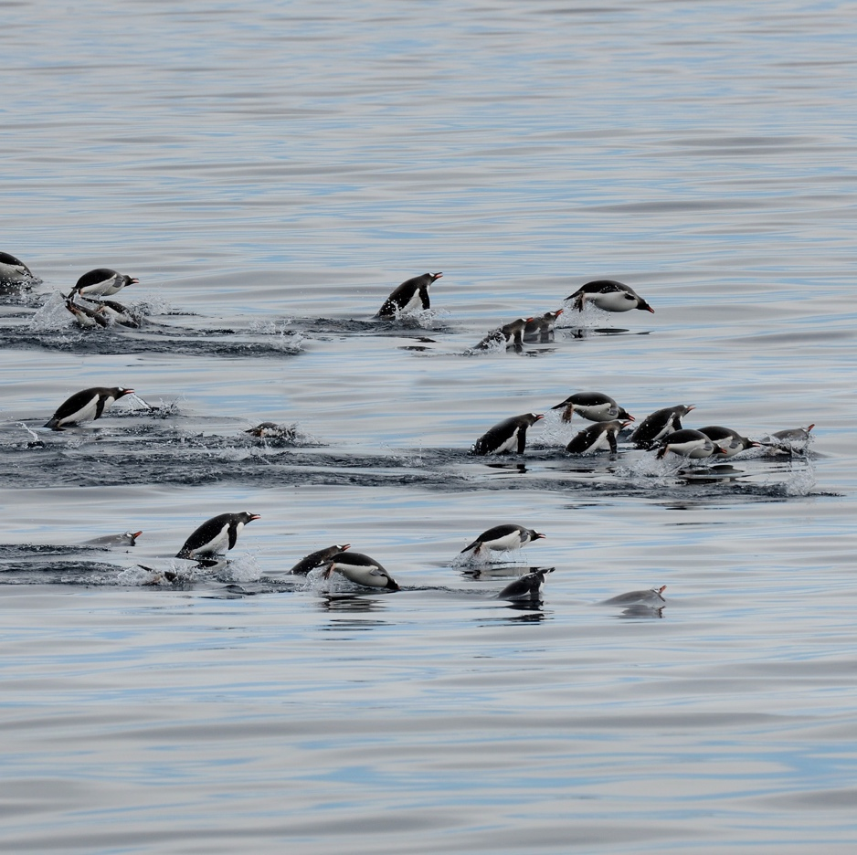
How Do Penguins Move?
Penguins are very good at swimming. They can quickly
swim through the water using their flippers.
  As they are swimming, some penguins will jump and dive in and out of the water. This is called porpoising and helps the penguins to breath, see where they are and escape from animals chasing them.
I love swimming. Can you swim?

Slide 9
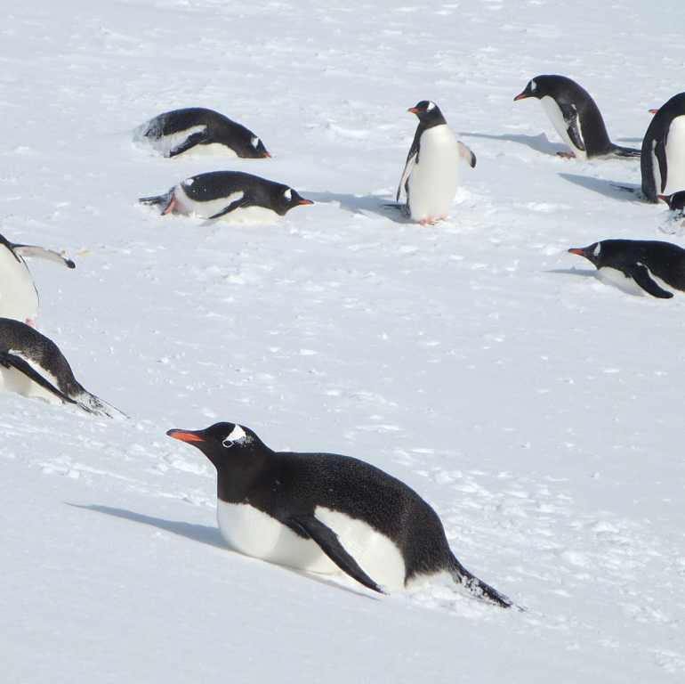
How Do Penguins Move?
When they are on land, penguins sometimes waddle along quite slowly.
They sometimes hop or jump and can jump or dive into
and out of the water.
  Penguins that live in snowy regions, like the Antarctic, sometimes slide along on their tummies and pull themselves along the ice using their flippers and feet. This is called tobogganing.
Tobogganing is lots of fun! Have you used a toboggan or sledge when it is snowy?
“Penguins on their Bellies” by David Stanley is licensed under CC BY 2.0

Slide 10
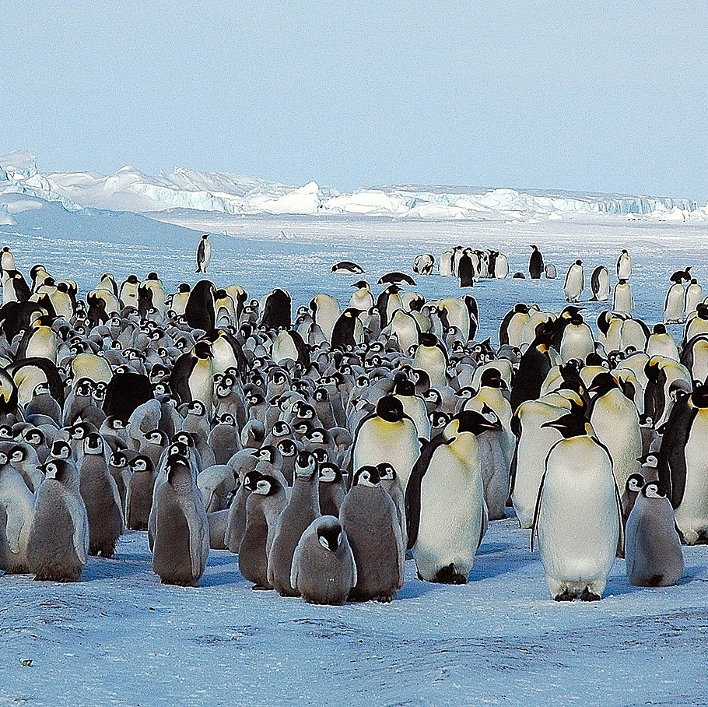
How Do Penguins
Keep Warm?
Penguins that live in cold places, sometimes gather together into large groups to help keep themselves warm. These are called huddles.
A penguin’s thick feathers help to keep them
warm and dry.
They also have a layer of blubber (fat) under their skin that also helps to keep them warm.
Look at these emperor penguins in a huddle together. Can you see the penguin chicks?

Slide 11
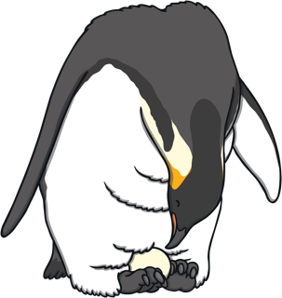
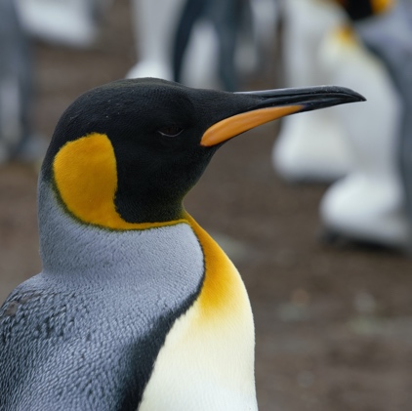
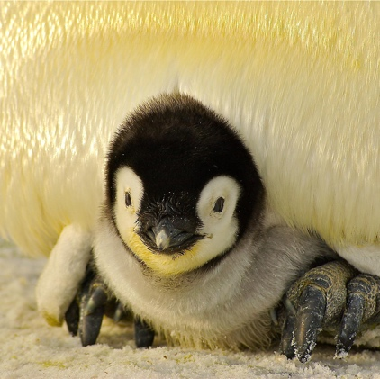
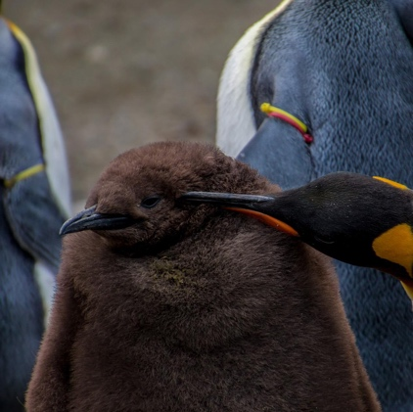
Life Cycle of an
Emperor Penguin
1
A penguin lays an egg which is
carried on the feet of the adult.
The fledging grows into an adult penguin.
4
2
Little, fluffy chicks hatch out of the eggs.
The chick grows larger into a fledging penguin. It begins to grow warm, waterproof feathers.
3
Can you tell a friend about the life cycle of an emperor penguin?

Slide 12
Fun Facts
There are different names for a group of penguins based on where they are and what they are doing.
A group of penguins in the water is known as a ‘raft’.
A group of penguins walking on land is known as a ‘waddle’.
Other names for a group of penguins include a ‘rookery’, a ‘huddle’ or a ‘colony’.
A penguin’s black and white feathers help to camouflage (hide) them when they are swimming.
Penguins make a special type of oil that they use to make their feathers waterproof.
My favourite food is fish! What is your favourite food?
World Penguin Day is held on the 25th April each year.

