Slide 2

Hi!
I’m Hattie.
Would you like to find out more about hedgehogs?
Come with me to learn
lots of fun facts.

Slide 3
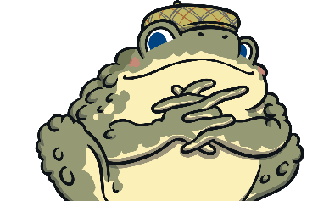

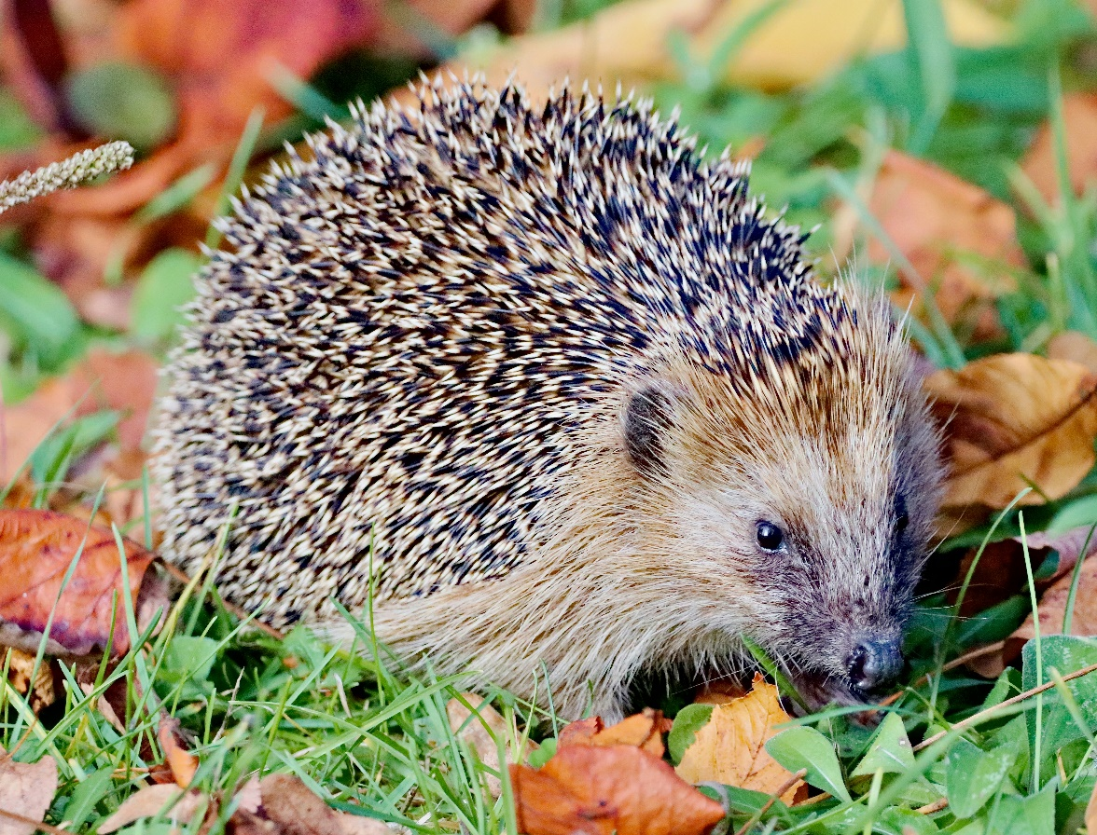

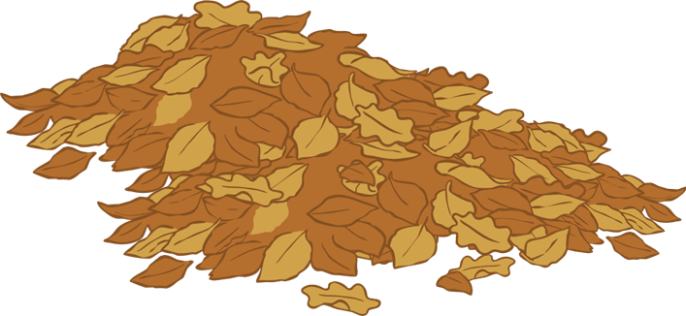
What Is a Hedgehog?
Hedgehogs are small mammals.
A male hedgehog is called a boar.
A female hedgehog is called a sow.
Baby hedgehogs are known as hoglets.

Slide 4
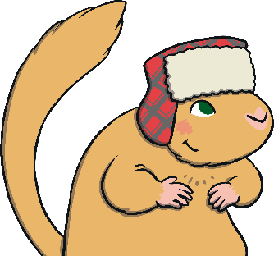
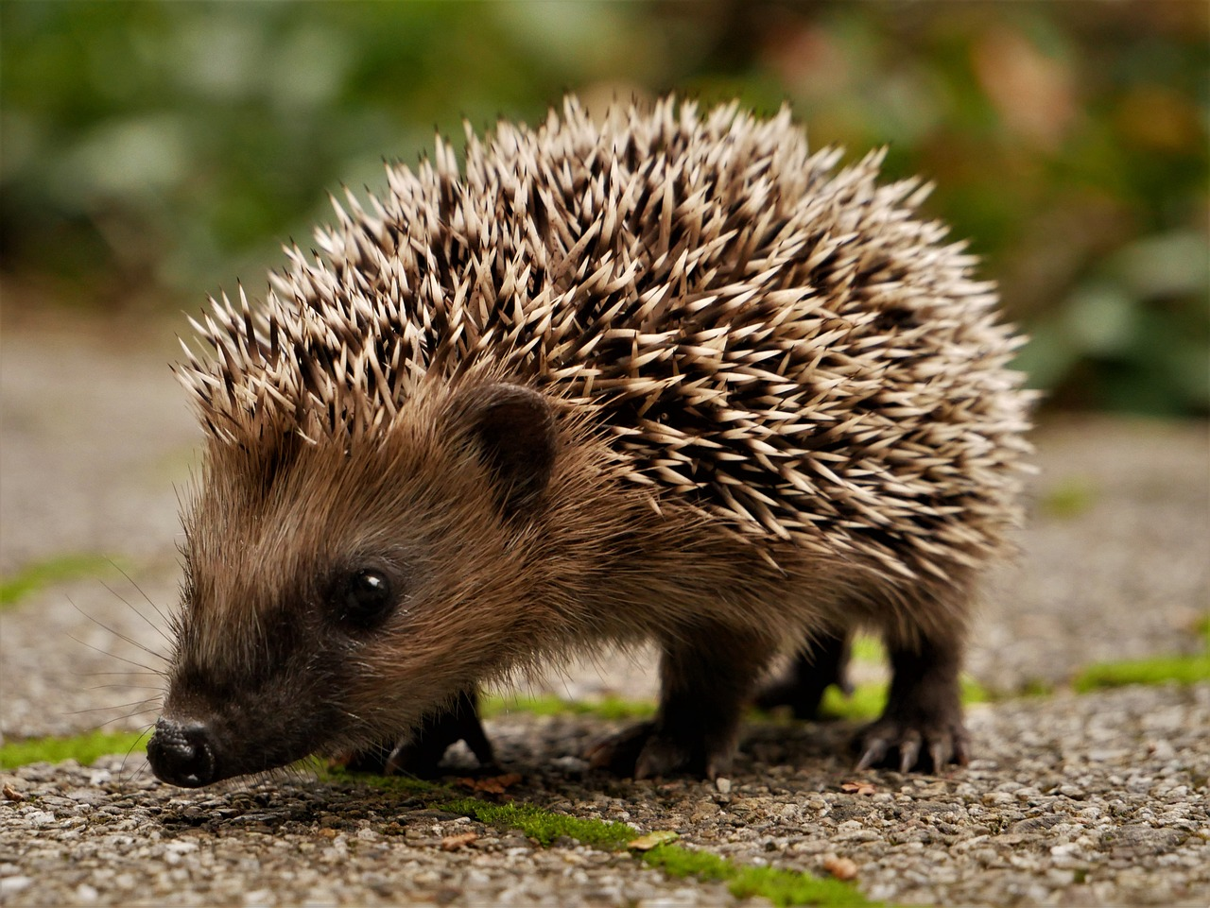

What Do Hedgehogs Look Like?
Hedgehogs have weak eyesight. They can’t see very clearly, especially in the dark!
Hedgehogs have sharp spines. When they are scared, they curl up in a ball.
Hedgehogs have four legs.
They have five toes on each of their paws.
A hedgehog has a long snout with a wet nose. This helps them to smell their food.
Did you know that an adult hedgehog has between 5,000 and 7,000 spines?

Slide 5
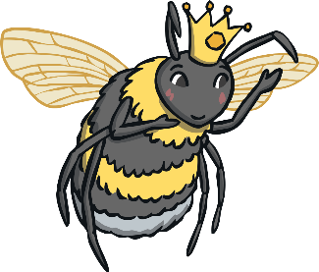
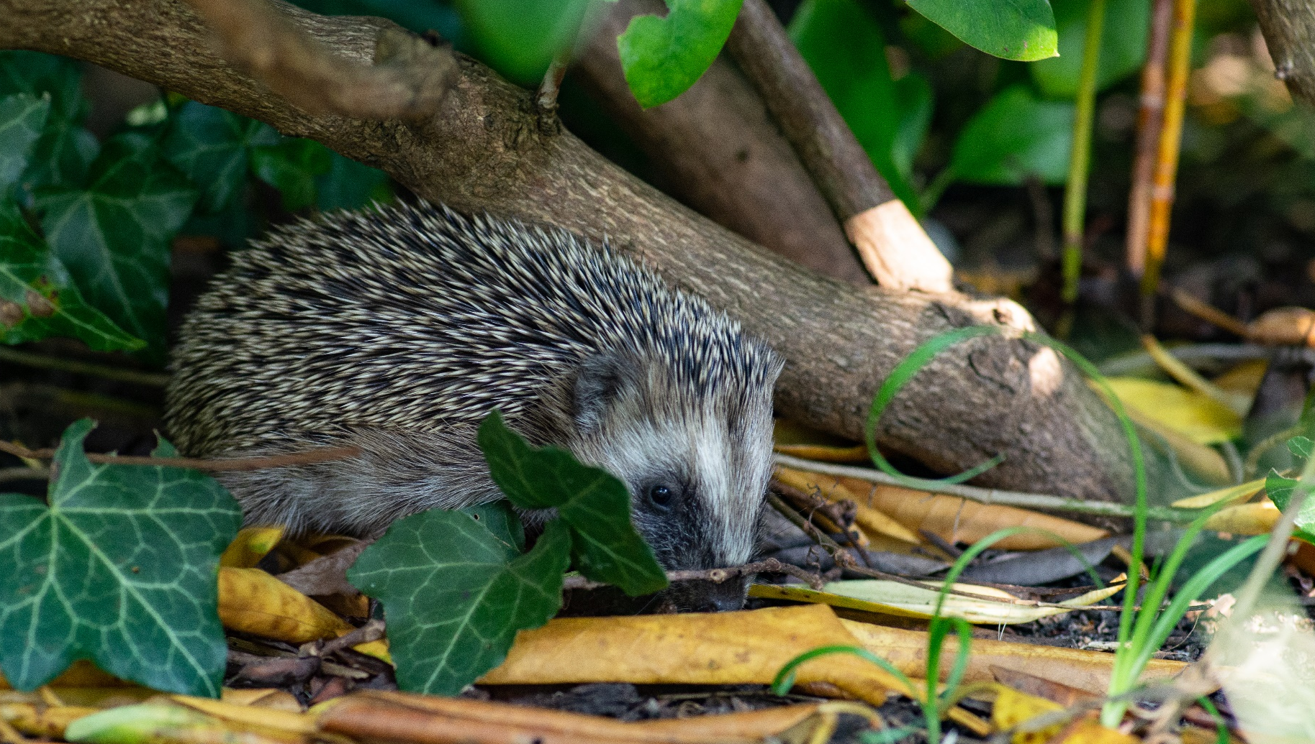

Did You Know?
Hedgehogs get their name from the way that they forage for food.
Hedgehogs use their nose to find food underneath hedges.
As they look for food, hedgehogs make a grunting sound
similar to the noise a pig makes.

Slide 6
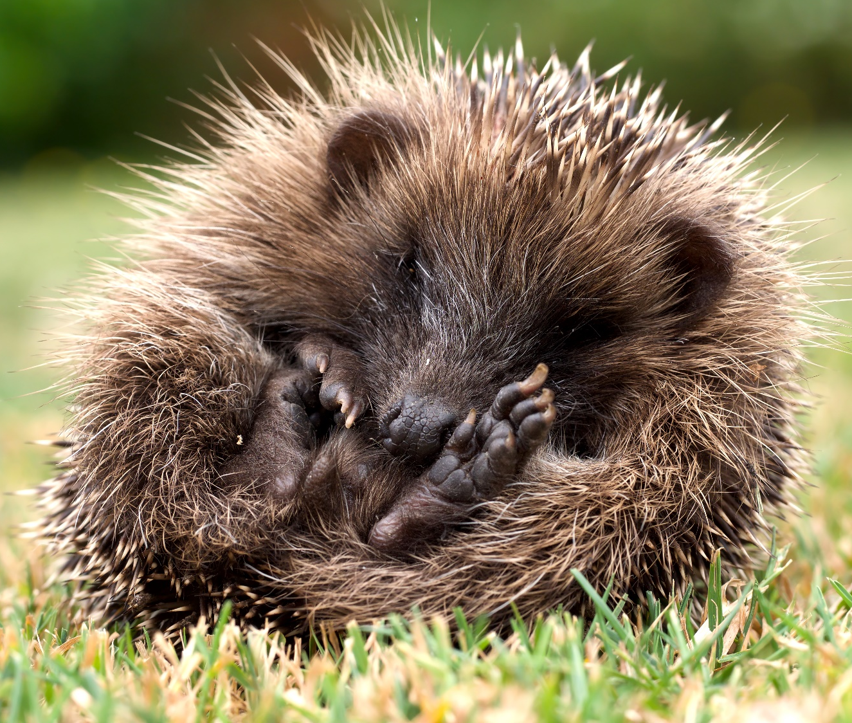
Did You Know?
Hedgehogs are nocturnal.
This means that they are awake at night and sleep during the day.
Hedgehogs sleep curled up in a ball so their spines protect them from predators.

Slide 7
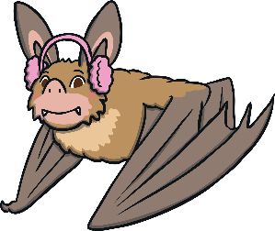
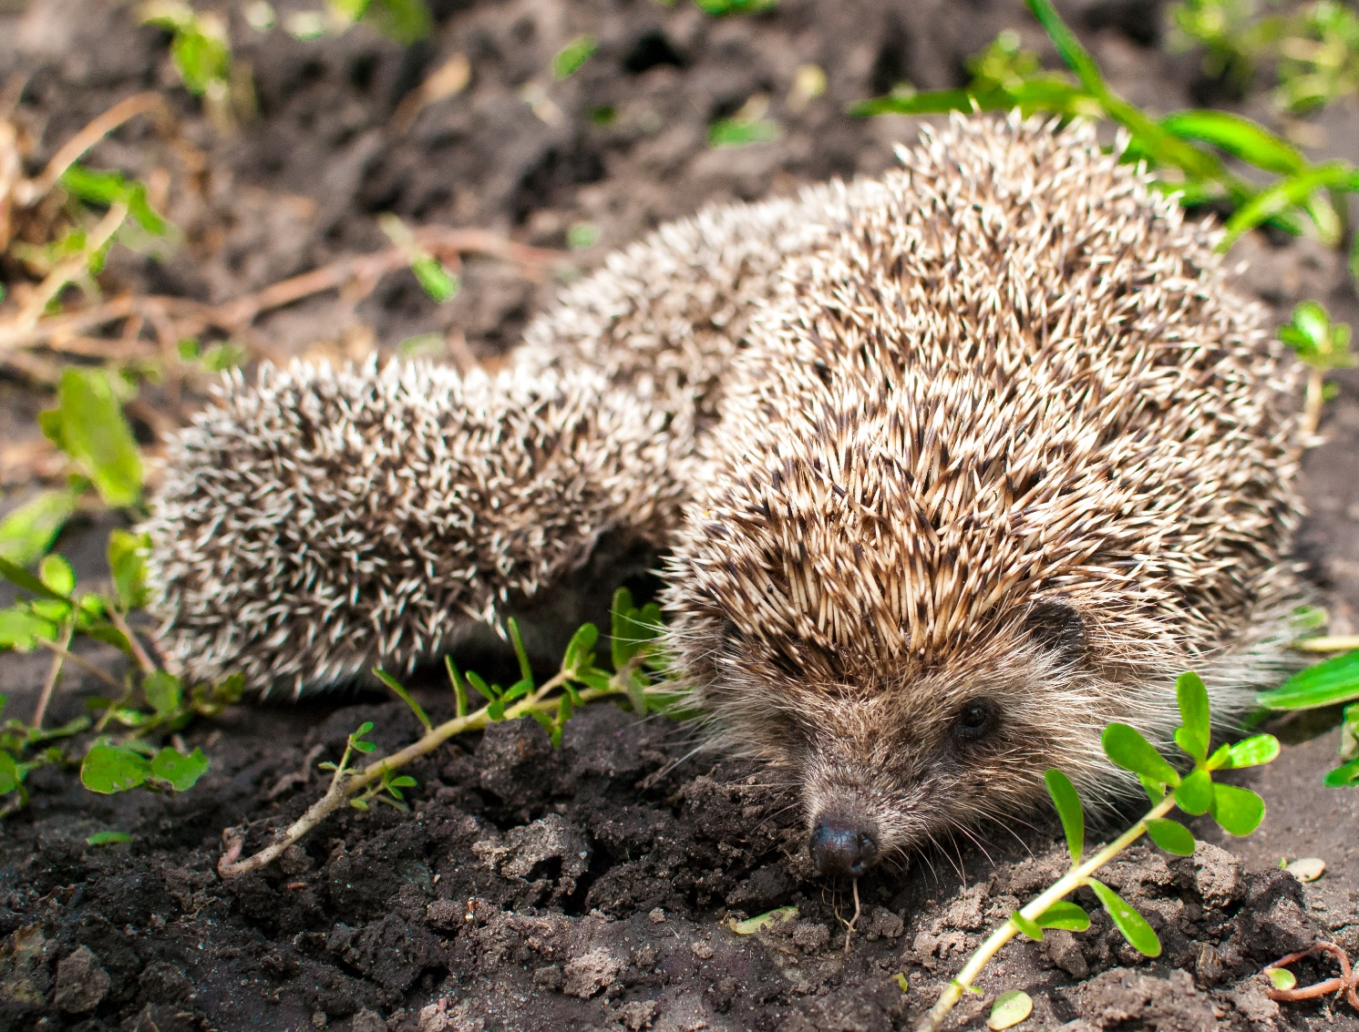
Did You Know?
A hedgehog can have up to seven hoglets at once.
Hoglets stay with their mother for six weeks before they leave to start life on their own.
If a hoglet is separated from its mother, it will make a whistling sound or cry until it is found!

Slide 8
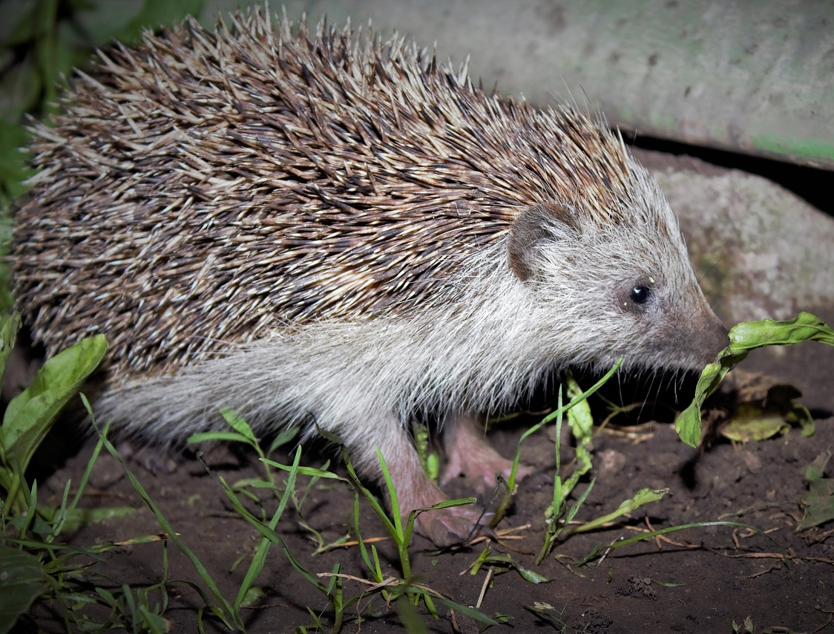
Did You Know?
There are 17 different types of hedgehog. They live in lots of different places across the world including in Europe, Asia, and Africa.
The European hedgehog is the only type of hedgehog that lives in the UK.

Slide 9
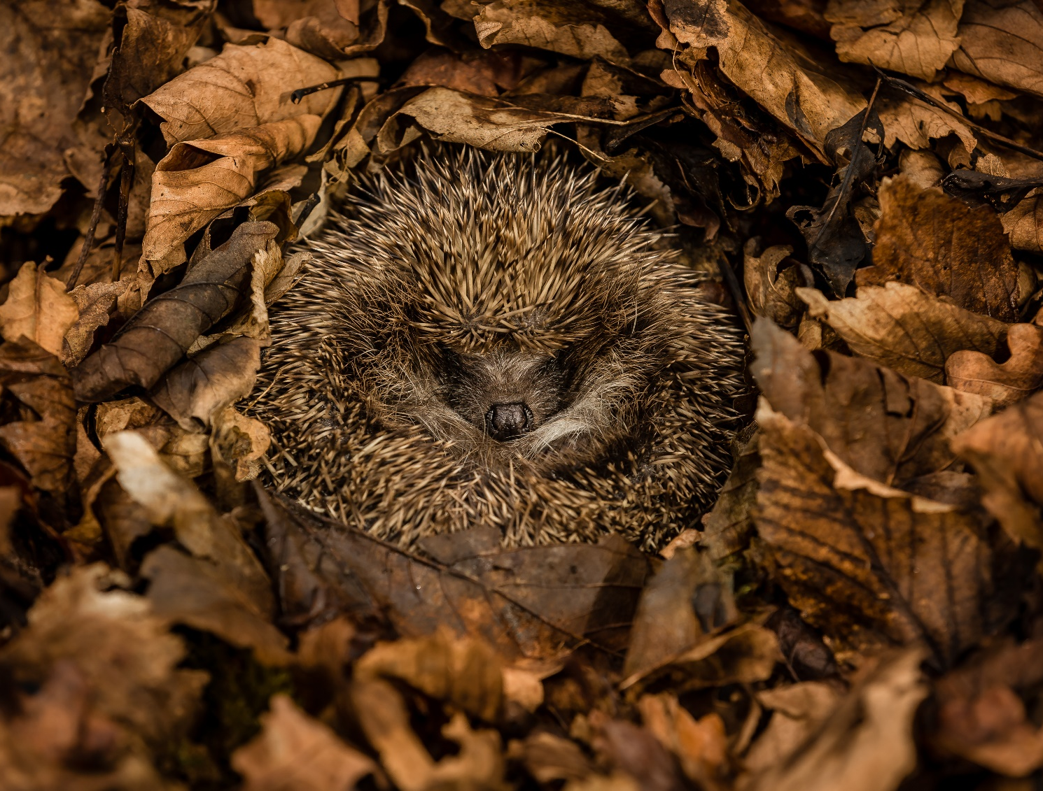
Did You Know?
Hedgehogs hibernate during the winter.
They eat as much as they can during summer so they survive winter when there is not as much food.
Hedgehogs find a hidden spot and build a nest using leaves, twigs and feathers.

Slide 10
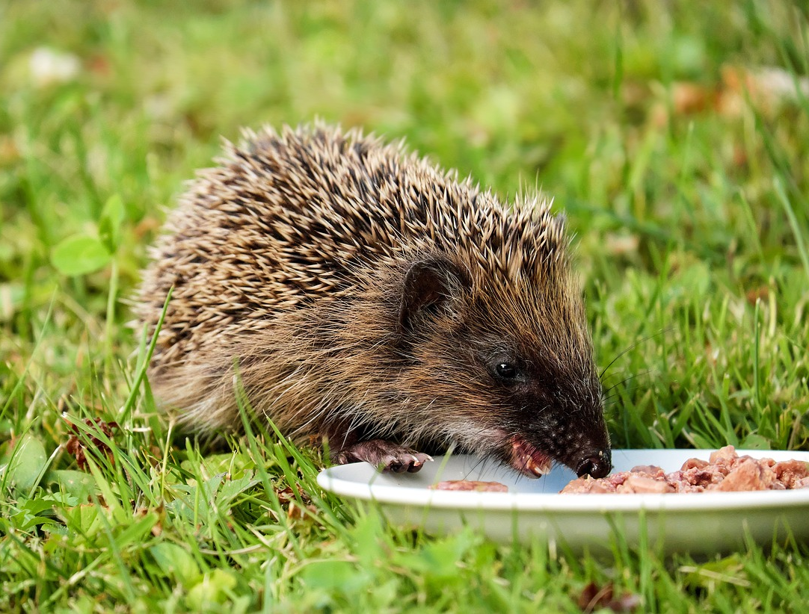
Did You Know?
Hedgehogs are lactose intolerant. This means that drinking milk isn’t good for them and can make them poorly.
Sometimes, people leave food out for hedgehogs who visit their garden. Hedgehogs can eat wet cat food and drink fresh water.
Most hedgehogs will eat insects, worms, slugs, snails and frogs. Some have been known to eat bird’s eggs or dead mice too. Hedgehogs also eat fallen fruit, berries, roots and seeds.

Slide 11
We hope you have enjoyed learning about hedgehogs!

Slide 12
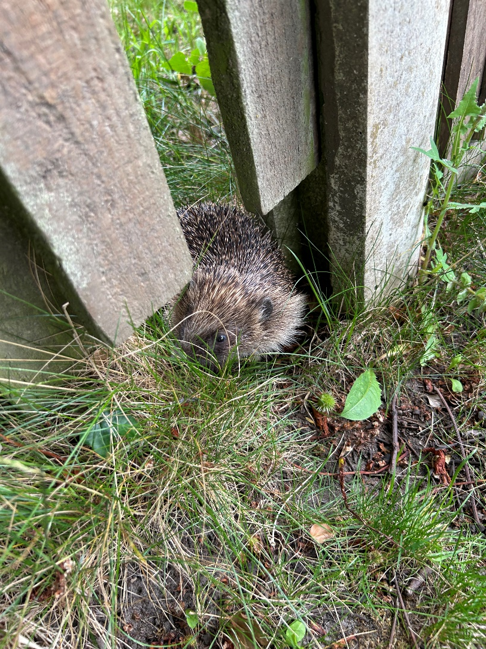
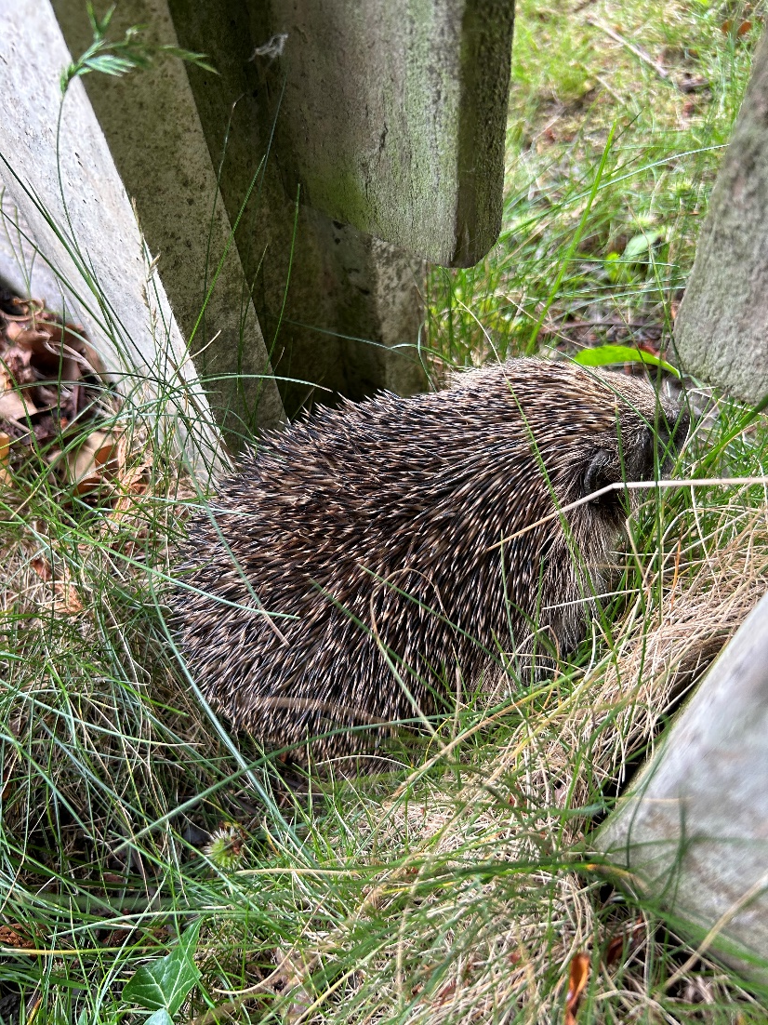

Slide 13
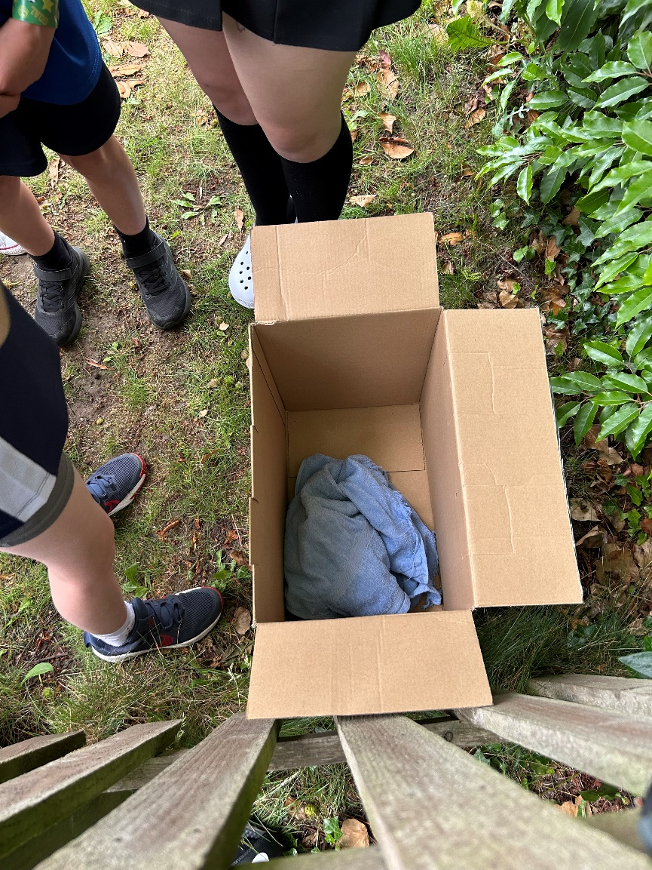
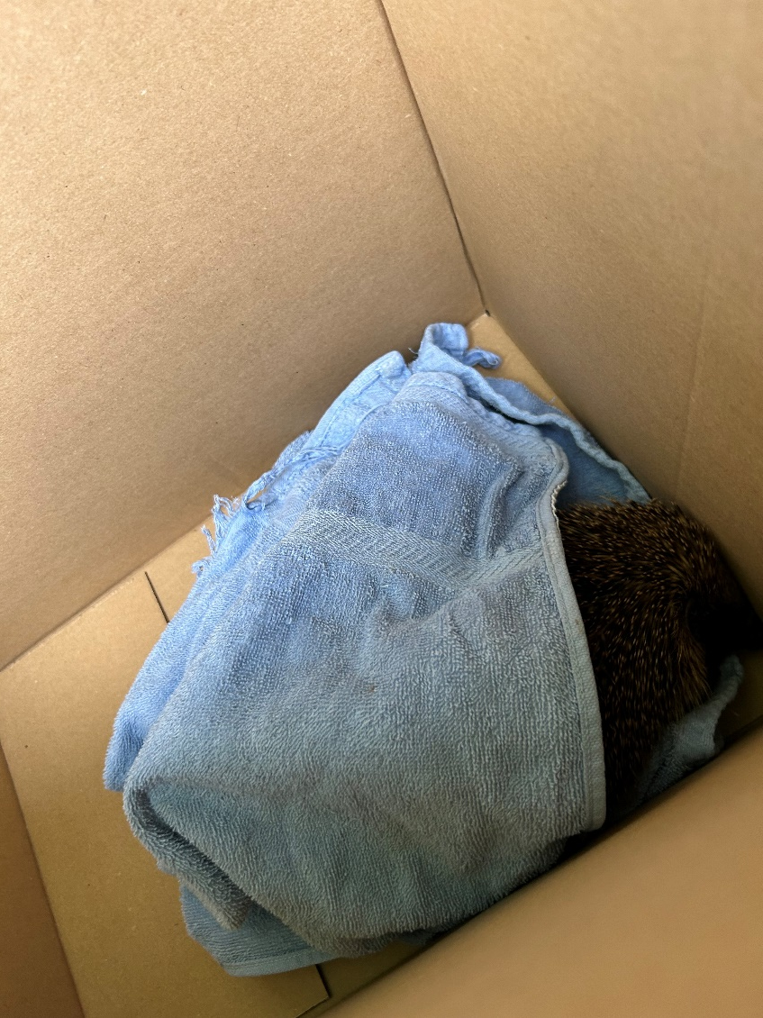

Slide 14
