Slide 2
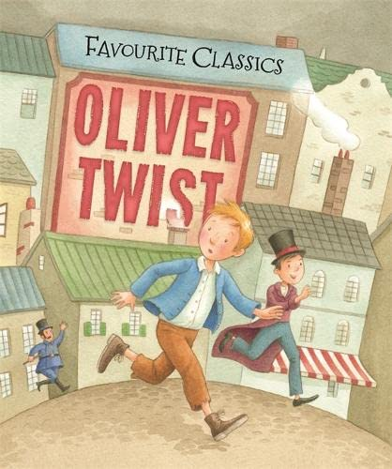
English, Communication and Languages
As writers, we will: Write coherently for a range of purposes. Plan, draft and edit independently. Select and accurately use appropriate grammar. Evaluate our own and others' writing. As readers, we will: Make comparisons within and across books. Retrieve, record and discuss information. Compare texts of different genres and writers. Identify themes, conventions and styles in books. Identify and summarise main ideas. Identify how language, structure and presentation contribute to meaning. Draw inferences and justify predictions. As French linguists, we will: Know the names and locations of some major ports and airports in France Ask and answer a question Tu aimes? Learn the numbers 12-31 Recap hobbies, opinions and months Learn to discuss transport, weather, clothing
Mathematics
As mathematicians, we will learn to: round decimals to the nearest whole number compare and order numbers up to 2 decimal places estimate, compare and calculate money in pounds and pence read, write, convert between analogue & digital 12- & 24-hr clocks solve problems converting units of time compare & classify shapes based on their properties and sizes identify acute/obtuse angles & order angles up to 2 right angles identify lines of symmetry in 2-D shapes in different orientations complete a simple symmetric figure describe positions on a 2-D grid as coordinates describe movements between positions as translations plot specified points and draw sides to complete a given polygon. interpret/present discrete/continuous data using charts & graphs solve comparison, sum and difference problems using information presented in bar charts, pictograms, tables
Physical Health and Wellbeing
As sports people, we will: jump as far as we can. Know how to use our body to maximise performance Hurdle effectively Triple jump effectively Throw the javelin effectively Run 400m effectively As citizens, we will: Learn how to look after our mental health Learn to recognise healthy and unhealthy influences Learn how to make healthy choices Learn to deal with my feelings Learn to show acceptance Learn what puberty is Understand periods Learn how to keep clean as we grow and change Learn basic first aid Learn about risks with spending
Summer Term 24/25 Class Text
Miss Steele, Madam Leydon,
Mrs Bundy, Miss Such
The Arts and Design
As artists, we will: Understand starting points in a design process. Explore techniques to develop imagery. Explore using a textile technique to develop patterns. Learn how to create a repeating pattern. Understand how art is made for different purposes As designers, we will: understand what frame and free-standing structures are. know that a pavilion is a decorative structure for leisure. know that cladding can be applied to structures. know that aesthetics are how a product looks. Design a stable pavilion structure that is aesthetic Build frame structures designed to support weight. Making different free-standing frame structures. Selecting appropriate materials for the cladding. Reinforcing corners to strengthen a structure. As musicians, we will: Listen and copy back melodic and rhythmic patterns. Identify 2/4, 3/4, and 4/4 metre. Identify the tempo, recognise the style & structure of music. Sing ‘on pitch' and 'in time'. Explore standard notation Rehearse and learn to play a simple melodic instrumental part by ear or from notation Compose accompaniments on tuned & untuned percussion Play and perform melodies following staff notation
Science and Technology
As scientists, we will learn about: Electricity: identify common appliances that run on electricity construct a simple series electrical circuit, naming cells, wires, bulbs, switches and buzzers identify whether or not a lamp will light in a simple series circuit recognise that a switch opens and closes a circuit and associate this with whether or not a bulb lights recognise some common conductors and insulators. Sound: identify how sounds are made, associating some of them with something vibrating recognise that vibrations from sounds travel through a medium to the ear find patterns between the pitch of a sound and features of the object that produced it find patterns between the volume of a sound and the strength of the vibrations that produced it recognise that sounds get fainter as the distance from the sound source increases As computer scientists, we will: Use a text-based programming language to explore count- controlled loops when drawing shapes. Use a block-based programming language to explore count- controlled and infinite loops when creating a game.
Humanities
As geographers, we will learn about: The name of some cities and counties in the UK. The main types of land use such as residential, agricultural, commercial and transportation. Some types of settlement such as village, town and city The different settlement patterns e.g. linear, nucleated and dispersed As historians, we will learn that: The Victorian period was from 1837-1901. The Industrial Revolution was the transition from making goods by hand to using machines, meaning more factories, goods produced, railways and development of steam power. Factory life was believed to be difficult due to poor and unsafe working conditions, long hours and punishments. People moved to towns to work in factories. Conditions in towns were poor because of cramped housing, shared toilets and communal water pump. Schooling was strict: rows facing forward, blackboard, rules. In 1834, a law meant that poor people were in workhouses. Boys could work as chimney sweep apprentices but the working conditions were poor and dangerous.

