Slide 1
Disclaimer/s
We hope you find the information on our website and resources useful.
Animations
This resource has been designed with animations to make it as fun and engaging as possible. To view the content in the correct formatting, please view the PowerPoint in ‘slide show mode’. This takes you from desktop to presentation mode. If you view the slides out of ‘slide show mode’, you may find that some of the text and images overlap each other and/or are difficult to read.
To enter slide show mode, go to the slide show menu tab and select either from beginning or from current slide.
You may wish to delete this slide before beginning the presentation.

Slide 3
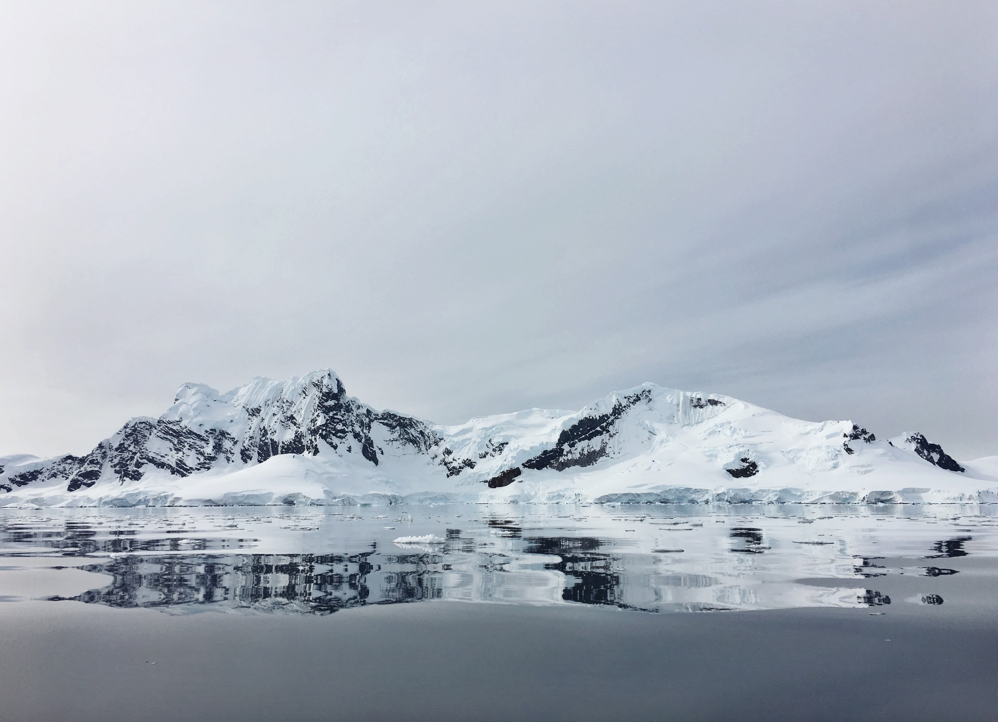
Hello everyone! My name is Ella and I’m a polar explorer. Would you like to come with me to explore the polar regions? I wonder what we will find.

Slide 4
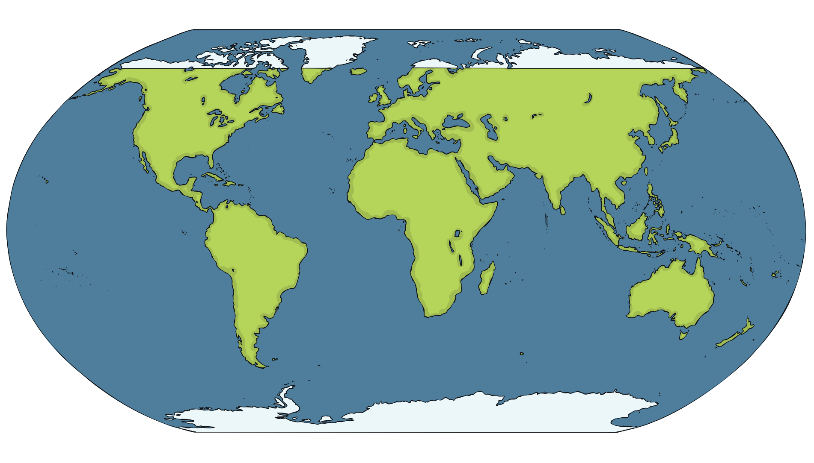
Here is a map of the world. Can you see that at the top and bottom there are areas coloured white? Why do you think they are coloured white? That’s right! They are covered in snow and ice.
Here is a map of the world. Can you see that at the top and bottom there are areas coloured white? Why do you think they are coloured white?
Here is a map of the world. Can you see that at the top and bottom there are areas coloured white?
Here is a map of the world.
That’s right! They are covered in snow and ice.

Slide 5
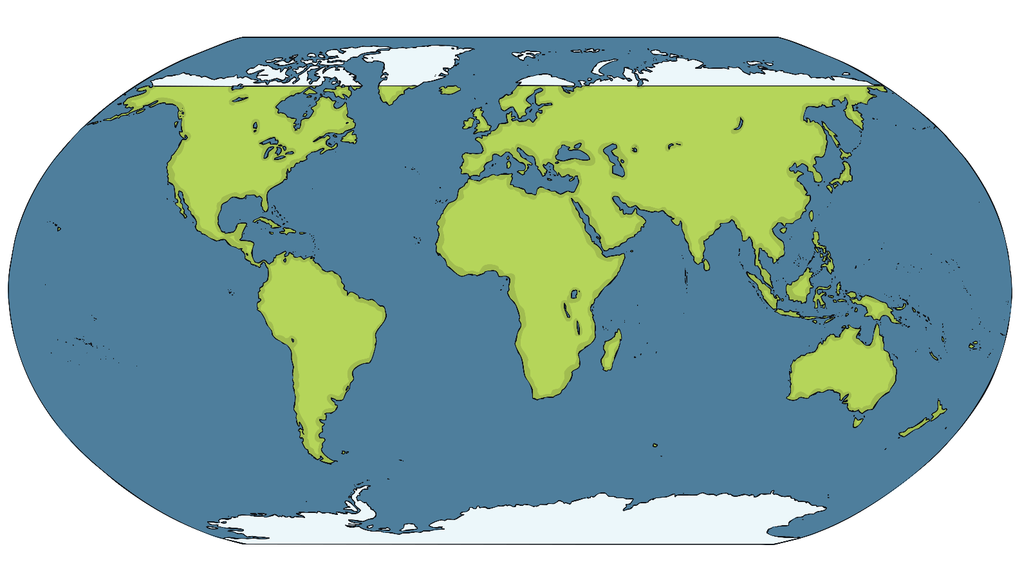
The area at the top, at the North Pole, is called the Arctic. It is mostly a frozen ocean.
Arctic
The area at the bottom, at the South Pole, is called the Antarctic. It is an area of land covered in ice. Together they are the polar regions.
Antarctic

Slide 6
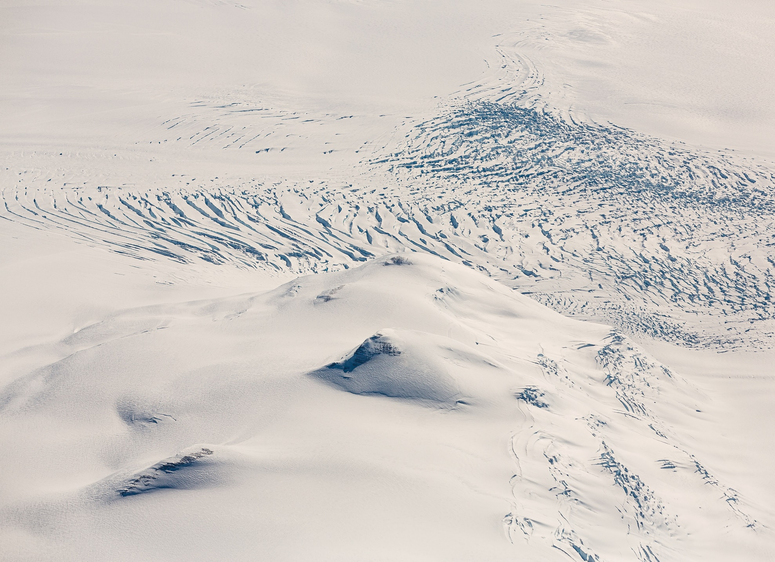
I hope you are wearing your warmest clothes! It is very cold in the polar regions – even in the summer – and the ground is almost always frozen.
I hope you are wearing your warmest clothes! It is very cold in the polar regions – even in the summer – and the ground is almost always frozen. In the summer, the sun never sets and it is always light. Then, in the winter, it is always dark.
I hope you are wearing your warmest clothes! It is very cold in the polar regions – even in the summer – and the ground is almost always frozen. In the summer, the sun never sets and it is always light.
I hope you are wearing your warmest clothes!

Slide 7
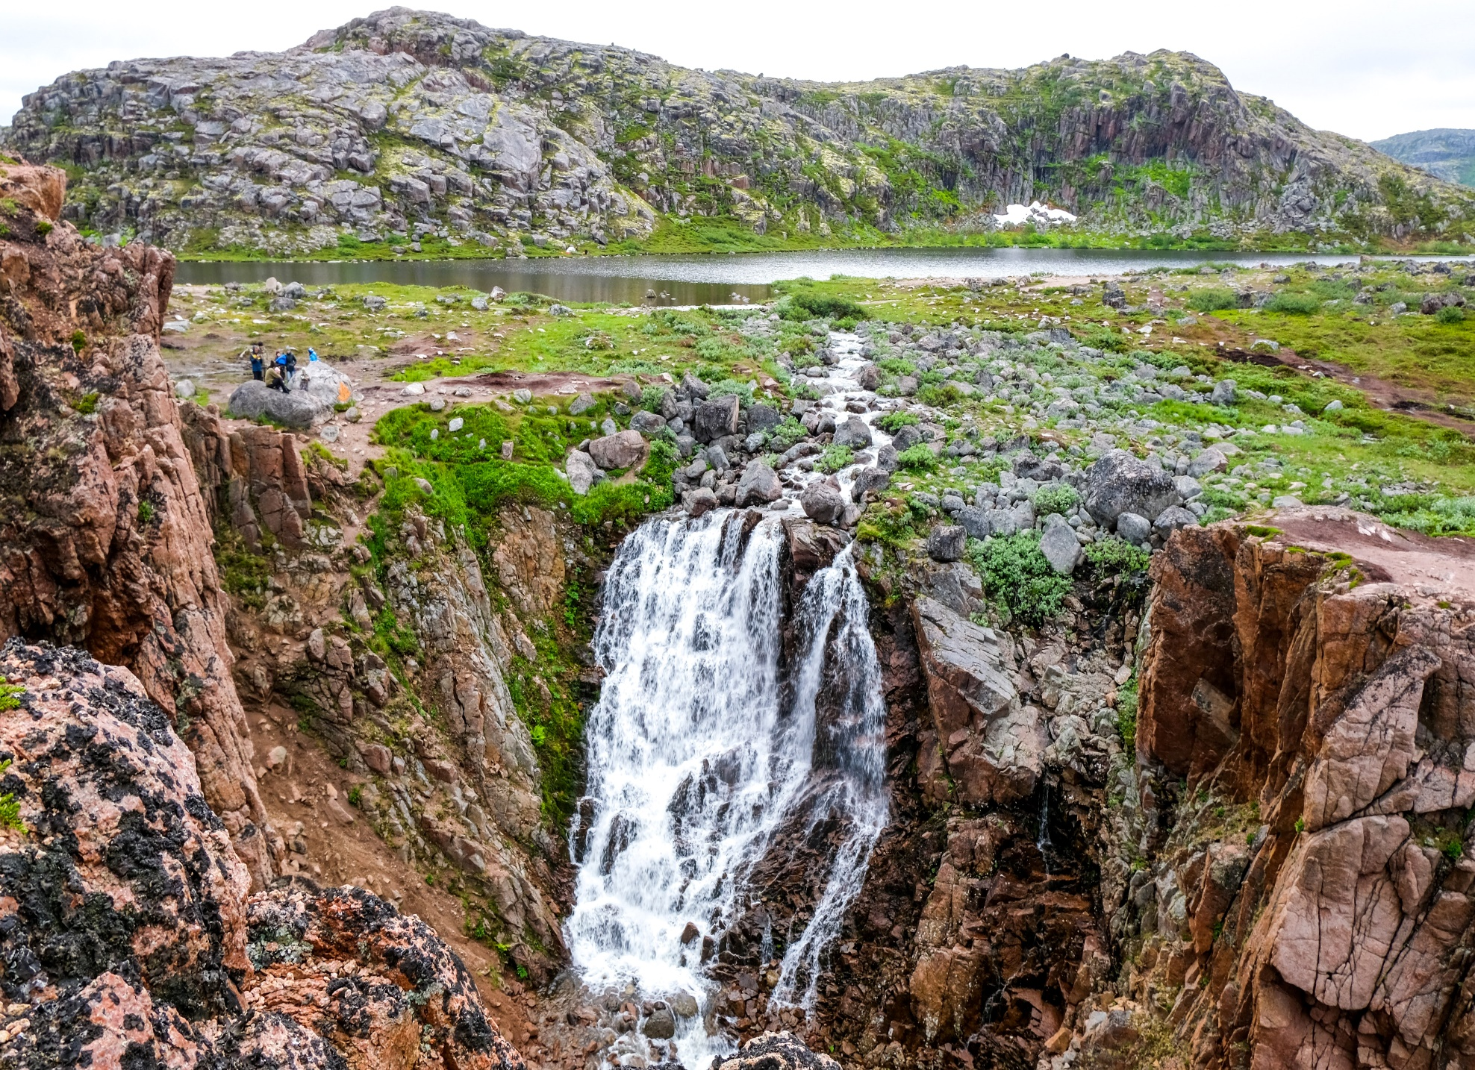
Can you see any plants growing here? In the summer, the very top part of the soil thaws.
Can you see any plants growing here? In the summer, the very top part of the soil thaws. This means that the snow and ice melt and then some plants grow. Trees have deeper roots so they can’t grow here.
Can you see any plants growing here? In the summer, the very top part of the soil thaws. This means that the snow and ice melt and then some plants grow.
Can you see any plants growing here?

Slide 8
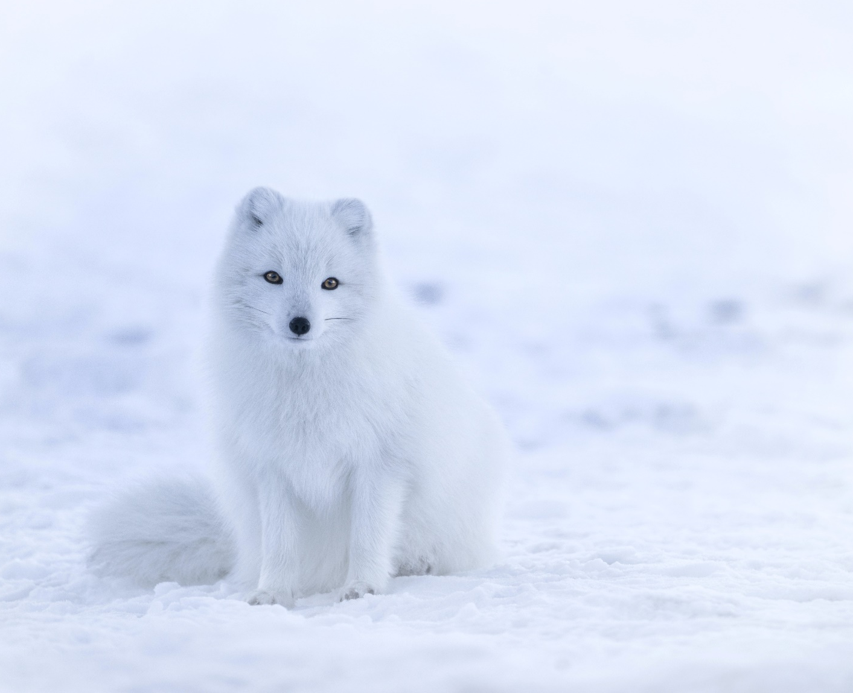
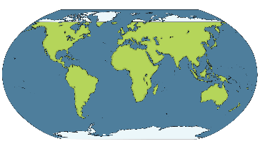
My fur helps me to blend in with the snow. I am camouflaged and can hide!
Let’s explore the Arctic to find some animals. This Arctic fox has a short nose and short ears to help it to keep warm.
Let’s explore the Arctic to find some animals.
Let’s explore the Arctic to find some animals. This Arctic fox has a short nose and short ears to help it to keep warm. Arctic foxes live in burrows under the ground. Their fur changes colour in summer and winter, to help them stay camouflaged.
Let’s explore the Arctic to find some animals. This Arctic fox has a short nose and short ears to help it to keep warm. Arctic foxes live in burrows under the ground.

Slide 9
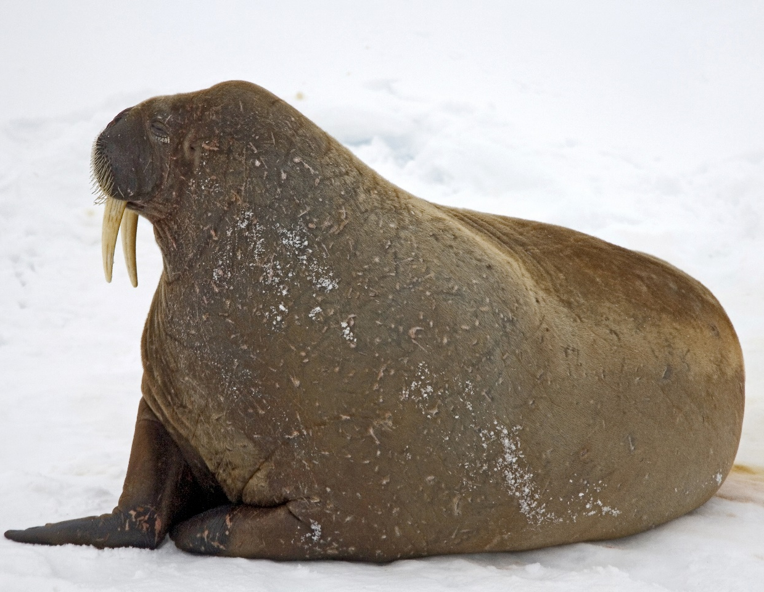
Oh look, a walrus! Can you see its long tusks?
Oh look, a walrus!
Oh look, a walrus! Can you see its long tusks? It can use these tusks to break holes in the ice so that it can breathe when it’s in the water. Like polar bears, walruses have a thick layer of blubber to keep them warm.
Oh look, a walrus! Can you see its long tusks? It can use these tusks to break holes in the ice so that it can breathe when it’s in the water.

Slide 10
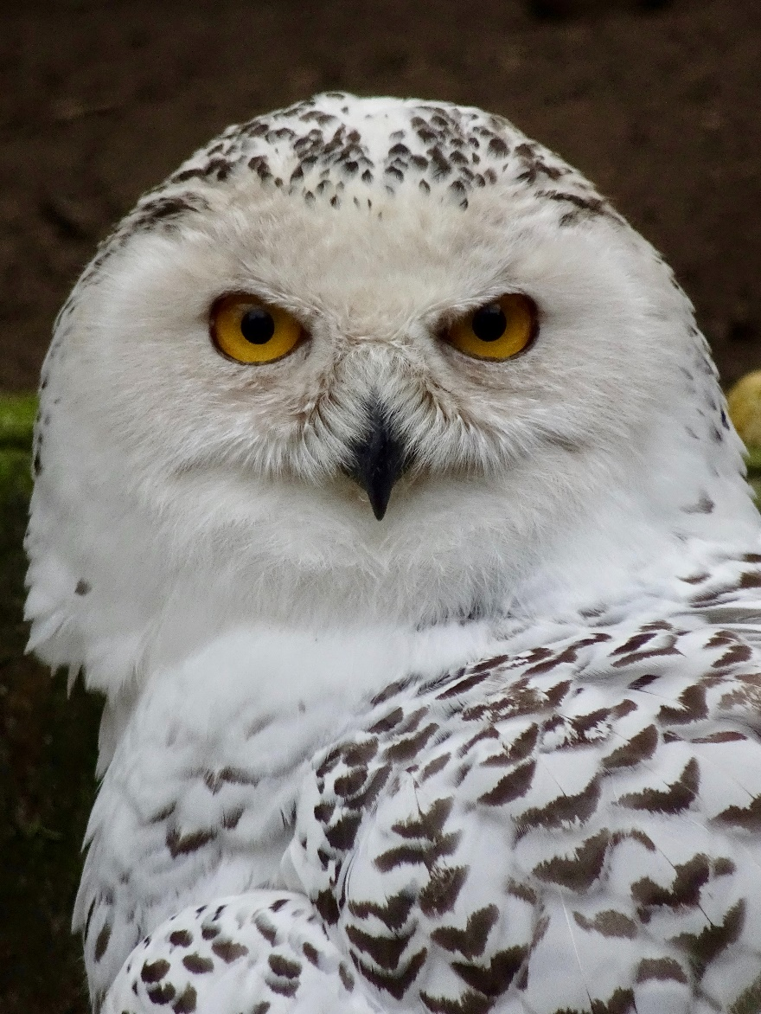
Did you notice the snowy owl?
Did you notice the snowy owl? Snowy owls have very good eyesight and their hearing is excellent too. This helps them to catch their prey in the snow.
Did you notice the snowy owl? Snowy owls have very good eyesight and their hearing is excellent too.

Slide 11
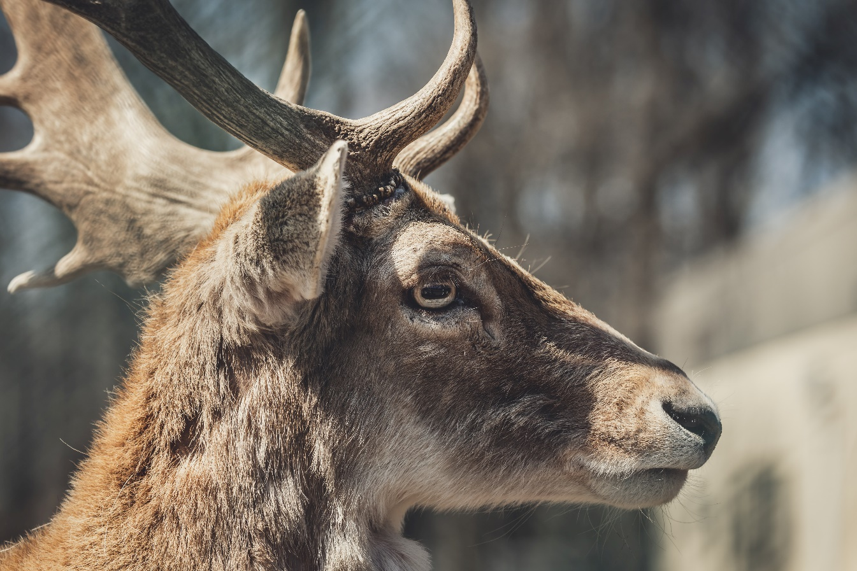
I am a female reindeer so I keep my antlers all through the winter. Male reindeers lose their antlers in the autumn.
Here’s a reindeer! Did you know that the fur underneath a reindeer’s hooves stops it from slipping on the ice?
Here’s a reindeer!
Here’s a reindeer! Did you know that the fur underneath a reindeer’s hooves stops it from slipping on the ice? A reindeer’s eyes are golden in the summer but turn blue in the winter so it can see better in the winter darkness.

Slide 12
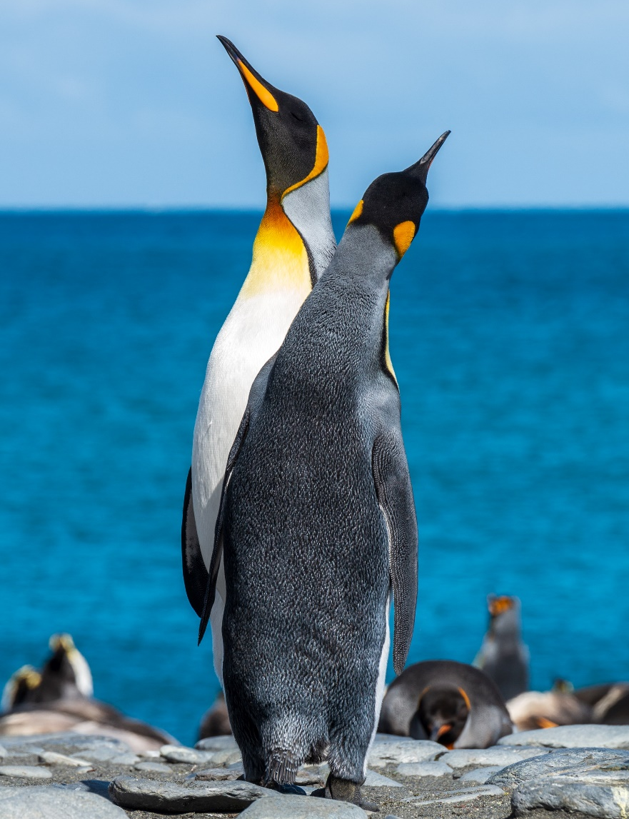
Now we’re travelling to the Antarctic to see some emperor penguins. They keep their eggs and their chicks off the cold ground by tucking them into a special flap of skin that’s just above their feet. Emperor penguins huddle together to keep warm.
Now we’re travelling to the Antarctic to see some emperor penguins. They keep their eggs and their chicks off the cold ground by tucking them into a special flap of skin that’s just above their feet.
Now we’re travelling to the Antarctic to see some emperor penguins.

Slide 13
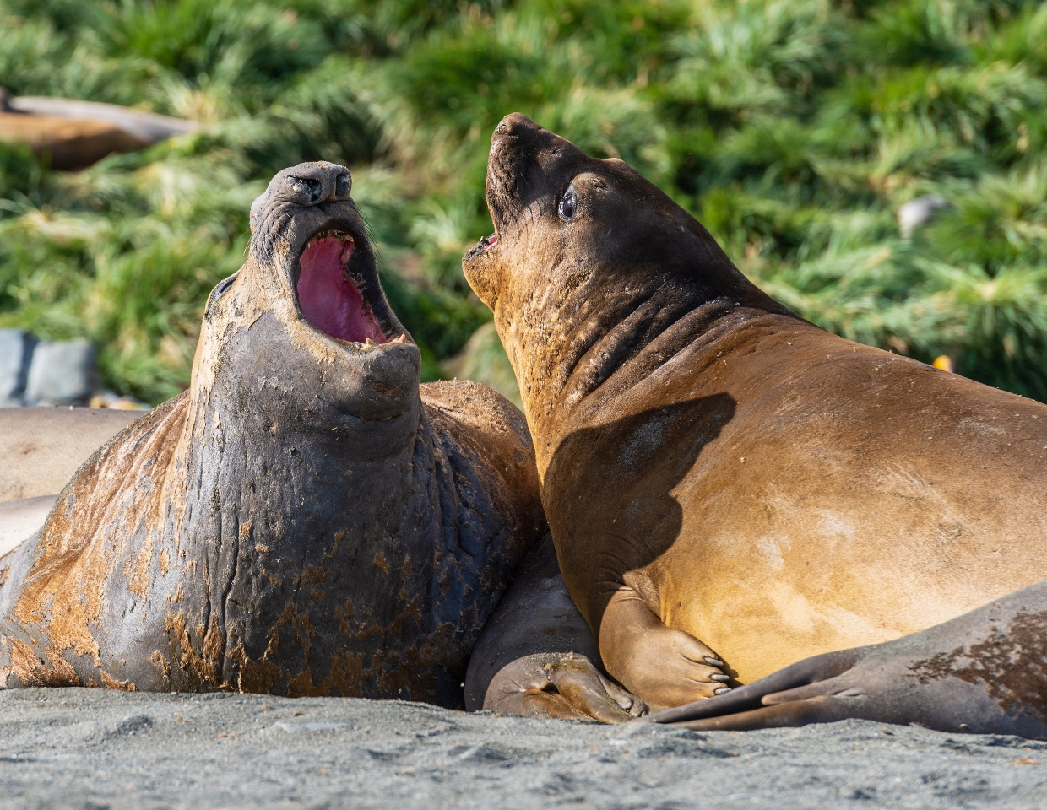
Elephant seals are the biggest seals in the world and they live in the Antarctic too. The males have large noses which they use to roar loudly. Elephant seals are amazing swimmers and can stay under the water for over two hours.
Elephant seals are the biggest seals in the world and they live in the Antarctic too. The males have large noses which they use to roar loudly.
Elephant seals are the biggest seals in the world and they live in the Antarctic too.

Slide 14
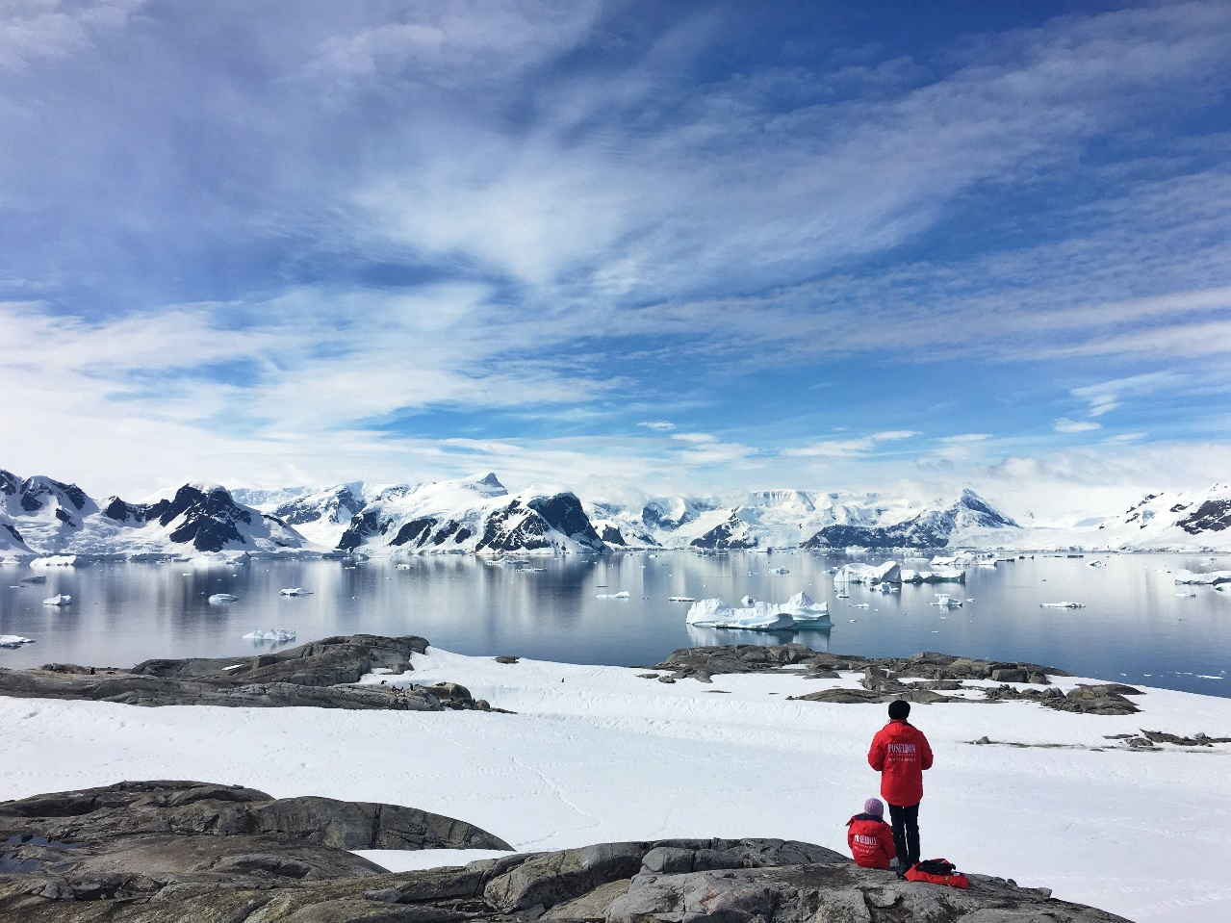
Do you think any people live in the Antarctic? It is too cold for anyone to live in Antarctica for long. Some people stay there for short periods of time to study the ice and the animals.
Do you think any people live in the Antarctic? It is too cold for anyone to live in Antarctica for long.
Do you think any people live in the Antarctic?

Slide 15
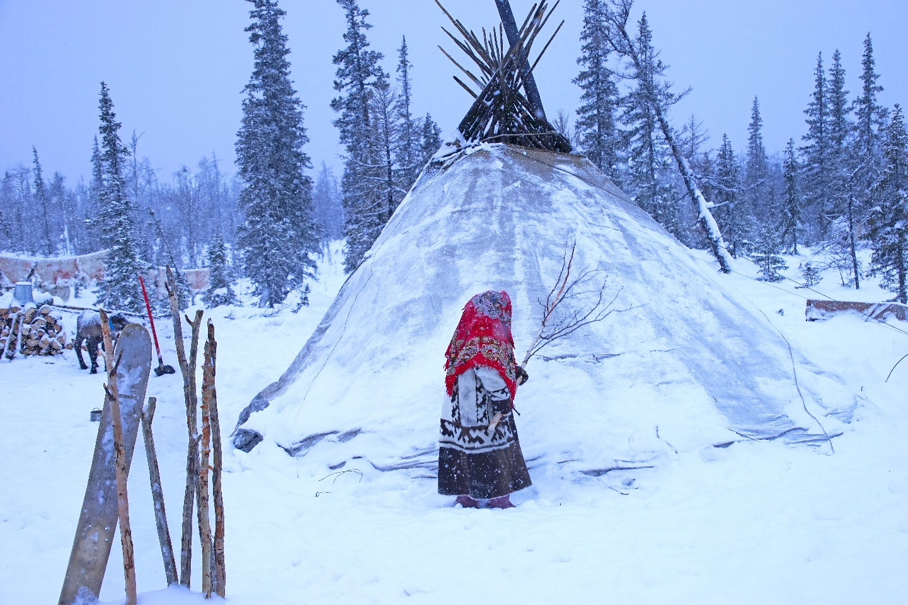
If we travel north to the Arctic again, we will meet people who live there all year round even though it is so cold. Today, these people mostly live in modern houses.
If we travel north to the Arctic again, we will meet people who live there all year round even though it is so cold.
If we travel north to the Arctic again, we will meet people who live there all year round even though it is so cold. Today, these people mostly live in modern houses. In the past, some people lived in tents made of animal skins in the summer. In winter, some people would build igloos made out of bricks of snow.

Slide 16
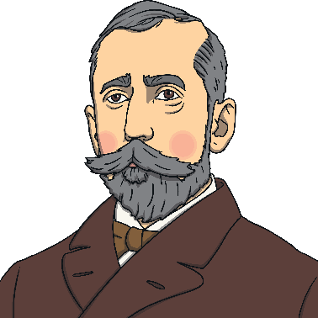
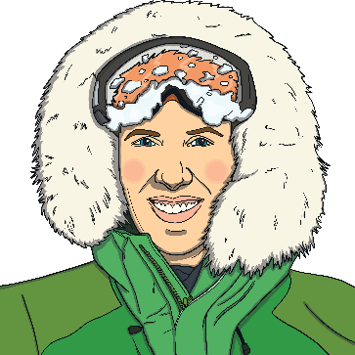
Roald Amundsen
Robert Falcon Scott
Felicity Aston
There have been many other explorers like me.
There have been many other explorers like me. Have you heard of Roald Amundsen? He was the first person to reach the South Pole and he arrived on the 14th December 1911. A few weeks later, Captain Robert Falcon Scott also made it to the South Pole. In 2012, Felicity Aston became the first woman to ski alone across Antarctica.
There have been many other explorers like me. Have you heard of Roald Amundsen? He was the first person to reach the South Pole and he arrived on the 14th December 1911. A few weeks later, Captain Robert Falcon Scott also made it to the South Pole.
There have been many other explorers like me. Have you heard of Roald Amundsen? He was the first person to reach the South Pole and he arrived on the 14th December 1911.

Slide 17
What amazing polar explorers you have been! Would you like to visit the polar regions again? Would you choose to visit the Arctic or the Antarctic? Can you say why? Which polar animal would you most like to see?

