Slide 1


Slide 3
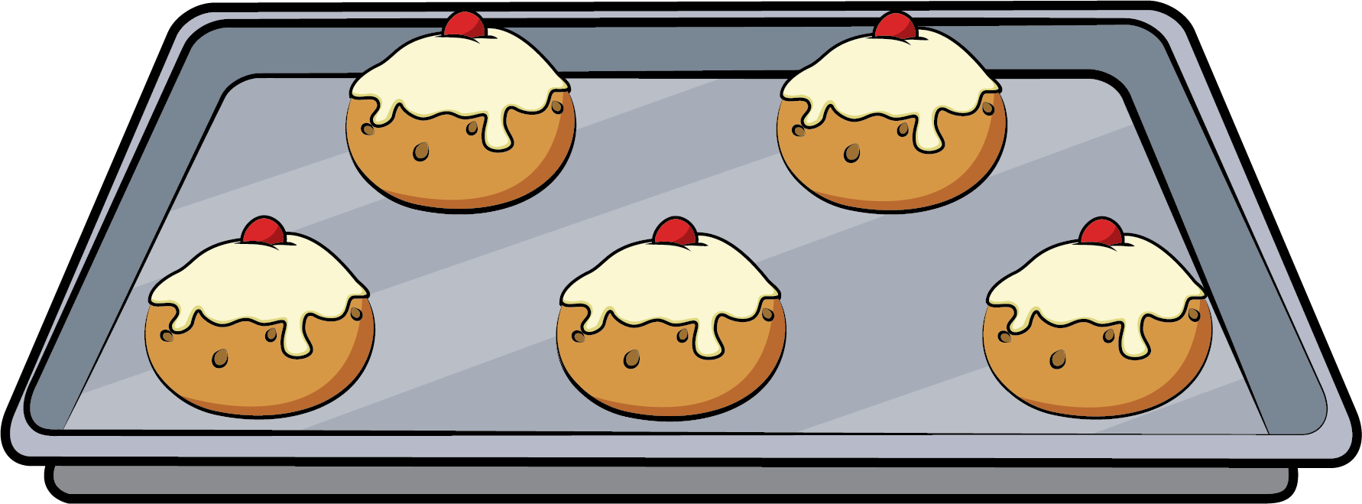
How many buns can you see?
5

Slide 4
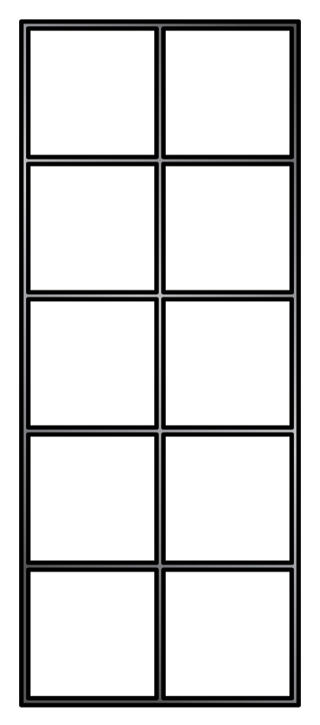
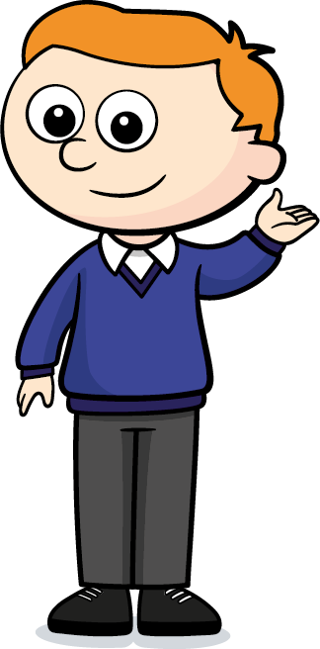
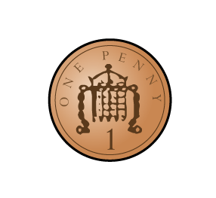
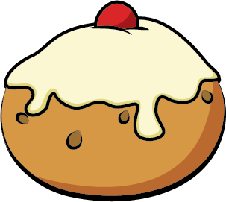

1 less than ___ is ___
5
4

Slide 5
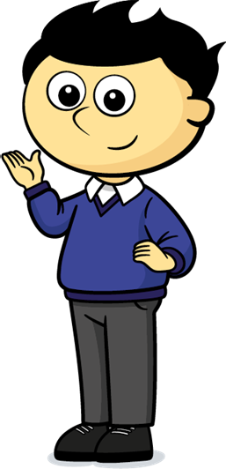
1 less than ___ is ___
4
3

Slide 6
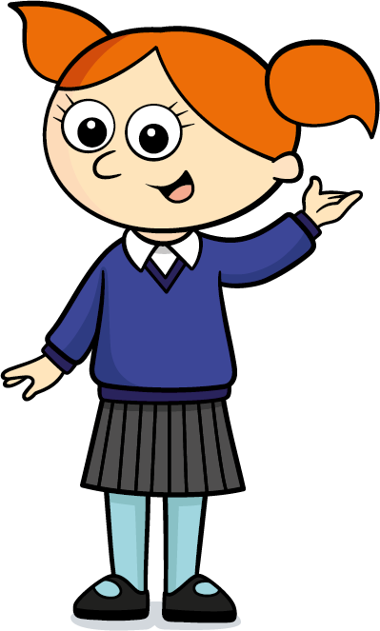
1 less than ___ is ___
3
2

Slide 7
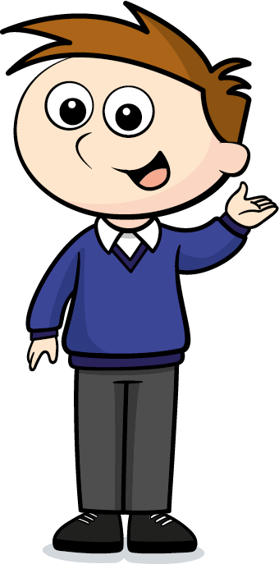
1 less than ___ is ___
2
1

Slide 8
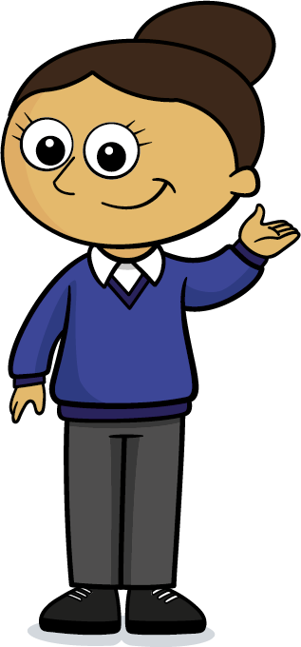
There are no buns left.

Slide 9
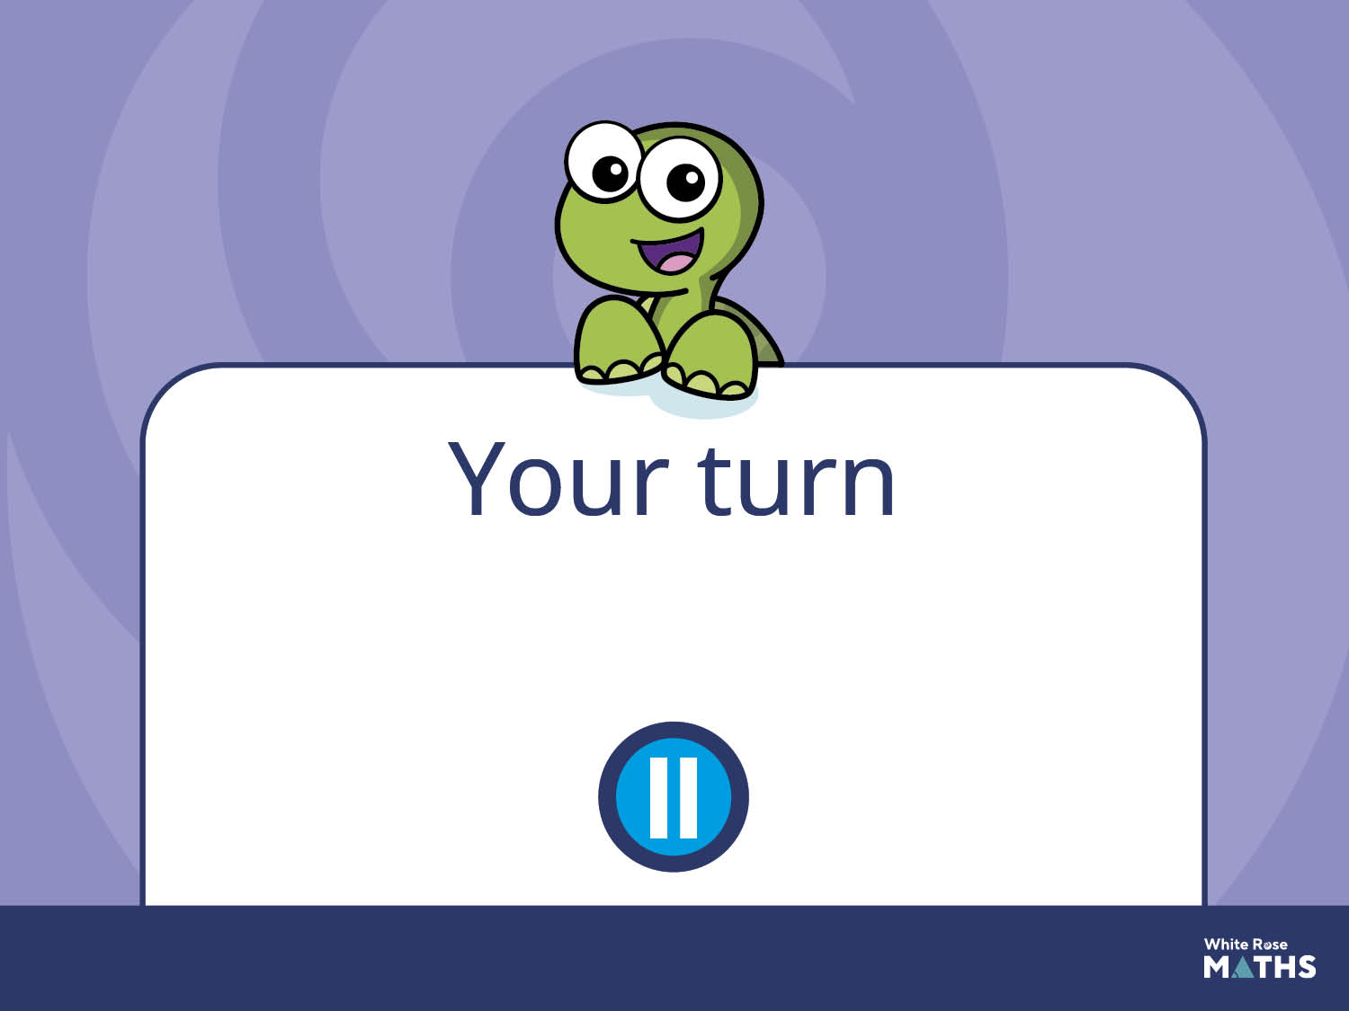
Have a go at the next activity.

Slide 10
Sing and act out the rhyme
Five Currant Buns together as a class. Pick 5 children to buy the buns.
Model the 1 less pattern using a five frame and counters.

