Slide 1


Slide 3


What is 1 more than 3?
3
3
1 more than ___ is ___
4

Slide 4

What is 1 more than 1?
1
1 more than ___ is ___
1
2

Slide 5

What is 1 more than 2?
2
3
1 more than ___ is ___
2

Slide 6

What is 1 more than 4?
4
1 more than ___ is ___
4
5

Slide 7
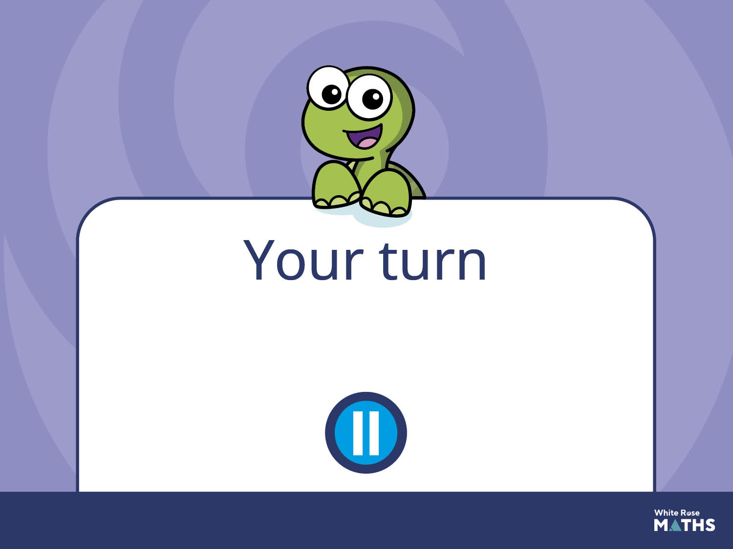
Have a go at the next activity.

Slide 8
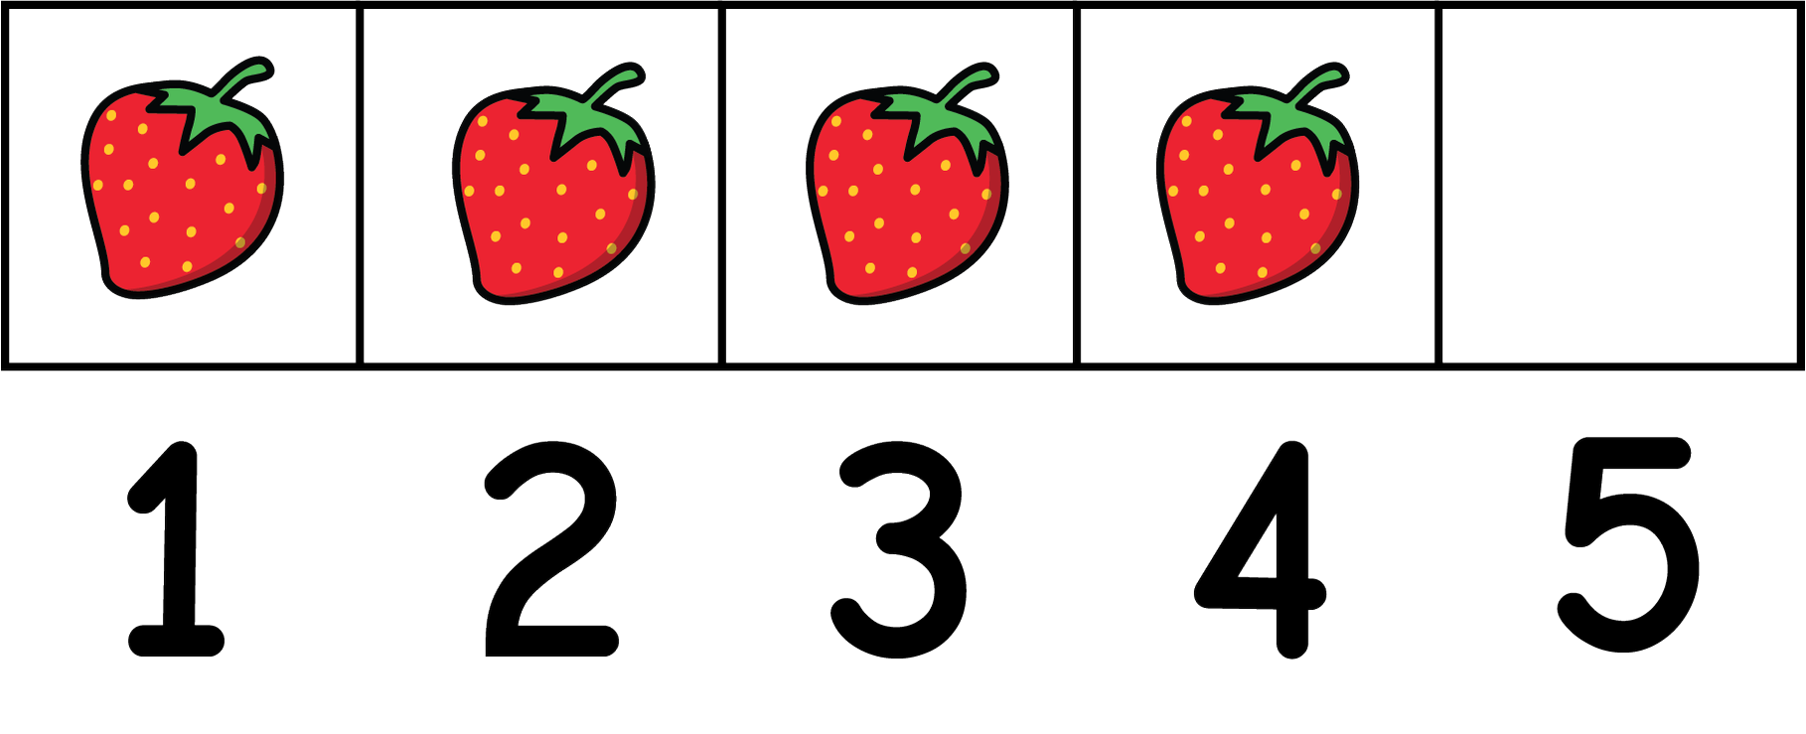
Give children a number to make on their five frame.
Prompt them to point to that number on the number track.
Encourage children to show what is
1 more. How many are there now?

