Slide 1



Slide 3
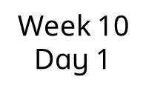

Complete the stem sentence.
I know that this shape is a ______
because it has _____________.
triangle
3 straight sides
3 corners

Slide 4
Complete the stem sentence.
I know that this shape is a _____
because it is _______.
circle
round

Slide 5

Complete the stem sentence.
I know that this shape is a ______
because it has _____________.
triangle
3 corners
3 straight sides

Slide 6


Slide 8
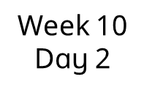
How have the shapes been sorted?
The shapes have been sorted into
______ and ______.
big
small

Slide 9
How have the shapes been sorted?
The shapes have been sorted into
______ and ______.
blue
green

Slide 10
How have the shapes been sorted?
The shapes have been sorted into
_______ and _______.
triangles
circles

Slide 11


Slide 13
Let’s make a shape picture
What shapes can you see?

Slide 14
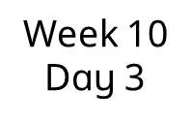
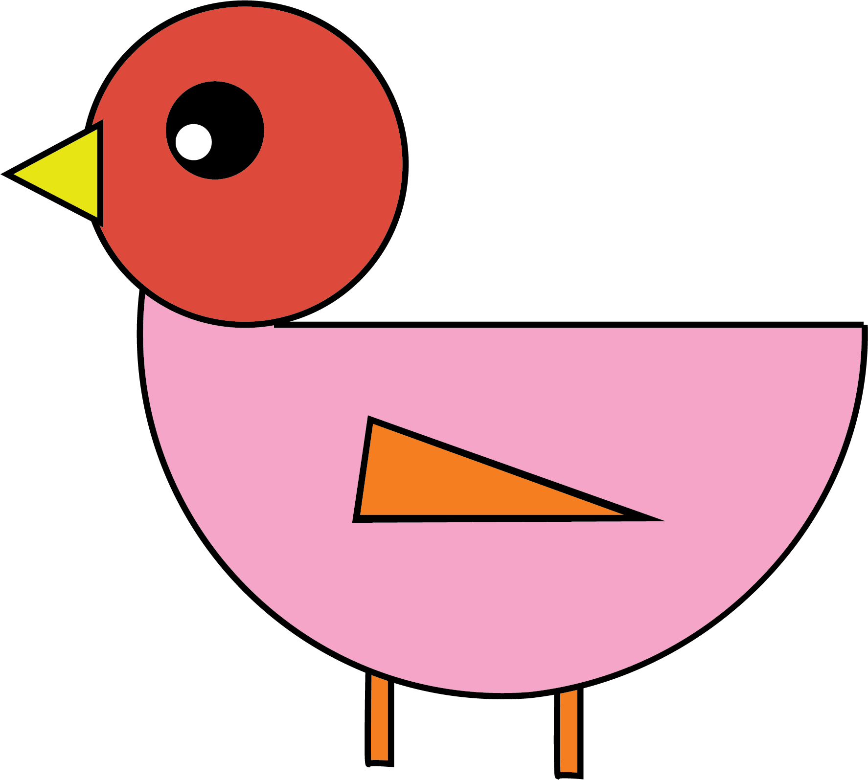
Where can you see a circle?
Where can you see a triangle?

Slide 15

Where can you see a circle?
Where can you see a triangle?

Slide 16


Slide 18
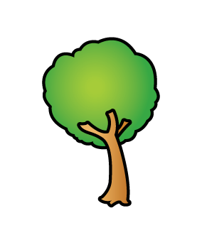
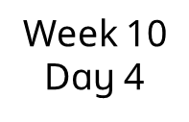
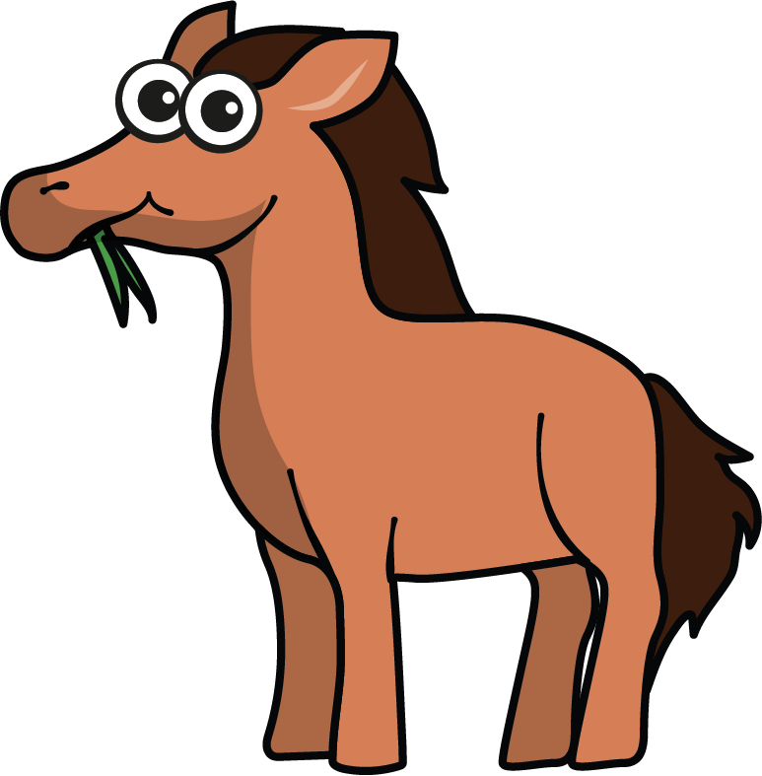
Complete the stem sentence.
The horse is _______ the tree.
behind

Slide 19




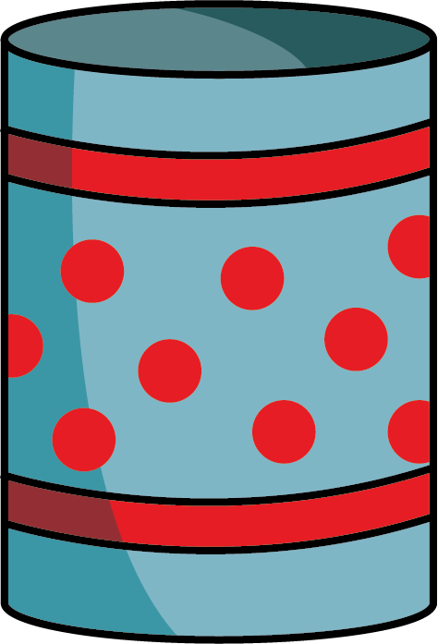
Complete the stem sentence.
The pencils are _____ the pot.
in

Slide 20
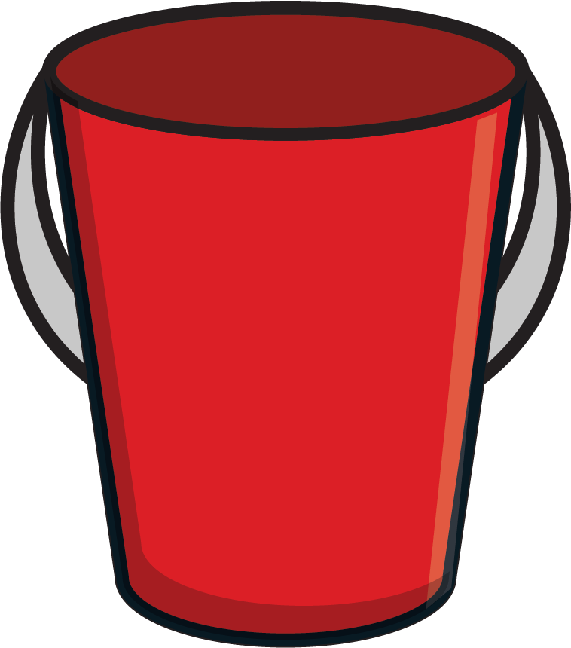
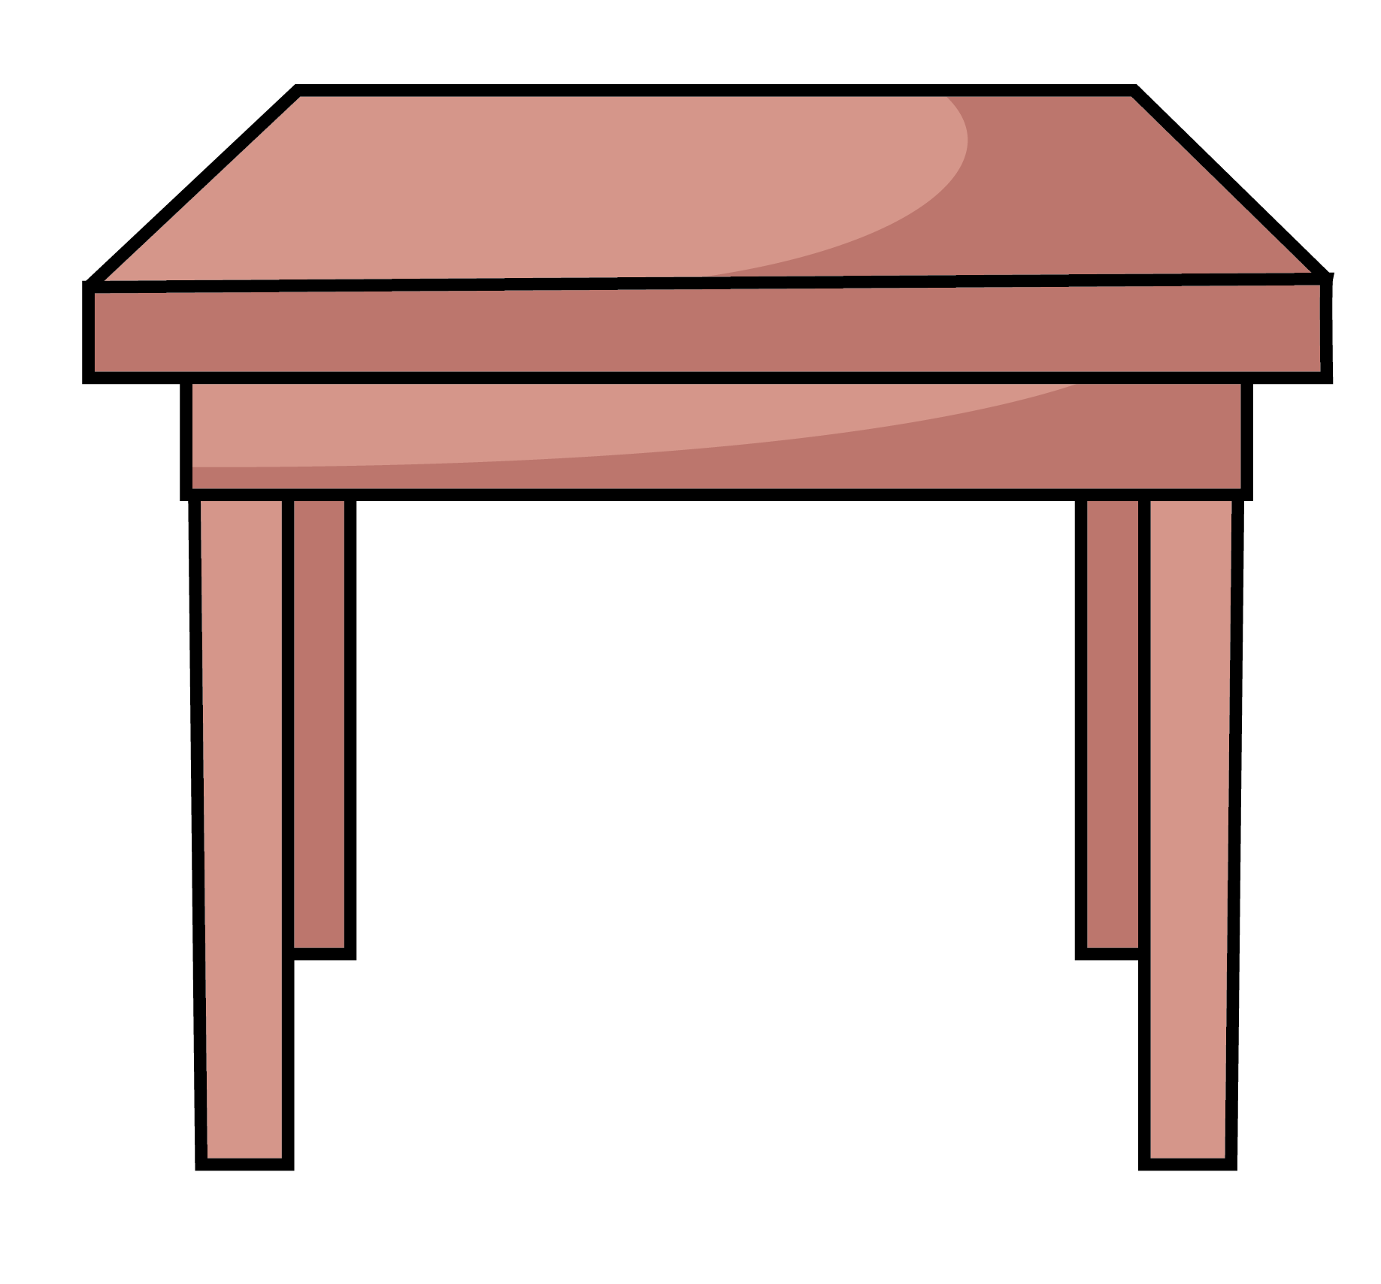
Complete the stem sentence.
The bucket is _____ the table.
on

Slide 21


Slide 23
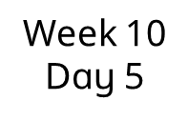
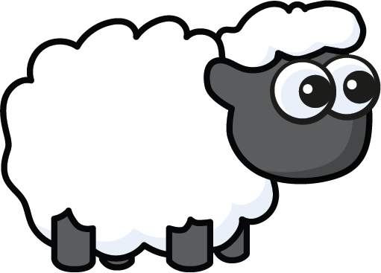
Complete the stem sentence.
The sheep is ________ the tree.
in front of

Slide 24
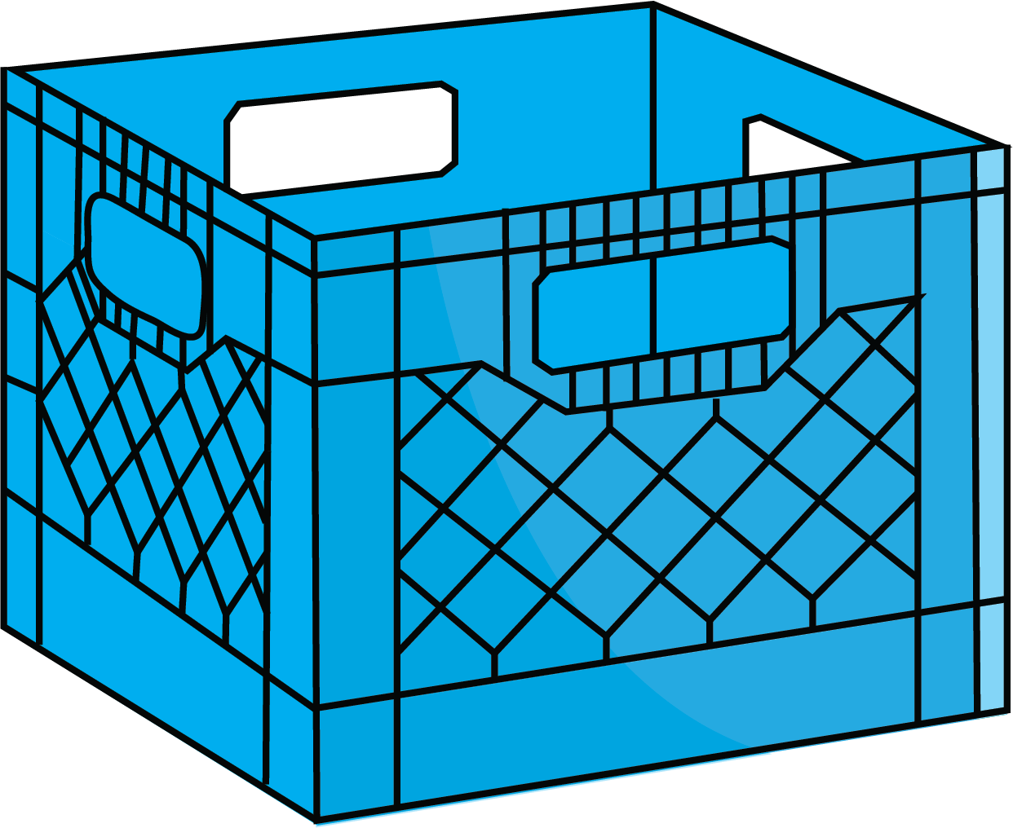
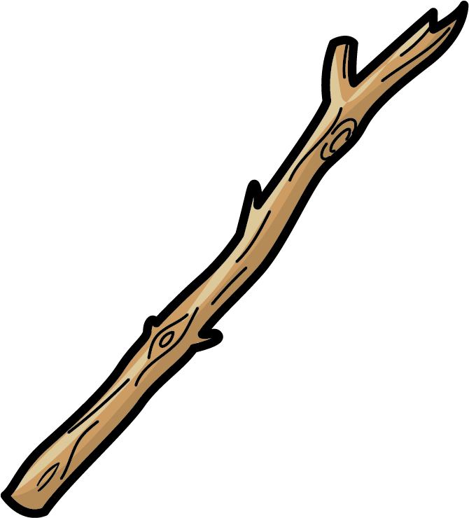
Complete the stem sentence.
The stick is ________ the crates.
between

Slide 25

Complete the stem sentence.
The teddy is _______ the table.
under

Slide 26


Slide 28


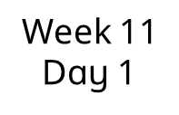
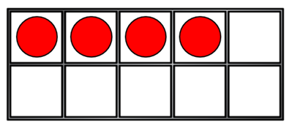


How many?

Slide 29





How many?

Slide 30

How many?

Slide 31


Slide 33

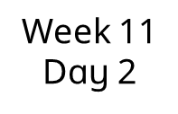
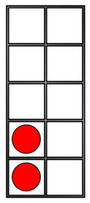
Match the numeral.
5

Slide 34


Match the numeral.
4

Slide 35

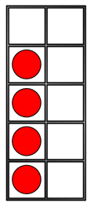
Match the numeral.
5

Slide 36


Slide 38
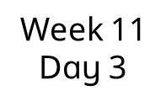
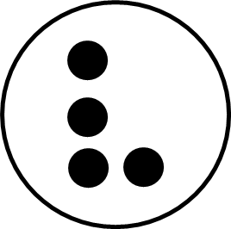
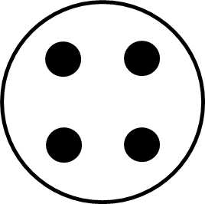
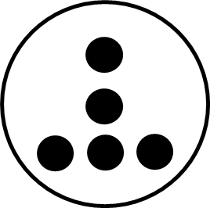
How many?
I can see __
4
5
4

Slide 39
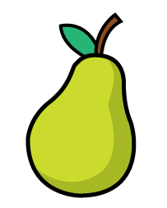
How many?
I can see __
4
4
5

Slide 40

Show me on your fingers.

Slide 41


Slide 43
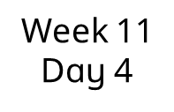
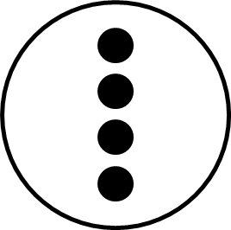
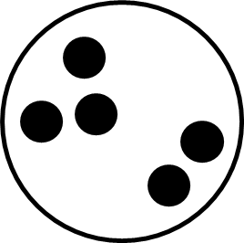
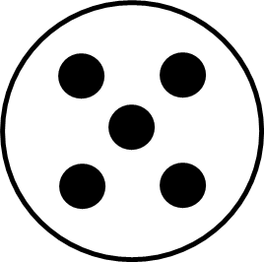
How many?
I can see __
5
4

Slide 44

How many?
I can see __
4
5

Slide 45


Show me on your fingers.

Slide 46


Slide 48
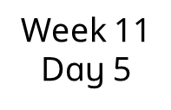


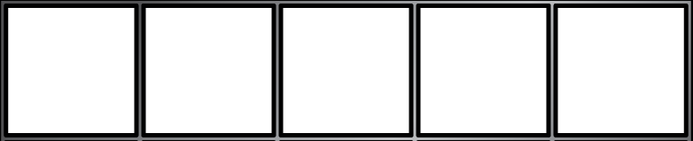
What is 1 more than 2?
1 more than 2 is ___
3

Slide 49

What is 1 more than 4?
1 more than 4 is ___
5

Slide 50


What is 1 more than 3?
1 more than 3 is ___
4

