Slide 1
Baby Owls
Disclaimer
We hope you find the information on our website and resources useful.
Animations
This resource has been designed with animations to make it as fun and engaging as possible. To view the content in the correct formatting, please view the PowerPoint in ‘slide show mode’. This takes you from desktop to presentation mode. If you view the slides out of ‘slide show mode’, you may find that some of the text and images overlap each other and/or are difficult to read.
To enter slide show mode, go to the slide show menu tab and select either from beginning or from current slide.
You may wish to delete this slide before beginning the presentation.

Slide 2
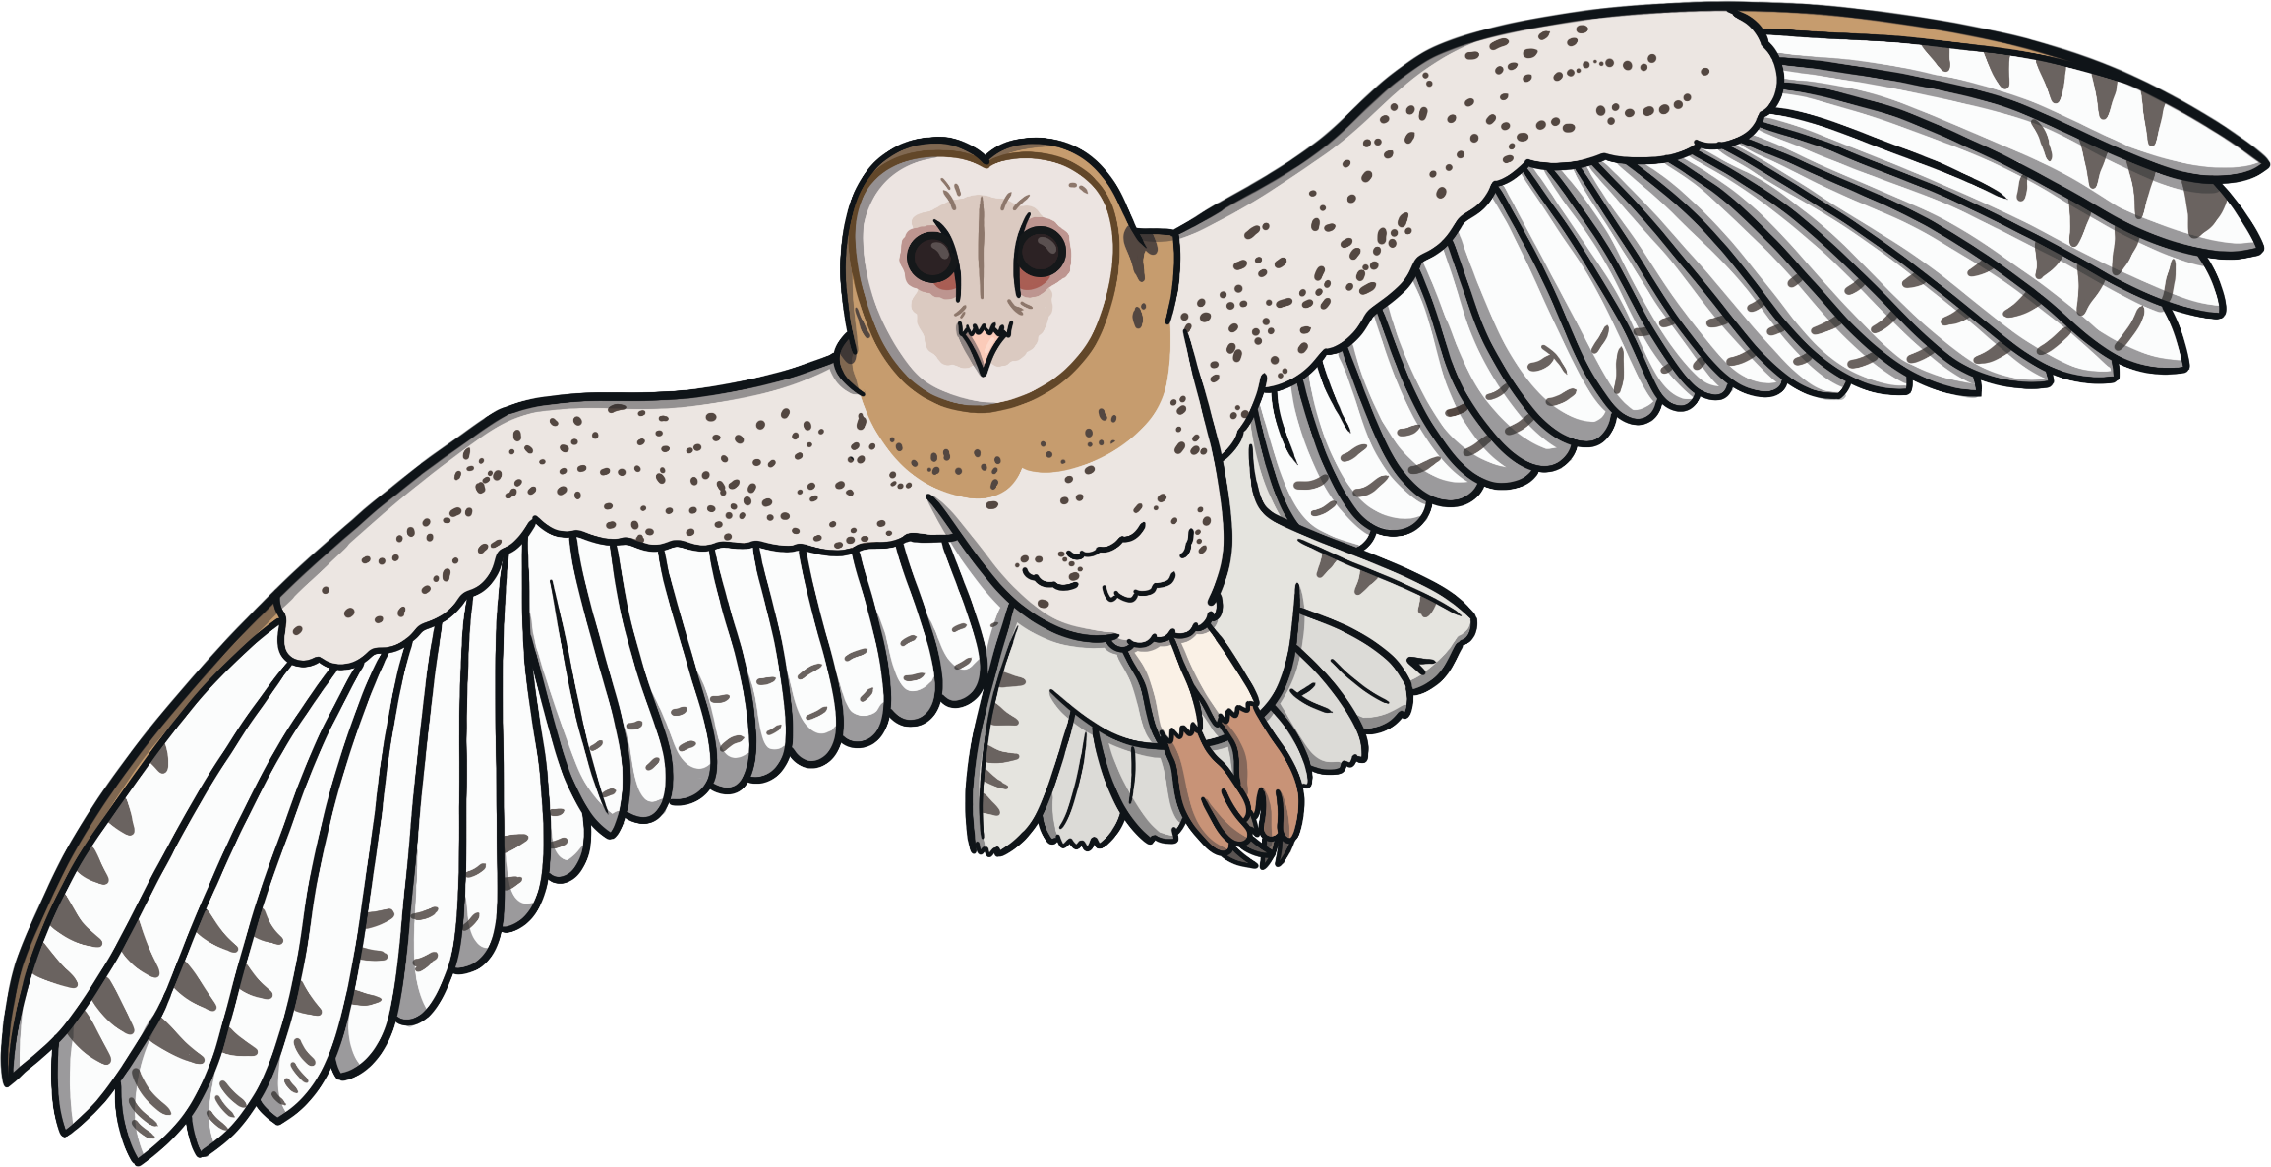


Slide 3
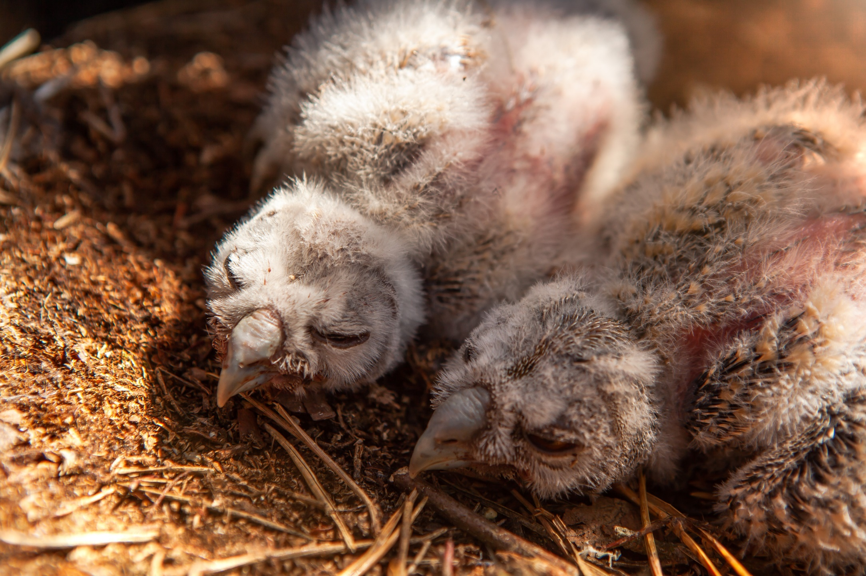

Baby Owls
Baby owls are called owlets.
They hatch from eggs.

Slide 4
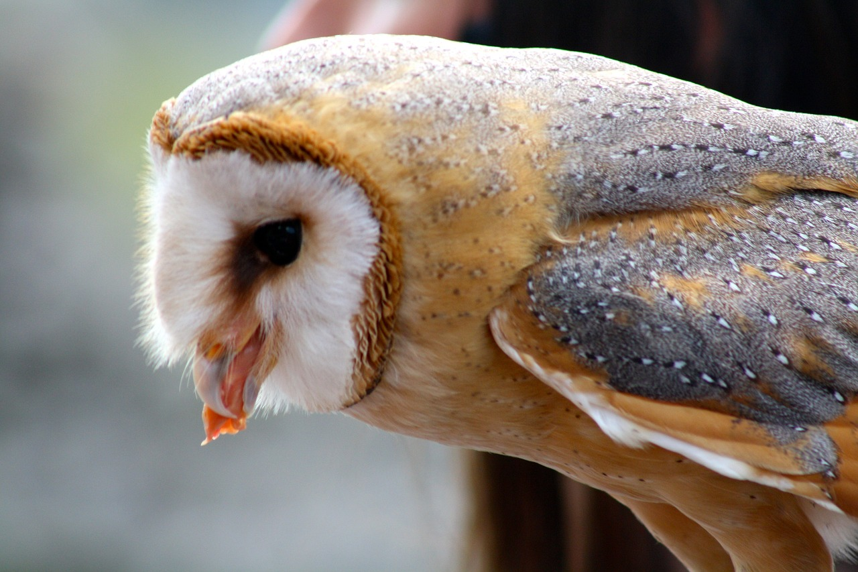
Food
Many owls eat mice.
Some eat spiders, worms and snails.

Slide 5
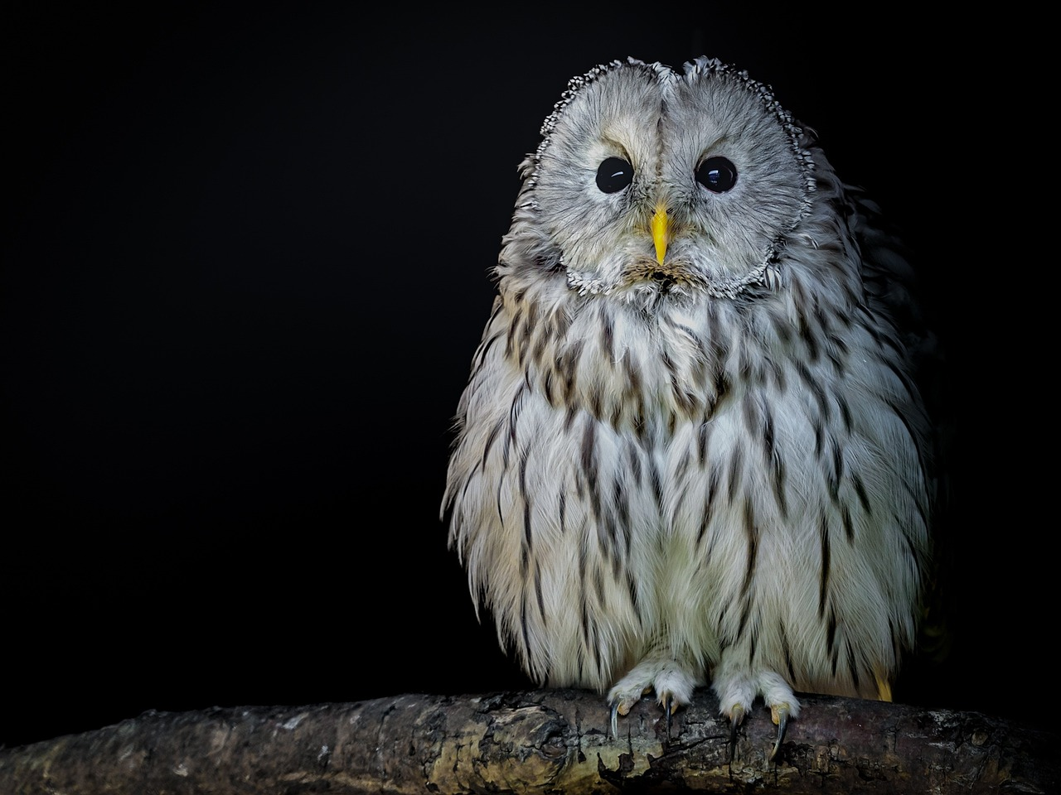
Behaviour
Most owls are nocturnal.
This means they are most active at night.

Slide 6
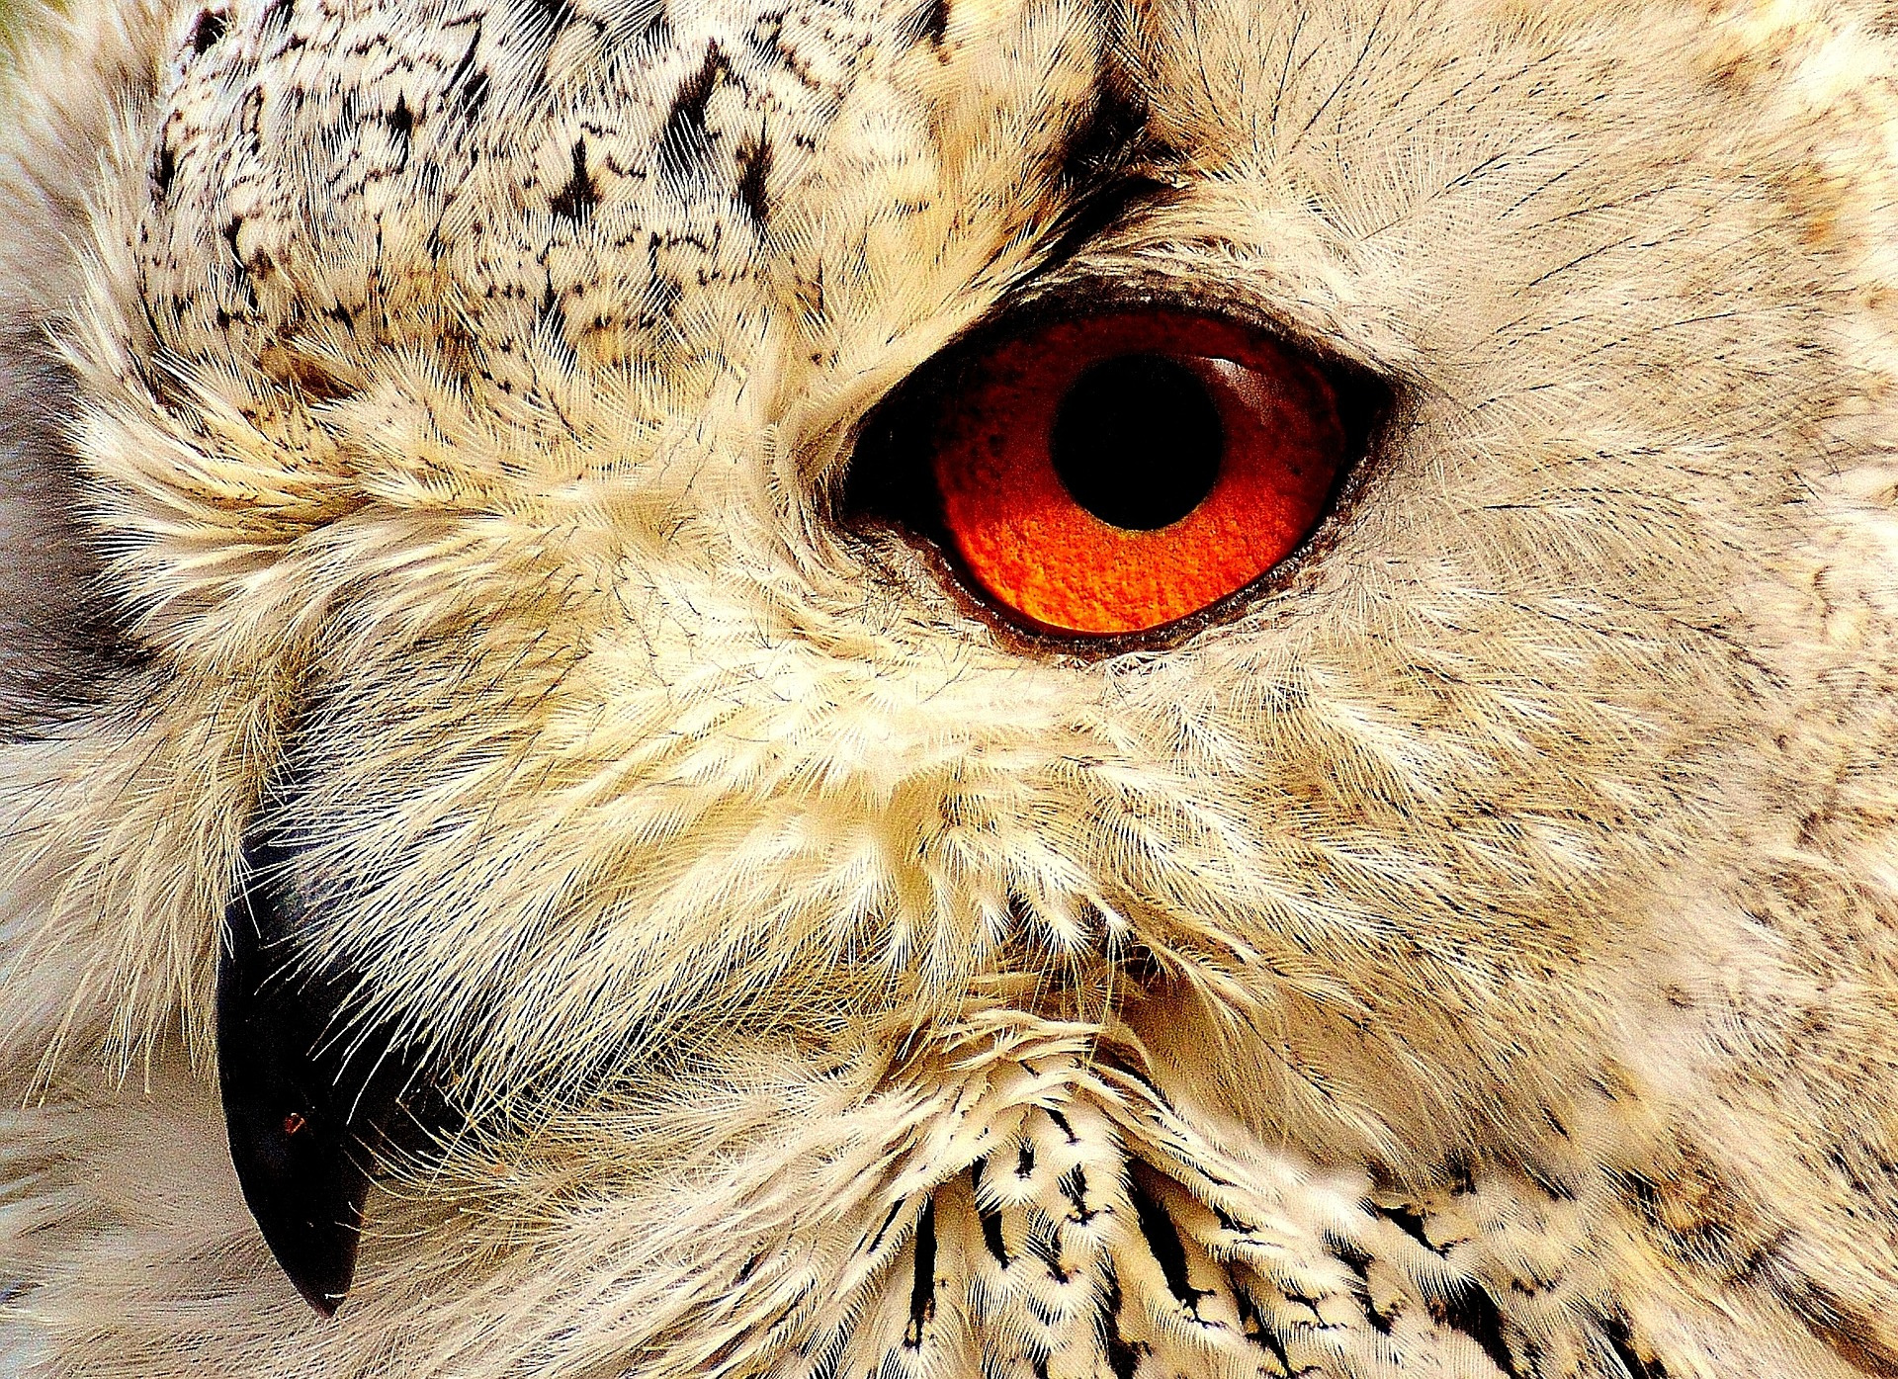

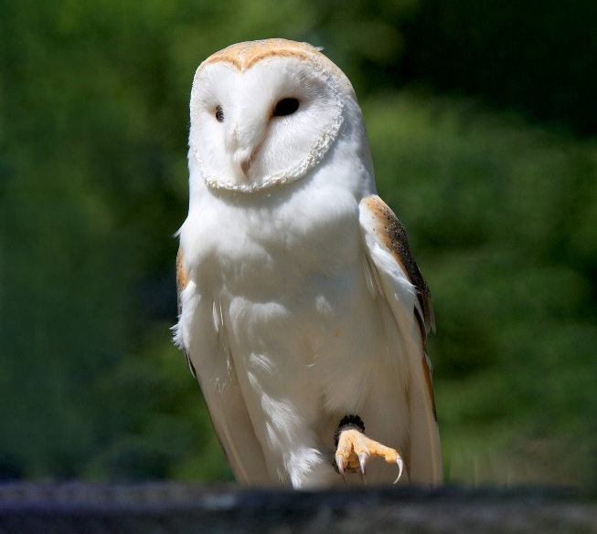
Features
Owls have hooked beaks and sharp talons.

Slide 7
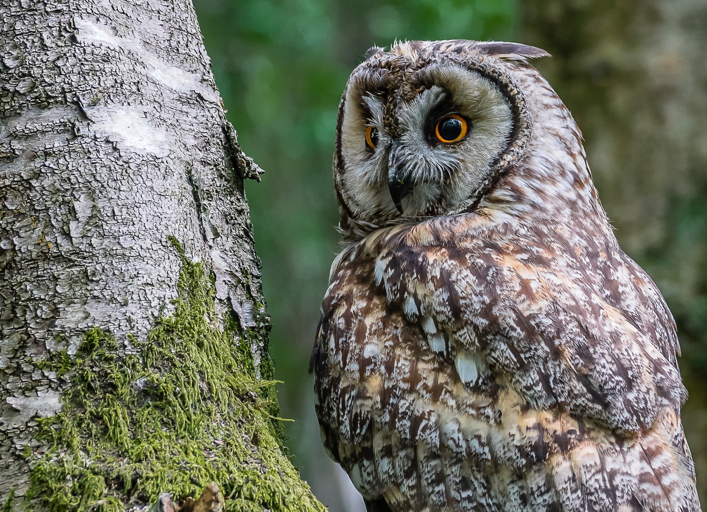
Features
Owls can turn their heads almost all the way around.
This helps them to see what is around them.

Slide 8
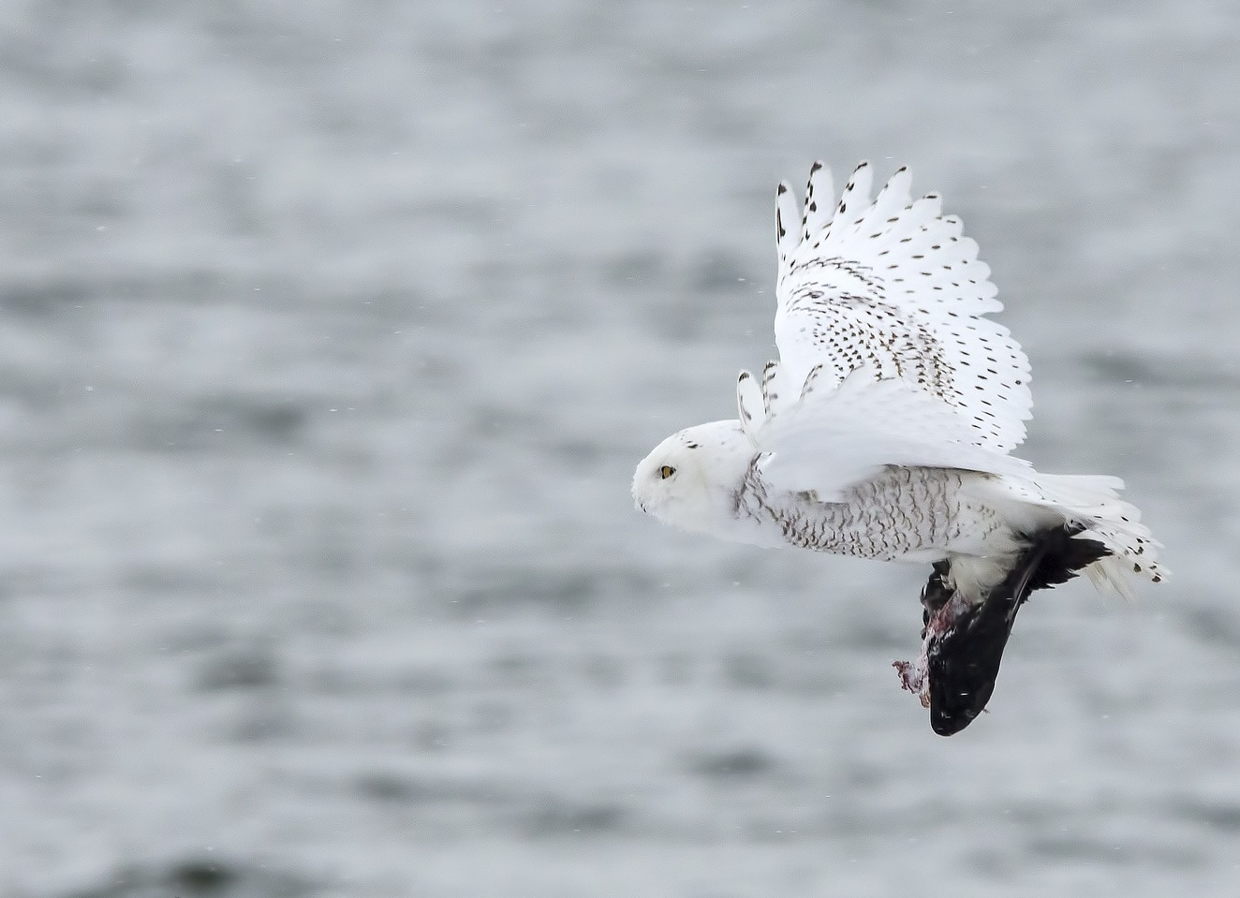
Habitat
Owls live all over the world except in Antarctica.
They live in many habitats including woodlands, mountains and deserts.
They can also live in snowy climates.

Slide 9
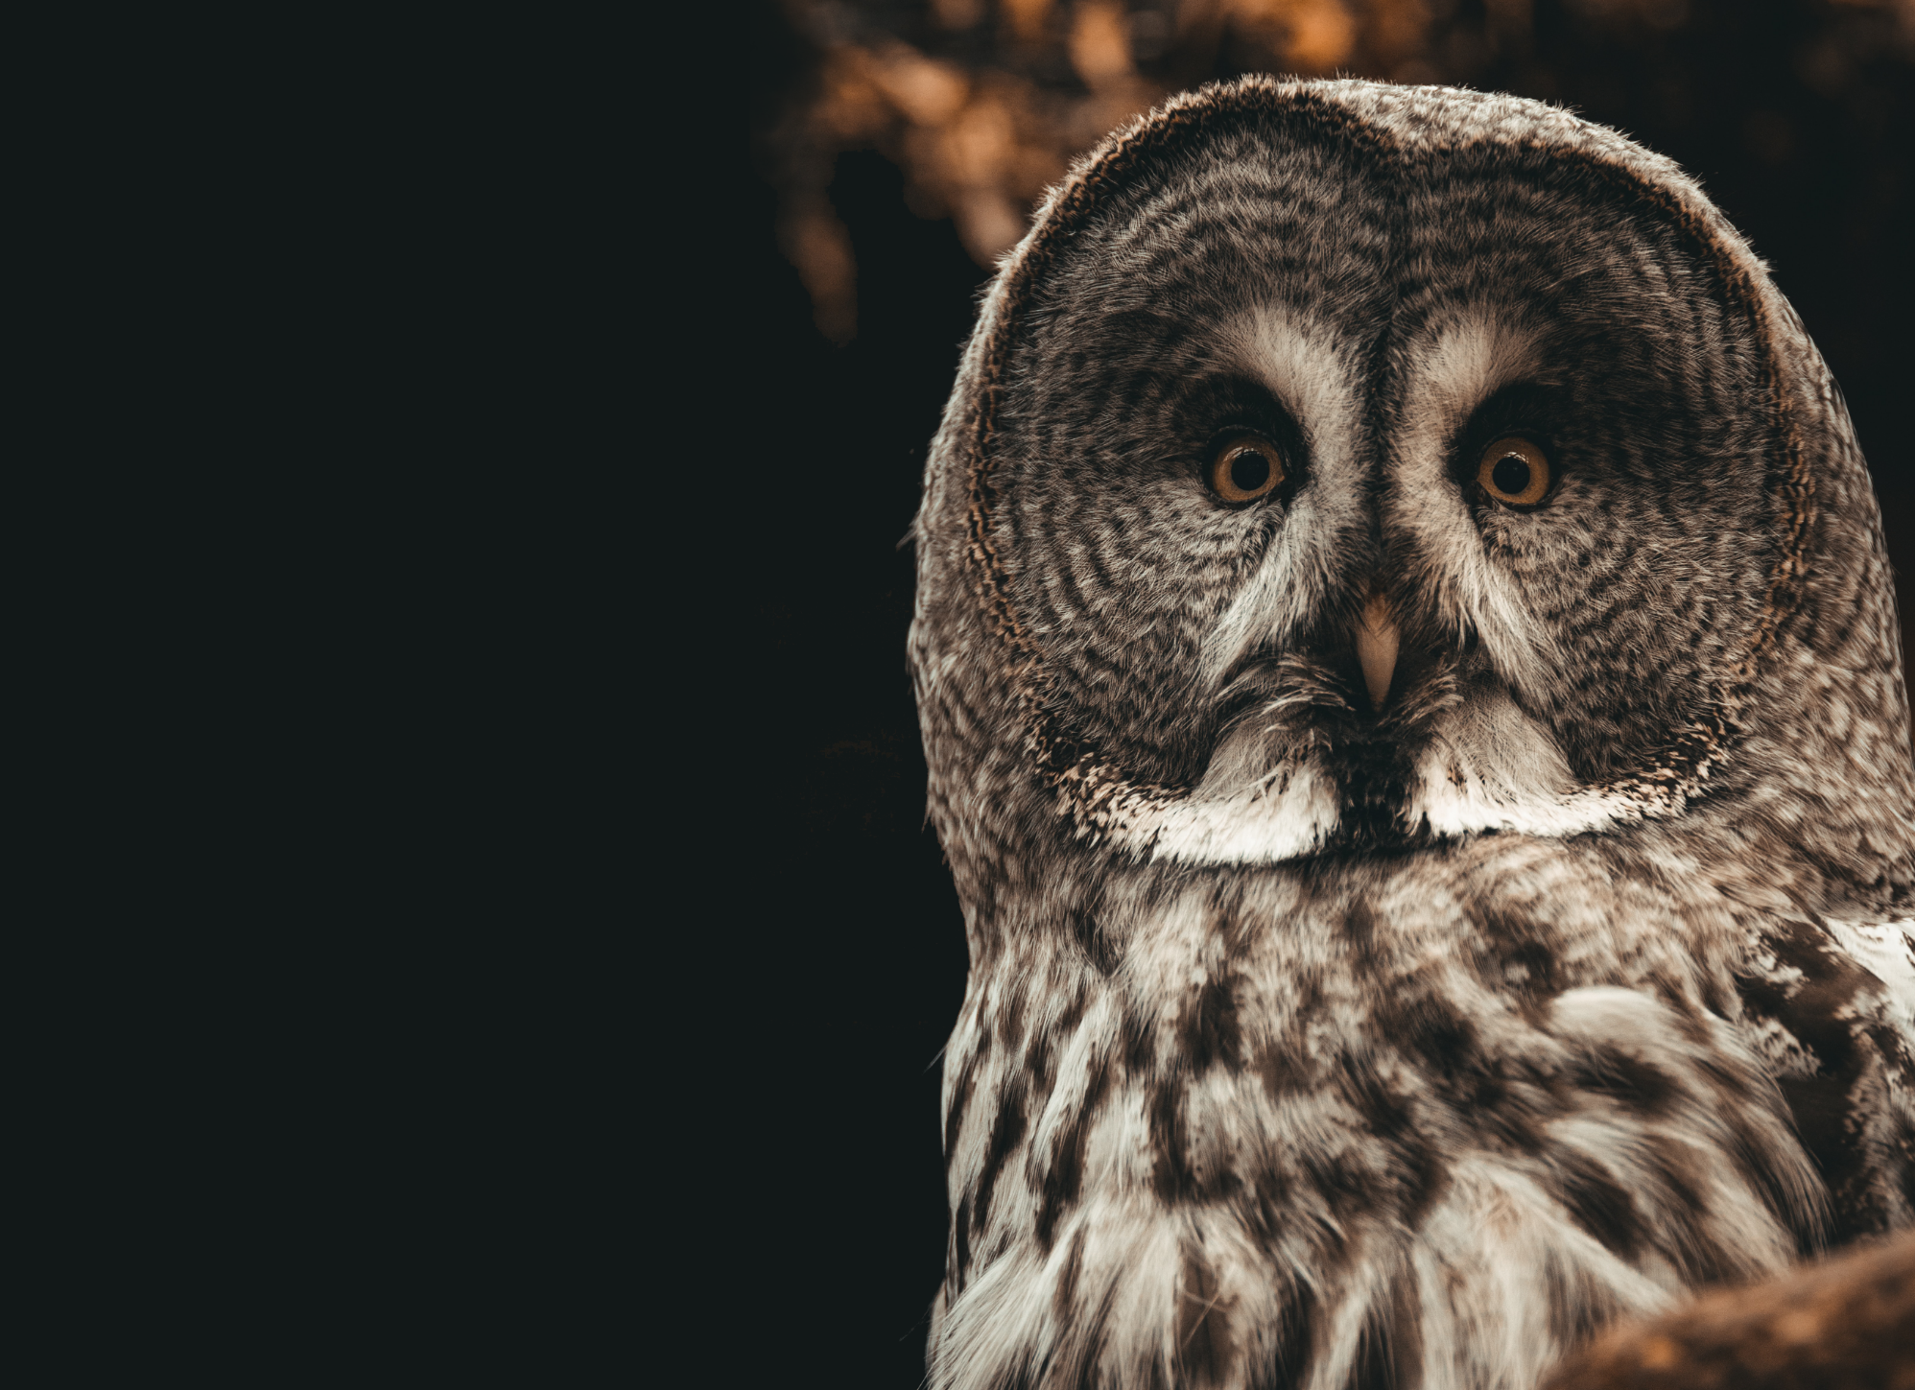
Lifespan
Owls can live up to 12 years in the wild.

Slide 10
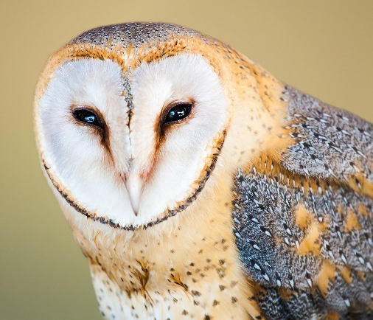
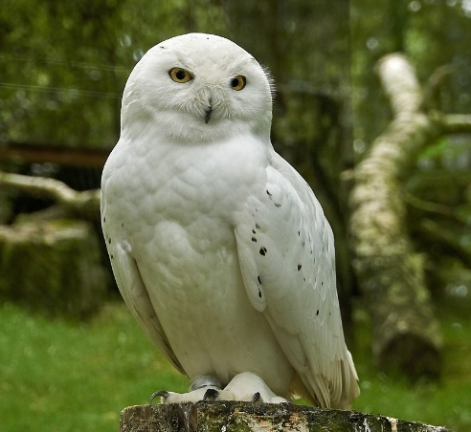
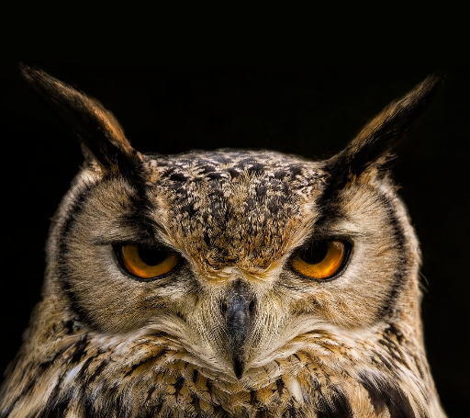
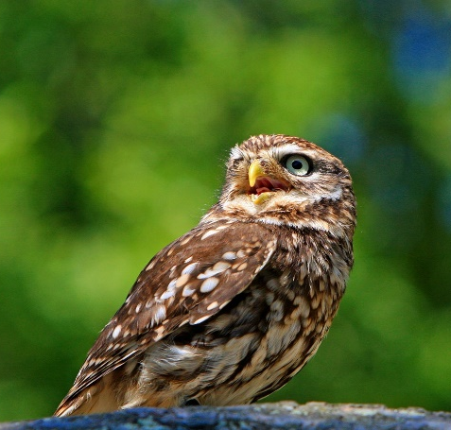
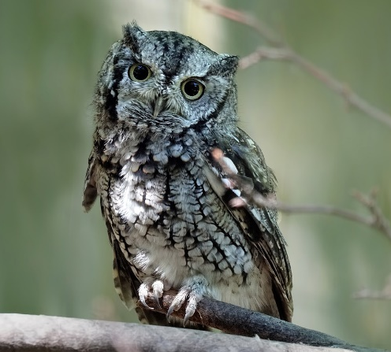
Species
There are many species of owl.
Some of them include:
Barn Owl
Snowy Owl
Eurasian Eagle Owl
Little Owl
Eastern Screech Owl

