Slide 2
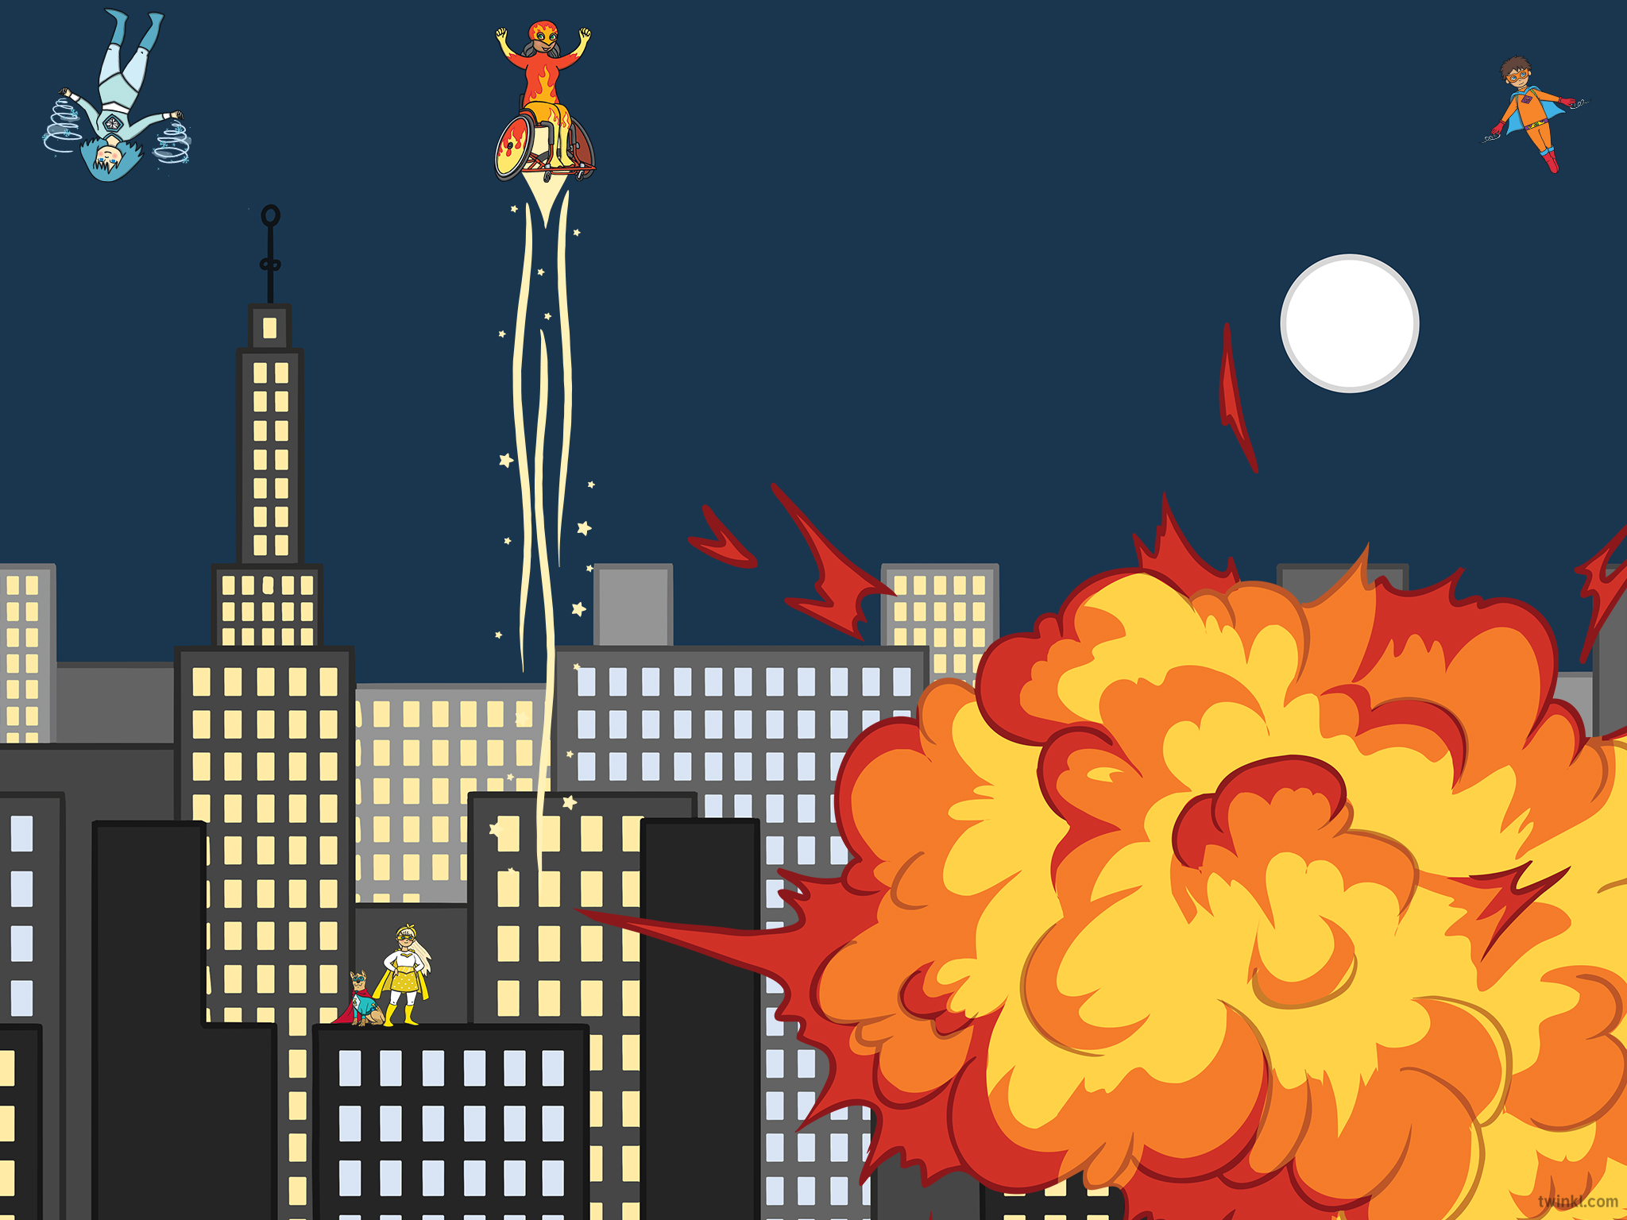

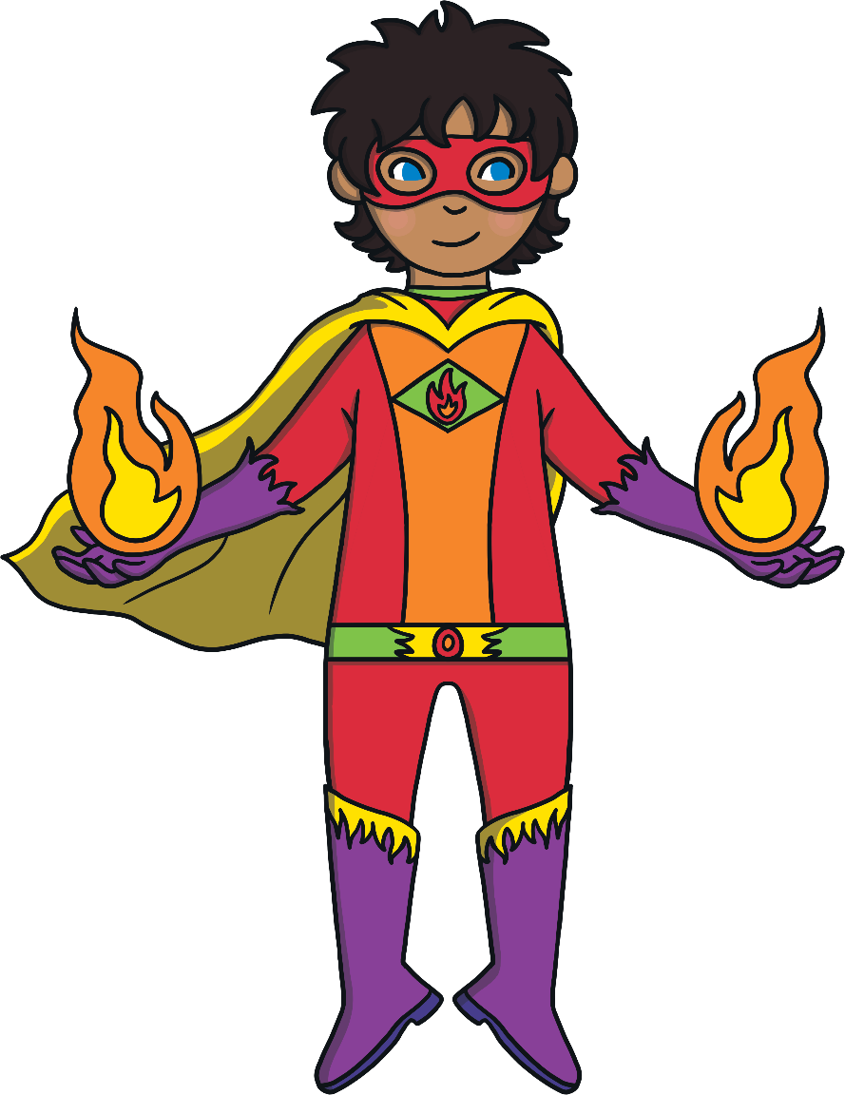
Take a look at the dots and see how many there are. Can you say how many dots there are before a superhero flies across the screen? You’ll need to be quick!
It’s super subitising time!
Can you become a subitising superhero?
Lets go!

Slide 3
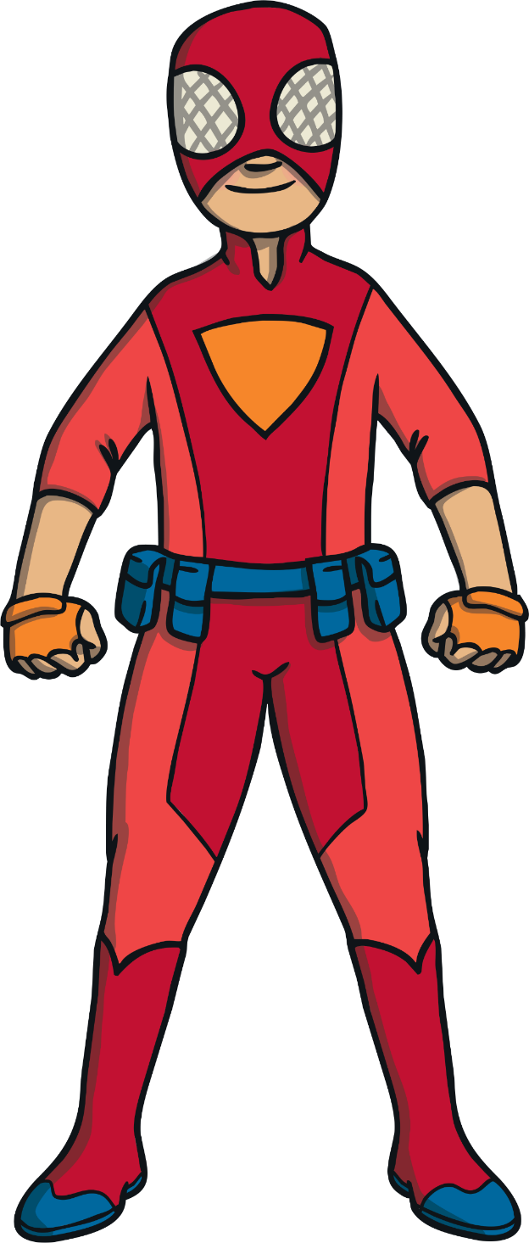


Slide 4

How many dots did you spot?
2
Next

Slide 5
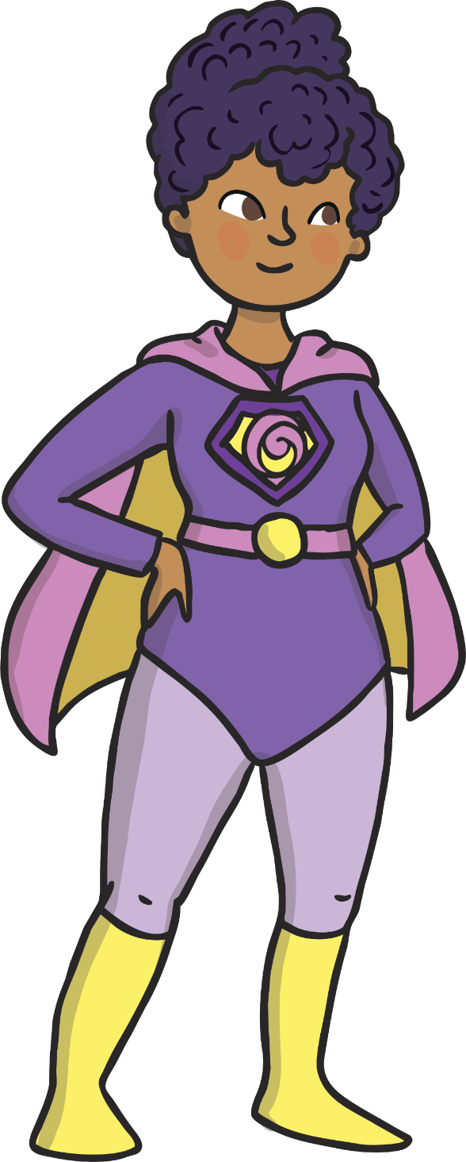

Slide 6

How many dots did you spot?
3
Next

Slide 7
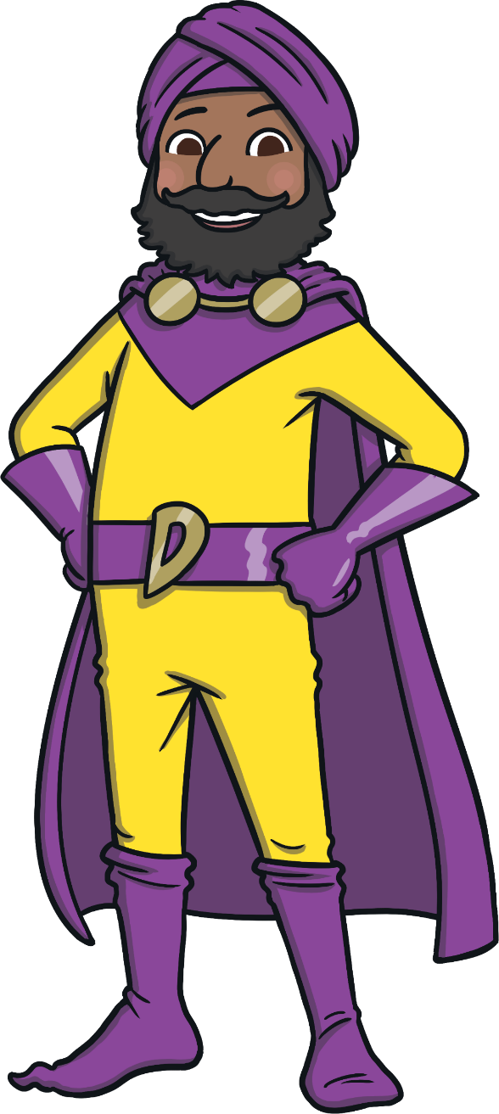

Slide 8

How many dots did you spot?
1
Next

Slide 9


Slide 10

How many dots did you spot?
5
Next

Slide 11
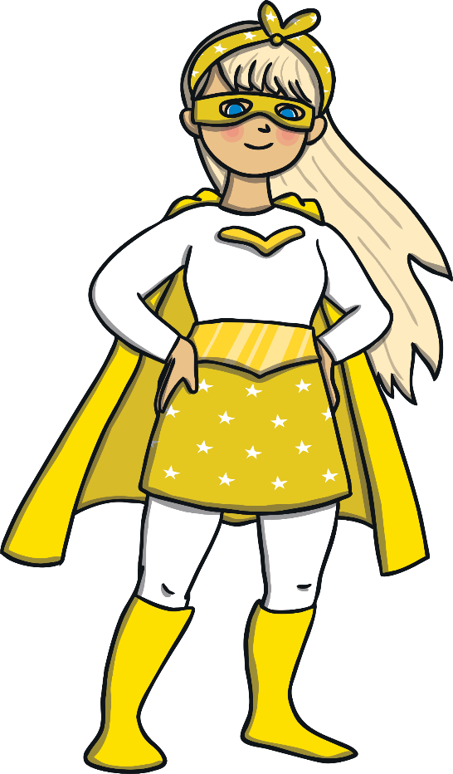

Slide 12

How many dots did you spot?
4
Next

Slide 13
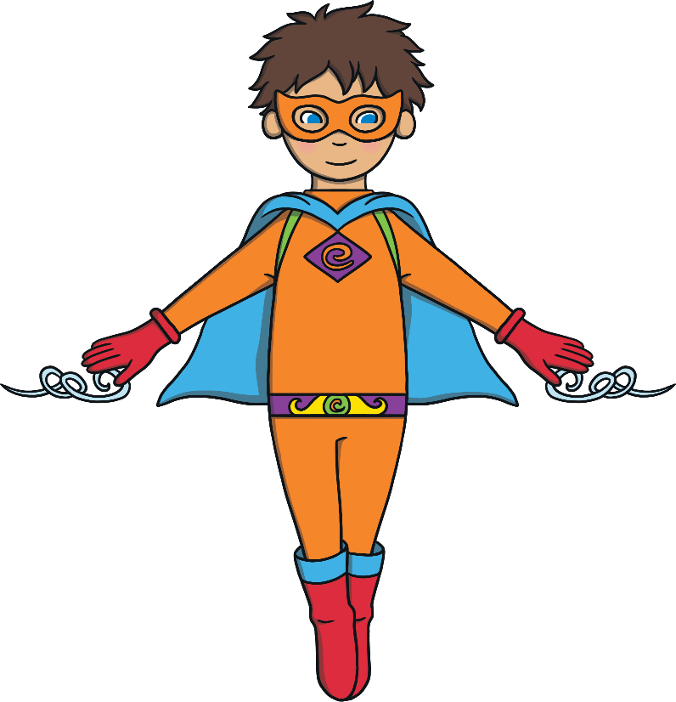

Slide 14
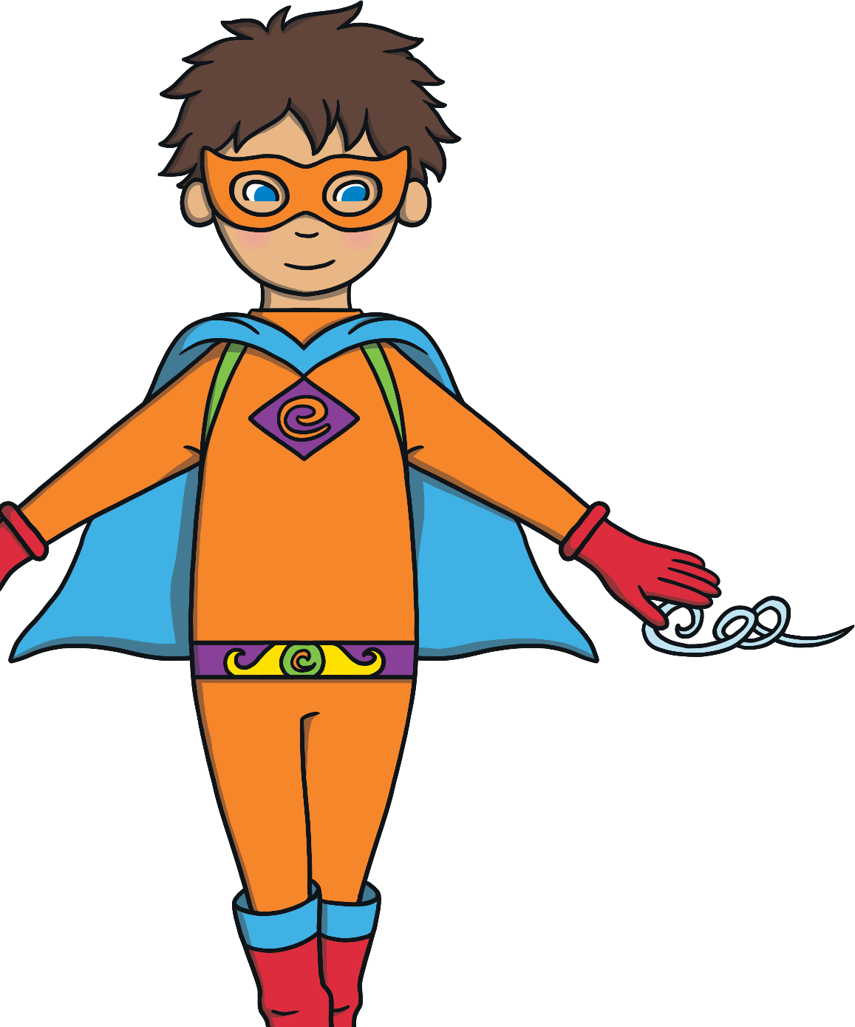
How many dots did you spot?
3
Next

Slide 15
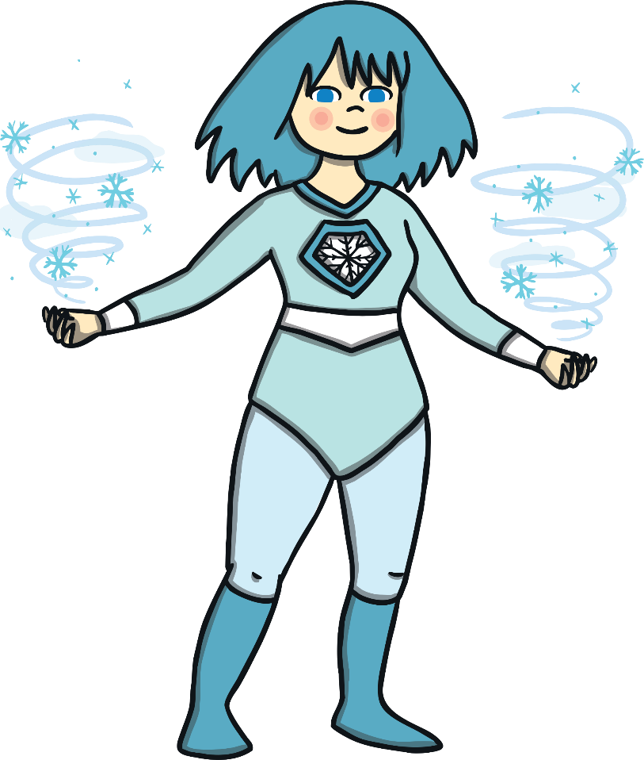

Slide 16

How many dots did you spot?
2
Next

Slide 17
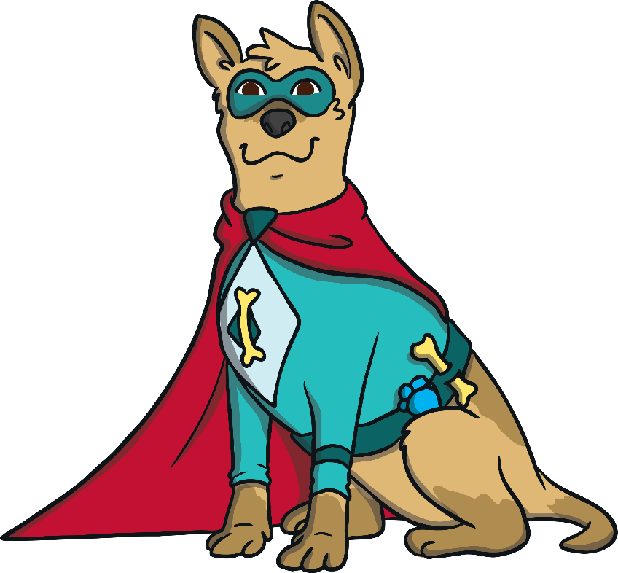

Slide 18

How many dots did you spot?
5
Next

Slide 19
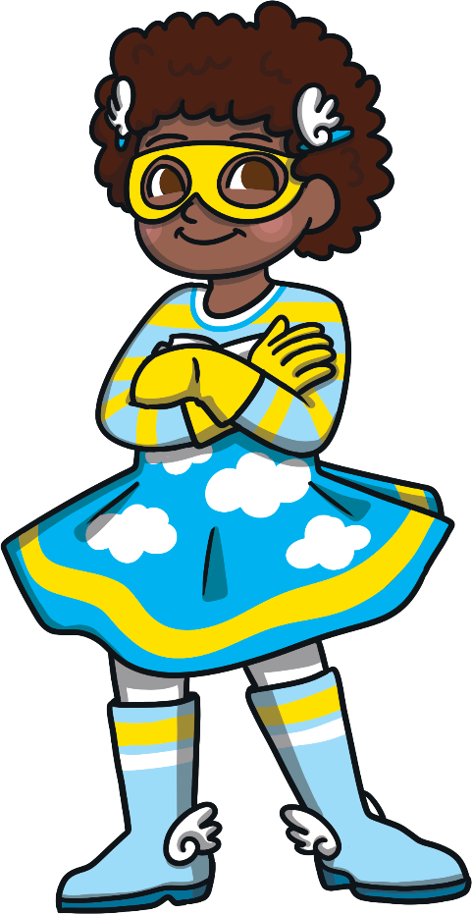

Slide 20

How many dots did you spot?
4
Next

Slide 21












Well done, great subitising!
You are a subitising superhero!
Finish

