Slide 1
Mastering Number
Reception
Term 1
Week 5
Focus: Comparison

Slide 2
Stem sentences
Information for teachers
Stem sentences used in this presentation:
_____ has more than _____ .
_____ has fewer than _____ .
On relevant slides, stem sentences will appear in a feature box:
_____ has more than _____ .
Mastering Number 2021/22 ncetm.org.uk

Slide 3
Session 2
Mastering Number 2021/22 ncetm.org.uk

Slide 4

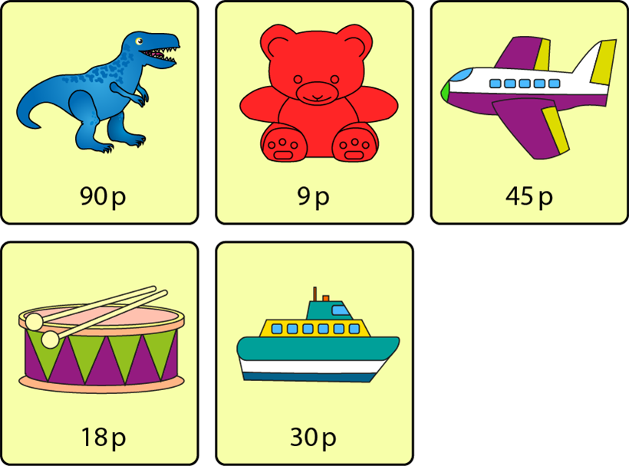
Pat
Sam
_____ has more than _____ .
Mastering Number 2021/22 ncetm.org.uk

Slide 5
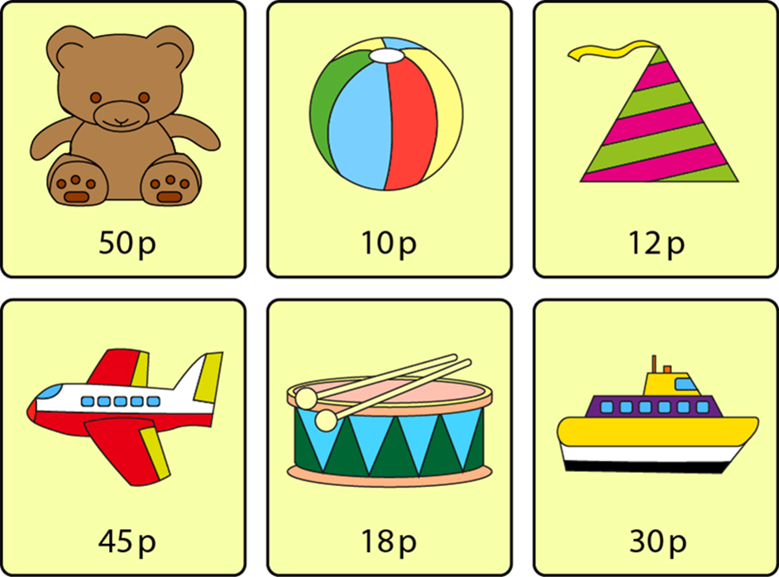
Pat
Sam
_____ has more than _____ .
Mastering Number 2021/22 ncetm.org.uk

Slide 6
Pat
Sam
_____ has more than _____ .
Mastering Number 2021/22 ncetm.org.uk

Slide 7
Pat
Sam
_____ has more than _____ .
Mastering Number 2021/22 ncetm.org.uk

Slide 8
Pat
Sam
_____ has more than _____ .
Mastering Number 2021/22 ncetm.org.uk

Slide 9
Session 3
Mastering Number 2021/22 ncetm.org.uk

Slide 10

Mastering Number 2021/22 ncetm.org.uk

Slide 11

Mastering Number 2021/22 ncetm.org.uk

Slide 12
Mastering Number 2021/22 ncetm.org.uk

Slide 13
Session 4
Mastering Number 2021/22 ncetm.org.uk

Slide 14
Mastering Number 2021/22 ncetm.org.uk

Slide 15
Mastering Number 2021/22 ncetm.org.uk

Slide 16
Mastering Number 2021/22 ncetm.org.uk

Slide 17
Pat
Sam
_____ has fewer than _____ .
Mastering Number 2021/22 ncetm.org.uk

Slide 18
Pat
Sam
_____ has fewer than _____ .
Mastering Number 2021/22 ncetm.org.uk

Slide 19
Pat
Sam
_____ has fewer than _____ .
Mastering Number 2021/22 ncetm.org.uk

Slide 20
Pat
Sam
_____ has fewer than _____ .
Mastering Number 2021/22 ncetm.org.uk

