Slide 1
Mastering Number
Reception
Term 1
Week 3
Focus: Composition

Slide 2
Stem sentences
Information for teachers
Stem sentences used in this presentation:
1 and another 1 is 2.
On relevant slides, stem sentences will appear in a feature box:
1 and another 1 is 2.
Mastering Number 2021/22 ncetm.org.uk

Slide 3
Session 1
Mastering Number 2021/22 ncetm.org.uk

Slide 4
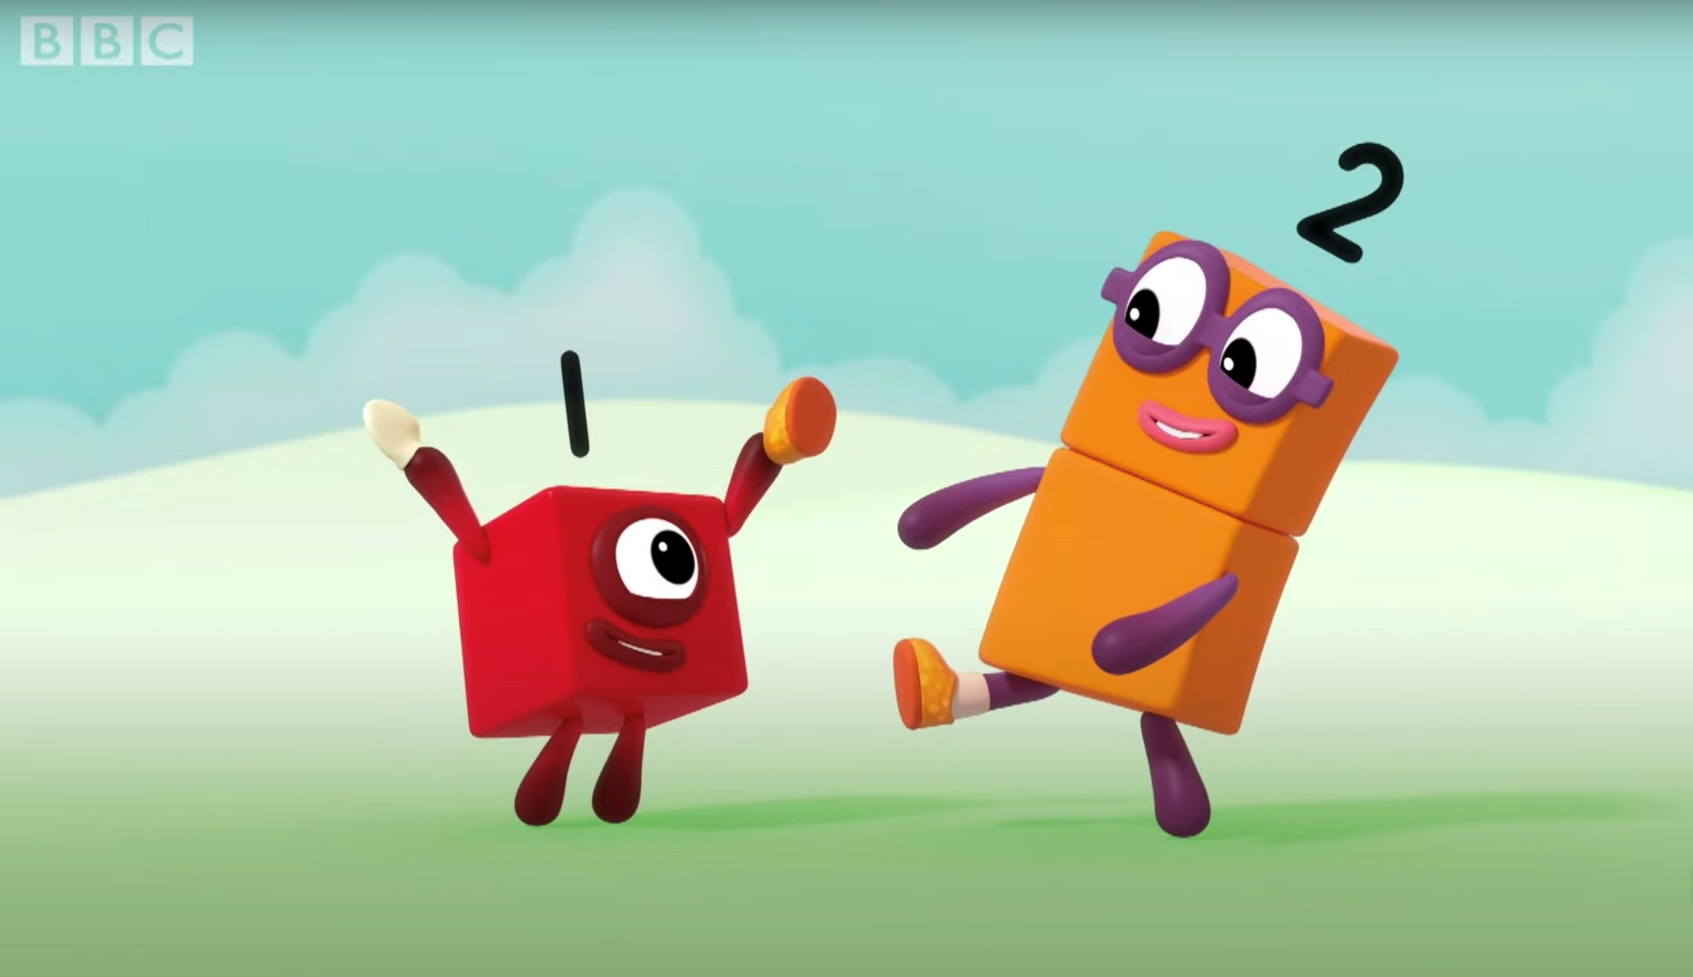
Numberblocks
Series 1, Episode 3: Two
Video © 2021 Alphablocks Ltd. All rights reserved. Mastering Number 2021/22 ncetm.org.uk

Slide 5
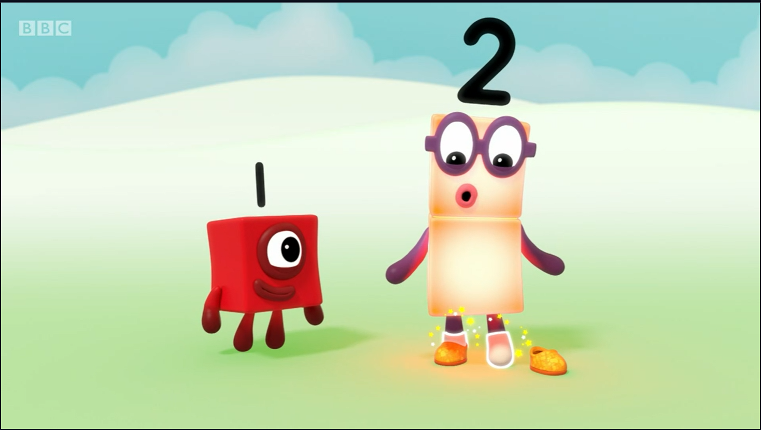
Now you have 2 socks and 2 shoes!
Image © 2021 Alphablocks Ltd. All rights reserved. Mastering Number 2021/22 ncetm.org.uk

Slide 6
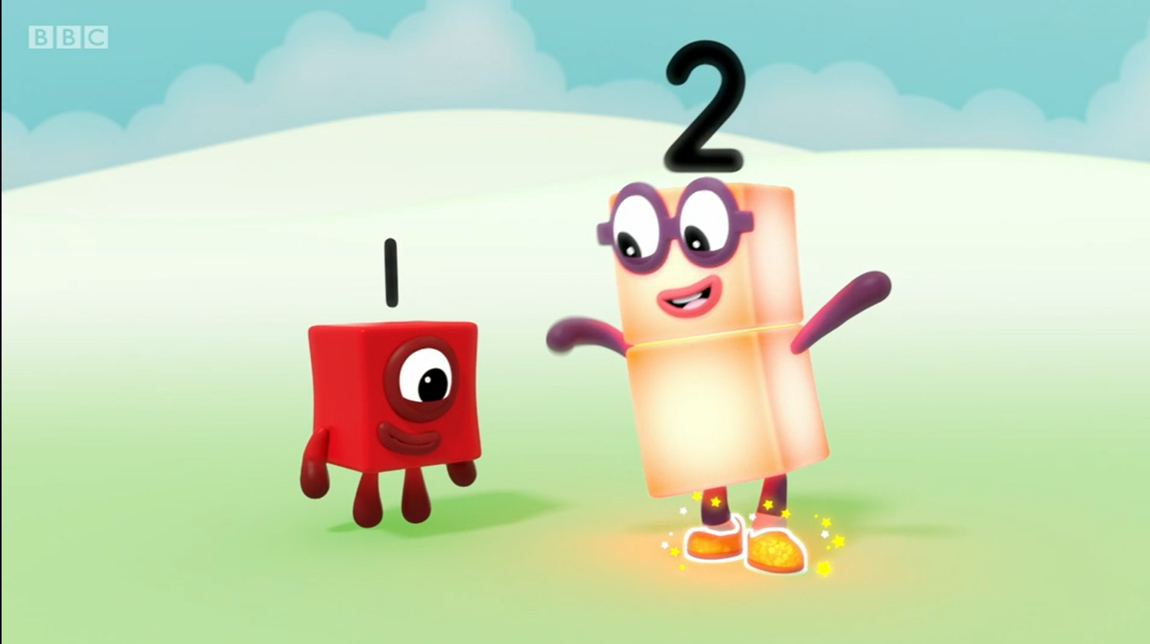
What other things can I have 2 of?
1 and another 1 is 2.
Image © 2021 Alphablocks Ltd. All rights reserved. Mastering Number 2021/22 ncetm.org.uk

Slide 7
Session 2
Mastering Number 2021/22 ncetm.org.uk

Slide 8
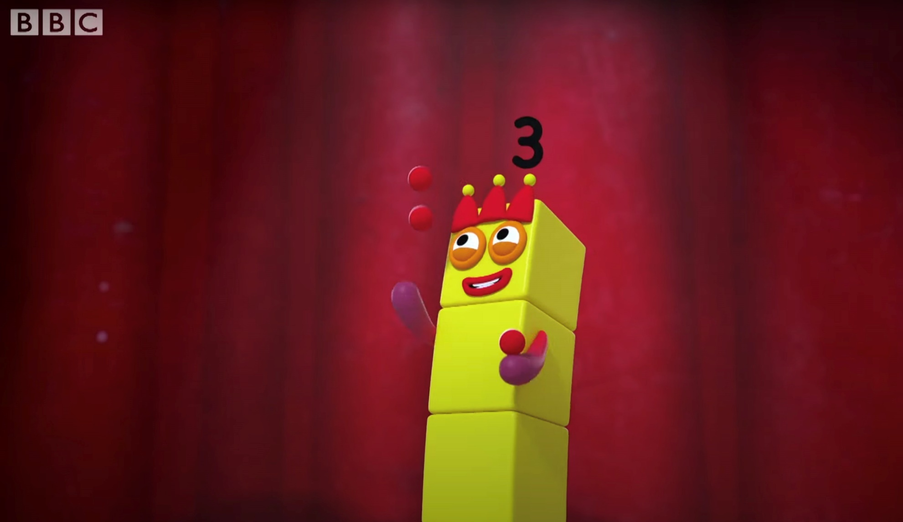
Numberblocks
Series 1, Episode 4: Three
Video © 2021 Alphablocks Ltd. All rights reserved. Mastering Number 2021/22 ncetm.org.uk

Slide 9
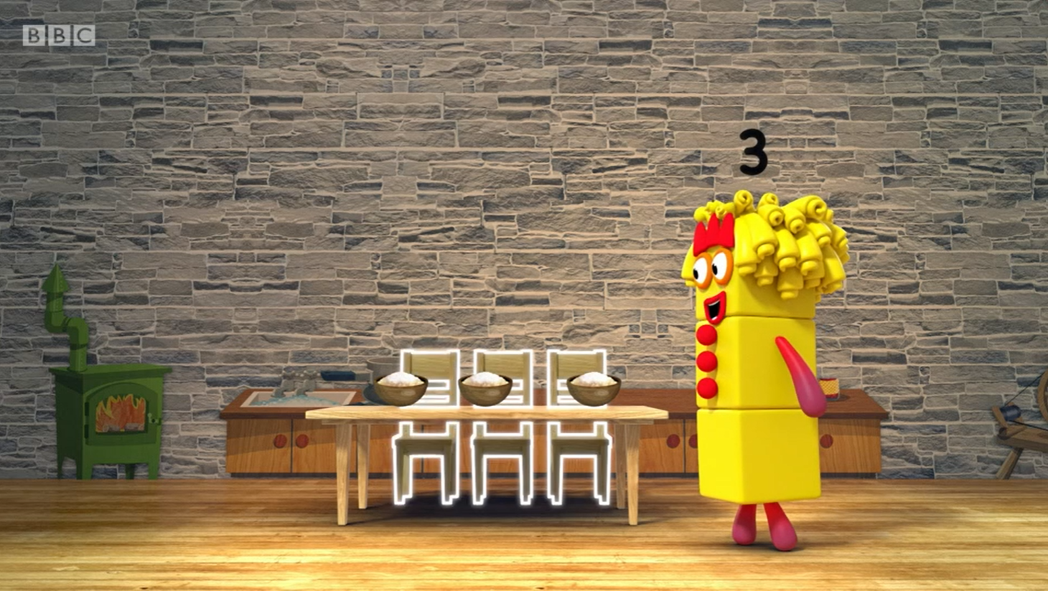
There are 3 chairs, 3 bowls… and what else?
Image © 2021 Alphablocks Ltd. All rights reserved. Mastering Number 2021/22 ncetm.org.uk

Slide 10
Session 3
Mastering Number 2021/22 ncetm.org.uk

Slide 11
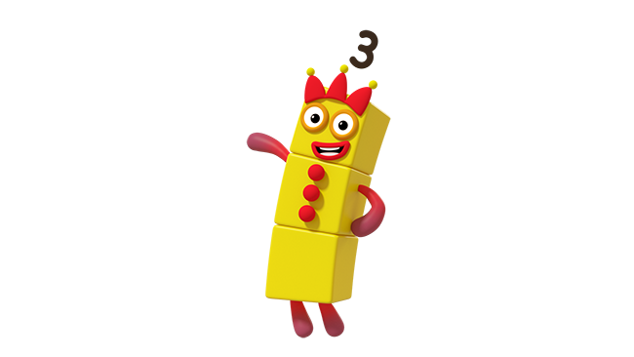
Can you say whether I have picked 3 flowers for the 3 bears?
Image © 2021 Alphablocks Ltd. All rights reserved. Mastering Number 2021/22 ncetm.org.uk

Slide 12
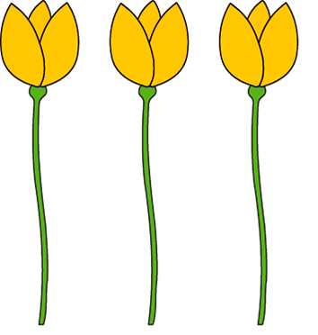
Mastering Number 2021/22 ncetm.org.uk

Slide 13

Mastering Number 2021/22 ncetm.org.uk

Slide 14
Mastering Number 2021/22 ncetm.org.uk

Slide 15
Session 4
Mastering Number 2021/22 ncetm.org.uk

Slide 16

Mastering Number 2021/22 ncetm.org.uk

Slide 17
Mastering Number 2021/22 ncetm.org.uk

Slide 18
Mastering Number 2021/22 ncetm.org.uk

Slide 19
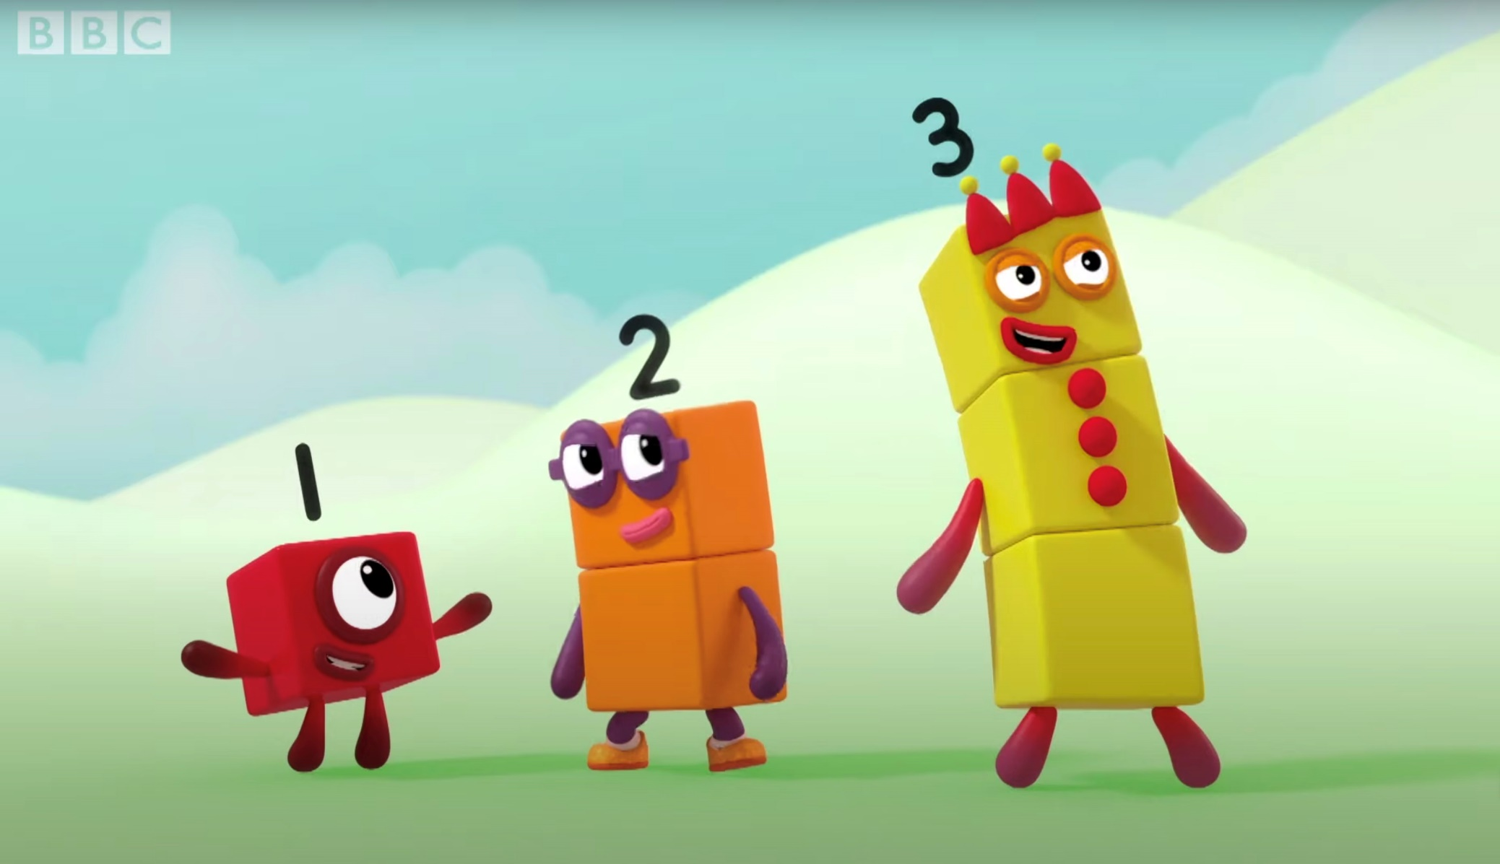
Numberblocks
Series 1, Episode 6: Four
Video © 2021 Alphablocks Ltd. All rights reserved. Mastering Number 2021/22 ncetm.org.uk

Slide 20
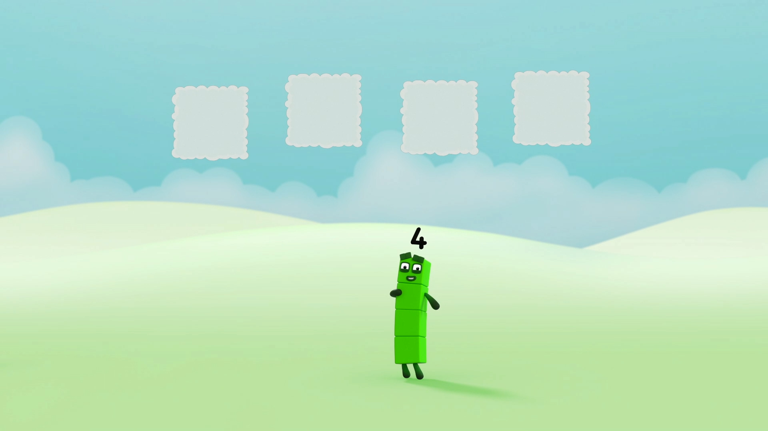
Image © 2021 Alphablocks Ltd. All rights reserved. Mastering Number 2021/22 ncetm.org.uk

Slide 21
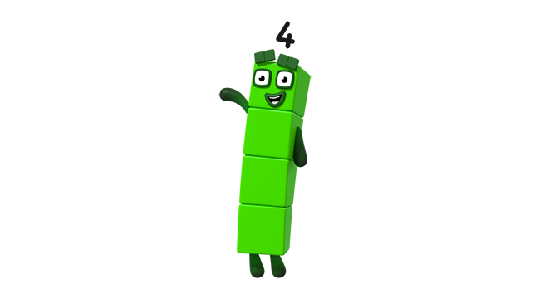
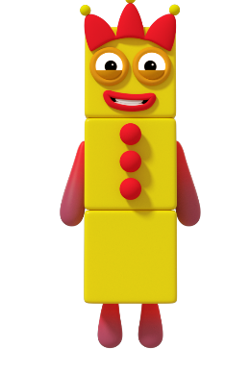
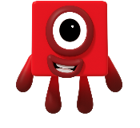
Three and One can make me!
Images © 2021 Alphablocks Ltd. All rights reserved. Mastering Number 2021/22 ncetm.org.uk

Slide 22
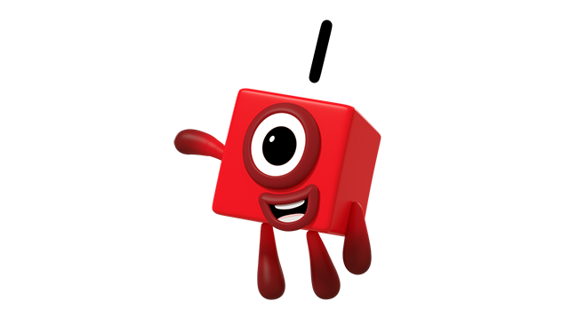
Can you make Four with lots of me?
Image © 2021 Alphablocks Ltd. All rights reserved. Mastering Number 2021/22 ncetm.org.uk

