Slide 1
Mastering Number
Reception
Term 1
Week 1
Focus: Subitising

Slide 2
Session 1
Mastering Number 2021/22 ncetm.org.uk

Slide 3
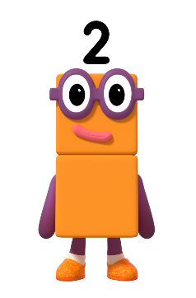

Can you say our numbers?
Images © 2021 Alphablocks Ltd. All rights reserved. Mastering Number 2021/22 ncetm.org.uk

Slide 4
Play our spotty game!
Images © 2021 Alphablocks Ltd. All rights reserved. Mastering Number 2021/22 ncetm.org.uk

Slide 5
Mastering Number 2021/22 ncetm.org.uk

Slide 6
Mastering Number 2021/22 ncetm.org.uk

Slide 7
Mastering Number 2021/22 ncetm.org.uk

Slide 8
Mastering Number 2021/22 ncetm.org.uk

Slide 9
Mastering Number 2021/22 ncetm.org.uk

Slide 10
Mastering Number 2021/22 ncetm.org.uk

Slide 11
Mastering Number 2021/22 ncetm.org.uk

Slide 12
Mastering Number 2021/22 ncetm.org.uk

Slide 13
Mastering Number 2021/22 ncetm.org.uk

Slide 14
Mastering Number 2021/22 ncetm.org.uk

Slide 15
Mastering Number 2021/22 ncetm.org.uk

Slide 16
Mastering Number 2021/22 ncetm.org.uk

Slide 17
Mastering Number 2021/22 ncetm.org.uk

Slide 18
Mastering Number 2021/22 ncetm.org.uk

Slide 19
Mastering Number 2021/22 ncetm.org.uk

Slide 20
Session 2
Mastering Number 2021/22 ncetm.org.uk

Slide 21
Can you remember our game?
Images © 2021 Alphablocks Ltd. All rights reserved. Mastering Number 2021/22 ncetm.org.uk

Slide 22
Mastering Number 2021/22 ncetm.org.uk

Slide 23
Mastering Number 2021/22 ncetm.org.uk

Slide 24
Mastering Number 2021/22 ncetm.org.uk

Slide 25
Mastering Number 2021/22 ncetm.org.uk

Slide 26
Mastering Number 2021/22 ncetm.org.uk

Slide 27
Mastering Number 2021/22 ncetm.org.uk

Slide 28
Mastering Number 2021/22 ncetm.org.uk

Slide 29
Mastering Number 2021/22 ncetm.org.uk

Slide 30
Mastering Number 2021/22 ncetm.org.uk

Slide 31
Mastering Number 2021/22 ncetm.org.uk

Slide 32
Mastering Number 2021/22 ncetm.org.uk

Slide 33
Mastering Number 2021/22 ncetm.org.uk

Slide 34
Mastering Number 2021/22 ncetm.org.uk

Slide 35
Mastering Number 2021/22 ncetm.org.uk

Slide 36
Mastering Number 2021/22 ncetm.org.uk

Slide 37
Mastering Number 2021/22 ncetm.org.uk

Slide 38
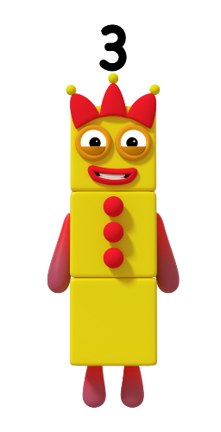
What can you see 3 of on me?
Image © 2021 Alphablocks Ltd. All rights reserved. Mastering Number 2021/22 ncetm.org.uk

Slide 39


Can you guess what I’ve been painting?
Image © 2021 Alphablocks Ltd. All rights reserved. Mastering Number 2021/22 ncetm.org.uk

Slide 40
Mastering Number 2021/22 ncetm.org.uk

Slide 41
Session 3
Mastering Number 2021/22 ncetm.org.uk

Slide 42
3 or NOT 3?
Image © 2021 Alphablocks Ltd. All rights reserved. Mastering Number 2021/22 ncetm.org.uk

Slide 43
Mastering Number 2021/22 ncetm.org.uk

Slide 44
Mastering Number 2021/22 ncetm.org.uk

Slide 45
Mastering Number 2021/22 ncetm.org.uk

Slide 46
Mastering Number 2021/22 ncetm.org.uk

Slide 47
Mastering Number 2021/22 ncetm.org.uk

Slide 48
Mastering Number 2021/22 ncetm.org.uk

Slide 49
Mastering Number 2021/22 ncetm.org.uk

Slide 50
Mastering Number 2021/22 ncetm.org.uk

Slide 51
Mastering Number 2021/22 ncetm.org.uk

Slide 52
Mastering Number 2021/22 ncetm.org.uk

Slide 53
Mastering Number 2021/22 ncetm.org.uk

Slide 54
Mastering Number 2021/22 ncetm.org.uk

Slide 55
Mastering Number 2021/22 ncetm.org.uk

Slide 56
Mastering Number 2021/22 ncetm.org.uk

Slide 57
Mastering Number 2021/22 ncetm.org.uk

Slide 58
Mastering Number 2021/22 ncetm.org.uk

Slide 59
Mastering Number 2021/22 ncetm.org.uk

Slide 60
Mastering Number 2021/22 ncetm.org.uk

Slide 61
Mastering Number 2021/22 ncetm.org.uk

Slide 62
Mastering Number 2021/22 ncetm.org.uk

Slide 63
Can you show us on your fingers?
Images © 2021 Alphablocks Ltd. All rights reserved. Mastering Number 2021/22 ncetm.org.uk

Slide 64
Session 4
Mastering Number 2021/22 ncetm.org.uk

Slide 65
Come and see our houses!
Images © 2021 Alphablocks Ltd. All rights reserved. Mastering Number 2021/22 ncetm.org.uk

Slide 66
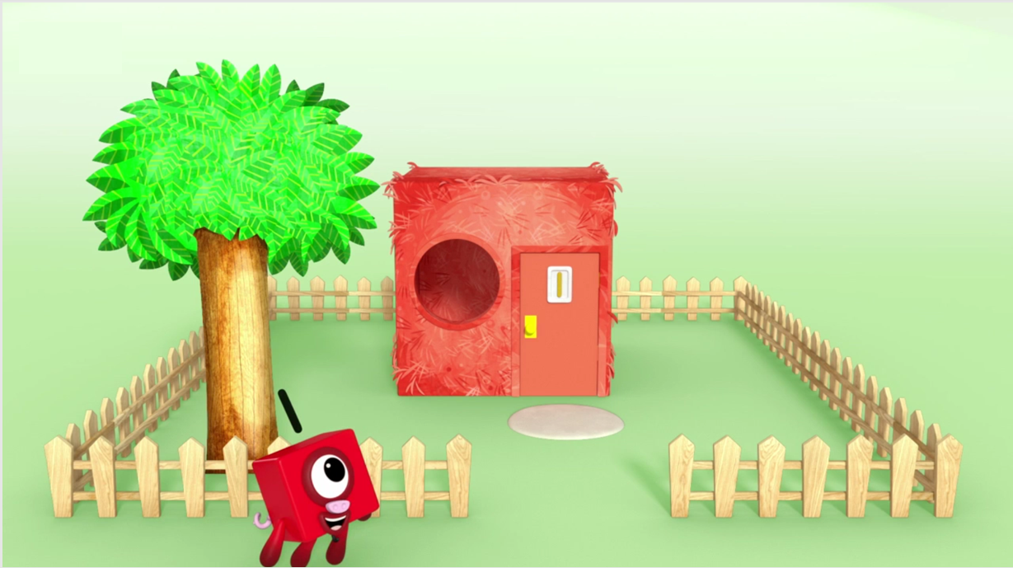
What can you see in the picture that there is 1 of?
Image © 2021 Alphablocks Ltd. All rights reserved. Mastering Number 2021/22 ncetm.org.uk

Slide 67
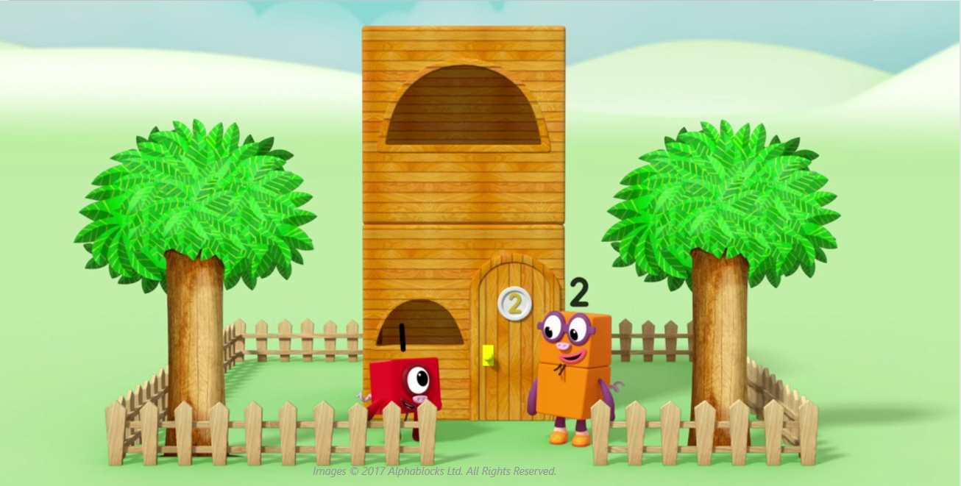
What can you see in the picture that there are 2 of?
Mastering Number 2021/22 ncetm.org.uk

Slide 68
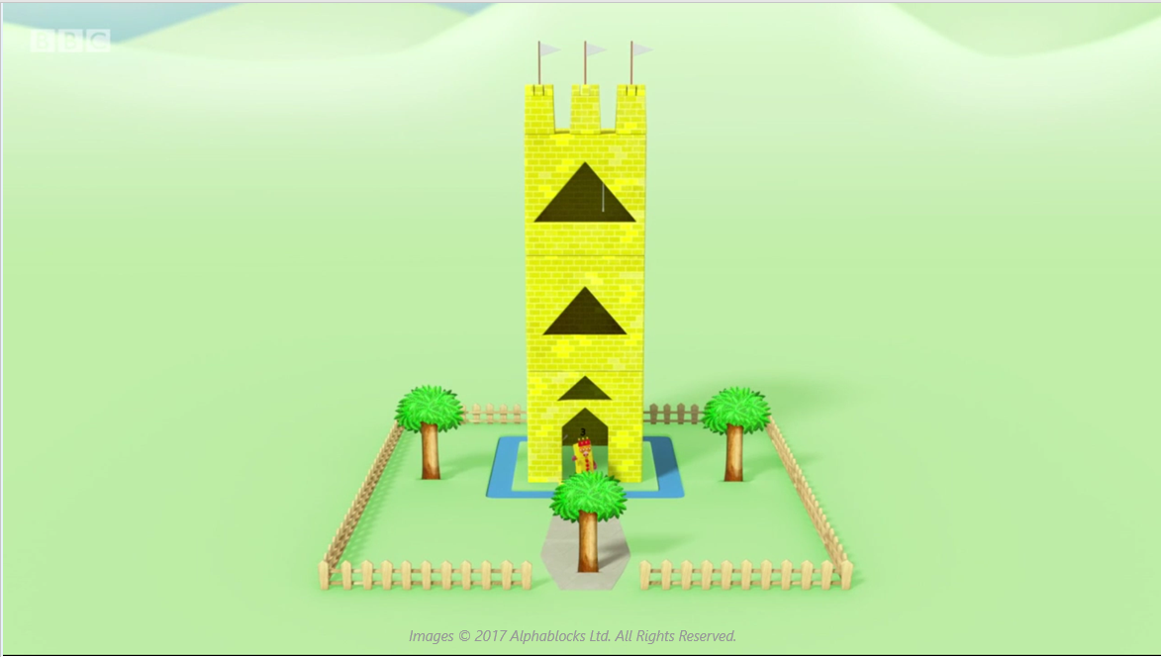
What can you see in the picture that there are 3 of?
Mastering Number 2021/22 ncetm.org.uk

Slide 69
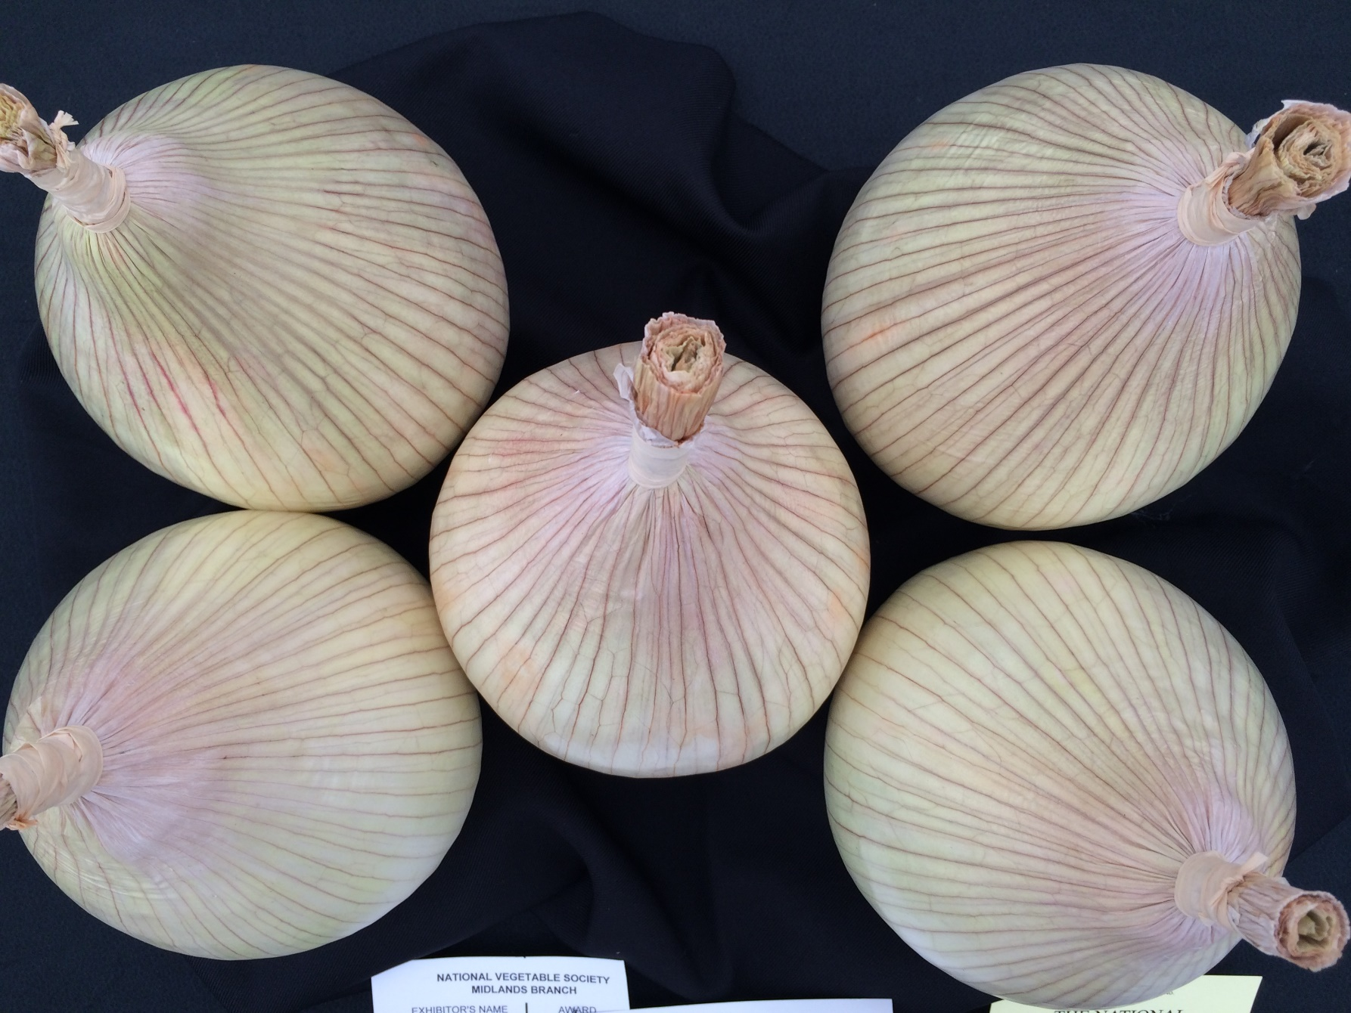
Mastering Number 2021/22 ncetm.org.uk

Slide 70
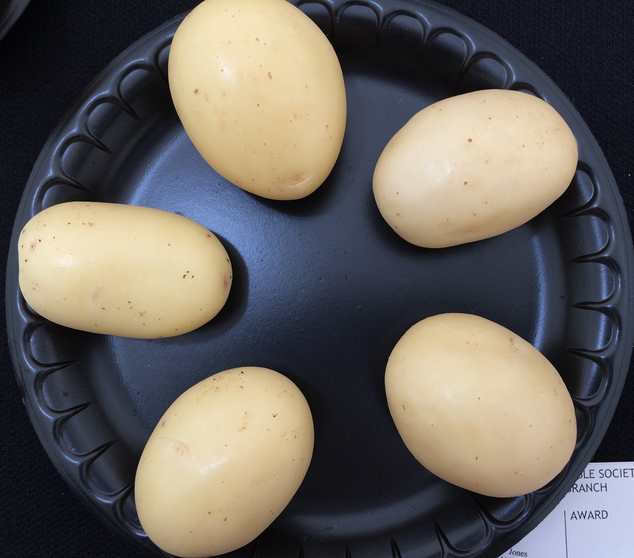
Mastering Number 2021/22 ncetm.org.uk

Slide 71
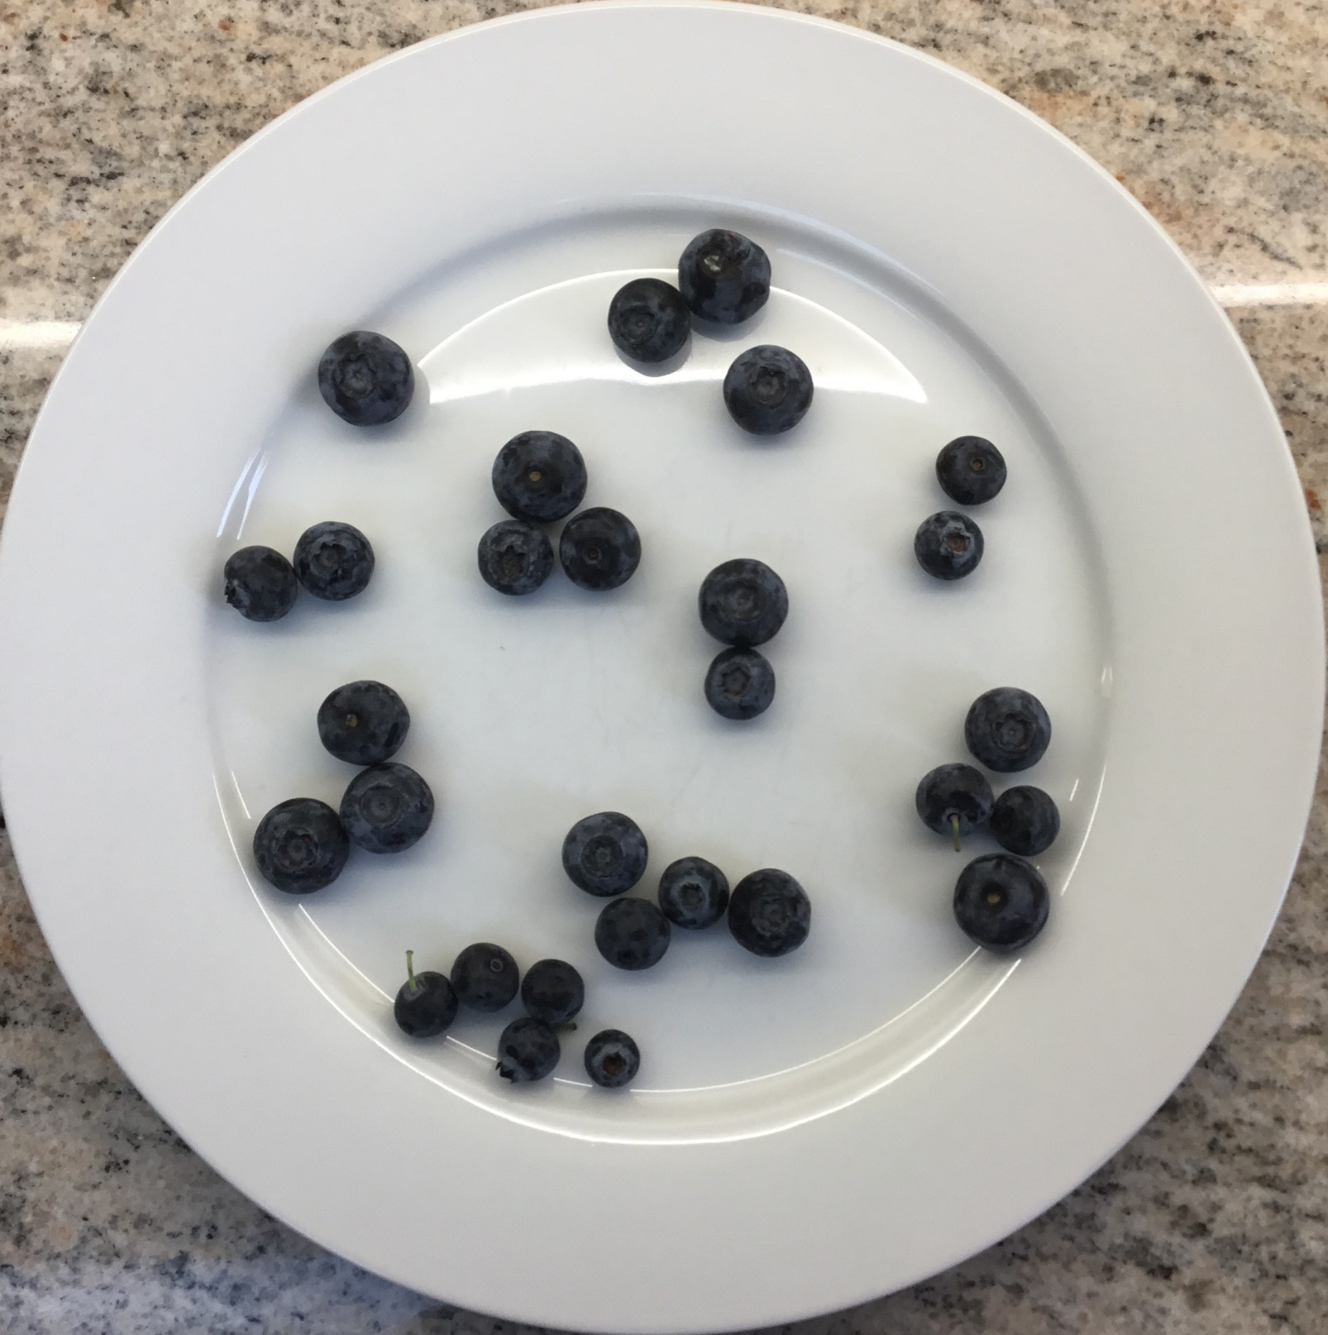
Mastering Number 2021/22 ncetm.org.uk

Slide 72
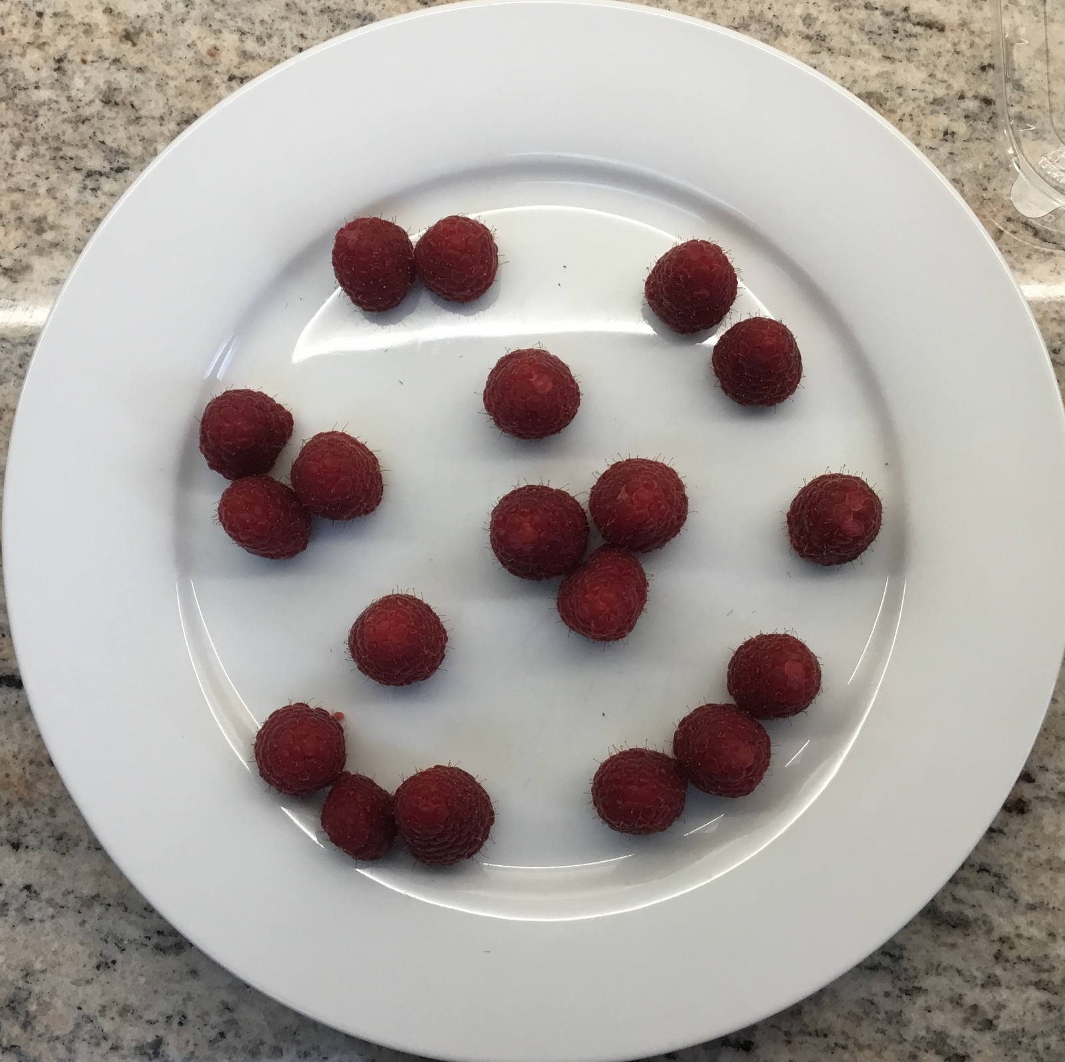
Mastering Number 2021/22 ncetm.org.uk

Slide 73
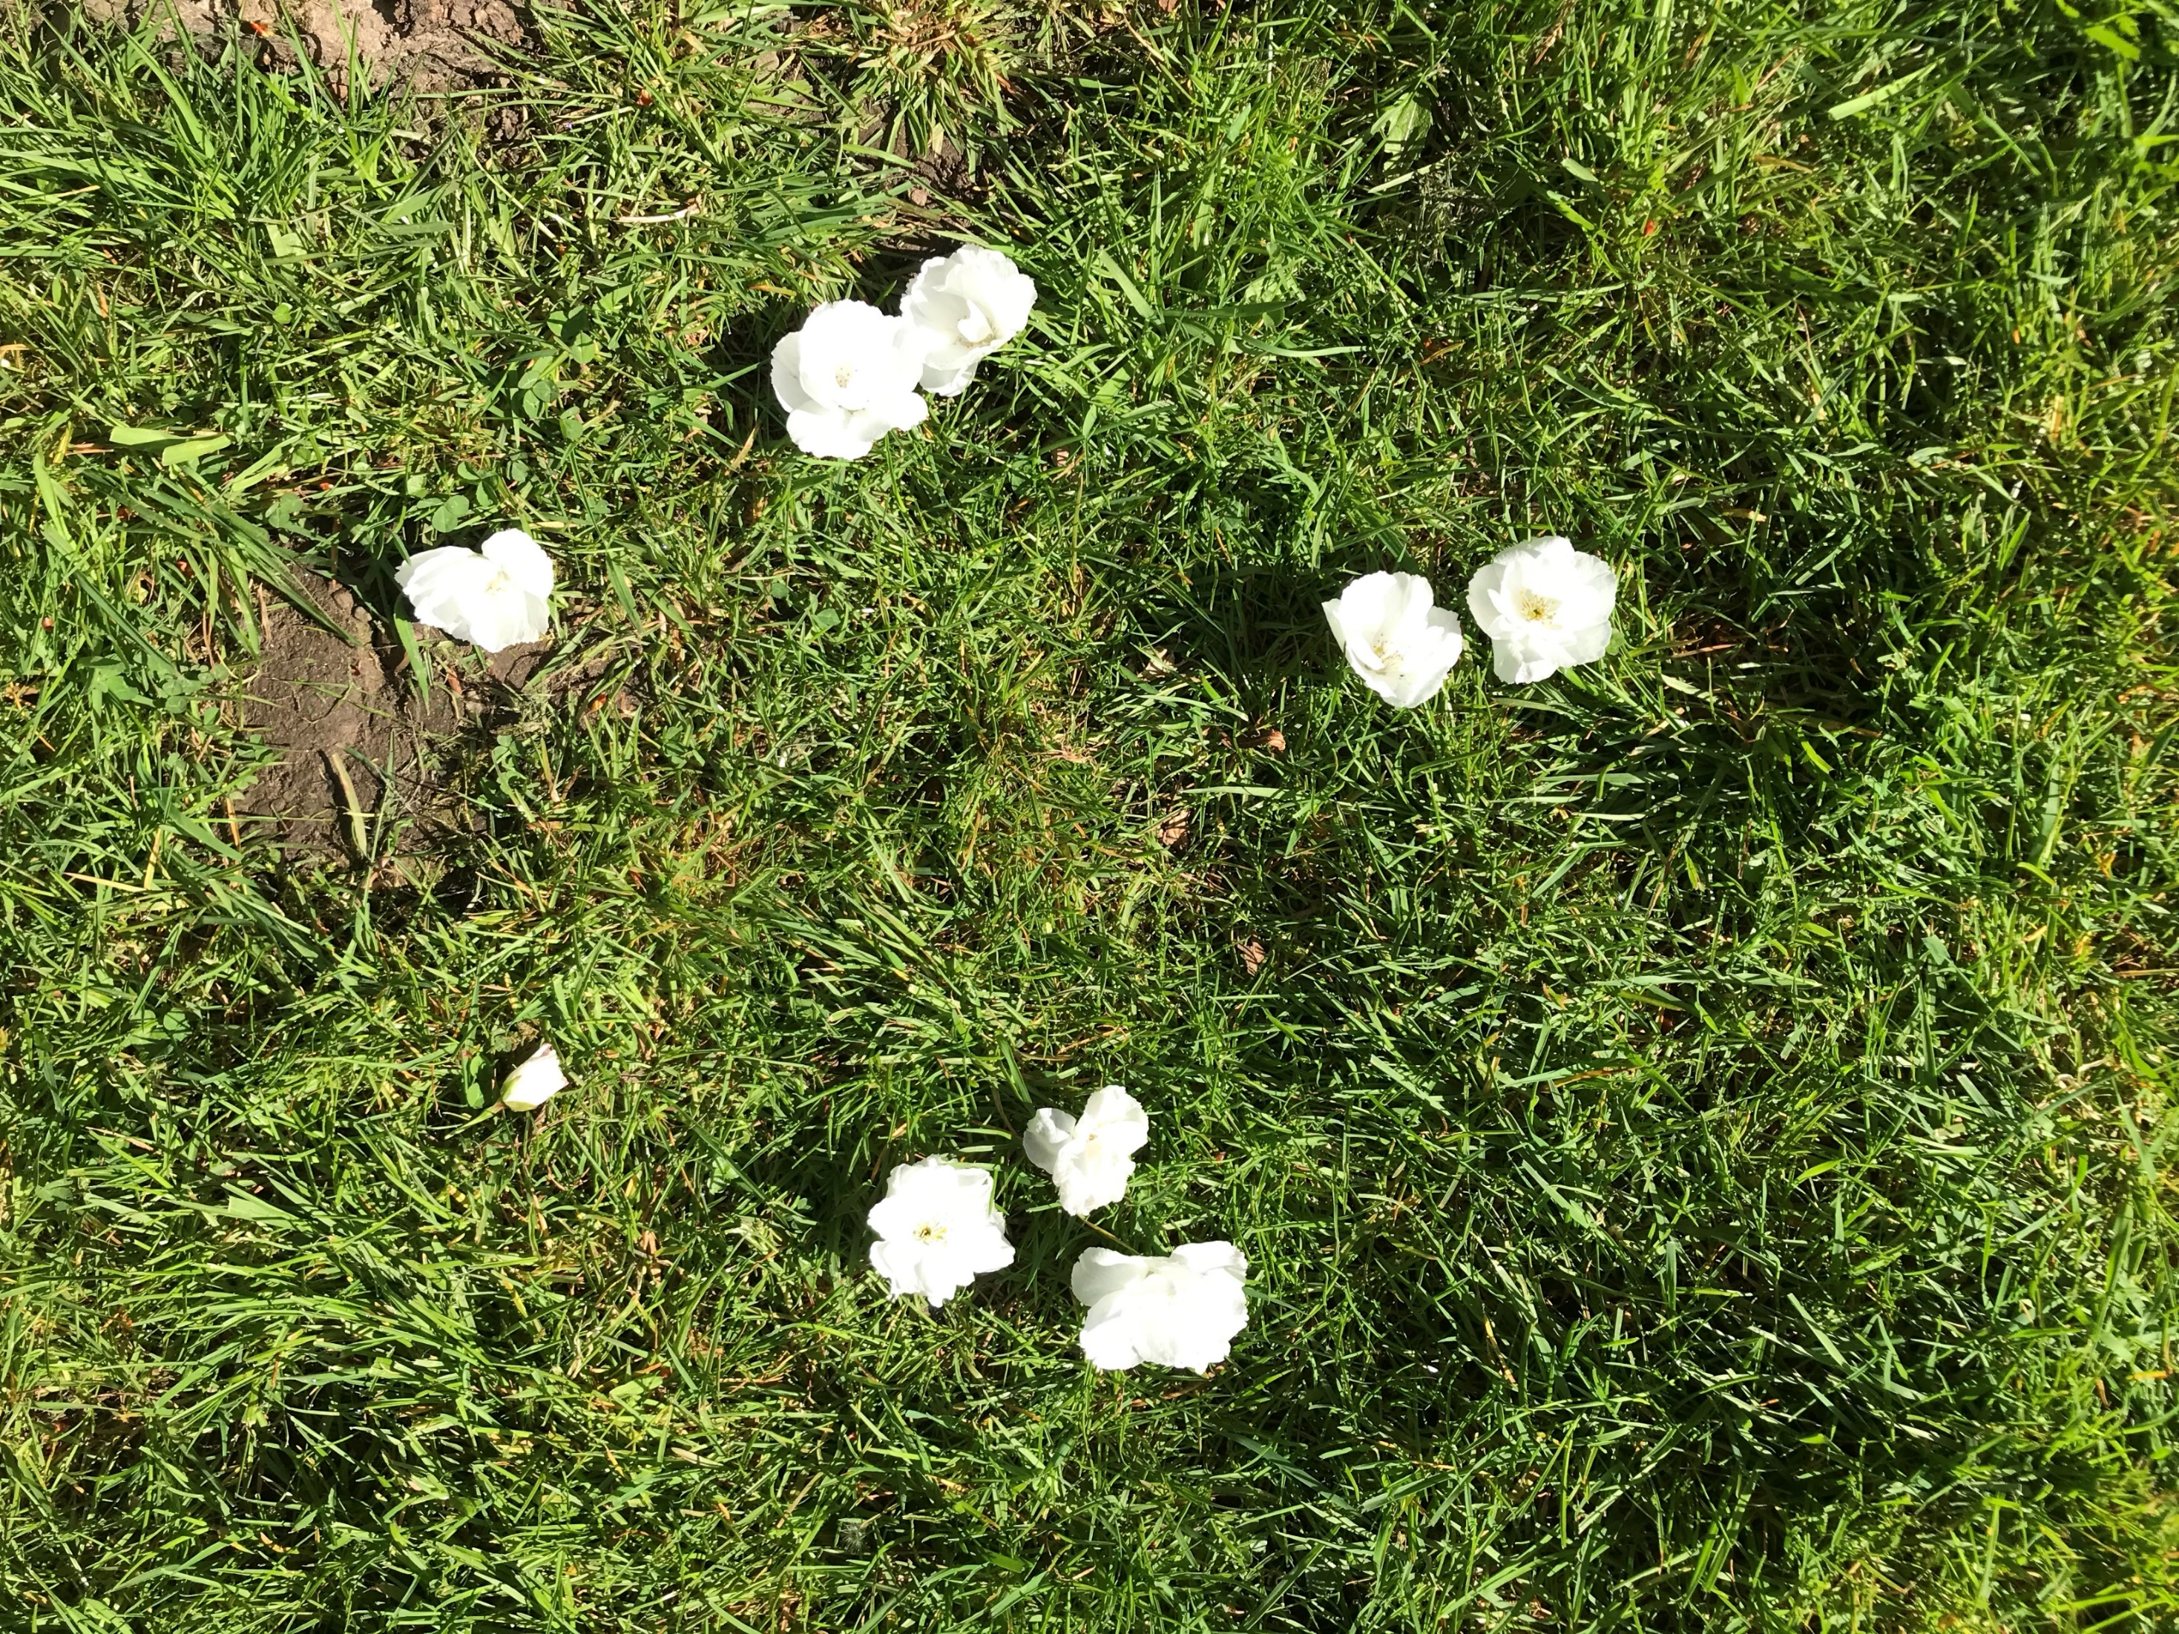
Mastering Number 2021/22 ncetm.org.uk

