Slide 1


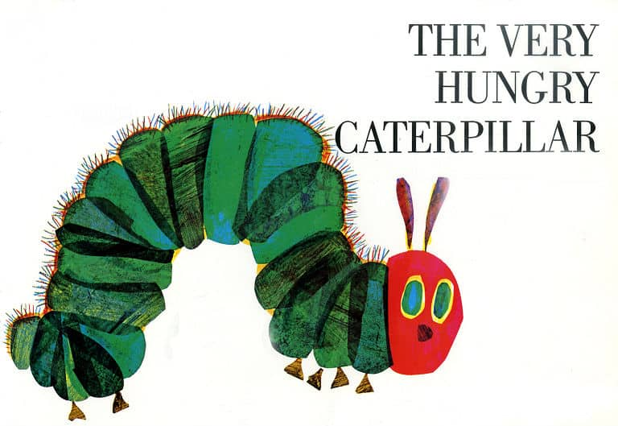

Slide 2
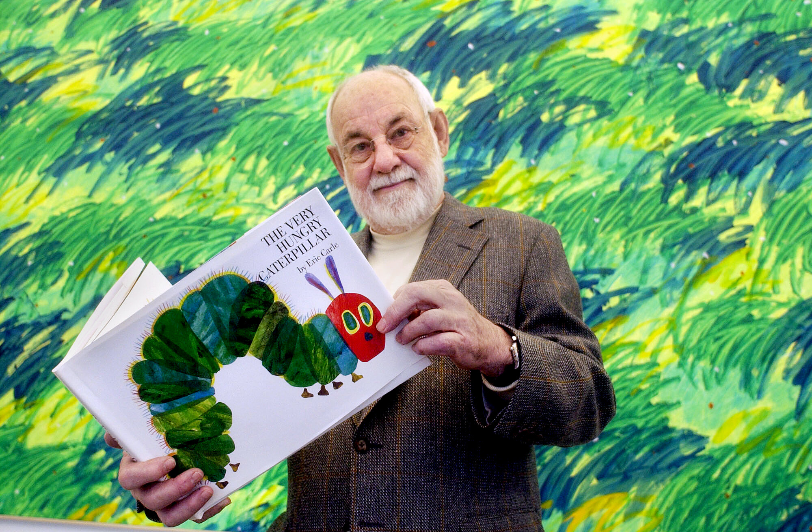
Eric Carle – Author and Illustrator
His illustrations help bring
the story to life
Collage

Slide 3


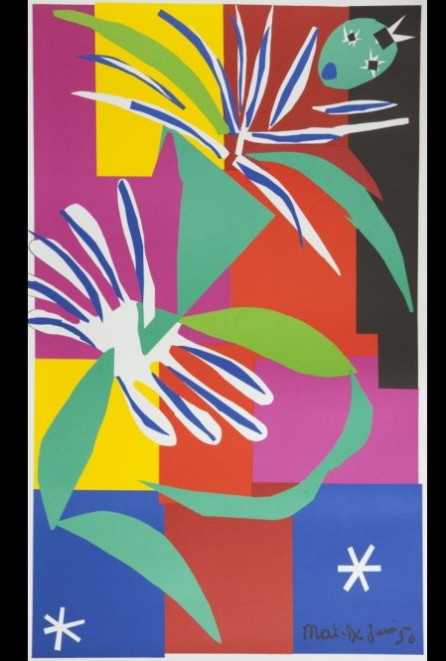
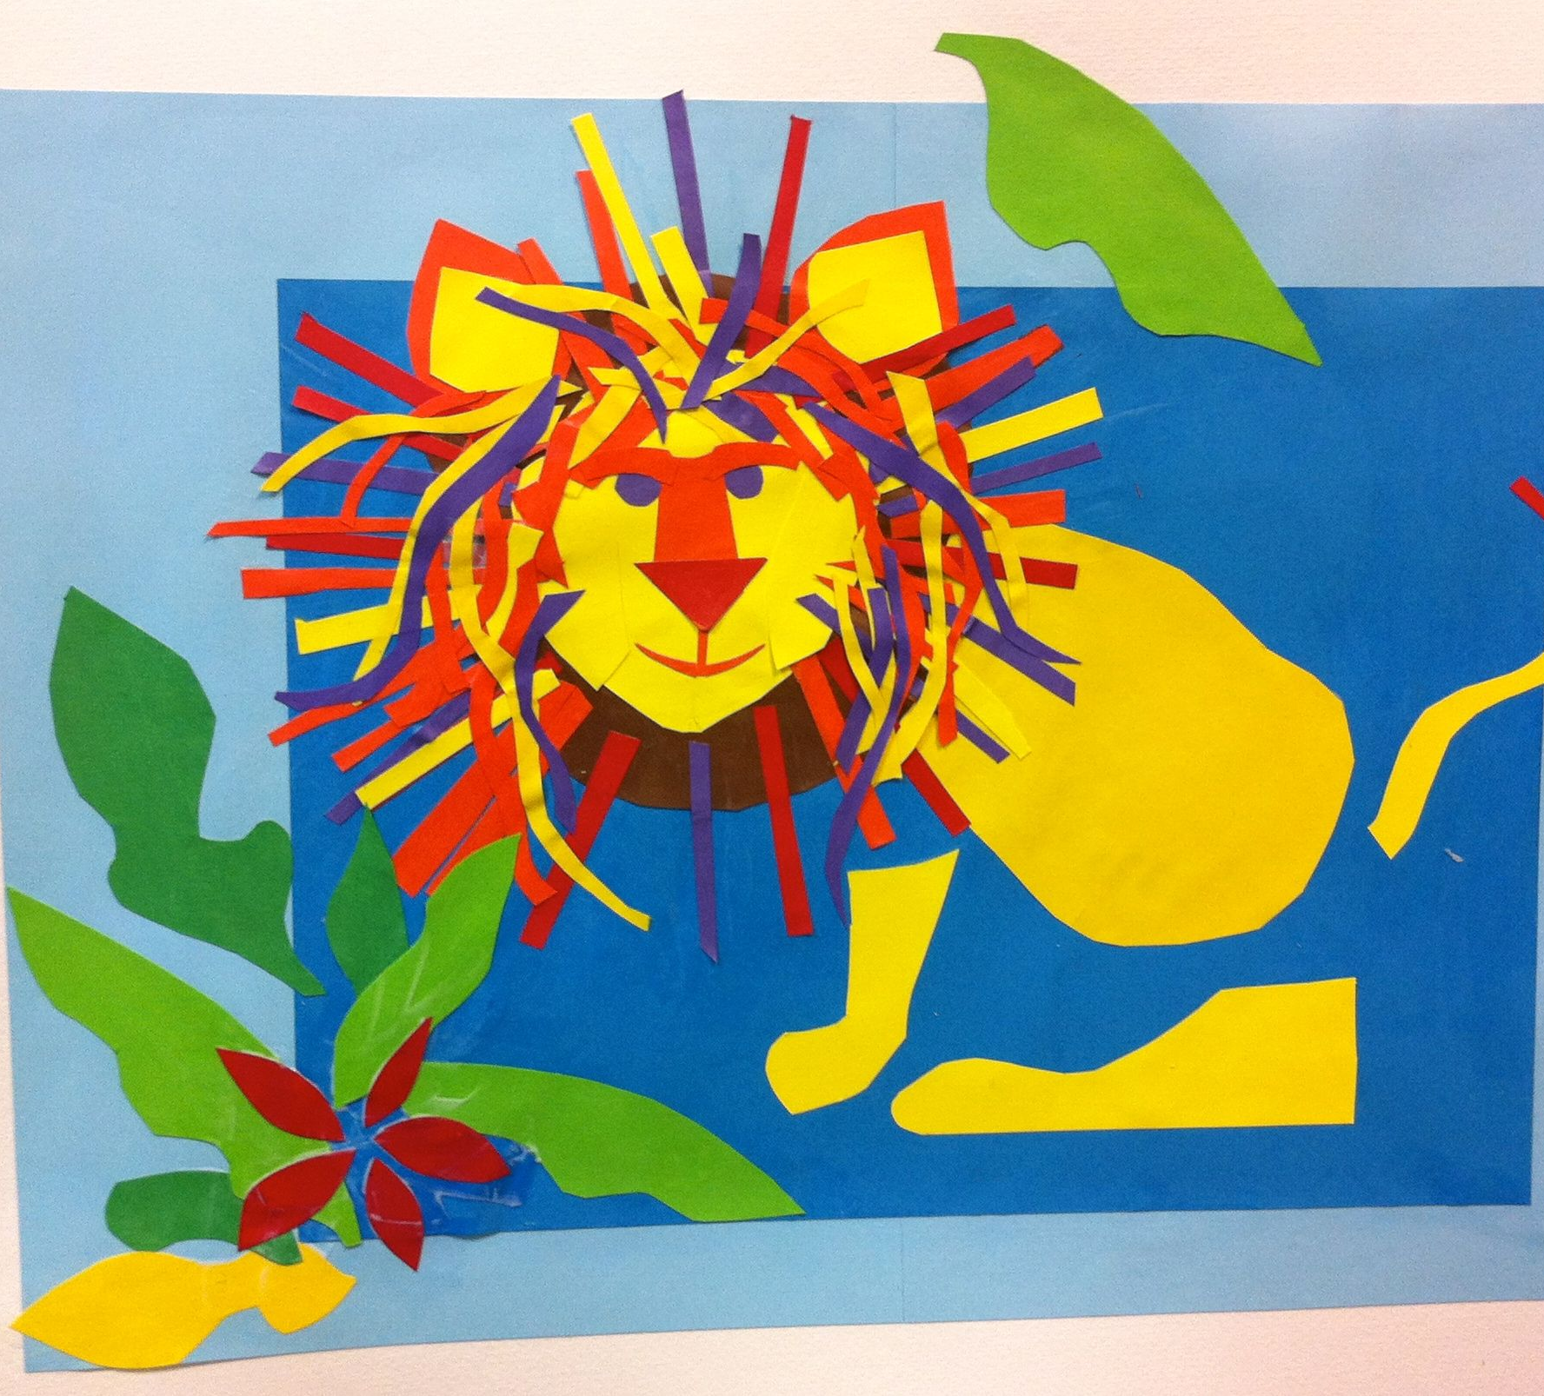

Slide 4
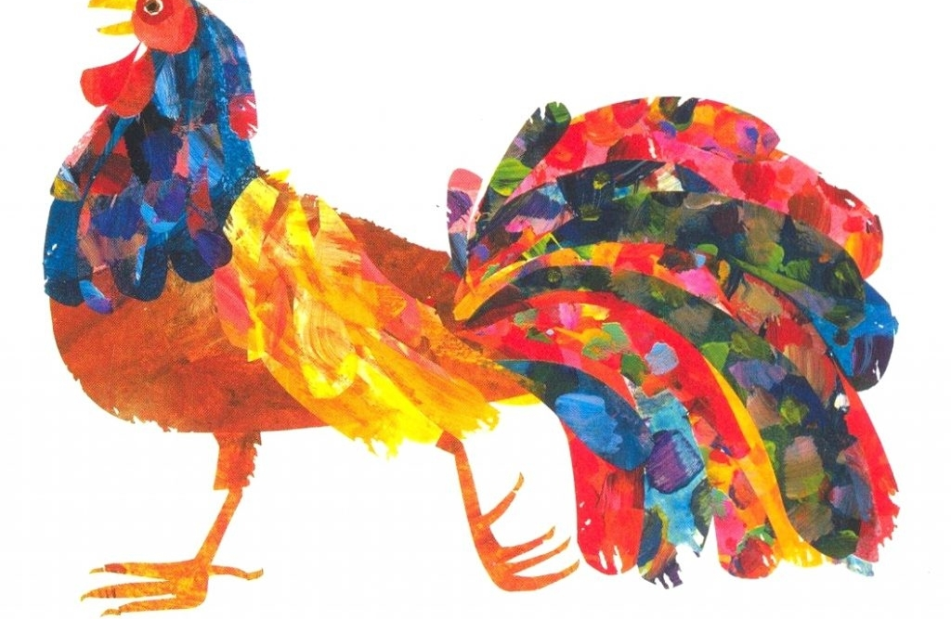
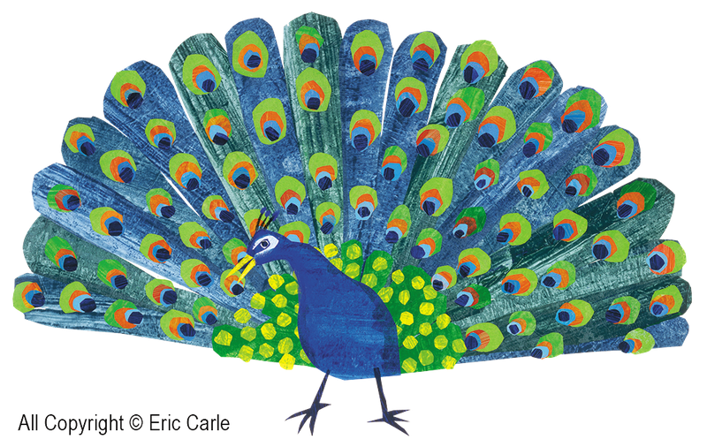

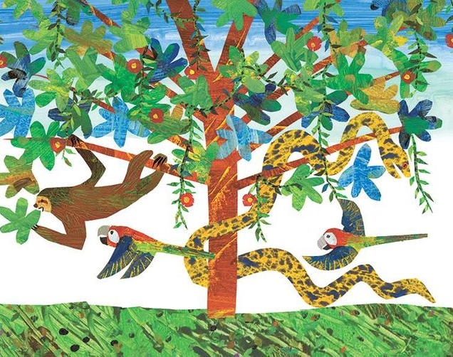


Slide 5
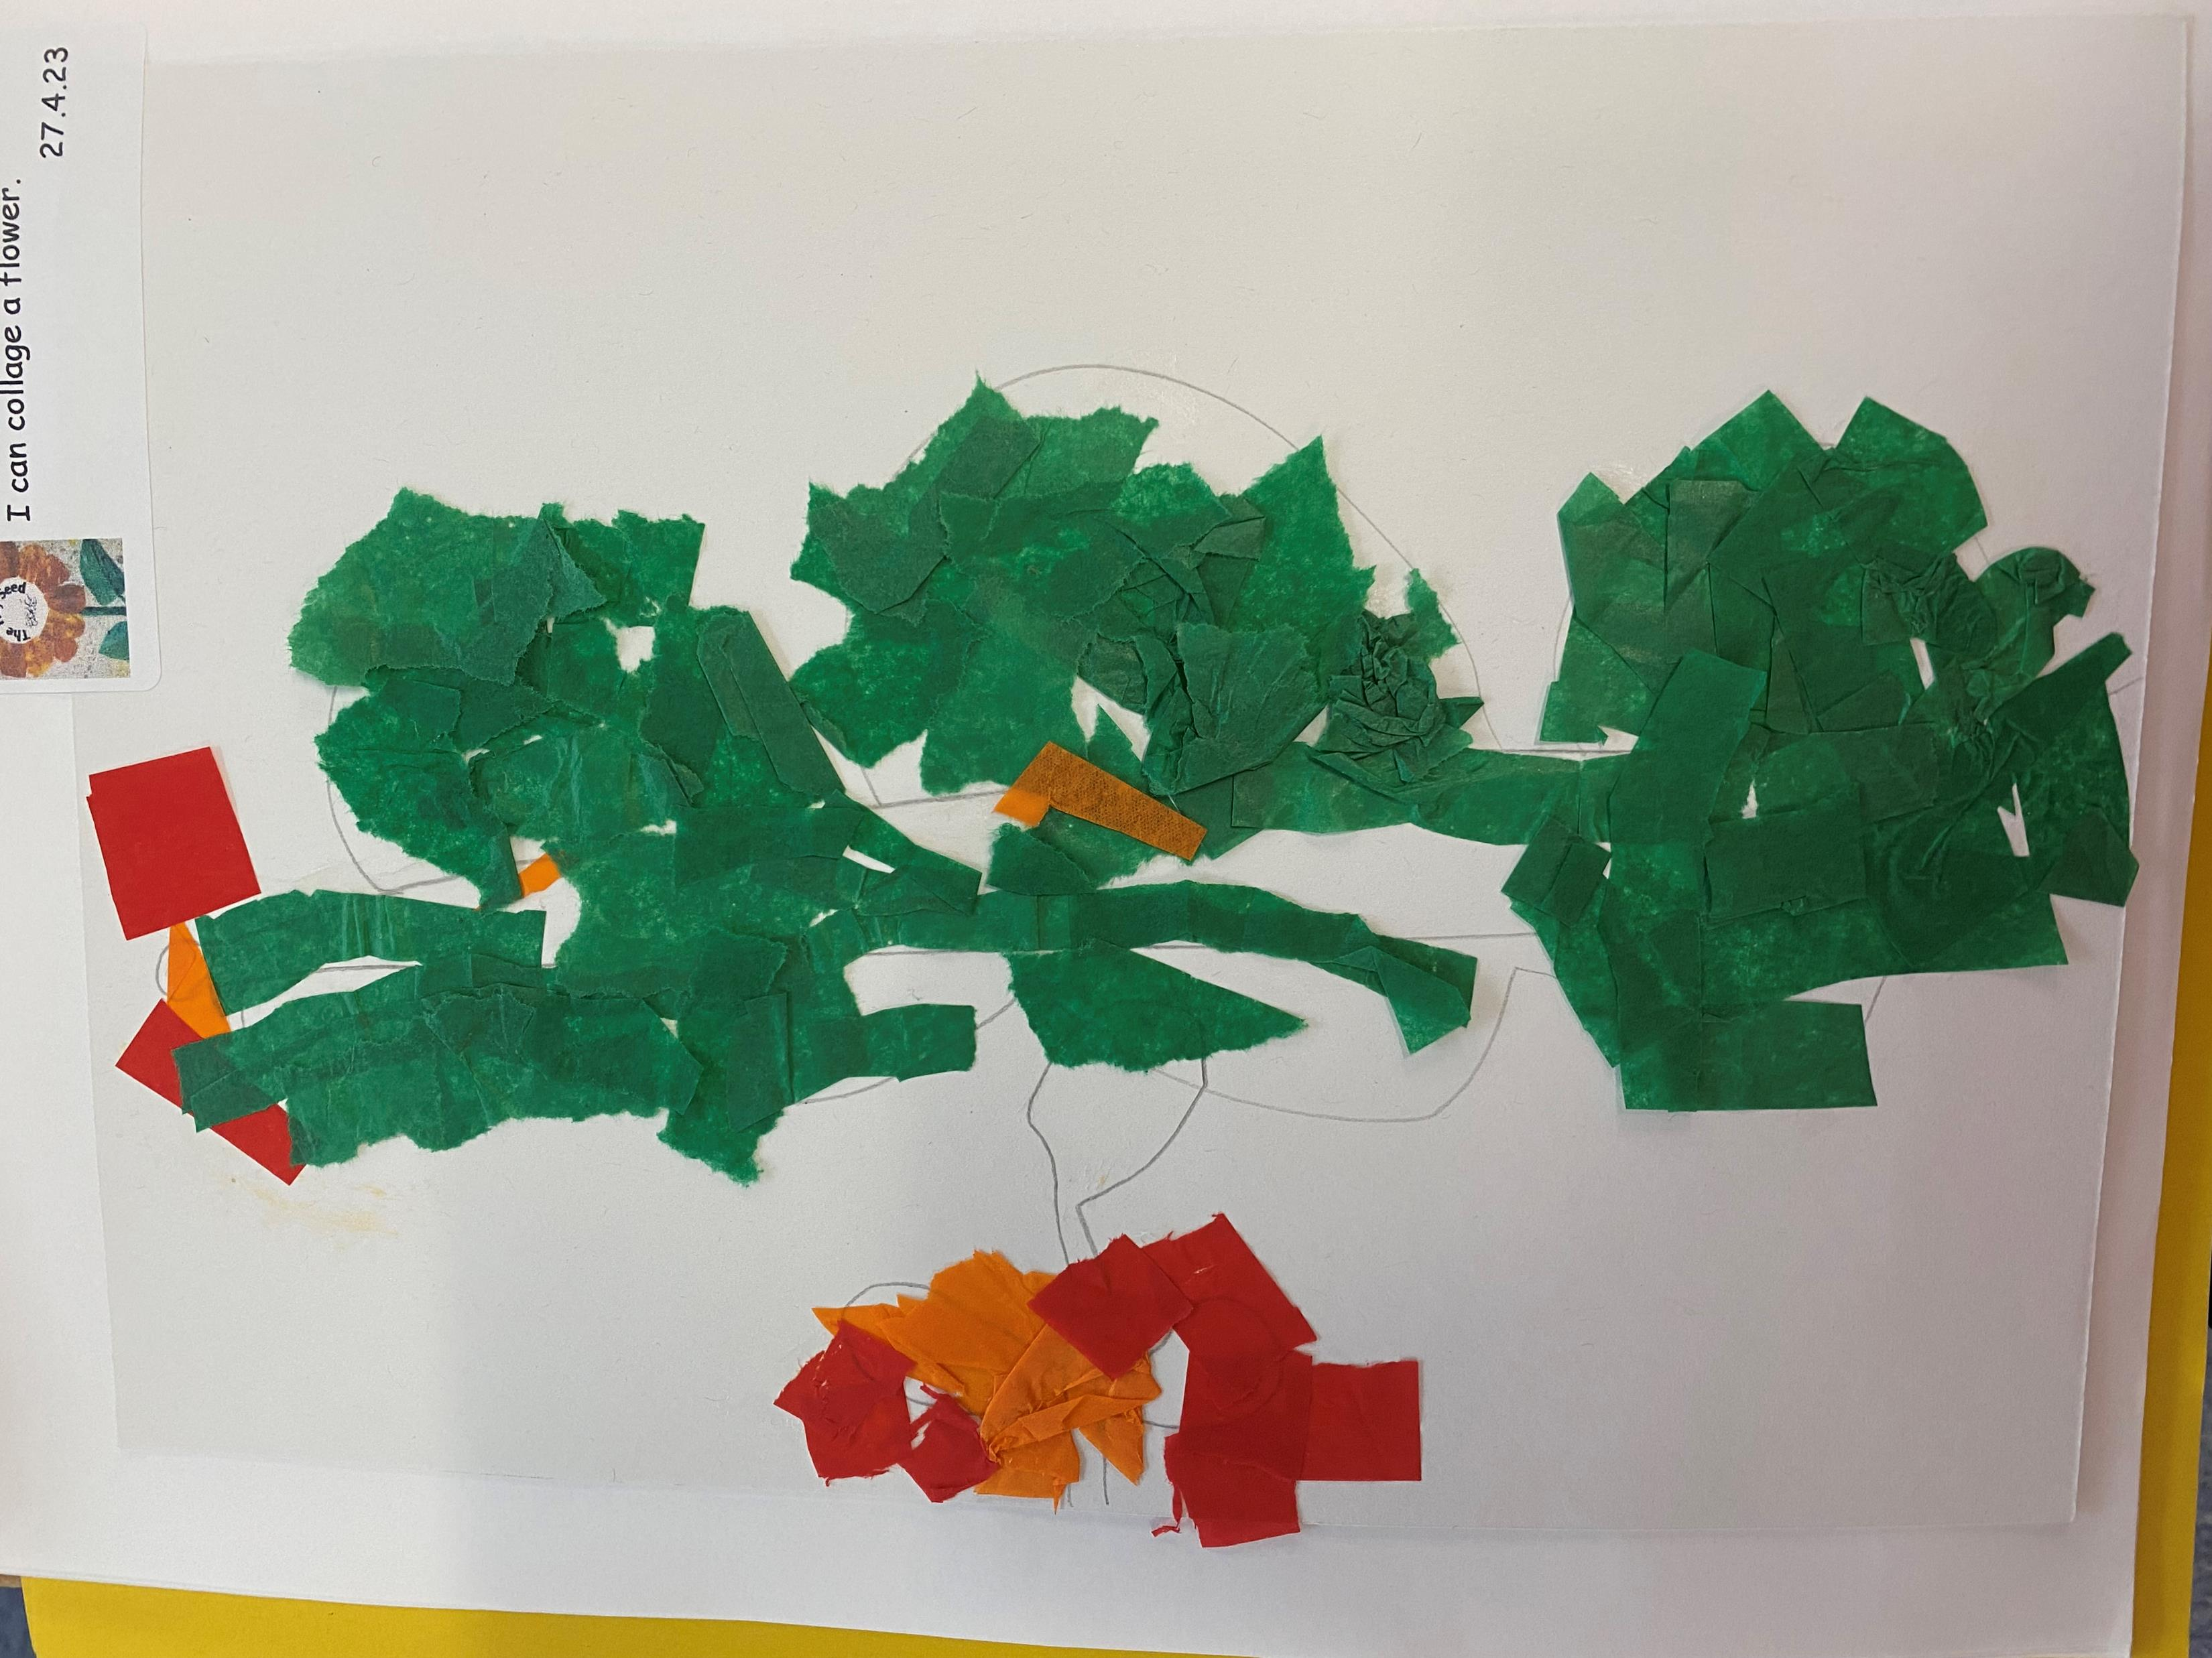
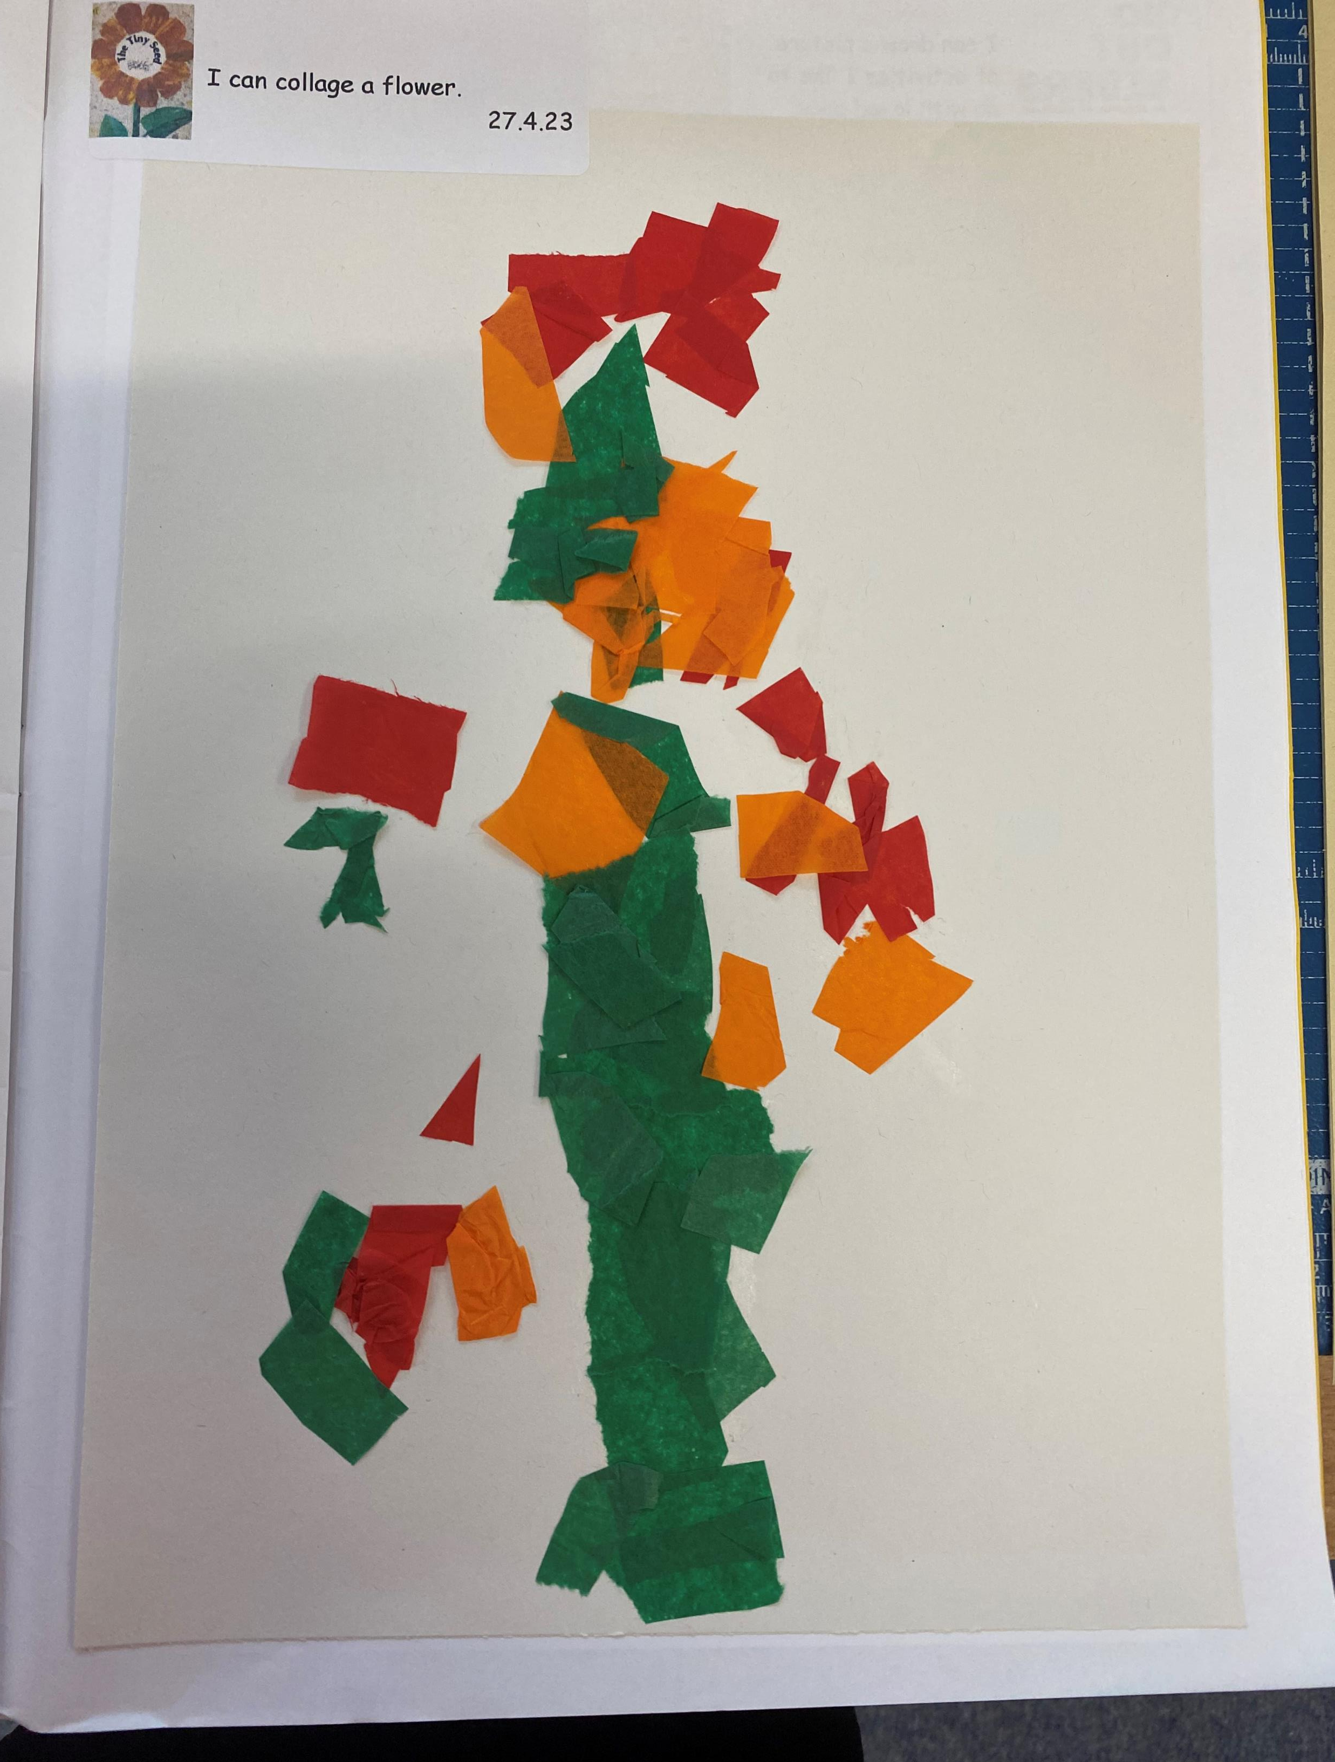
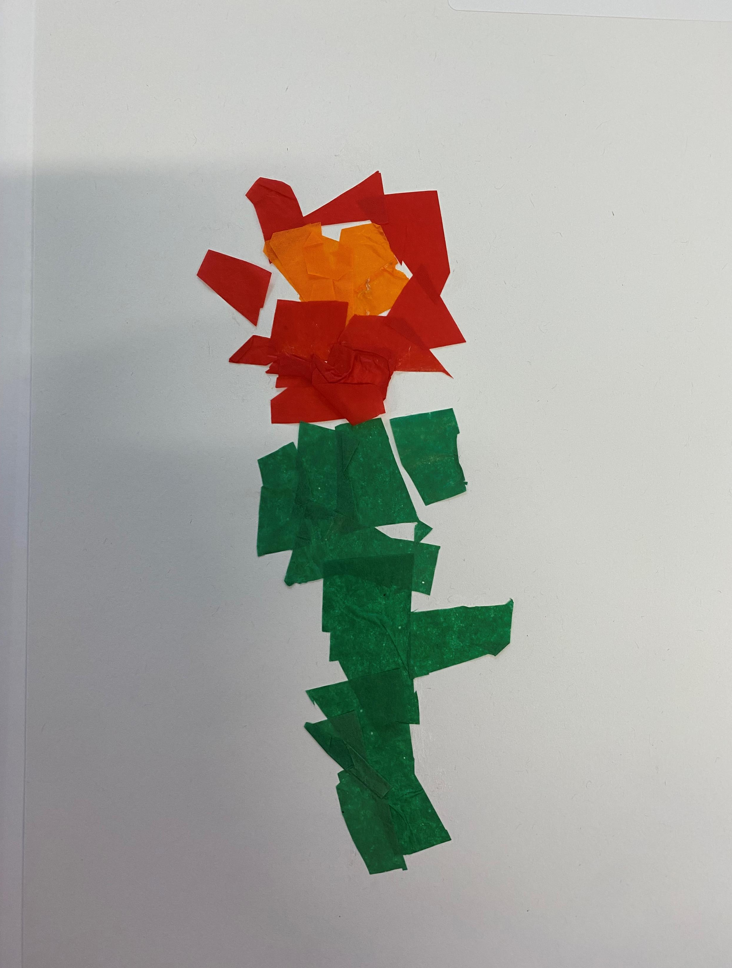
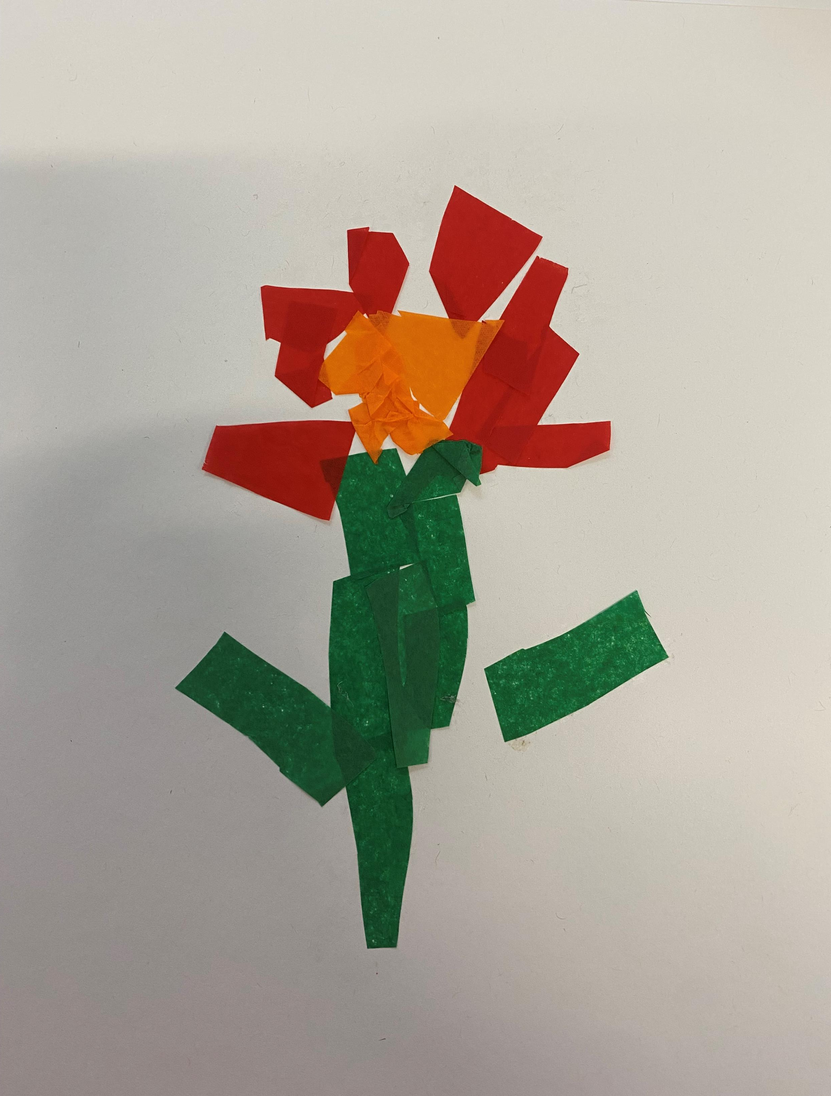

Slide 6
https://misterrogers.org/videos/eric-carle/
Eric Carle: Collage Technique | Watch as Eric Carle explains his signature collage technique that he uses in The Very Hungry Caterpillar! The Very Hungry Caterpillar is celebrating 50... | By The World of Eric Carle | Facebook

Slide 7
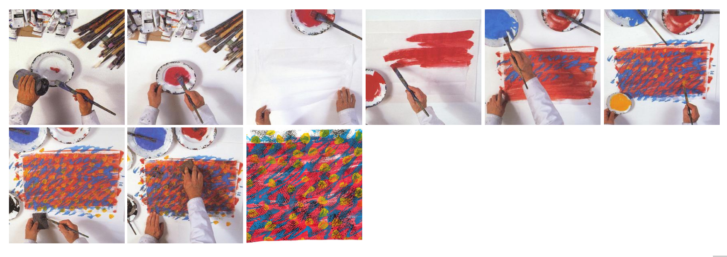

Slide 8


