Slide 2
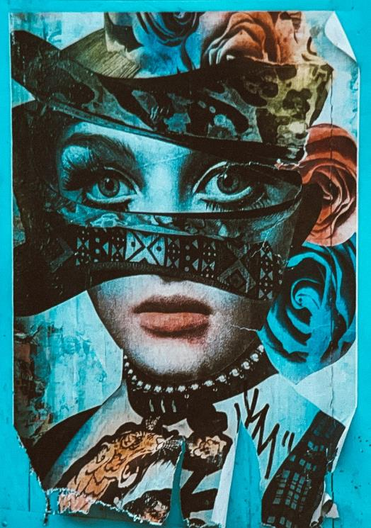
Collage
Materials often used and combined in collage are:
  newspapers and magazines clippings
  photographs
  pieces of fabric
  wallpaper

Slide 3
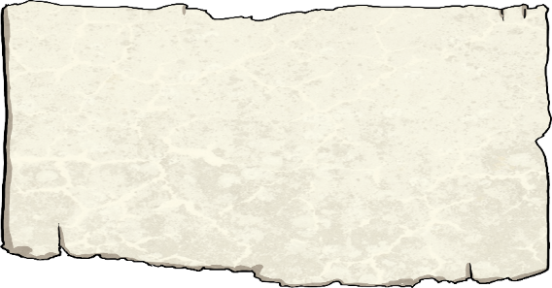
Did You Know…?
The word collage comes from the French word ‘coller’ which means ‘to glue’.

Slide 4
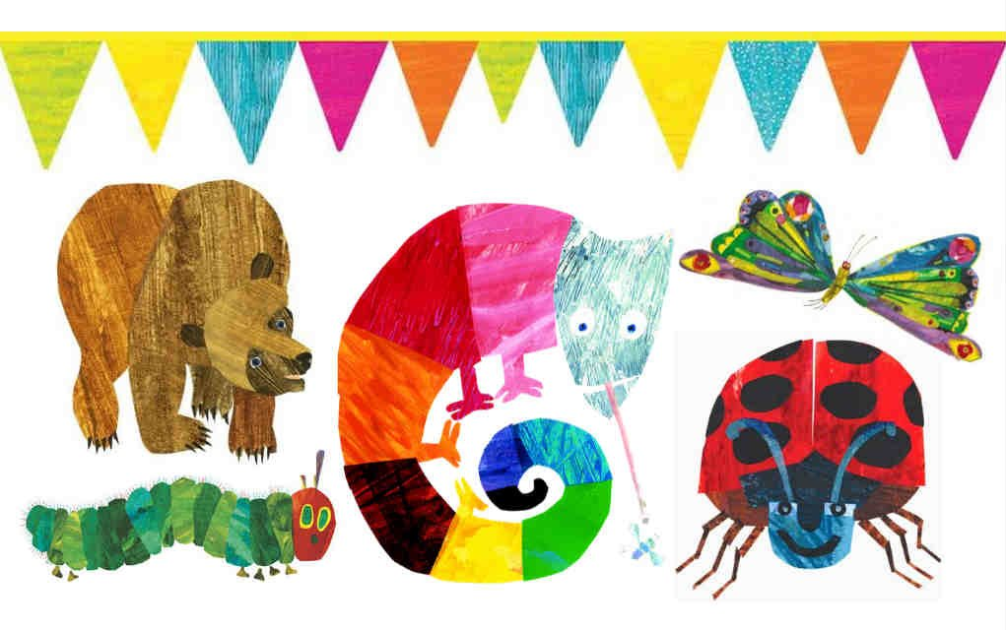

Slide 5
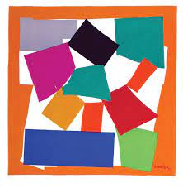

Slide 6
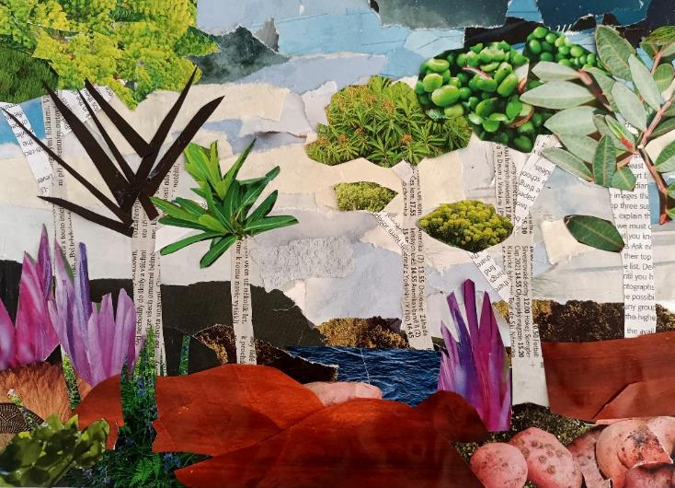
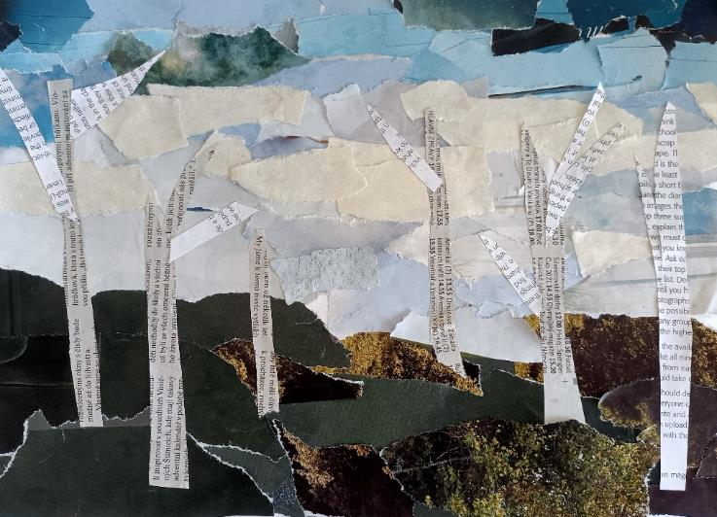
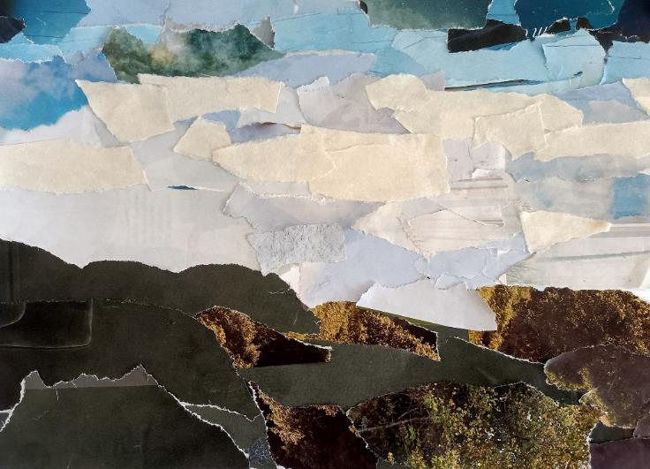

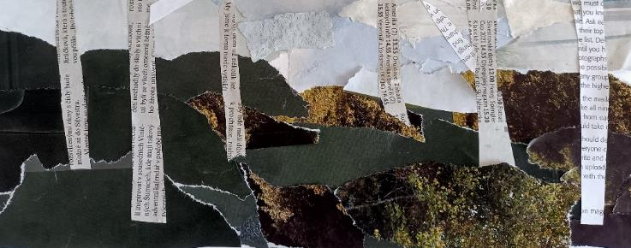

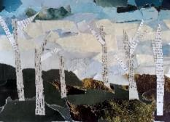



Collage Technique …………….
New Textures
1
2
3
4
Here, a landscape was created by gluing down torn up pieces of blue and green paper for the sky and hills.
The tree trunks and branches were then made by cutting up newspapers with scissors.
Photos of plants were used for the leaves on the trees. At this point, the bottom half of the collage looked very dark.
To brighten it up, a zoomed-in flower photo was cut up to create the exotic-looking purple plants.
To add a central point, boulder shapes were cut out from a picture of a carpet and added to the foreground, as well as a photo of waves to create the lake.
You can use cut outs from magazines and newspapers as textures to represent objects and shapes in your collage.
As this is a landscape, the furthest away objects were glued down first and the things in the foreground were left until last.
Talk About It
These rocks were made by cutting out a photo of a certain type of vegetable. Can you guess which one?
foreground:
The part of a photo or an artwork that is the closest to the person looking at it.

