Slide 2
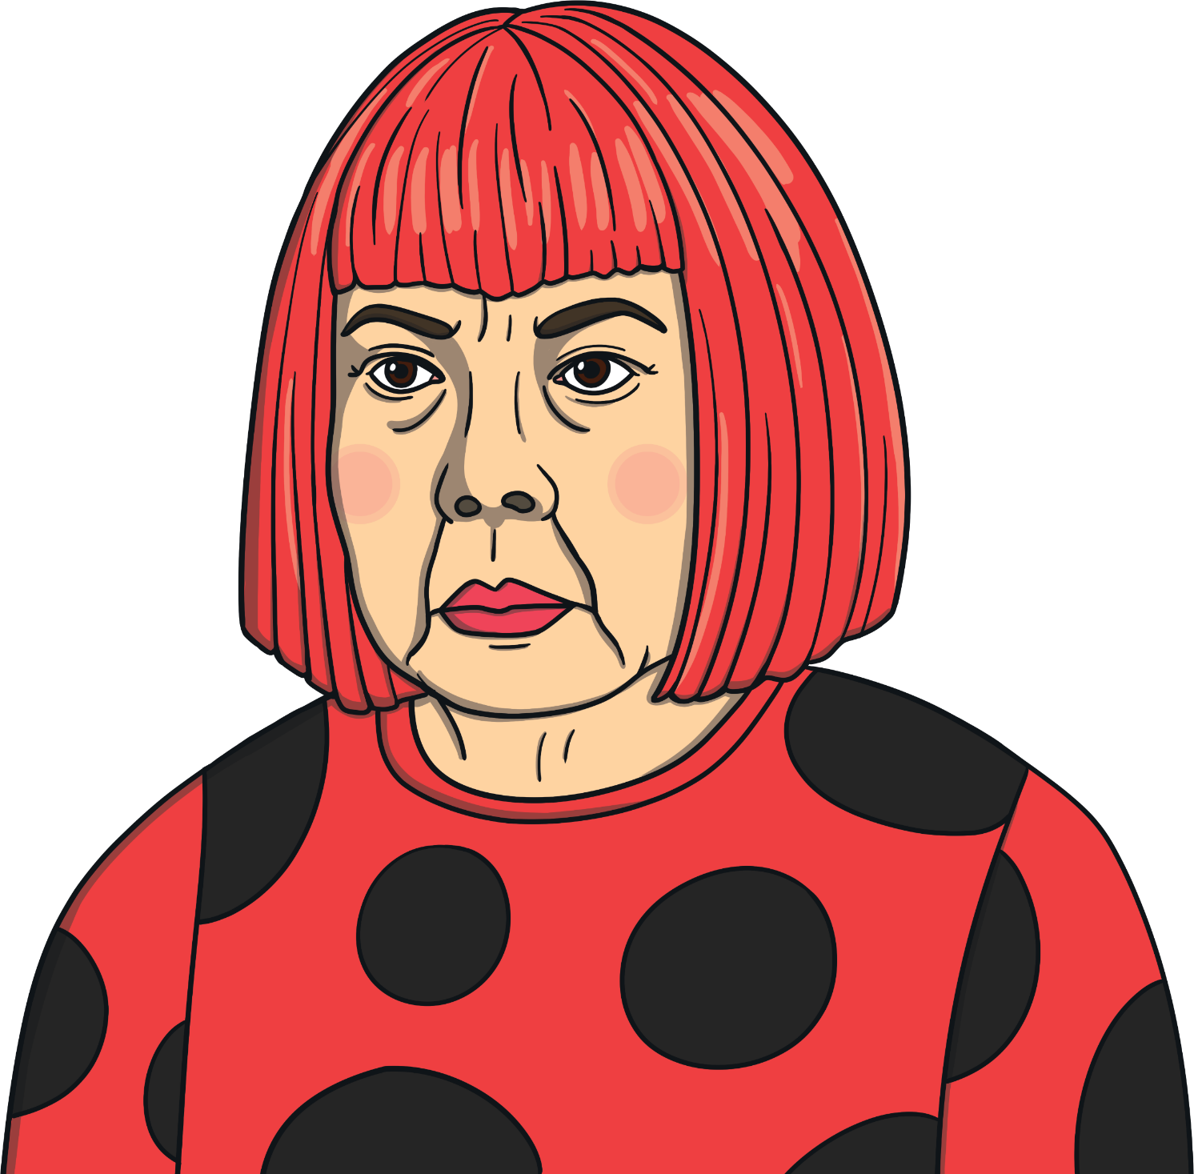
Yayoi Kusama
Yayoi Kusama was born in Japan in March 1929. She is 94 years old! She was born into a rich family.
From an early age, Yayoi was interested in art. She particularly enjoyed exploring polka dots, nature and writing poetry.
Yayoi’s family didn’t want her to become an artist. Her mother would take away her drawings and try to stop her from doing any more. This was because Yayoi’s family expected her to get married and have children, instead of getting a job.

Slide 3

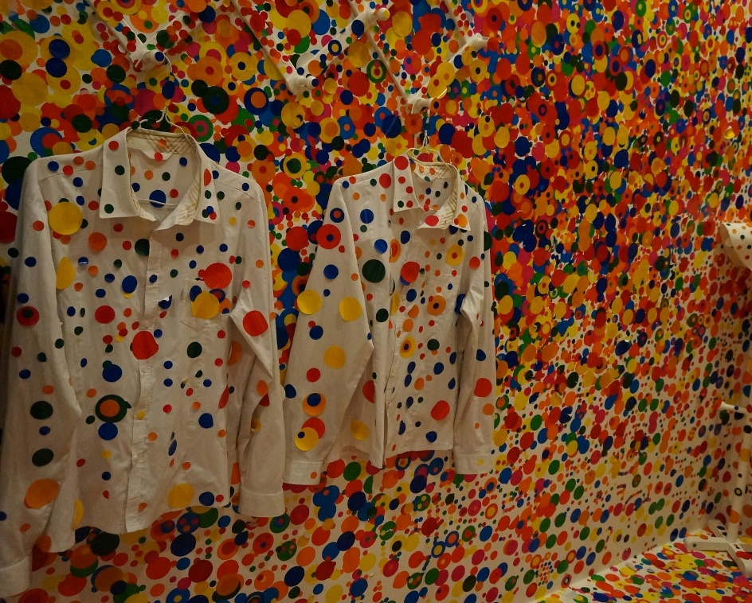
Starting to Be an Artist
Yayoi convinced her family to let her study at art college.
She began to paint polka dots on walls, floors, household objects and even her assistant! Yayoi called these series of polka dots ‘infinity nets’.
Can you see the white shirts?

Slide 4
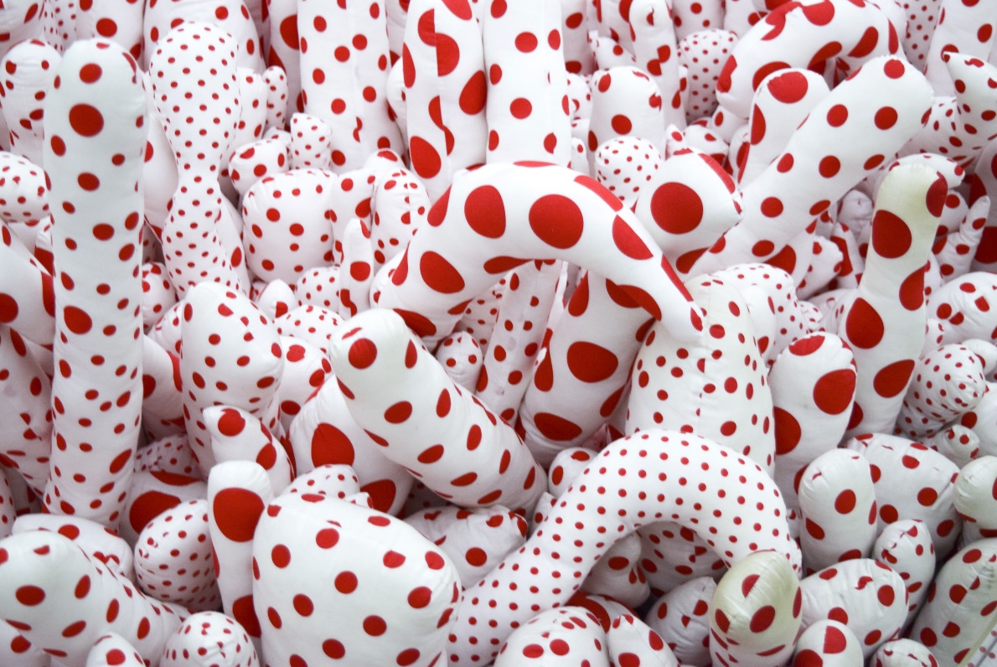
America
In America, Yayoi had her first art exhibition. An art exhibition is when an artist's work is displayed for people to come and look at. Sometimes, they may even buy the art. After her first exhibition, Yayoi began to become quite famous.

Slide 5
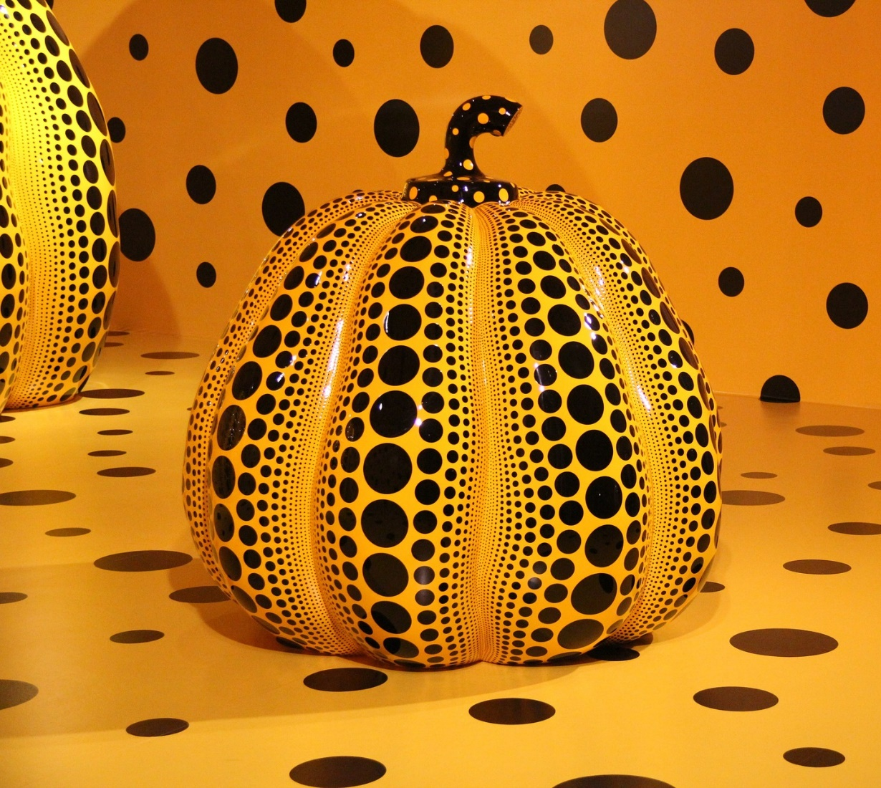
Pumpkins
When she was growing up, Yayoi’s family grew pumpkins at their plant nursery. As a child, she drew pumpkins and continued this when she was an adult.
Yayoi has made pumpkin art on paper, as sculptures and also as
infinity nets.

Slide 6
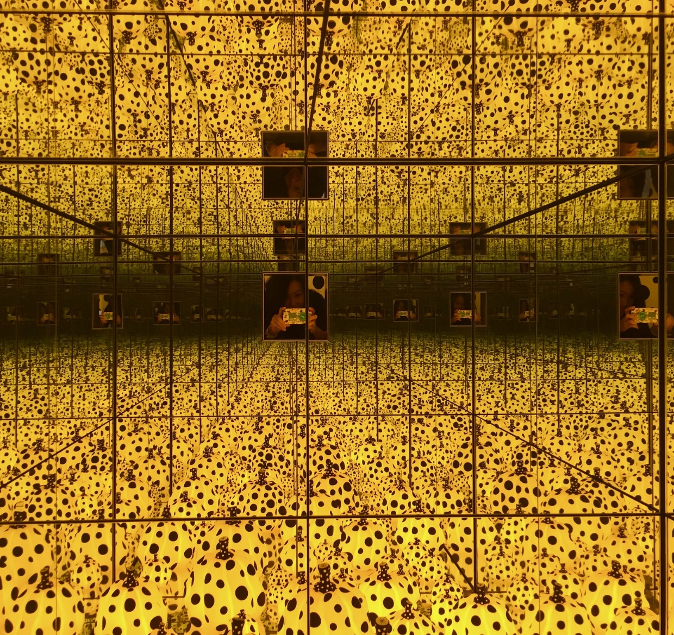
Infinity Rooms
Yayoi has created many pieces of art which she calls ‘infinity rooms’. These are rooms where the walls are lined with mirrors. She places sculptures at different heights within the rooms. People can then enter the room and stand on small platforms. The mirrors give the impression that the room never ends and the art keeps going.

Slide 7
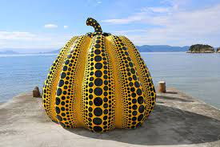

Slide 8
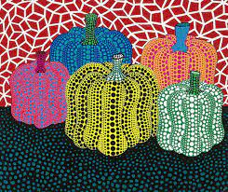

Slide 9
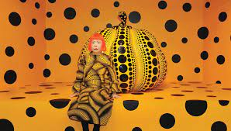

Slide 10
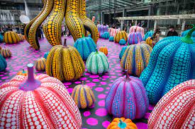

Slide 11
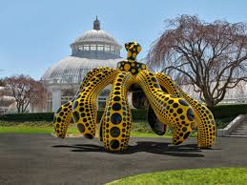

Slide 12
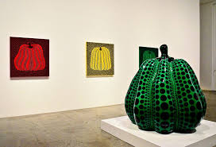

Slide 13
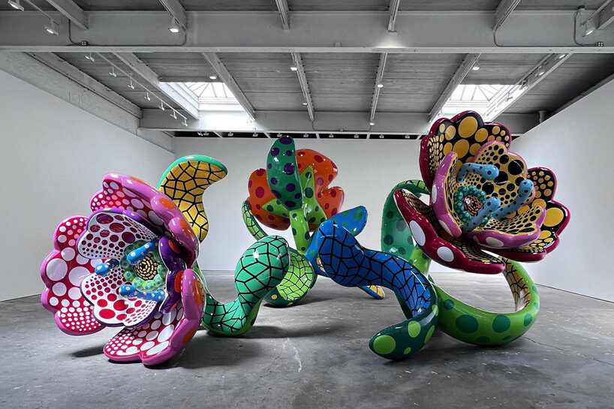

Slide 14
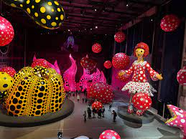

Slide 15


