Slide 1
Disclaimer/s
We hope you find the information on our website and resources useful.
Animations
This resource has been designed with animations to make it as fun and engaging as possible. To view the content in the correct formatting, please view the PowerPoint in ‘slide show mode’. This takes you from desktop to presentation mode. If you view the slides out of ‘slide show mode’, you may find that some of the text and images overlap each other and/or are difficult to read.
To enter slide show mode, go to the slide show menu tab and select either from beginning or from current slide.
You may wish to delete this slide before beginning the presentation.

Slide 2
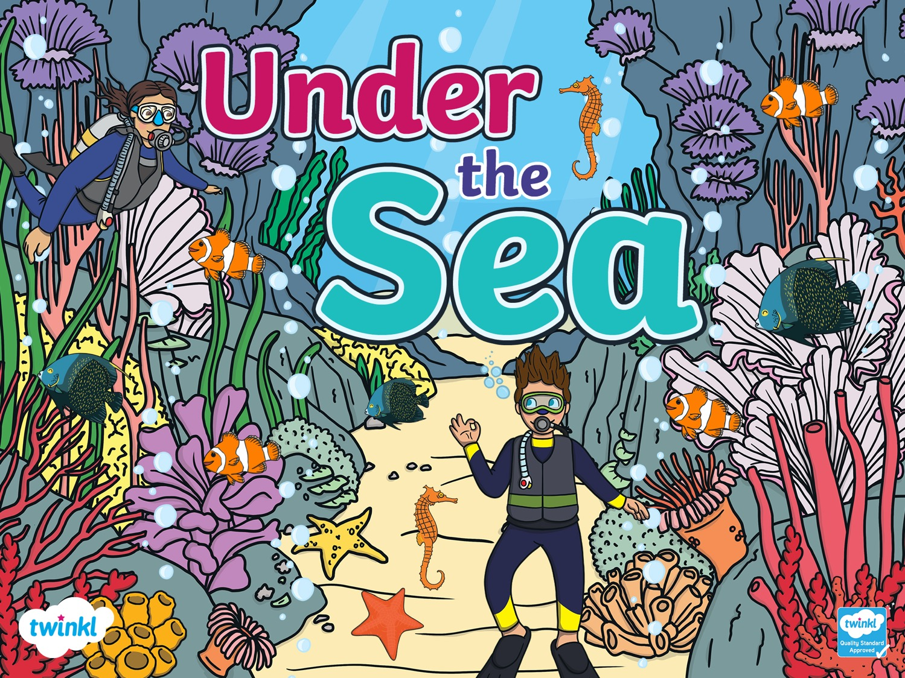

Slide 3
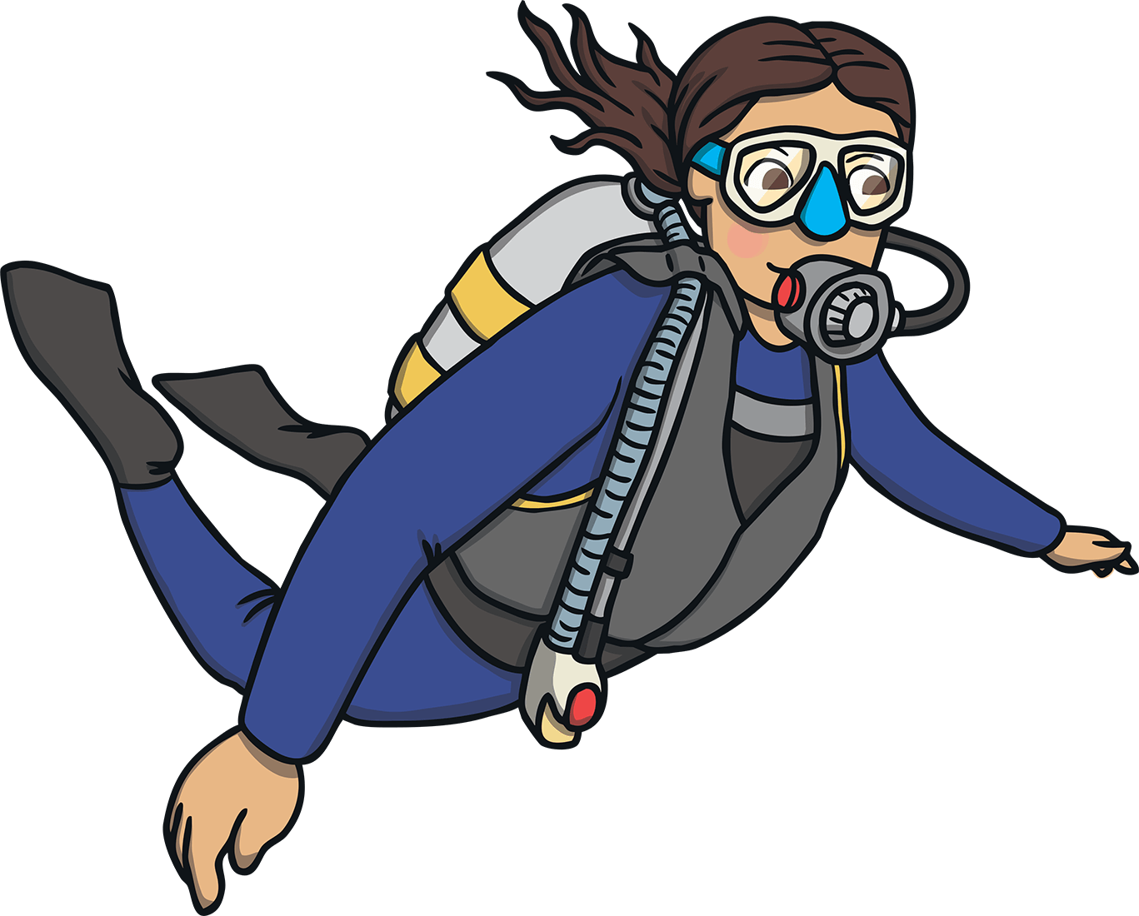
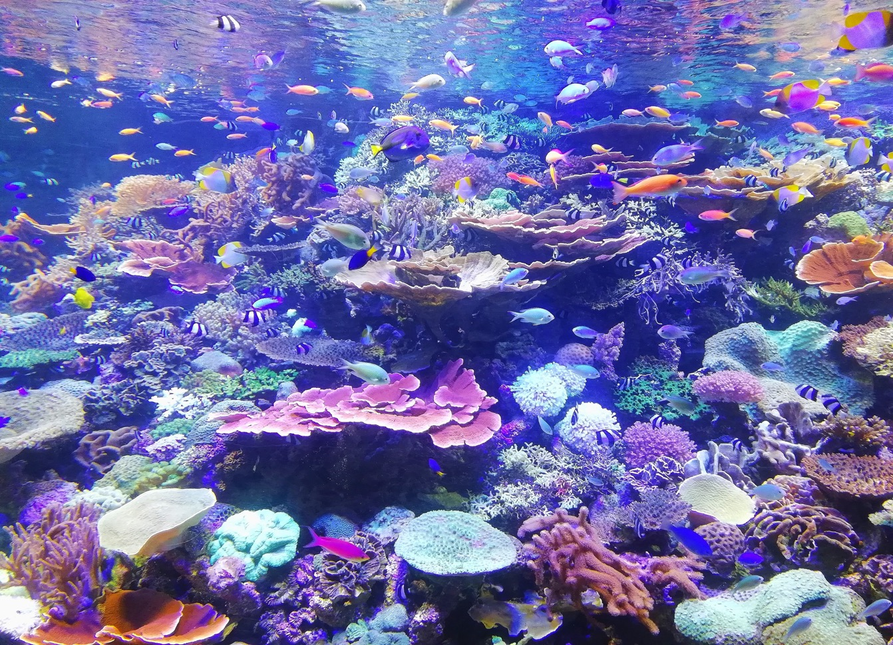
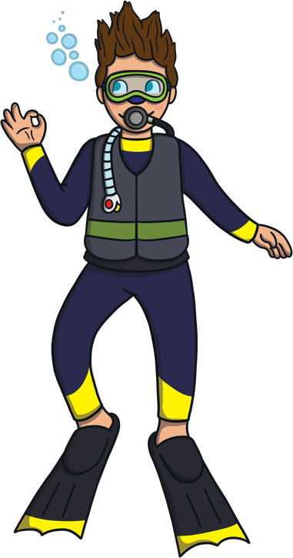
Hello everyone! My name is Dan.
I am a diver and I like going on diving adventures under the sea.
Would you like to come with me?
I wonder what we will see.

Slide 4
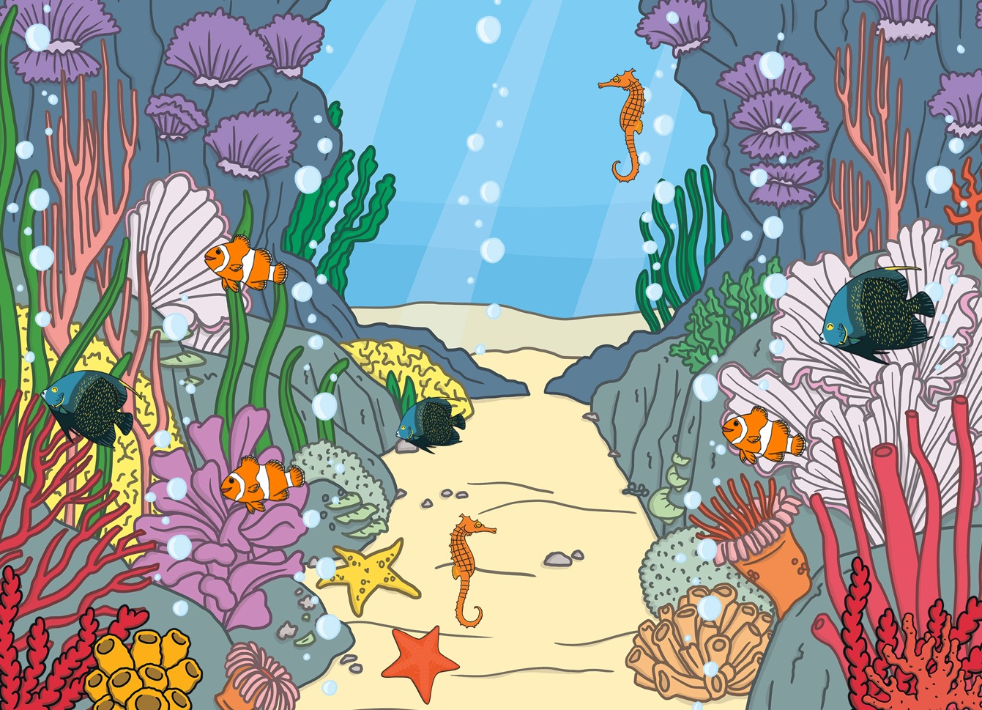
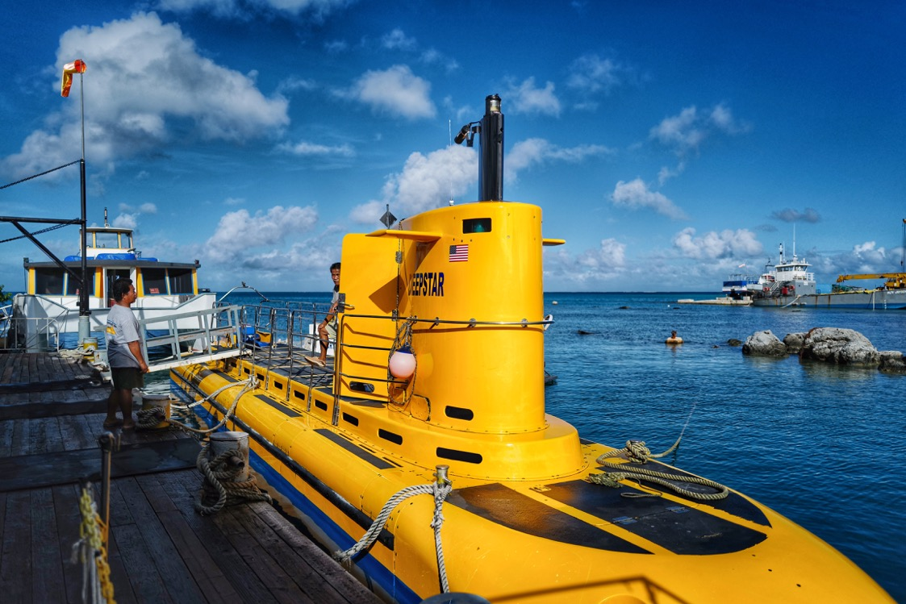
This is a submarine.
Sometimes, I go inside a submarine to travel under the water instead of diving.
A submarine often uses a propeller to travel through the water.
Lots of submarines have a long periscope on top, which helps the people inside the submarine to see things in and above the water.

Slide 5
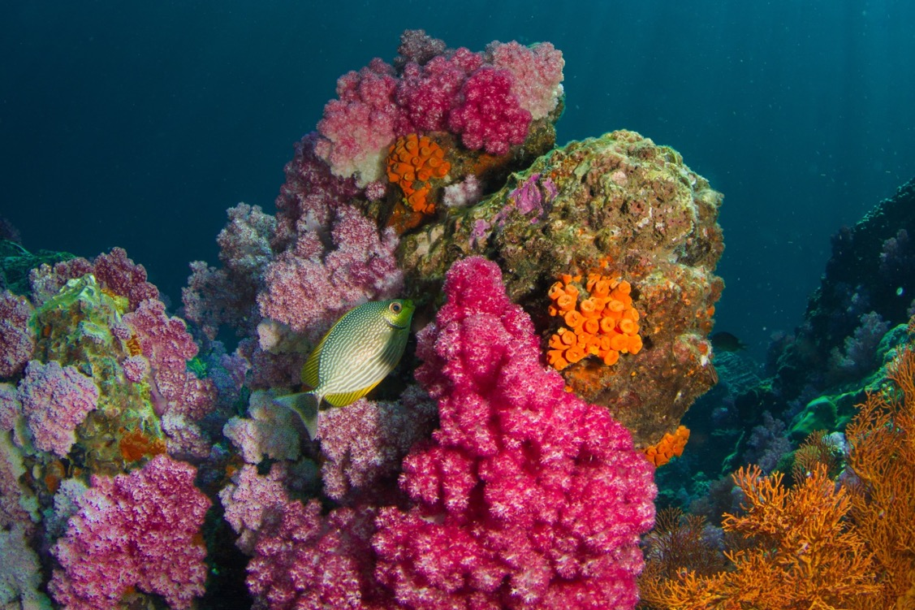

Coral looks like a plant but it is actually an animal.
Look at this colourful coral!
Lots of fish and other sea creatures make their homes in coral.
Look carefully, can you spot any fish?

Slide 6
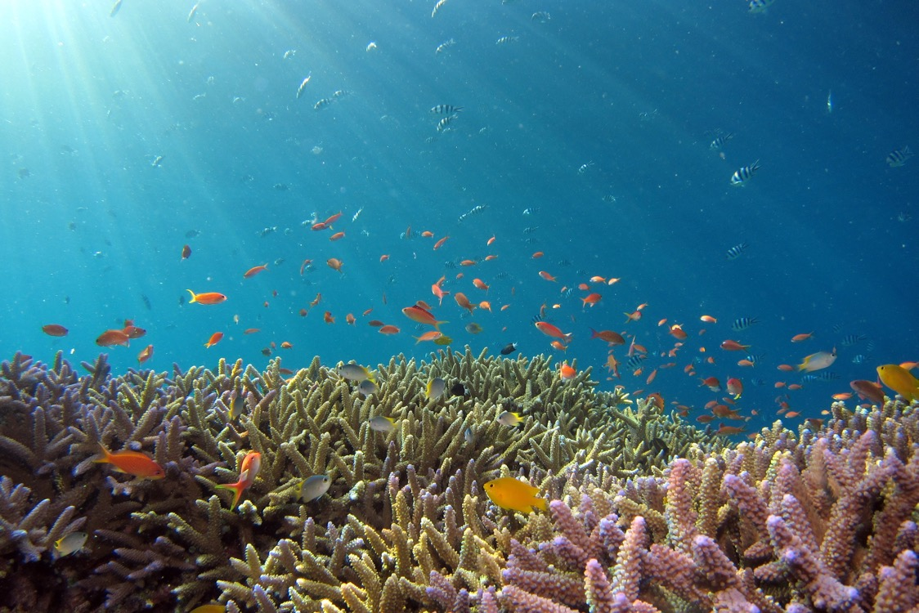
There are lots and lots of different kinds of fish that live in oceans all around the world.
Fish can breathe underwater.
They have gills which take in oxygen from the water.
These colourful fish live in warm, tropical waters - often in coral reefs.

Slide 7
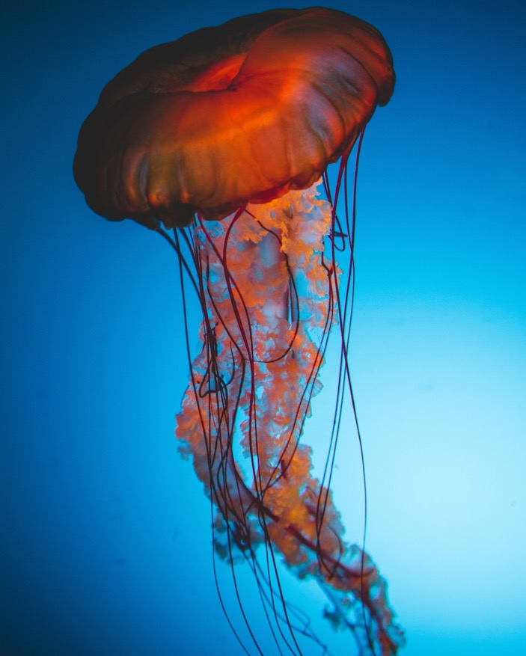
Jellyfish have umbrella or bell-shaped bodies.
This is a jellyfish.
They also have long tentacles that hang down from their bodies.

Slide 8
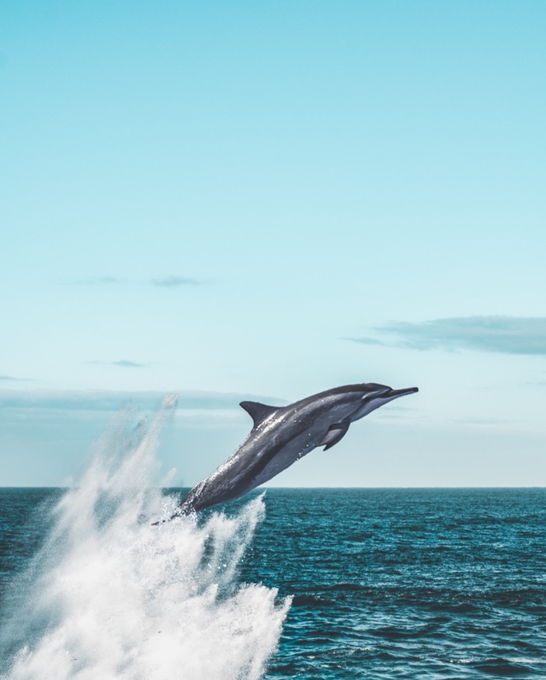
Dolphins talk to their friends using clicks, whistles and squeaks.
Oh look, a dolphin!
Dolphins have a curved fin on their backs and long noses.
You might see a dolphin diving in and out of the water.

Slide 9
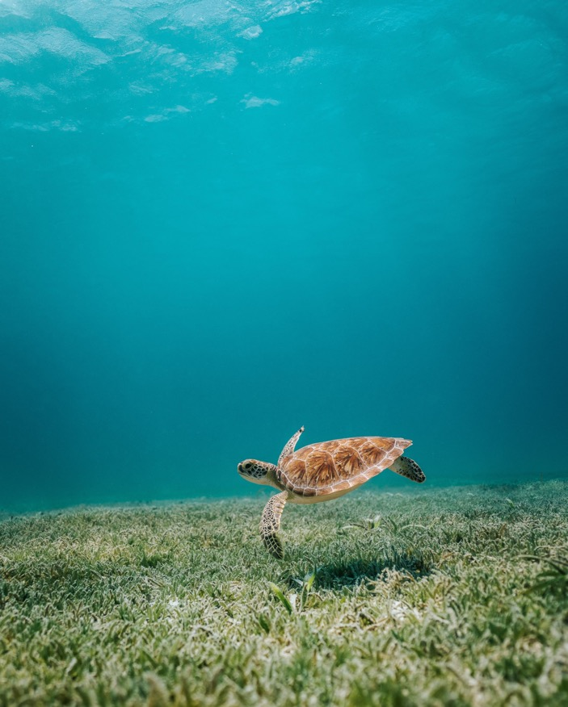
Shhh! Look what I’ve spotted – it’s a turtle.
Turtles have hard shells.
They have flippers which they use to swim through the water.

Slide 10
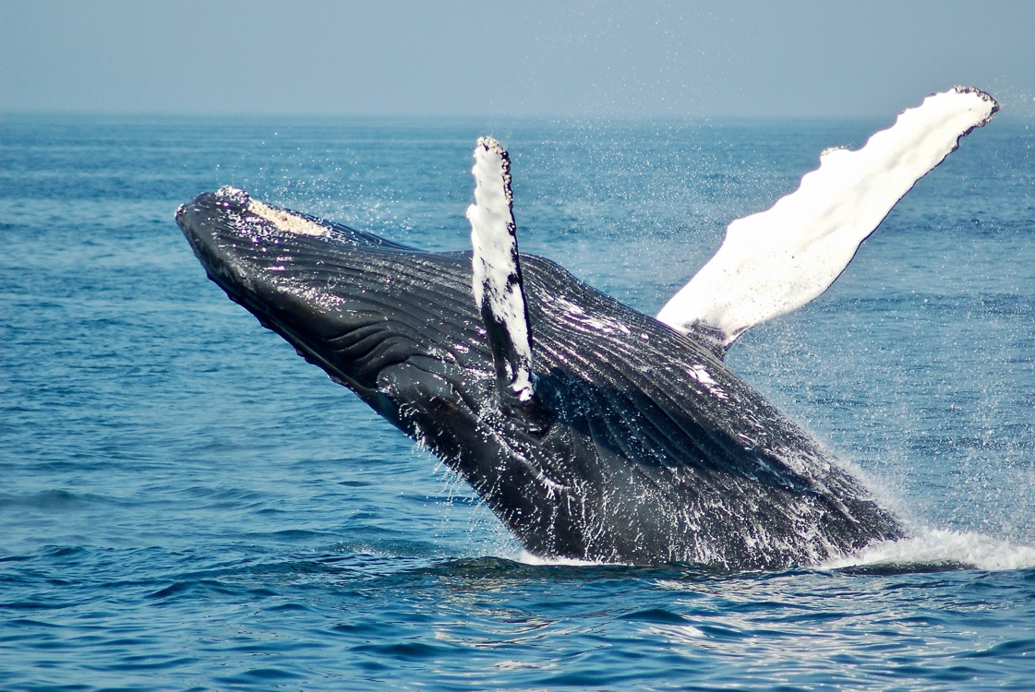
Wow! Look, it’s a whale!
There are lots of different types of whales. This one is a blue whale. They are the largest animals on Earth.

Slide 11
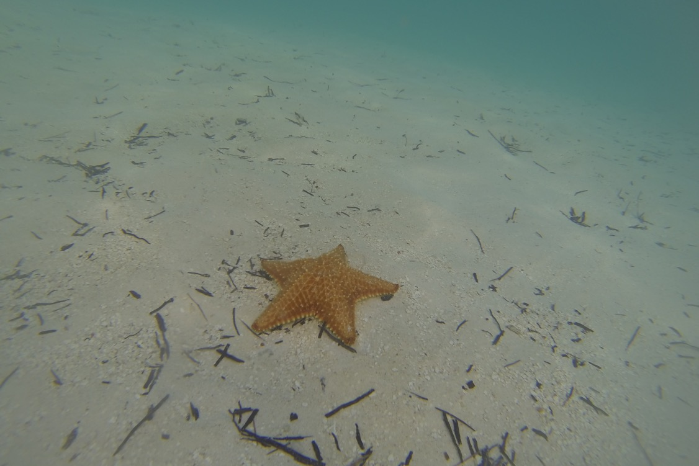
Starfish usually have five arms but some types have lots of arms.
This is a starfish.
They are sometimes called sea stars.

Slide 12
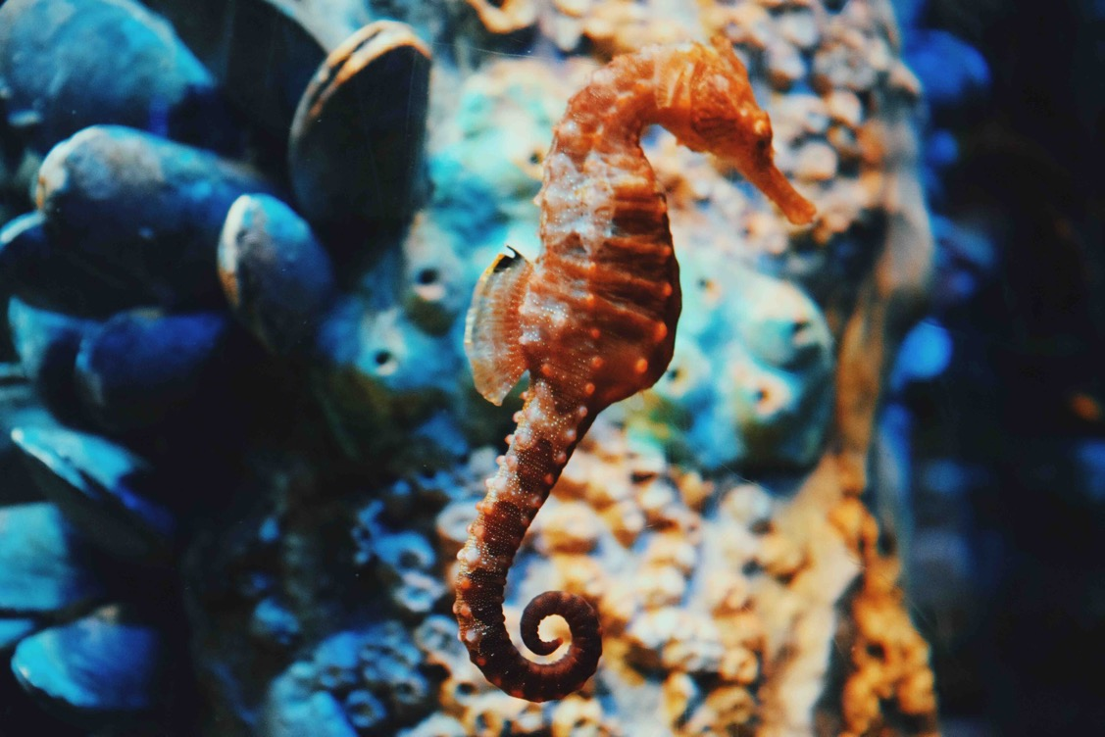
Here’s a seahorse.
Seahorses can change colour to blend in with their surroundings. This is called camouflage.
Seahorses are a type of fish.
They have long bodies and a curled tail.

Slide 13
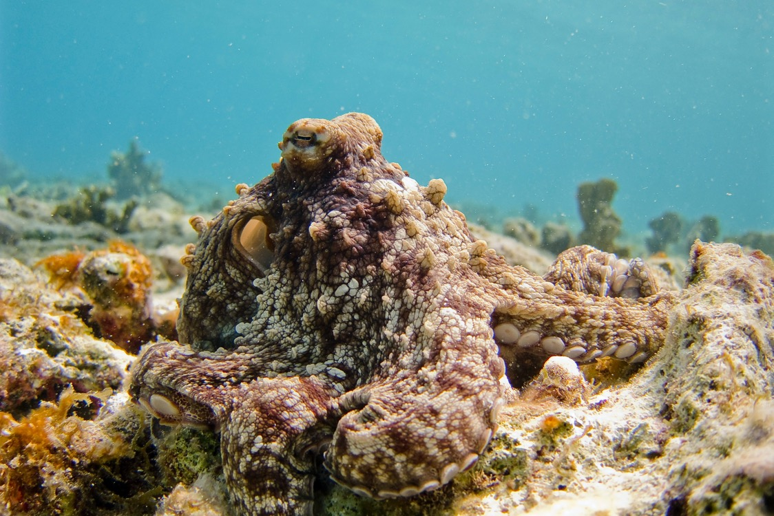
Octopuses have eight long tentacles. They have strong suction cups on each tentacle.
Another sea creature that can change colour is an octopus.
Look carefully, can you see an octopus in this photo?

Slide 14
Wow! We saw a lot of sea creatures on our under the sea adventure.
Which one was your favourite?

