Slide 2
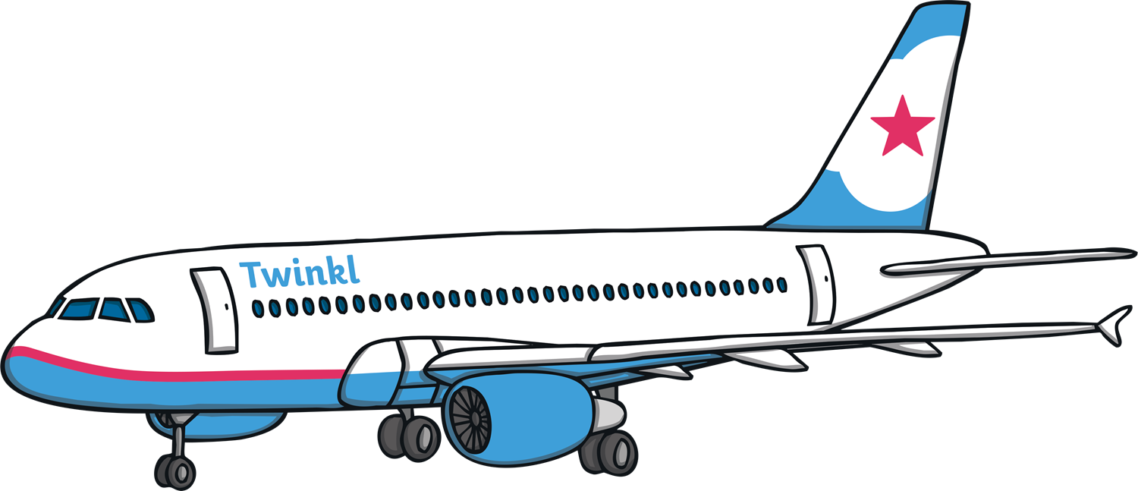
An airport is a place where people go when they want to travel on a plane.
Discuss It!
Have you ever travelled on a plane? Where did you go?

Slide 3
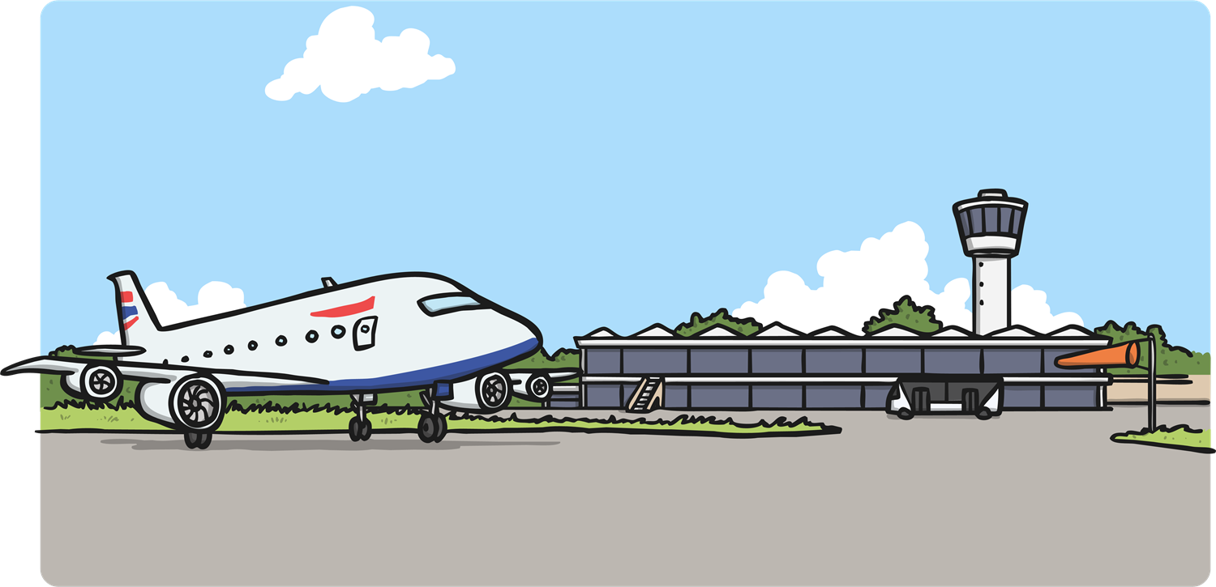
There is a lot to see in an airport!
Let’s take a look inside.

Slide 4
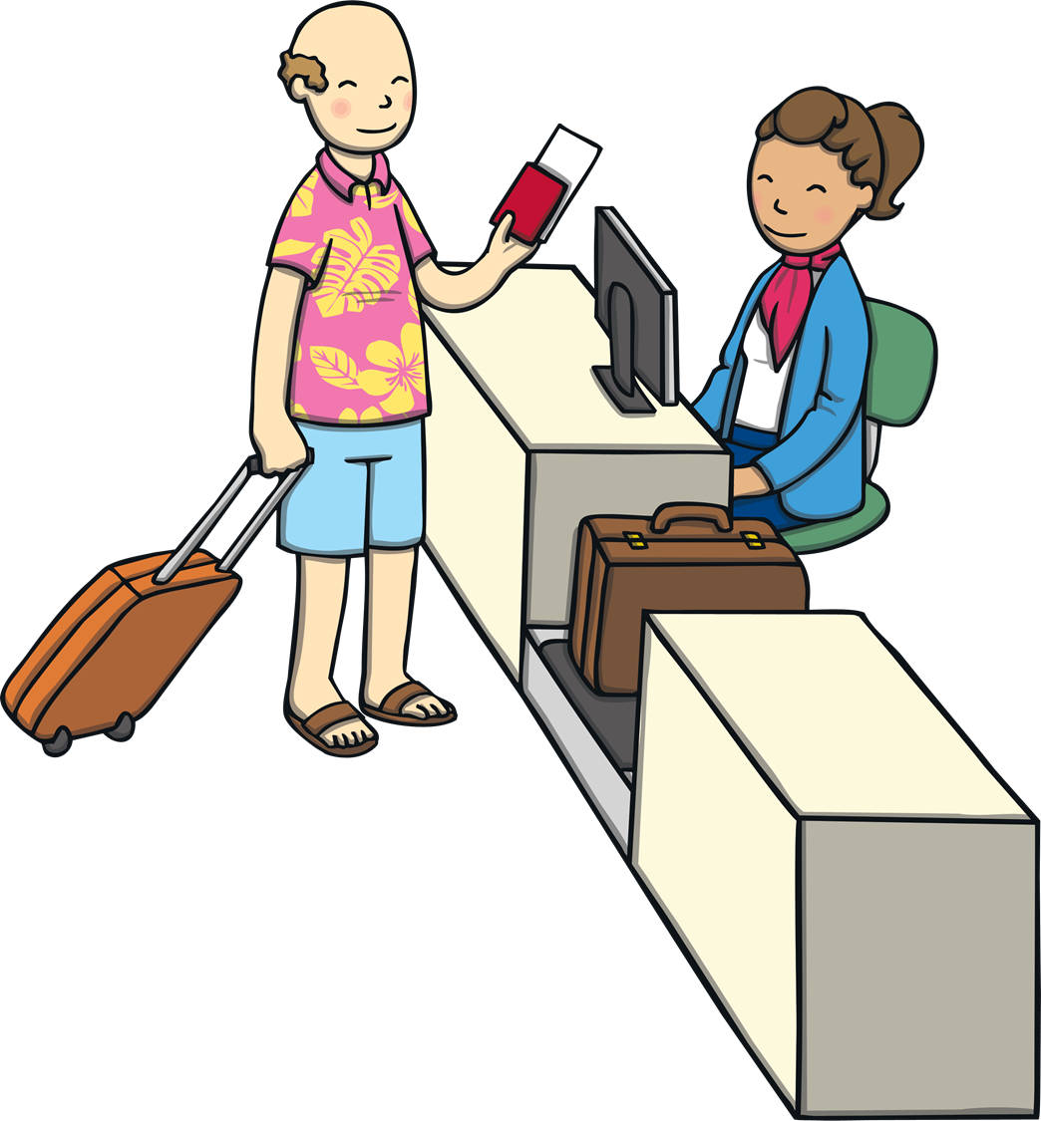
First, we’ll go to the check-in desk to tell them that we are ready for our plane.

Slide 5

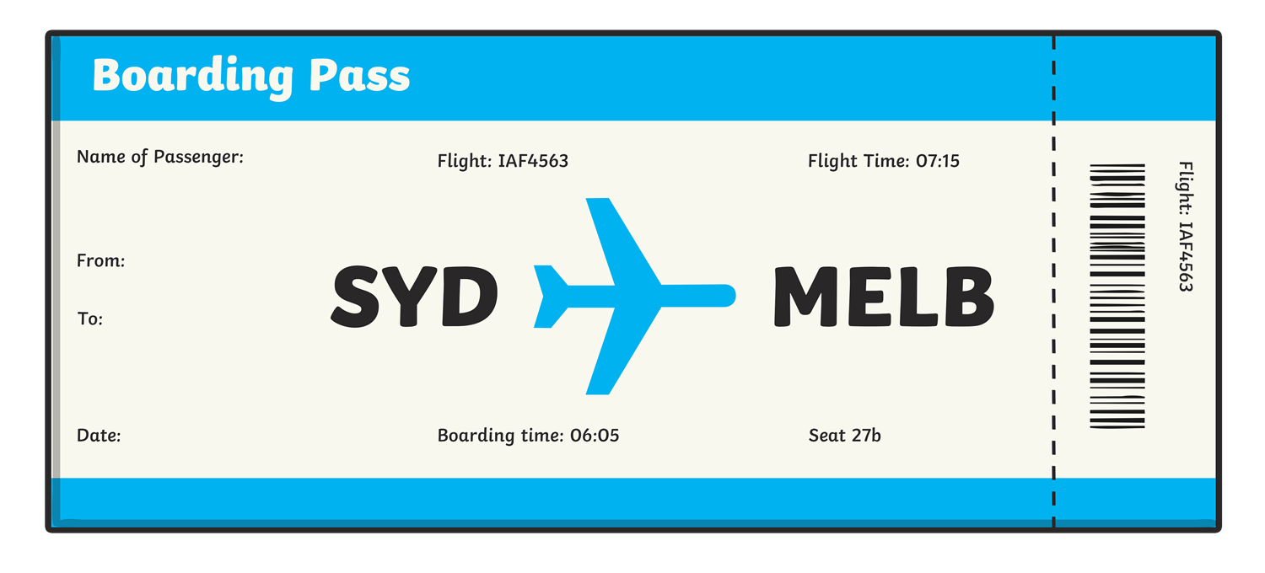
We need to show our passport and ticket or boarding pass to show that we are allowed to get on the plane.

Slide 6
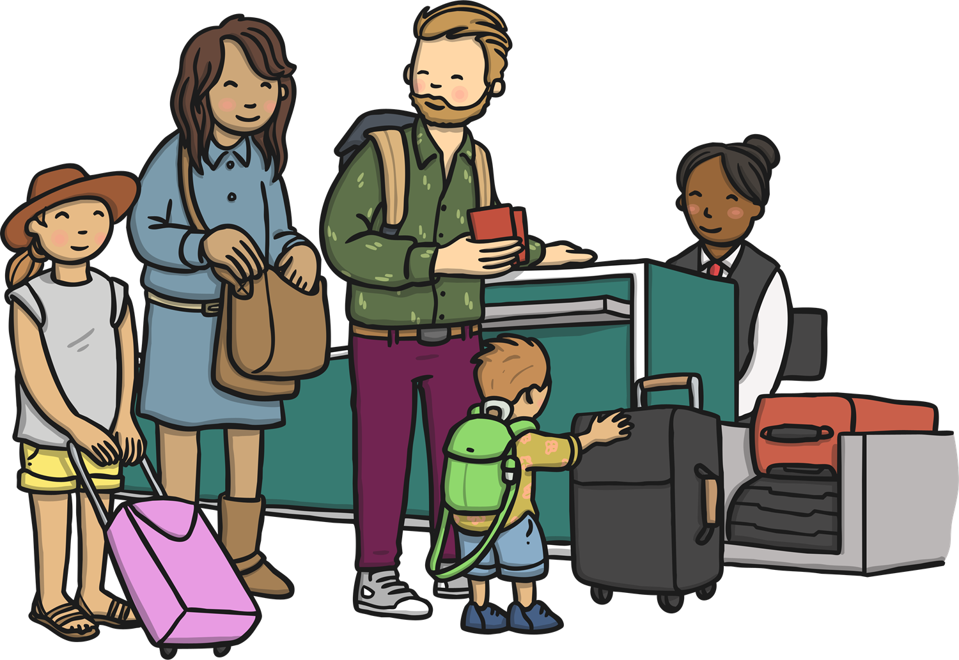
We hand in our luggage at the check in desk so that it can be put on the plane.

Slide 7
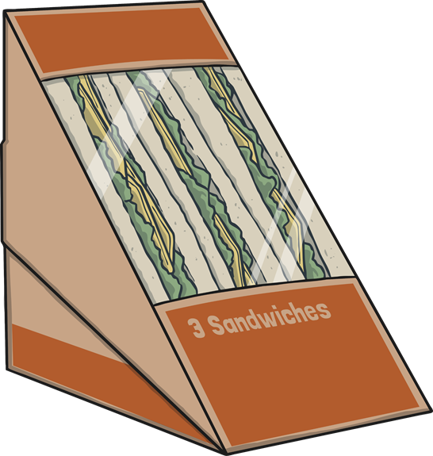

Now we have to wait for our plane.
What shall we do?
There are lots of cafes at the airport.
Would you like a drink or a snack?

Slide 8



There are lots of shops at the airport.
Do you need to buy anything?

Slide 9
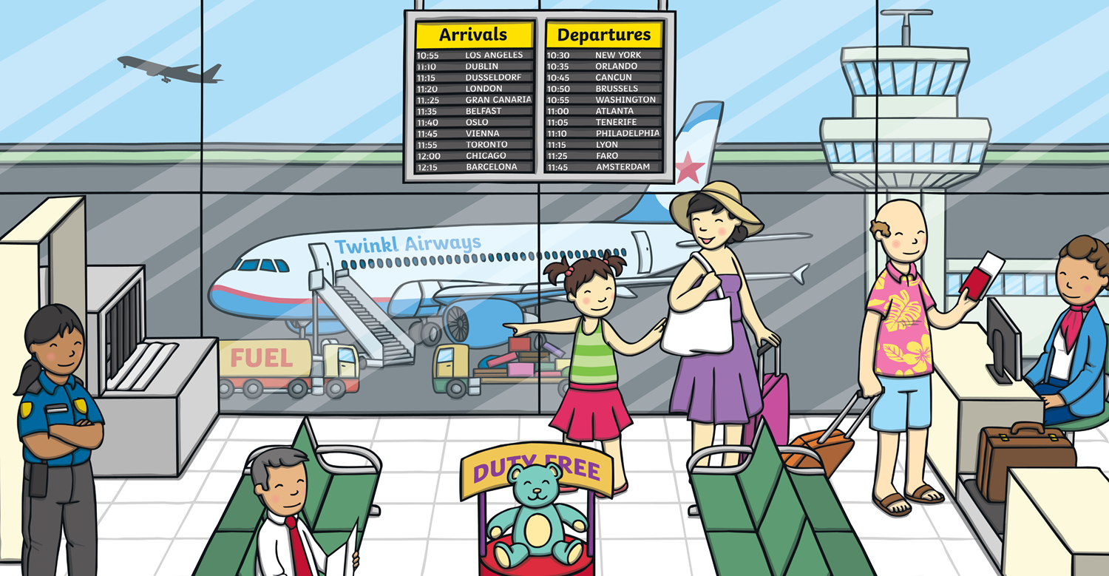
It’s nearly time to get on the plane.
Let’s wait at the boarding gate. We can watch the planes through the window.

Slide 10

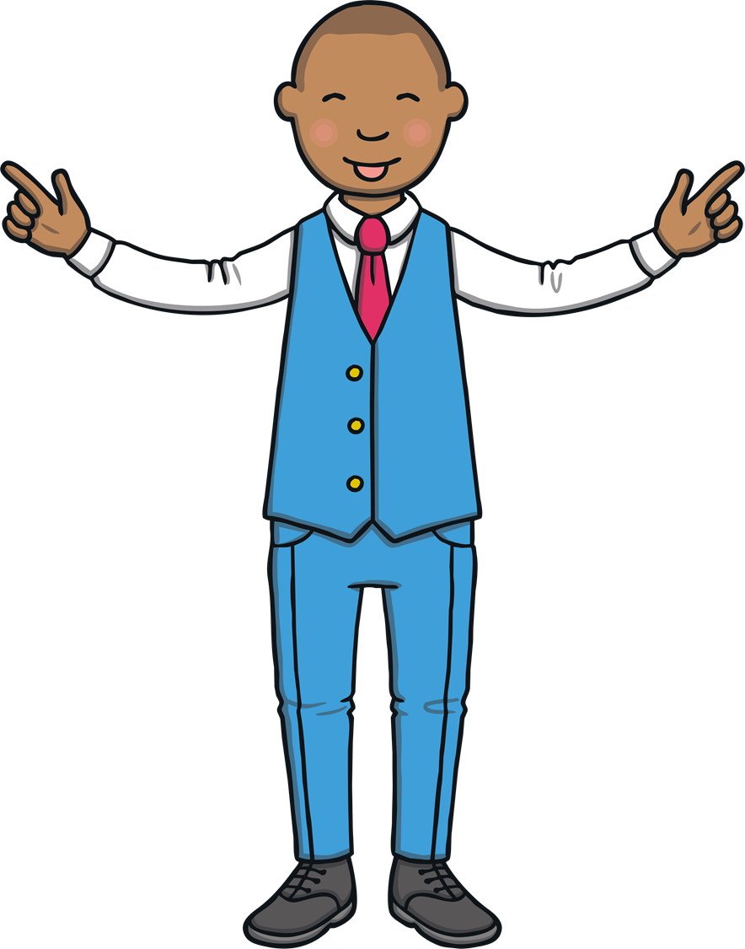
Hooray! Our plane is ready to board.
The flight attendant will show us where to sit.

Slide 11
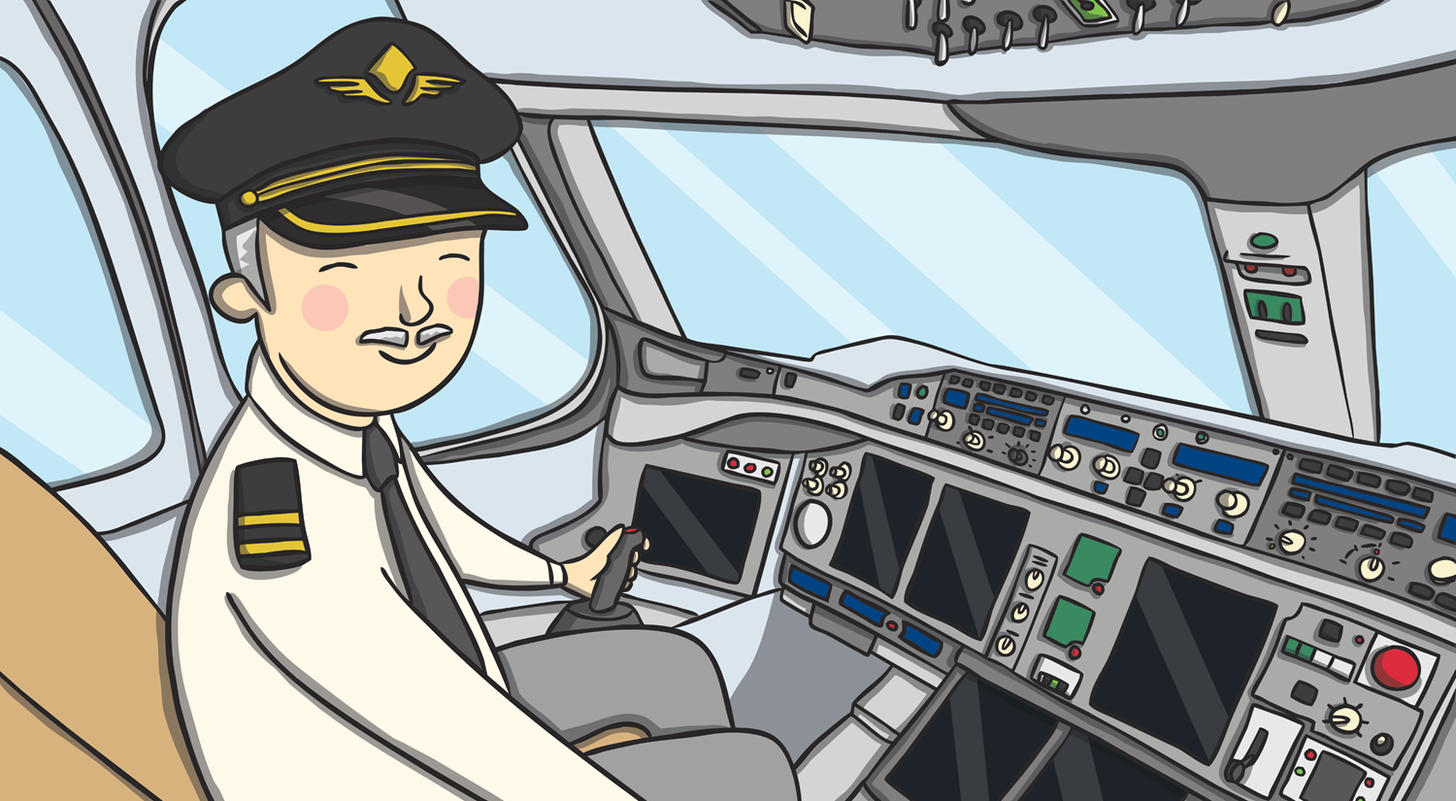
Shall we say hello to the pilot?
He is ready to fly the plane.

Slide 12
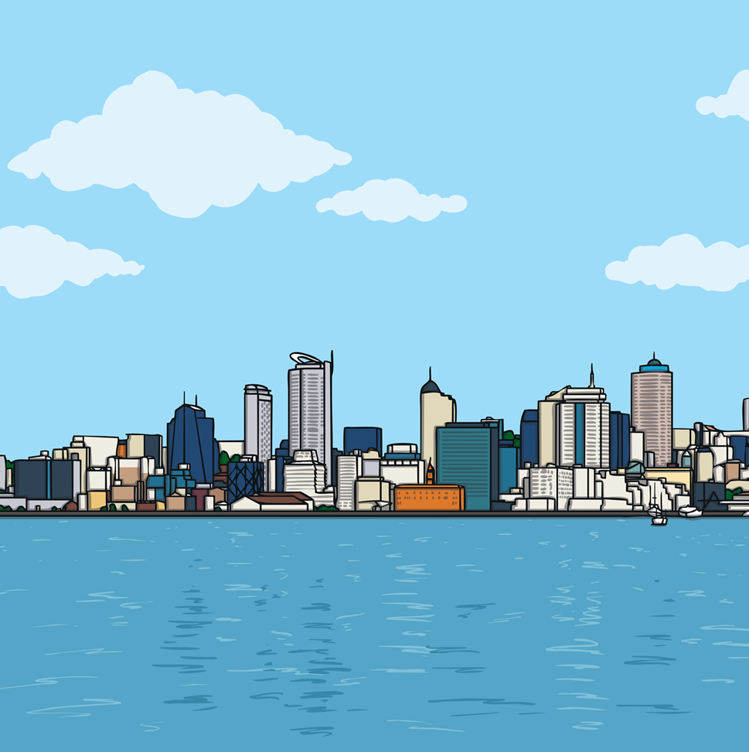


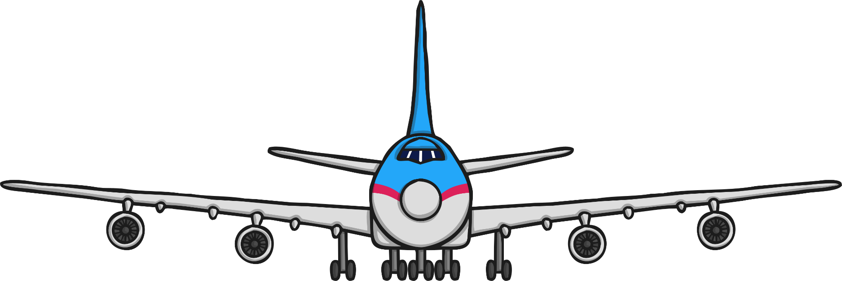
Where do you think we’ll go today?

Slide 13
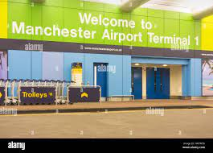
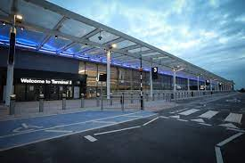
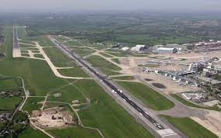
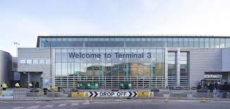
Manchester Airport

Slide 14
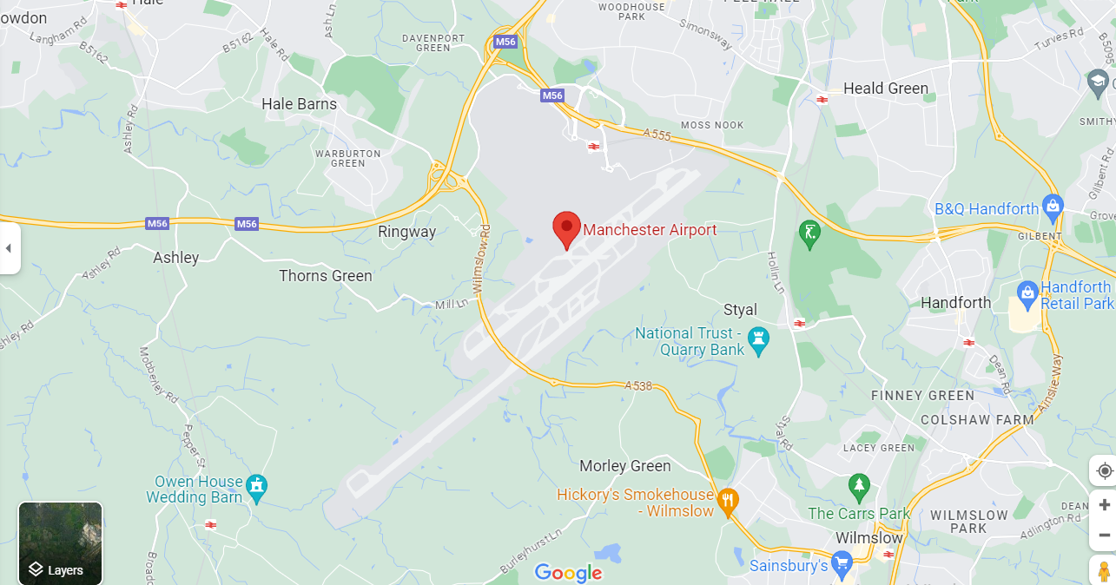

Slide 15
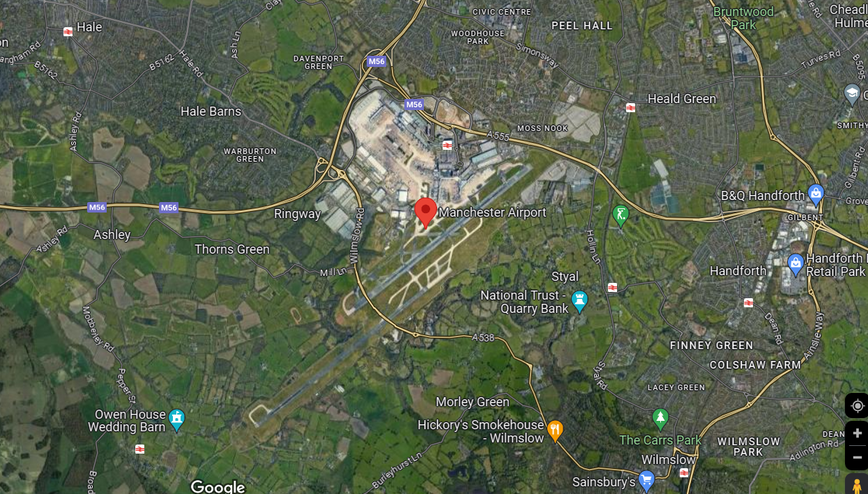

Slide 16
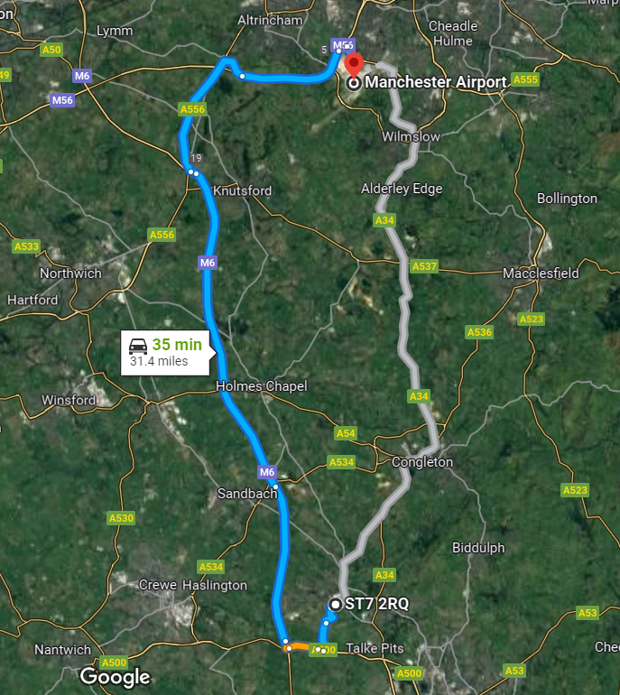
Our journey

Slide 17
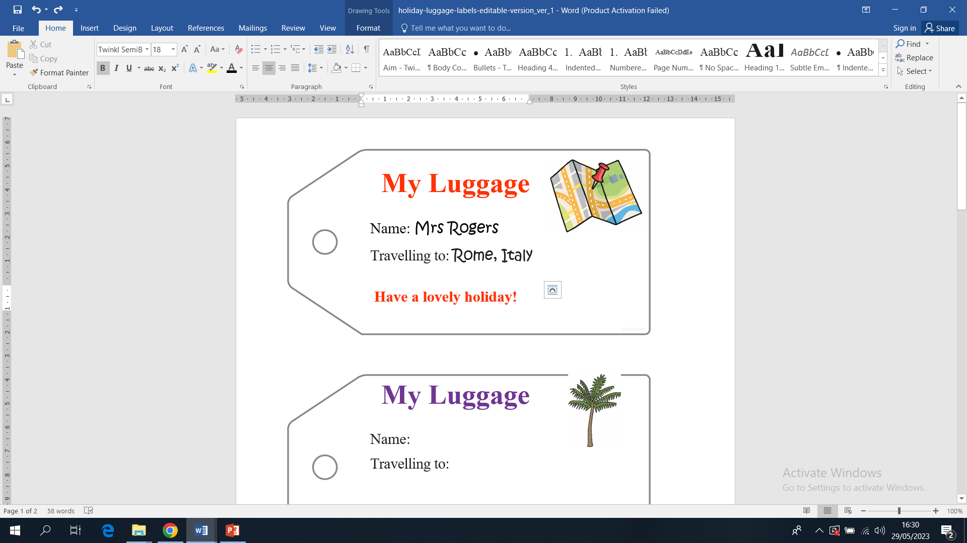
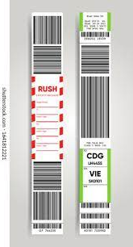
Where would you visit?

Slide 18
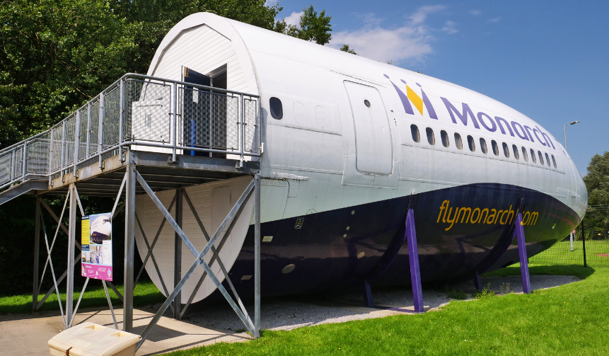
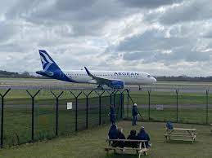
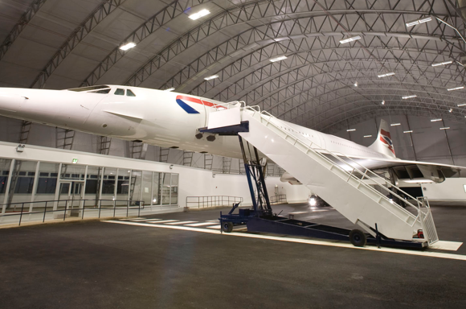
Runway Visitor Park

Slide 19
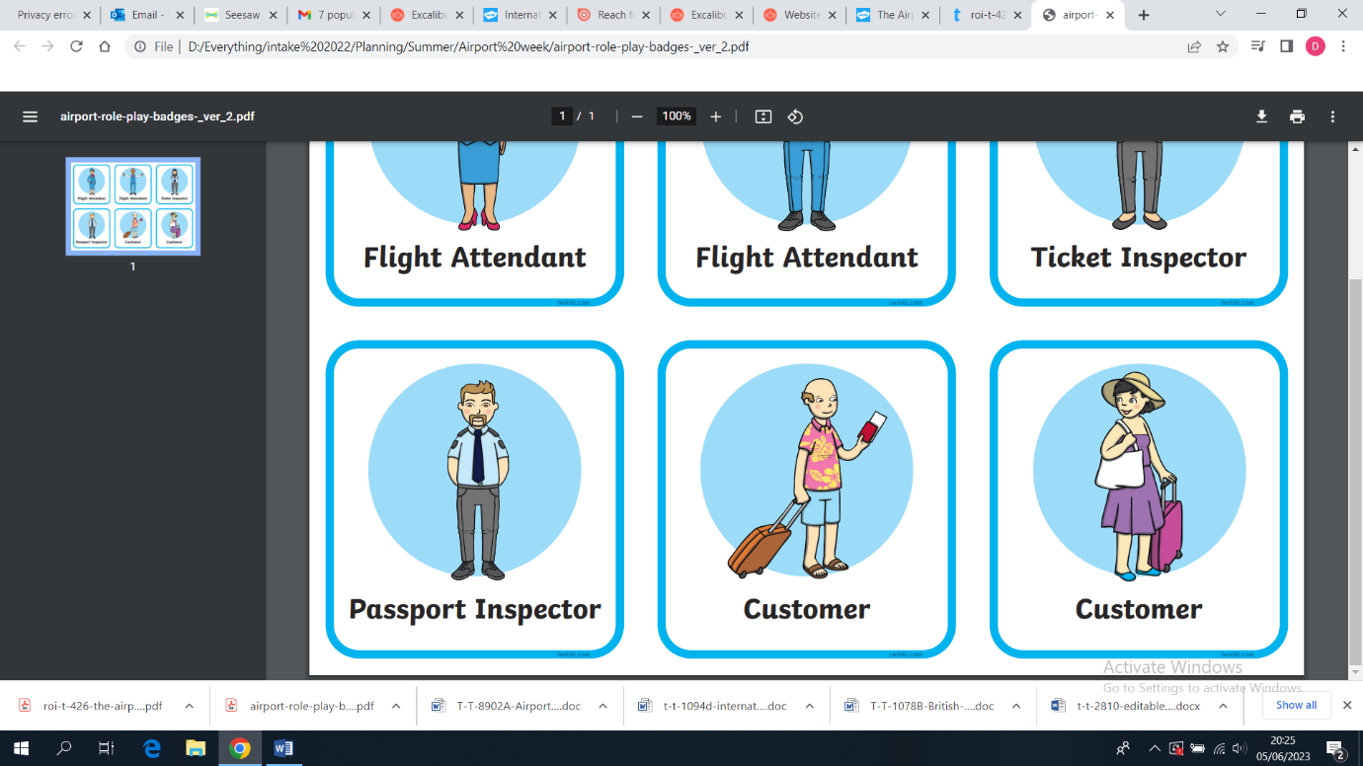
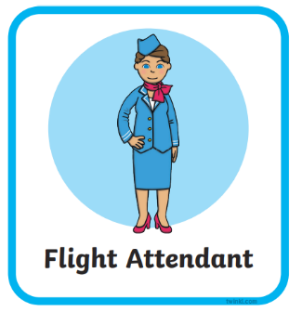
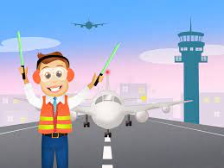
air traffic controller

