Slide 1
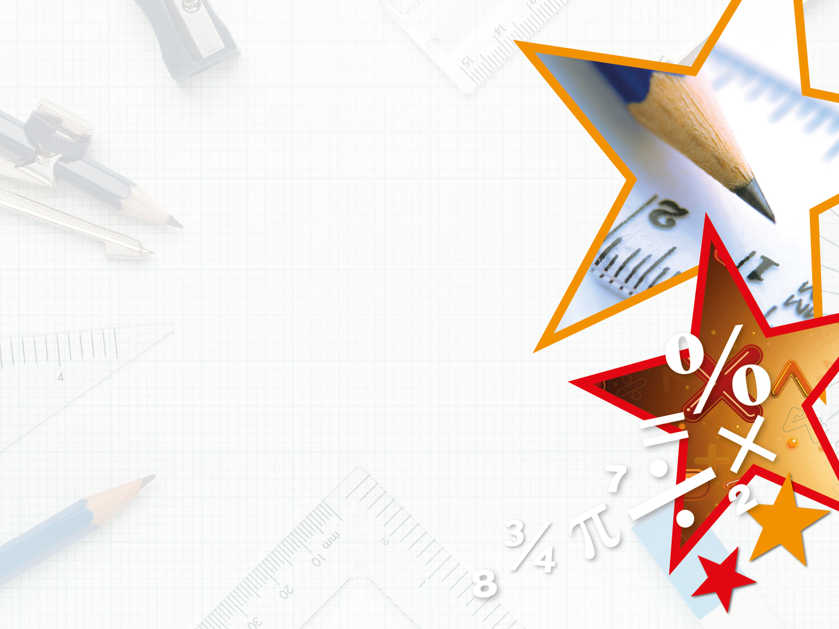


LIFE/work balance
We have started a #LIFEworkbalance campaign and we need your help to complete our LIFE/work balance survey.
We hope to publish the results soon, so please give 15 minutes of your time to help us get a true picture of school life.
Want to be a part of this campaign? Take the survey on our website and share it with your colleagues!
© Classroom Secrets Limited 2018

Slide 2
Year 3 – Summer Block 3 – Properties of Shape – Recognise and Describe 2D Shapes
About This Resource:
This PowerPoint has been designed to support your teaching of this small step. It includes a starter activity and an example of each question from the Varied Fluency and Reasoning and Problem Solving resources also provided in this pack. You can choose to work through all examples provided or a selection of them depending on the needs of your class.
National Curriculum Objectives:
Mathematics Year 3: (3G3a) Draw 2-D shapes
Mathematics Year 3: (3G4a) Recognise angles as a property of shape or a description of a turn
Mathematics Year 3: (3G4b) Identify right angles, recognise that two right angles make a half-turn, three make three quarters of a turn and four a complete turn; identify whether angles are greater than or less than a right angle
Mathematics Year 3: (3G2) Identify horizontal and vertical lines and pairs of perpendicular and parallel lines
More Year 3 Properties of Shapes resources.
Did you like this resource? Don’t forget to review it on our website.
© Classroom Secrets Limited 2018

Slide 3
Year 3 – Summer Block 3 – Properties of Shape
Step 7: Recognise and Describe 2D Shapes
© Classroom Secrets Limited 2018

Slide 4
Introduction
Circle the descriptions which match the shape below.
Equal sides
Fewer than 4 sides
2 pairs of parallel lines
More than 4 sides
All obtuse angles
perpendicular lines
© Classroom Secrets Limited 2018

Slide 5
Introduction
Circle the descriptions which match the shape below.
Equal sides
Fewer than 4 sides
2 pairs of parallel lines
More than 4 sides
All obtuse angles
perpendicular lines
© Classroom Secrets Limited 2018

Slide 6
Varied Fluency 1
Label the shapes.
__________ | __________ | __________
© Classroom Secrets Limited 2018

Slide 7
Varied Fluency 1
Label the shapes.
__________ | __________ | __________
hexagon
rhombus
right-angle triangle
© Classroom Secrets Limited 2018

Slide 8
Varied Fluency 2
Draw the shapes below in your book. Use a ruler.
A quadrilateral with at least 1 acute angle.
A triangle with 1 set of perpendicular lines.
© Classroom Secrets Limited 2018

Slide 9
Varied Fluency 2
Draw the shapes below in your book. Use a ruler.
A quadrilateral with at least 1 acute angle.
Various possible answers, for example:
A triangle with 1 set of perpendicular lines.
Various possible answers, for example:
© Classroom Secrets Limited 2018

Slide 10
Varied Fluency 3
Circle one shape which matches the description below.
Fewer sides than a pentagon.
1 line of symmetry.
No acute angles.
© Classroom Secrets Limited 2018

Slide 11
Varied Fluency 3
Circle one shape which matches the description below.
Fewer sides than a pentagon.
1 line of symmetry.
No acute angles.
© Classroom Secrets Limited 2018

Slide 12
Varied Fluency 4
I have no parallel lines.
I have more than 4 sides.
I have less 5 lines of symmetry.
I am a _____________ .
Now draw me in your book.
© Classroom Secrets Limited 2018

Slide 13
Varied Fluency 4
I have no parallel lines.
I have more than 4 sides.
I have less 5 lines of symmetry.
I am a pentagon.
Now draw me in your book.
© Classroom Secrets Limited 2018

Slide 14
Problem Solving 1
Draw a shape which could represent
each letter in the Venn diagram.
Fewer than
4 sides
At least 1
obtuse angle
C
A
B
D
© Classroom Secrets Limited 2018

Slide 15
Problem Solving 1
Draw a shape which could represent
each letter in the Venn diagram.
Various possible answers, for example:
Fewer than
4 sides
At least 1
obtuse angle
C
A
B
D
© Classroom Secrets Limited 2018

Slide 16
Reasoning 1
Always, sometimes, never?
Quadrilaterals do not have acute angles.
Explain your answer and draw shapes to prove it.
Remember to use a ruler.
© Classroom Secrets Limited 2018

Slide 17
Reasoning 1
Always, sometimes, never?
Quadrilaterals do not have acute angles.
Explain your answer and draw shapes to prove it.
Remember to use a ruler.
Sometimes because…
© Classroom Secrets Limited 2018

Slide 18
Reasoning 1
Always, sometimes, never?
Quadrilaterals do not have acute angles.
Explain your answer and draw shapes to prove it.
Remember to use a ruler.
Sometimes because some quadrilaterals have acute angles such as trapeziums or parallelograms. However some quadrilaterals do not have acute angles such as squares and rectangles.
© Classroom Secrets Limited 2018

Slide 19
Reasoning 2
Explain what is similar about these shapes.
© Classroom Secrets Limited 2018

Slide 20
Reasoning 2
Explain what is similar about these shapes.
Each shape is made up of one type of…
© Classroom Secrets Limited 2018

Slide 21
Reasoning 2
Explain what is similar about these shapes.
Each shape is made up of one type of angle. The pentagon has all obtuse angles, the triangle has all acute angles and the square has all right angles.
© Classroom Secrets Limited 2018

