Slide 1

Year 4 – Spring Block 3 – Noun Phrases – Using Expanded Noun Phrases
About This Resource:
This PowerPoint has been designed to support your teaching of this small step. It includes a starter activity and an example of each question from the Varied Fluency and Application and Reasoning resources also provided in this pack. You can choose to work through all examples provided or a selection of them depending on the needs of your class.
National Curriculum Objectives:
English Year 4: (4G3.2) Noun phrases expanded by the addition of modifying adjectives, nouns and preposition phrases (e.g. the teacher expanded to: the strict maths teacher with curly hair)​
More resources from our Grammar, Punctuation and Spelling scheme of work.
Did you like this resource? Don’t forget to review it on our website.
© Classroom Secrets Limited 2019

Slide 2
Year 4 – Spring Block 3 – Noun Phrases – Using Expanded Noun Phrases
Notes and Guidance:
In the previous steps, children have been introduced to different ways of creating an expanded noun phrase.
In this step, children will use expanded noun phrases in a variety of ways, using their prior learning.
Focused Questions
Add an expanded noun phrase to this sentence which contains a preposition phrase.
Change this expanded noun phrase to include a modifying adjective.
© Classroom Secrets Limited 2019

Slide 3
Year 4 – Spring Block 3 – Noun Phrases
Step 5: Using Expanded Noun Phrases
© Classroom Secrets Limited 2019

Slide 4
Introduction
Label the features of the expanded noun phrase.
I stand under the old oak tree at the end of the garden
because it provides lots of shade.
A – Adjective D – Determiner
P – Prepositional Phrase N – Modifying Noun
© Classroom Secrets Limited 2019

Slide 5
Introduction
Label the features of the expanded noun phrase.
I stand under the old oak tree at the end of the garden
because it provides lots of shade.
A – Adjective D – Determiner
P – Prepositional Phrase N – Modifying Noun
P
D
A
N
© Classroom Secrets Limited 2019

Slide 6
Varied Fluency 1
Underline the expanded noun phrase in the sentence below.
The new shop near the bridge opens next Monday.
© Classroom Secrets Limited 2019

Slide 7
Varied Fluency 1
Underline the expanded noun phrase in the sentence below.
The new shop near the bridge opens next Monday.
© Classroom Secrets Limited 2019

Slide 8
Varied Fluency 2
Tick the features that have been used in the underlined expanded noun phrase.
The big toy box under my bed is full of toys.
determiner
adjective
modifying noun
prepositional phrase
© Classroom Secrets Limited 2019

Slide 9
Varied Fluency 2
Tick the features that have been used in the underlined expanded noun phrase.
The big toy box under my bed is full of toys.
determiner |  | ✓
adjective |  | ✓
modifying noun |  | ✓
prepositional phrase |  | ✓
© Classroom Secrets Limited 2019

Slide 10
Varied Fluency 3
Choose the noun phrase that makes most sense in the sentence below.
I went to the_______________________________________________________
to get some bread.
A. new office near the supermarket
B. disused shop next to the café
C. little bakery at the end of the road
© Classroom Secrets Limited 2019

Slide 11
Varied Fluency 3
Choose the noun phrase that makes most sense in the sentence below.
I went to the_______________________________________________________
to get some bread.
A. new office near the supermarket
B. disused shop next to the café
C. little bakery at the end of the road
© Classroom Secrets Limited 2019

Slide 12
Application 1
Use an adjective and a preposition to expand the underlined noun phrase.
I swept up the leaves to make the garden tidy.
© Classroom Secrets Limited 2019

Slide 13
Application 1
Use an adjective and a preposition to expand the underlined noun phrase.
Various possible answers, for example:
I swept up the dead leaves under the tree to make the garden tidy.
© Classroom Secrets Limited 2019

Slide 14
Application 2
Use the word bank to write an expanded noun phrase which includes two adjectives and a preposition.
the
little
stone
bridge
over
across
© Classroom Secrets Limited 2019

Slide 15
Application 2
Use the word bank to write an expanded noun phrase which includes two adjectives and a preposition.
Various possible answers, for example:
I use the little, stone bridge over the river to get to school.
the
little
stone
bridge
over
across
© Classroom Secrets Limited 2019

Slide 16
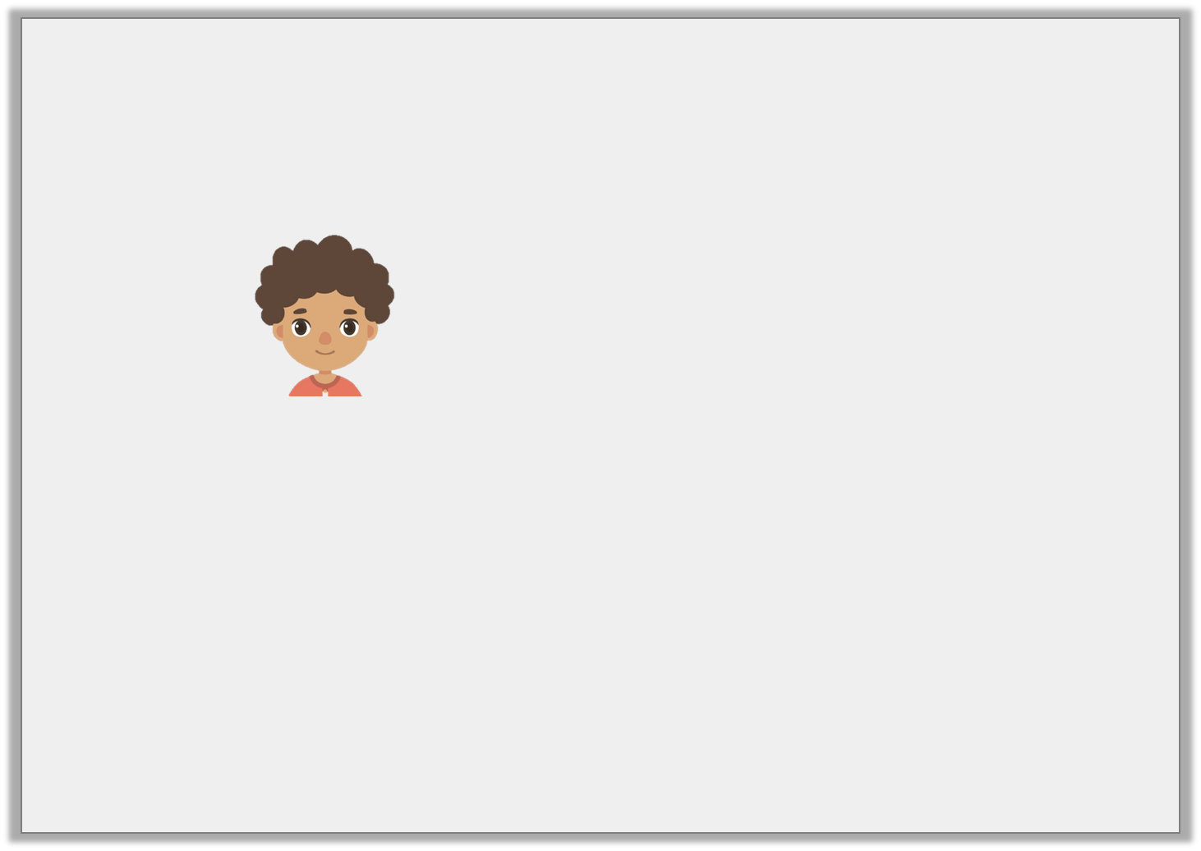
Reasoning 1
Is Noah correct? Explain your answer.
I’ve tried the new slide in the playground and it is fun.
The expanded noun phrase in the sentence below includes an adjective and a preposition.
© Classroom Secrets Limited 2019

Slide 17
Reasoning 1
Is Noah correct? Explain your answer.
I’ve tried the new slide in the playground and it is fun.
Noah is correct because…
The expanded noun phrase in the sentence below includes an adjective and a preposition.
© Classroom Secrets Limited 2019

Slide 18
Reasoning 1
Is Noah correct? Explain your answer.
I’ve tried the new slide in the playground and it is fun.
Noah is correct because the noun phrase ‘the new slide in the playground’ contains the adjective ‘new’ and the preposition ‘in’.
The expanded noun phrase in the sentence below includes an adjective and a preposition.
© Classroom Secrets Limited 2019

