Slide 1
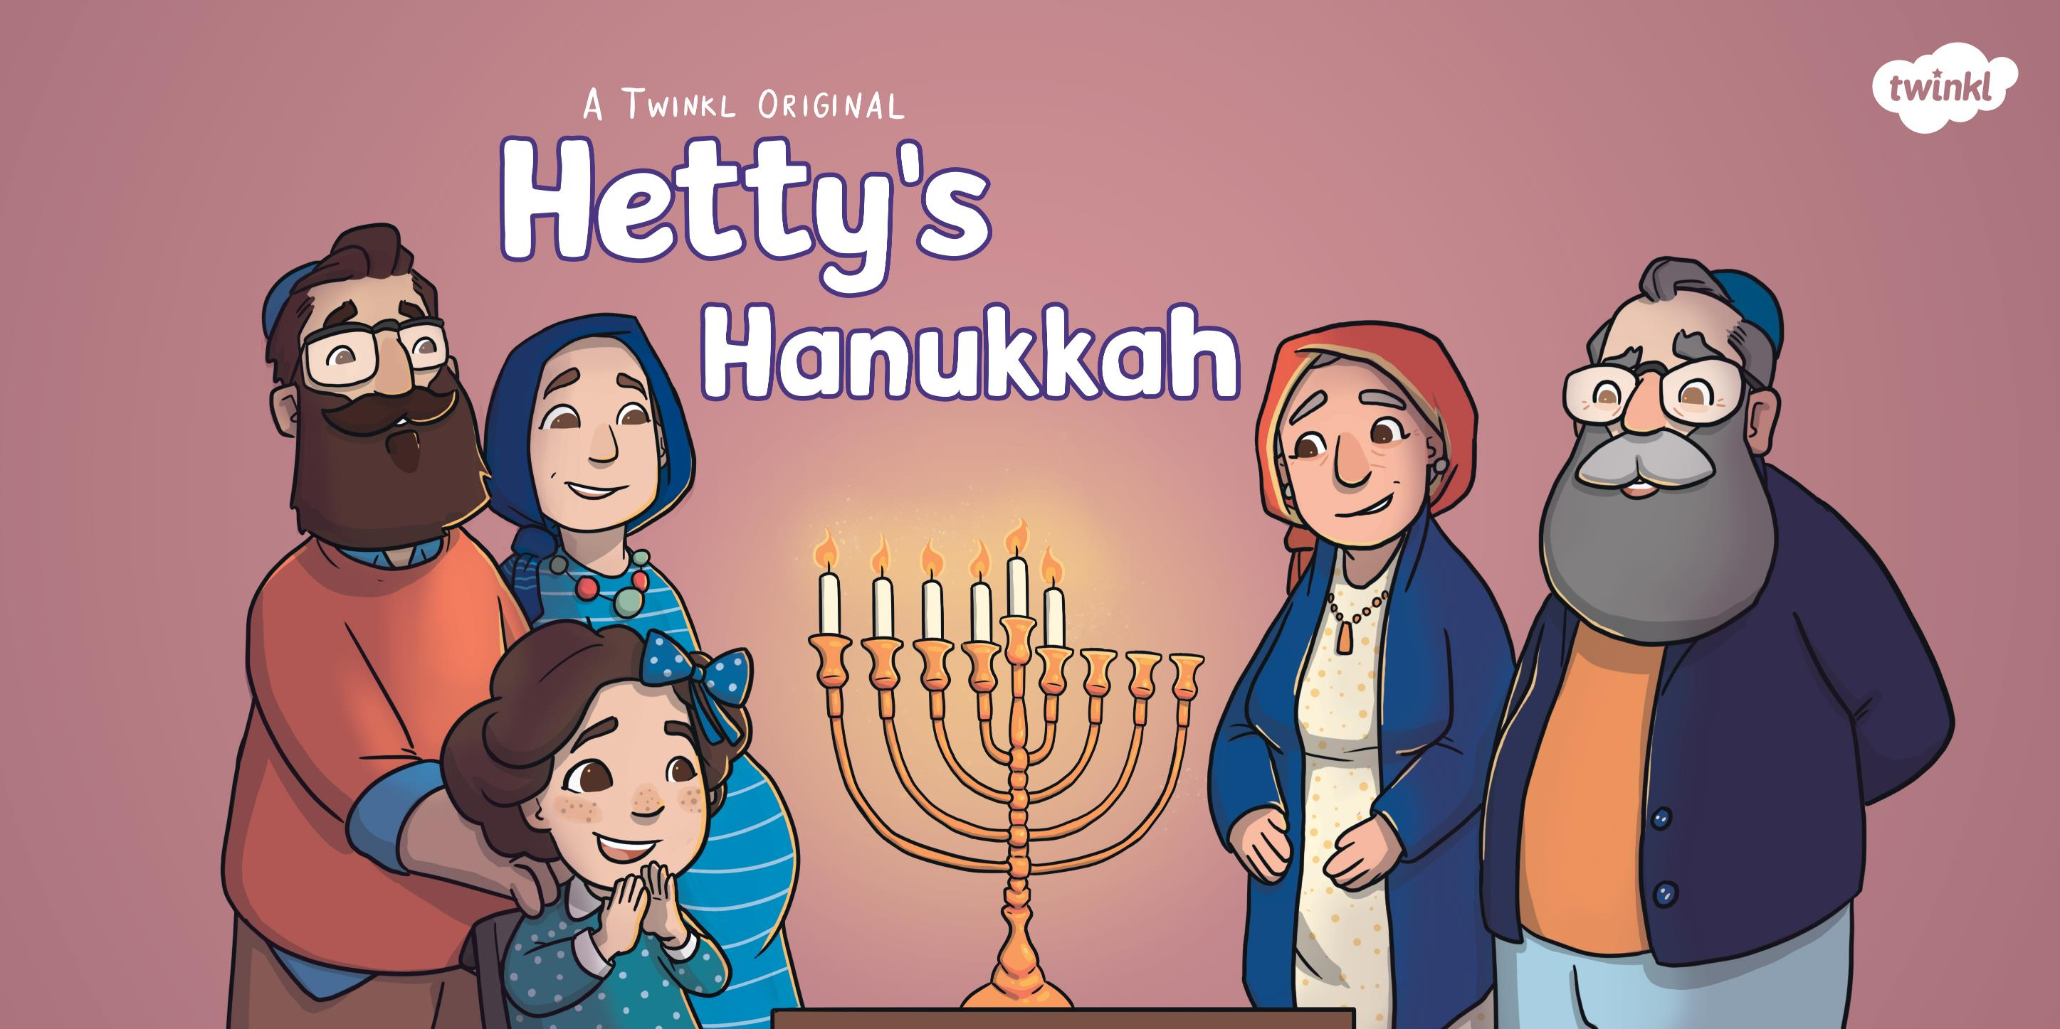

Slide 2
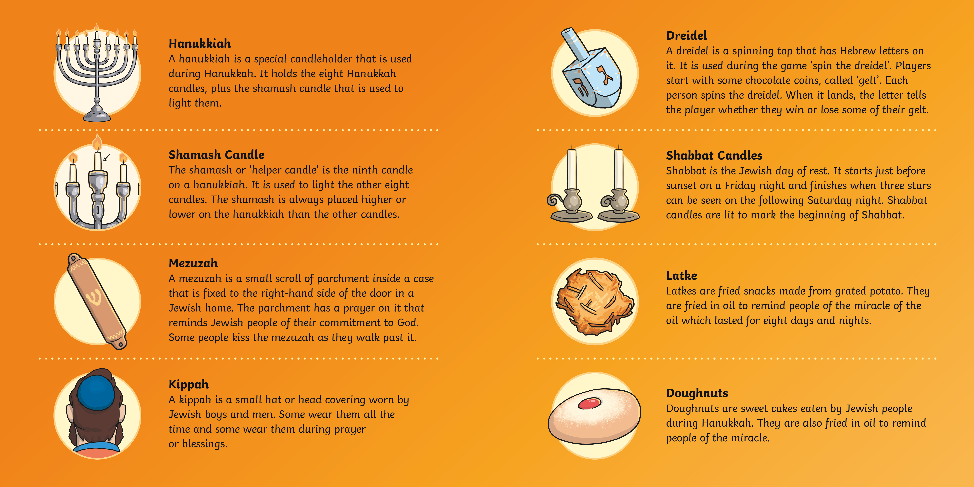

Slide 3
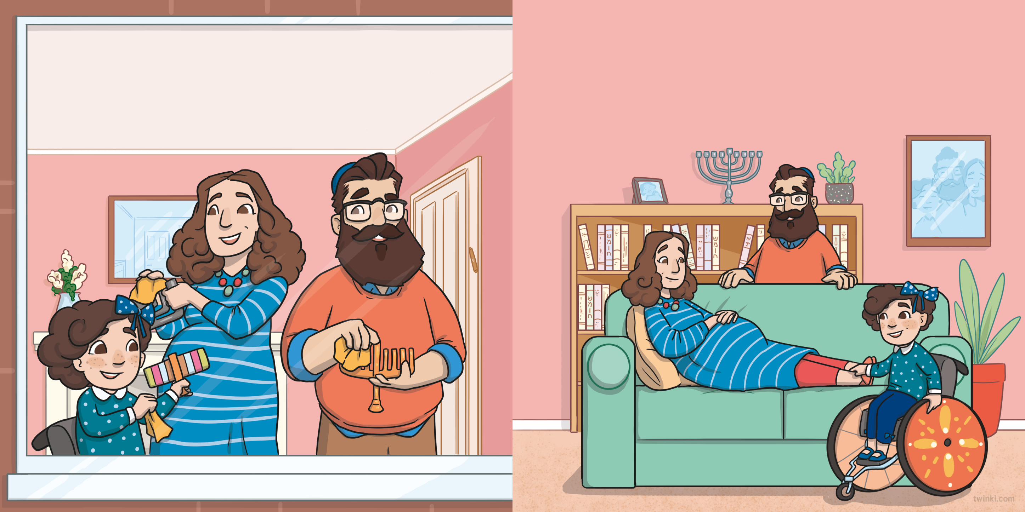
Hetty was helping Mummy and Daddy to polish some special menorahs called hanukkiahs. They needed to be ready to display in the window. This would show everyone how
proud the family were to be celebrating Hanukkah.
“Hanukkah starts tonight,” said Daddy.
“I hope the baby comes in time to join in,” said Hetty.
“It could be any time now,” smiled Mummy, who was resting
on the sofa.

Slide 4
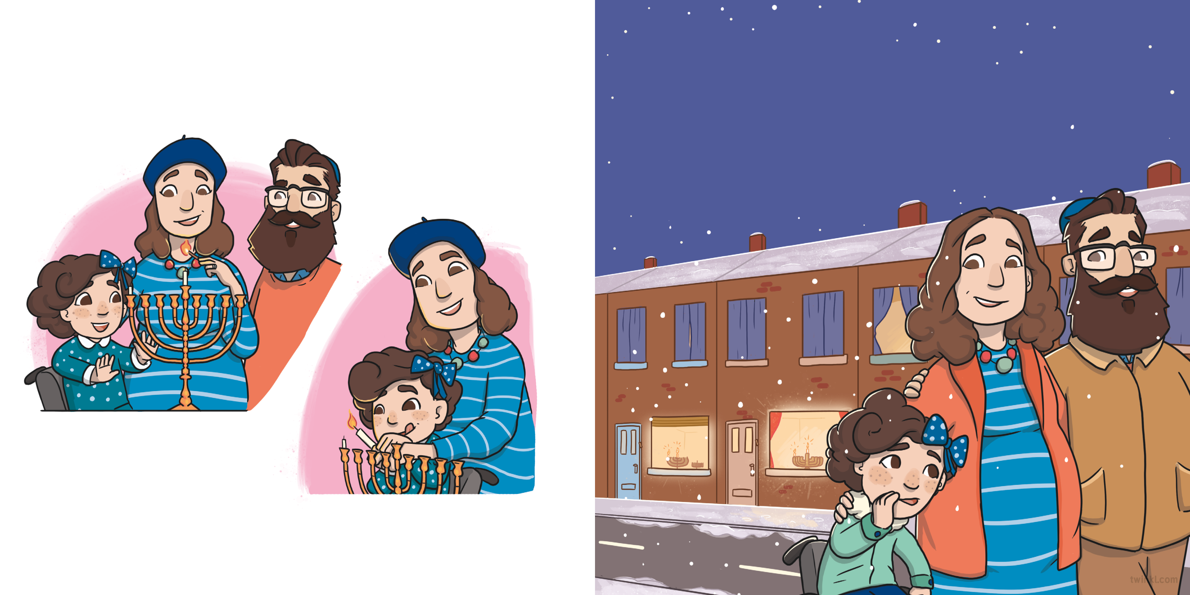
That evening, just after the sun went down, Mummy lit the shamash. The family sang three blessings for the first night of Hanukkah. Hetty helped to light one candle on a hanukkiah.
“Great idea!” said Daddy.
“Seven nights of Hanukkah to go,” whispered Hetty
to the baby inside Mummy’s tummy.
The hanukkiahs shining in the windows were beautiful.
“Can we go and see all the lights down the street?” Hetty asked when the candles had burned down.

Slide 5
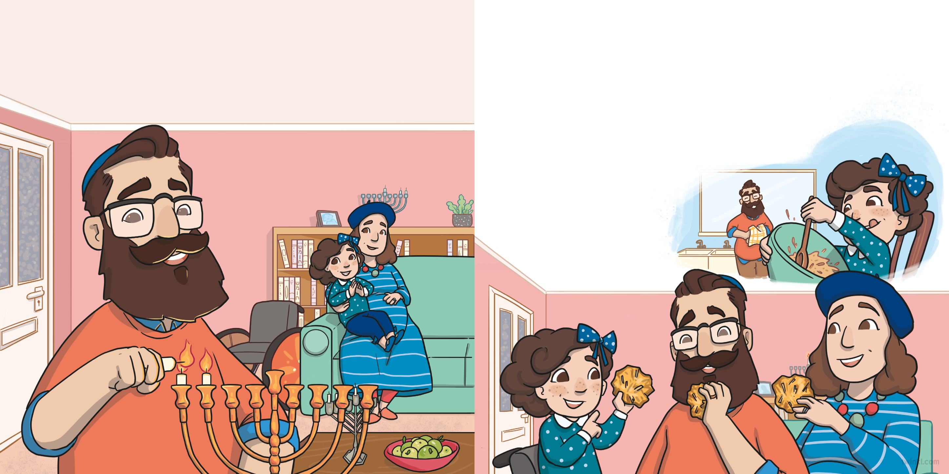
On the second night of Hanukkah, the family sang two blessings. Then, Daddy used the shamash to light two candles.
“Who wants a latke?” asked Daddy.
Hetty licked her lips. Earlier, she had helped Daddy to grate the potatoes and mix all the ingredients together before frying them.
They said a blessing and then all tucked in.
“Six days left for the baby to come,” said Hetty.
“So delicious,” said Hetty.

Slide 6
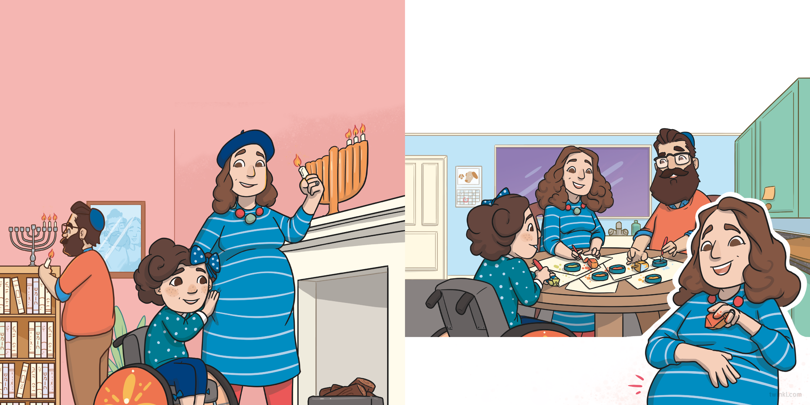
On the third night of Hanukkah, the family sang two blessings and then lit three candles.
Hetty, Daddy and Mummy worked together to paint the dreidels. They sang a special song:
“Five nights left for the baby to join in,” said Hetty. “Let’s sing while we decorate the dreidels. Then, she will want to come out and meet us.”
“I have a little dreidel. I made it out of clay.
And when it’s dry and ready, then dreidel I shall play!”
“The baby just kicked!” said Mummy.
“I think she can hear us.”

Slide 7
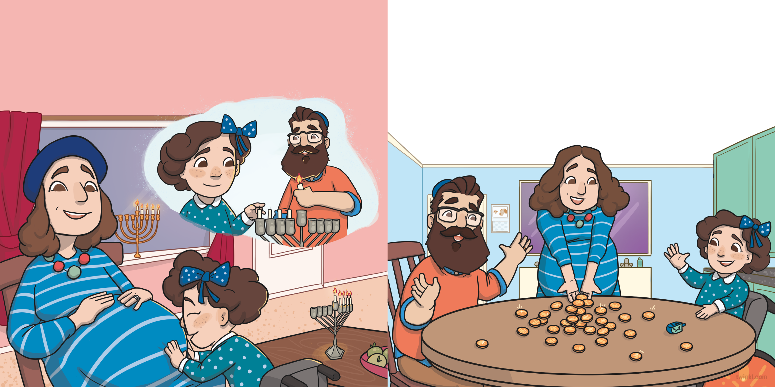
The next night, Hetty counted out four candles and Daddy helped her to use the shamash to light them.
“Fancy a game of spin the dreidel?” asked Daddy. “The paint should be dry by now.”
“Yes, please!” said Hetty excitedly.
“Four days left of Hanukkah,” Hetty whispered to Mummy’s baby bump.
Mummy gave them some chocolate Hanukkah gelt to use in the game. “You’ll have to teach your sister how to play one day,” she smiled.

Slide 8
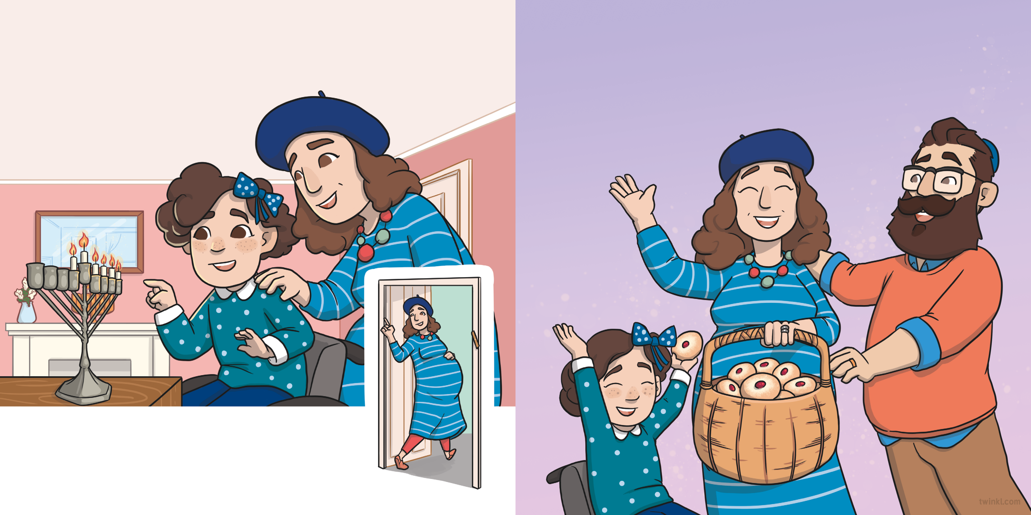
“One, two, three, four, five,” counted Hetty as she helped Mummy to light the candles for the fifth night of Hanukkah.
“Five candles lit and three
nights left to go.”
She came back with a basket of Mrs Bloom’s homemade doughnuts.
“Yum!” shouted Hetty. “My favourite!”
“I have a surprise for you,” grinned Mummy as she disappeared into the kitchen.

Slide 9
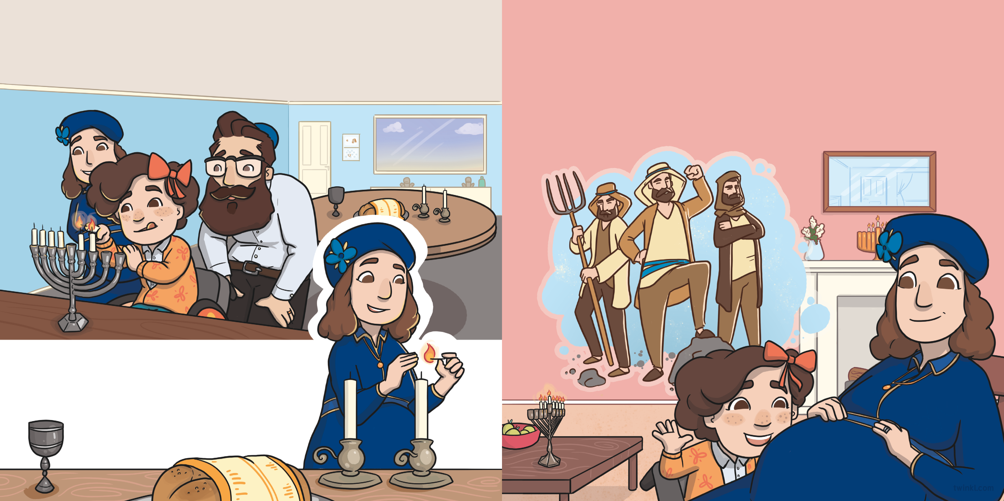
The sixth night of Hanukkah was a Friday. The family sang the two Hanukkah blessings before lighting the hanukkiahs.
“We heard the story of Hanukkah in school today,” said Hetty.
“Shall I tell the baby all about it?”
Hetty told the story of the Maccabees and how only a small amount of oil kept the menorah in the temple alight for eight days.
After that, Mummy lit the candles for Shabbat, the Jewish day of rest.
“Happy Hanukkah and Shabbat shalom,” said Daddy.

Slide 10
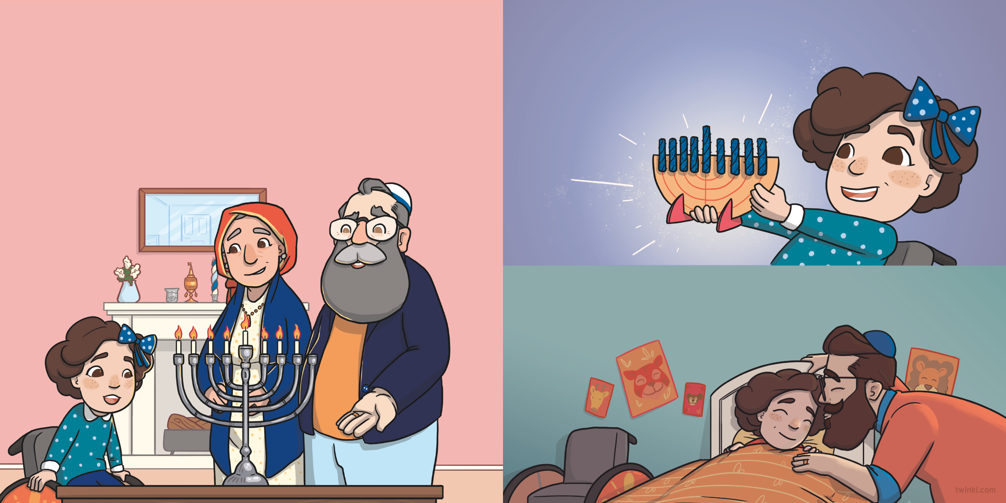
On the seventh night of Hanukkah, after Shabbat, Hetty’s saba and savta came round. They brought their own hanukkiah with them and lit seven candles.
Saba told Hetty that it had belonged to his mother and had been passed down through many generations.
Hetty showed them a hanukkiah that she had made in school.
“It’s a Hanukkah gift for the baby,” she said.
Hetty went to bed and hoped that she would be able to give her baby sister the gift before the end of Hanukkah.

Slide 11
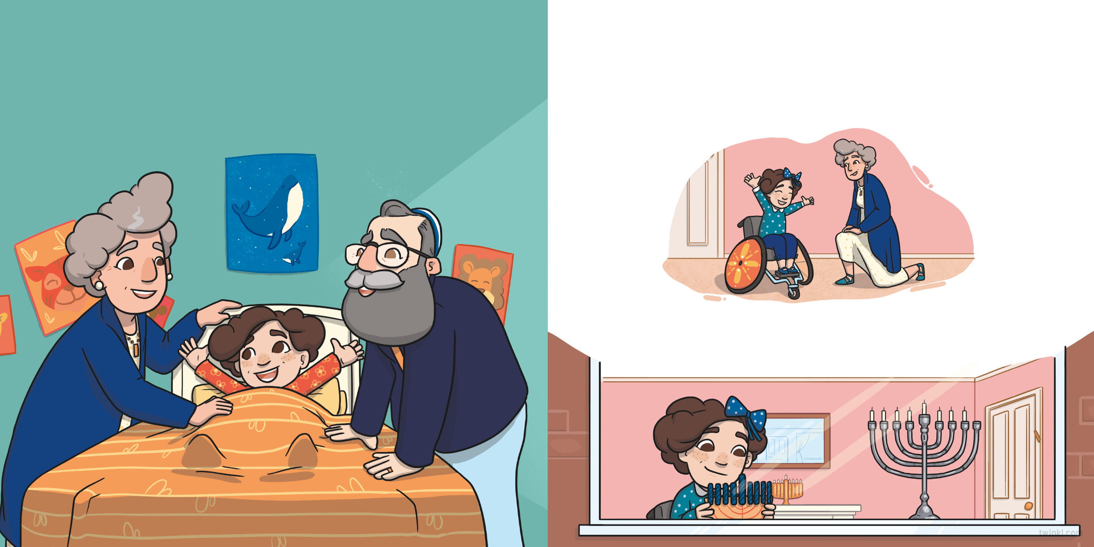
The next morning, Hetty was woken up by Saba and Savta, who had stayed the night.
Hetty was so excited. “If she comes home today, she will be here to light the last candle!” she said.
“Mummy and Daddy have gone to the hospital,” Savta told her.
“The baby is coming!”
“Be patient,” laughed Savta. “She will come when she’s ready.”
So, Hetty sat by the window with the baby’s gift. She waited...

Slide 12
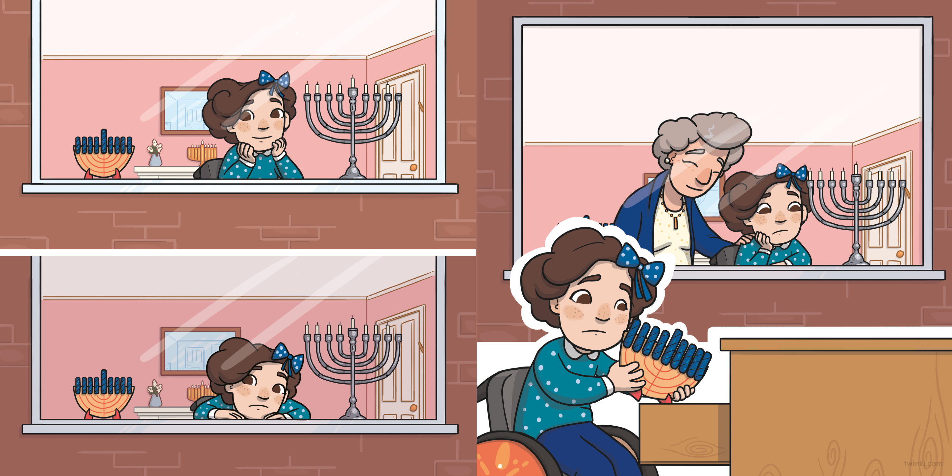
...and waited...
Eventually, the sun began to go down.
“We’ll be lighting the Hanukkah candles soon,” Hetty said to Savta, feeling disappointed. “I don’t think the baby is going to be here in time.”
...and waited.
She went to her room and popped the Hanukkah gift in her drawer, ready for next year.

Slide 13
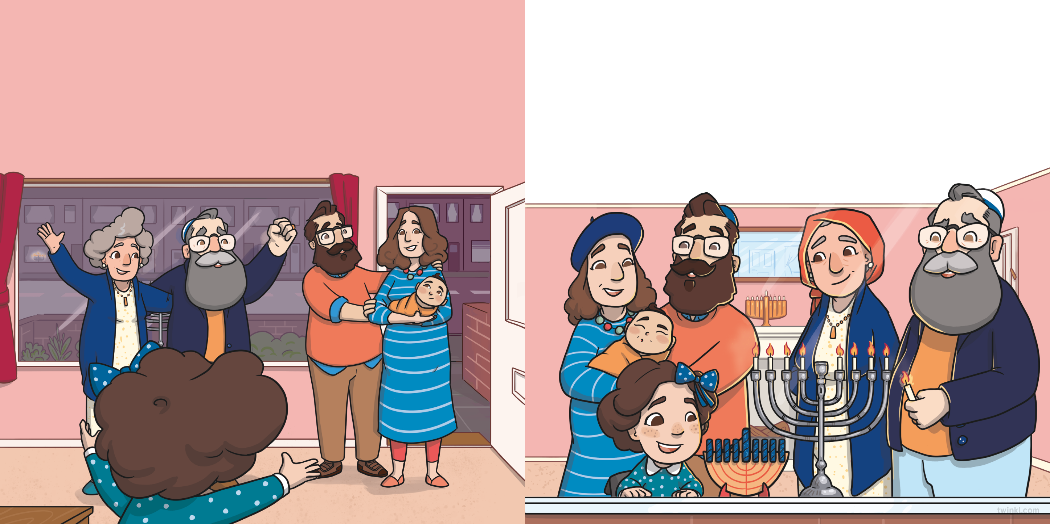
When she came back, she couldn’t believe her eyes! Mummy and Daddy had arrived with her new baby sister. Hetty was so happy that she thought she would burst.
Finally, Hetty was able to share the new hanukkiah with her sister. The whole family gathered around the hanukkiah to light eight candles for the last night of Hanukkah.
“Mazal Tov!” they both said.
“What are you going to name the baby?” asked Saba.
“We haven’t quite decided yet,” said Daddy.
Saba and Savta congratulated Mummy and Daddy.

Slide 14
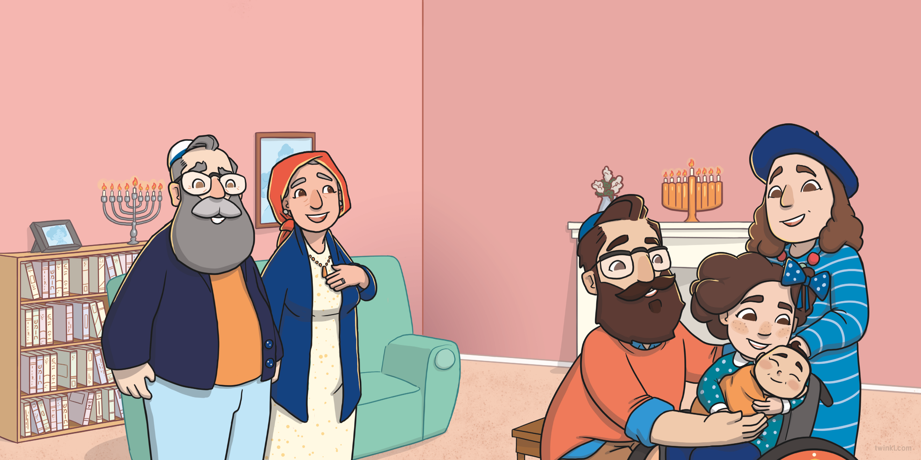
“Well, whatever you decide, she has certainly brought even more light into our lives,” said Savta, gazing at the flickering candles.
The baby gurgled. “I think she likes it,” smiled Hetty.
“That’s decided, then,” said Daddy.
“Happy Hanukkah, Liora,” whispered Hetty.
Mummy and Daddy looked at each other. “In Hebrew, the name ‘Liora’ is connected to light,” said Mummy.

Slide 15
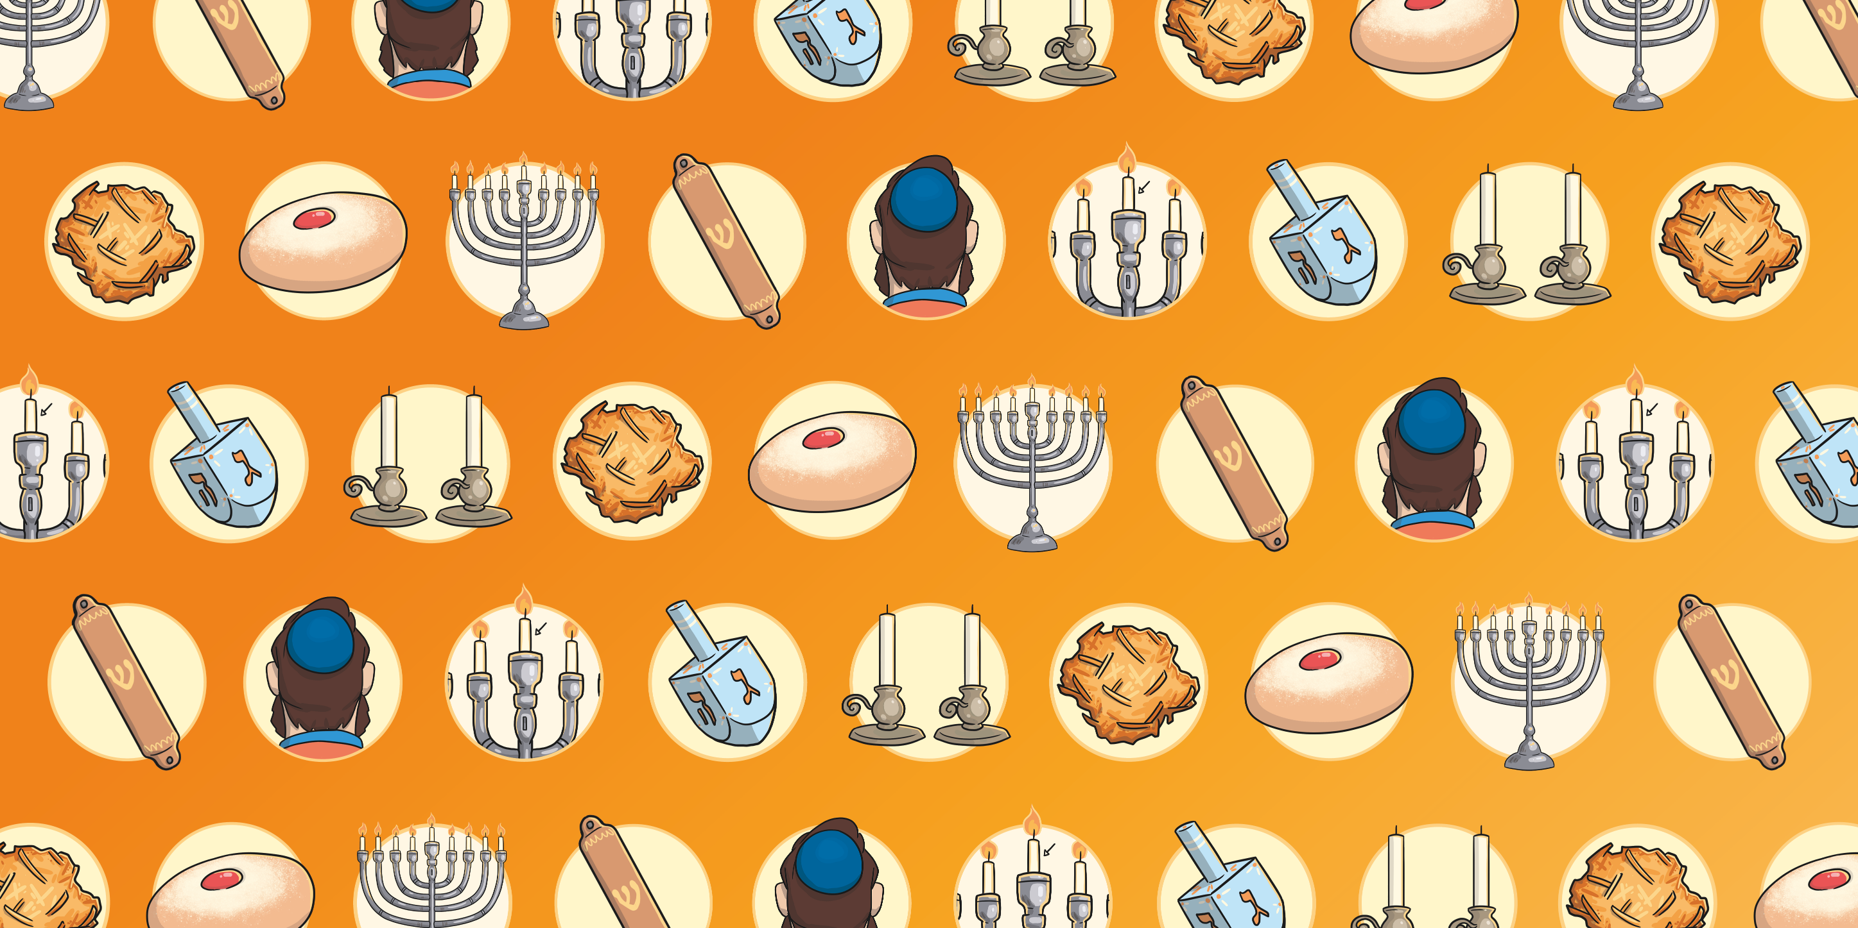

Slide 16
