Slide 1


Slide 3





Match the multiplication to the addition
5 × 2 9 + 9 + 9
0 × 6 2 + 2 + 2 + 2 + 2
9 × 3 + + +
4 × 0 + 0 + 0 + 0 + 0 + 0
$$\frac{\text{1}}{\text{5}}$$
$$\frac{\text{1}}{\text{5}}$$
$$\frac{\text{1}}{\text{5}}$$
$$\frac{\text{1}}{\text{5}}$$
$$\frac{\text{1}}{\text{5}}$$

Slide 4
Match the multiplication to the addition
5 × 2 9 + 9 + 9
0 × 6 2 + 2 + 2 + 2 + 2
9 × 3 + + +
4 × 0 + 0 + 0 + 0 + 0 + 0
$$\frac{\text{1}}{\text{5}}$$
$$\frac{\text{1}}{\text{5}}$$
$$\frac{\text{1}}{\text{5}}$$
$$\frac{\text{1}}{\text{5}}$$
$$\frac{\text{1}}{\text{5}}$$

Slide 6

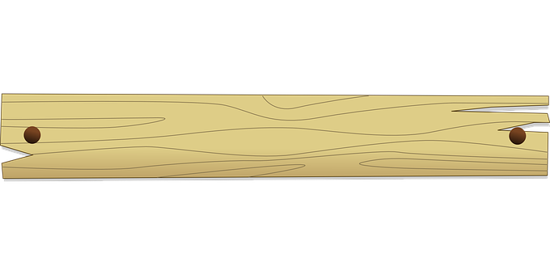











Alex has 4 pieces of wood.
$$\frac{\text{1}}{\text{7}}$$
Each piece of wood is m long.
$$\frac{\text{4}}{\text{7}}$$
How long is all of Alex’s wood?
m
Have a think
$$\frac{\text{1}}{\text{7}}$$
$$\frac{\text{1}}{\text{7}}$$
$$\frac{\text{1}}{\text{7}}$$
$$\frac{\text{1}}{\text{7}}$$
$$\frac{\text{1}}{\text{7}}$$
$$\frac{\text{1}}{\text{7}}$$
$$\frac{\text{1}}{\text{7}}$$
$$\frac{\text{1}}{\text{7}}$$
$$\frac{\text{4}}{\text{7}}$$
+
+
+
=

Slide 7












$$\frac{\text{1}}{\text{7}}$$
$$\frac{\text{1}}{\text{7}}$$
$$\frac{\text{1}}{\text{7}}$$
$$\frac{\text{1}}{\text{7}}$$
$$\frac{\text{4}}{\text{7}}$$
+
+
+
=
$$\frac{\text{1}}{\text{7}}$$
$$\frac{\text{4}}{\text{7}}$$
4 ×
=
Have a think
$$\frac{\text{1}}{\text{4}}$$
$$\frac{\text{1}}{\text{4}}$$
$$\frac{\text{1}}{\text{4}}$$
$$\frac{\text{1}}{\text{4}}$$
$$\frac{}{\text{4}}$$
3
+
+
=
×
3
=

Slide 8







$$\frac{\text{1}}{\text{3}}$$
$$\frac{\text{1}}{\text{3}}$$
$$\frac{\text{1}}{\text{3}}$$
$$\frac{\text{2}}{\text{3}}$$
+
=
2
×
=
Have a think
$$\frac{\text{1}}{\text{10}}$$
$$\frac{\text{5}}{\text{10}}$$
$$\frac{\text{1}}{\text{2}}$$
×
5
=
=

Slide 9
Have a go at questions
1 - 4 on the worksheet

Slide 10









$$\frac{\text{1}}{\text{3}}$$
$$\frac{\text{5}}{\text{3}}$$
$$\frac{\text{2}}{\text{3}}$$
5 ×
=
=
1
Have a think
0
1
2
$$\frac{\text{1}}{\text{3}}$$
$$\frac{\text{2}}{\text{3}}$$
$$\frac{\text{3}}{\text{3}}$$
$$\frac{\text{4}}{\text{3}}$$
$$\frac{\text{5}}{\text{3}}$$
$$\frac{\text{6}}{\text{3}}$$

Slide 11







$$\frac{\text{1}}{\text{2}}$$
$$\frac{\text{8}}{\text{2}}$$
Have a think
8 ×
=
=
4
$$\frac{\text{1}}{\text{6}}$$
$$\frac{\text{14}}{\text{6}}$$
$$\frac{\text{2}}{\text{6}}$$
$$\frac{\text{1}}{\text{3}}$$
× 14
=
=
2
=
2
$$\frac{\text{1}}{\text{9}}$$
×
=
2

Slide 12



$$\frac{\text{1}}{\text{9}}$$
×
=
2
$$\frac{\text{1}}{\text{9}}$$
$$\frac{\text{18}}{\text{9}}$$
×
18
=

Slide 13







Have a think
$$\frac{\text{1}}{\text{8}}$$
$$\frac{\text{3}}{\text{8}}$$
×
11
=
1
$$\frac{\text{11}}{\text{8}}$$
$$\frac{\text{1}}{\text{6}}$$
$$\frac{\text{2}}{\text{3}}$$
$$\frac{\text{4}}{\text{6}}$$
10
×
=
1
=
1
$$\frac{\text{10}}{\text{6}}$$

Slide 14
Have a go at questions
5 - 7 on the worksheet

