Slide 1

English Friday 5 March
Today, read your notes for ‘Living in a Castle’. Use your facts to write complete sentences. Remember that a paragraph is continuous, so no need to start a new line for every sentence.
If you don’t think you have enough facts you can use mine. Here are my ‘Castle Defences’ notes. I’m going to write my paragraph.
Can you see my subheading?
sound button
Castle Defences
Castles were safe places for lords and ladies to live and to keep all their treasures. But sometimes they were attacked by other lords and their armies. How did lords keep the enemy out? Castles were built out of thick stone walls with tall towers and a deep moat surrounding the castle. The entrance to the castle was usually protected by a drawbridge which could be lifted to keep enemies our or lowered to let people in. Also, a portcullis made from a metal grille, could be dropped quickly to protect the castle entrance. Archers used the battlements to fire arrows at approaching enemies, as well as the narrow window slots in the tower walls.
Castle defences
moat – deep water no windows downstairs narrow windows – archers fired arrows out, difficult to fire arrows in battlements – shelter behind upright parts if castle under attack thick stone walls tall towers portcullis made of metal or wood thick wooden doors

Slide 2

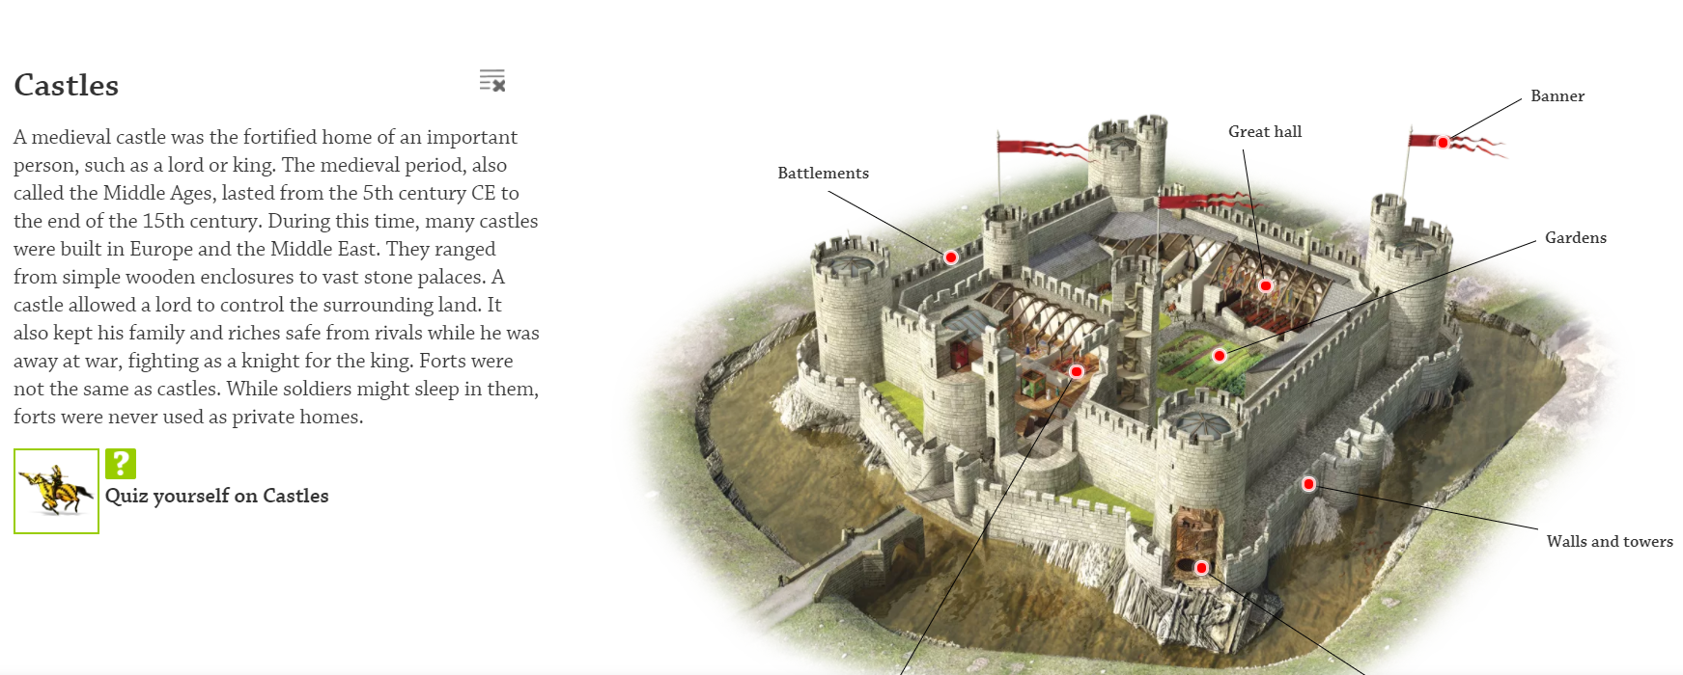
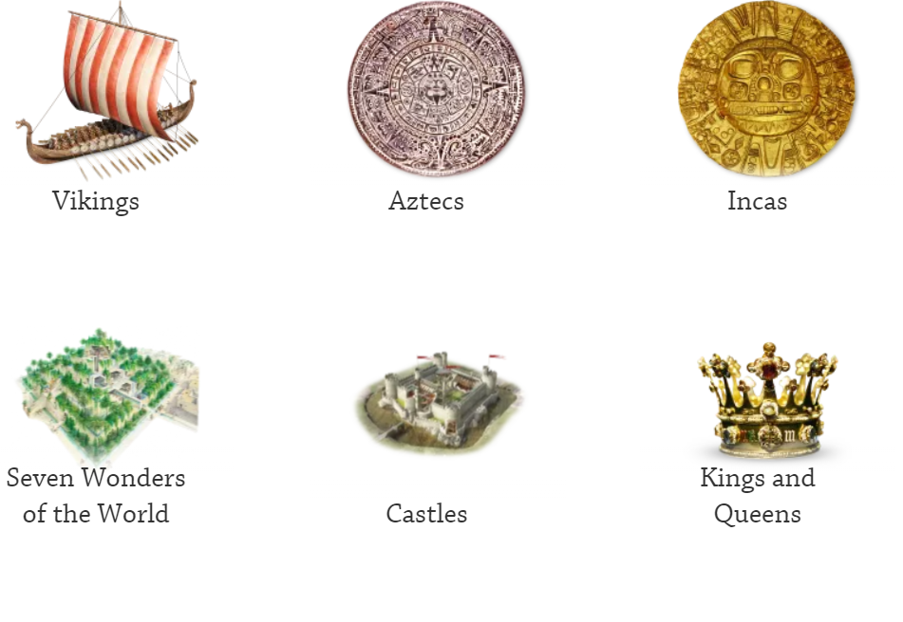
On our class page have a look at DKFindout. In the History section there is a lot of information about castles and the people who used to live in them. Enjoy finding out about castles and decide what interests you.
I have chosen castle defences and knights.
Click on the red dots to find out more. It is a very interactive site.

