Slide 1
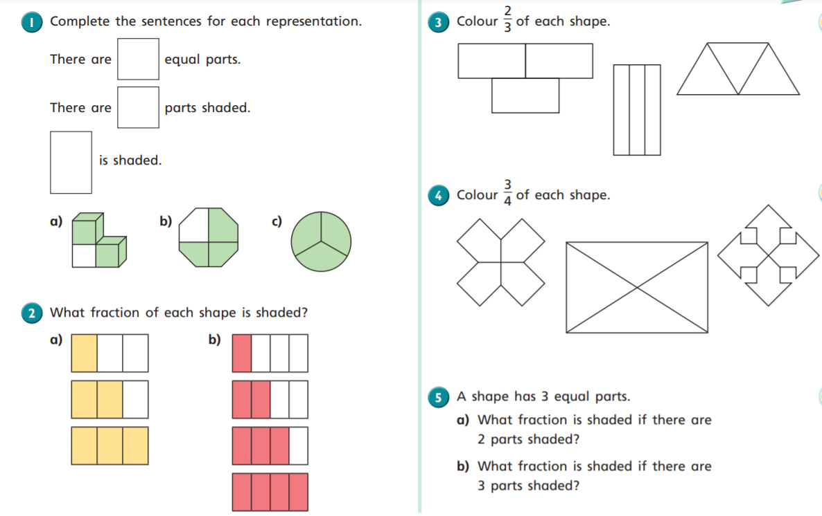



Slide 2
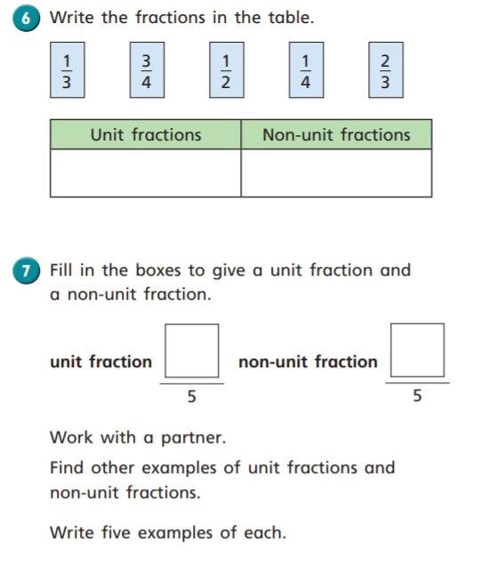
As it is World Book Day, check out the files on our online learning page for today. There is a Solar System Code Cracker. Lots of quick mental maths to do!

