Slide 1

English Wednesday 3 March
Task 1
In your paragraph today, try to include a ‘Did you know….?’ sentence.
First, read these sentences, spot the mistake and then write them out correctly.
They are questions. Check for capital letter at the beginning and a question mark at the end.
?What time is it.
Where? is my pencil to write with.
Did you know? some castles had deep moats.
did you know that knights wore armour made out of metal
sound button

Slide 2
Task 2
Choose one of your castle topics and use the facts you collected yesterday to write your paragraph. You need enough facts for at least 6 sentences. Use my facts if you don’t think you have enough. Remember to include a Did you know …..? question.
sound button
I’ll have a go too. My paragraph is going to be about knights.
Most knights were lords who served their king by defending their lands. Every knight had to have his own horse and armour. Even though the armour was easy to walk in, it was hot wear and fight in. Armour protected the knights body in battle. The helmet, breast plate and gauntlets were made out of metal and were made in sections. Knights had to learn how to fight and use their weapons. They had a sword and a mace. Did you know that a lance was 4m long and made from wood?
When they were not fighting, they practised their skills by taking part in tournaments. The main event was a joust. Two knights charged at each other and tried to knock their opponent off their horse with a lance.
Knights
had to have his own horse and armour his staff helped him mount and dismount staff looked after weapons and horses some knights were lords some knights lived in a lord’s castle armour – helmet, breast plate, gauntlet, made out of sections easy to walk in hot to wear and fight in dubbed in a ceremony to be a knight at 21 page, squire, knight lance – long, wooden, spear like, 4m

Slide 3
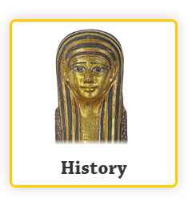
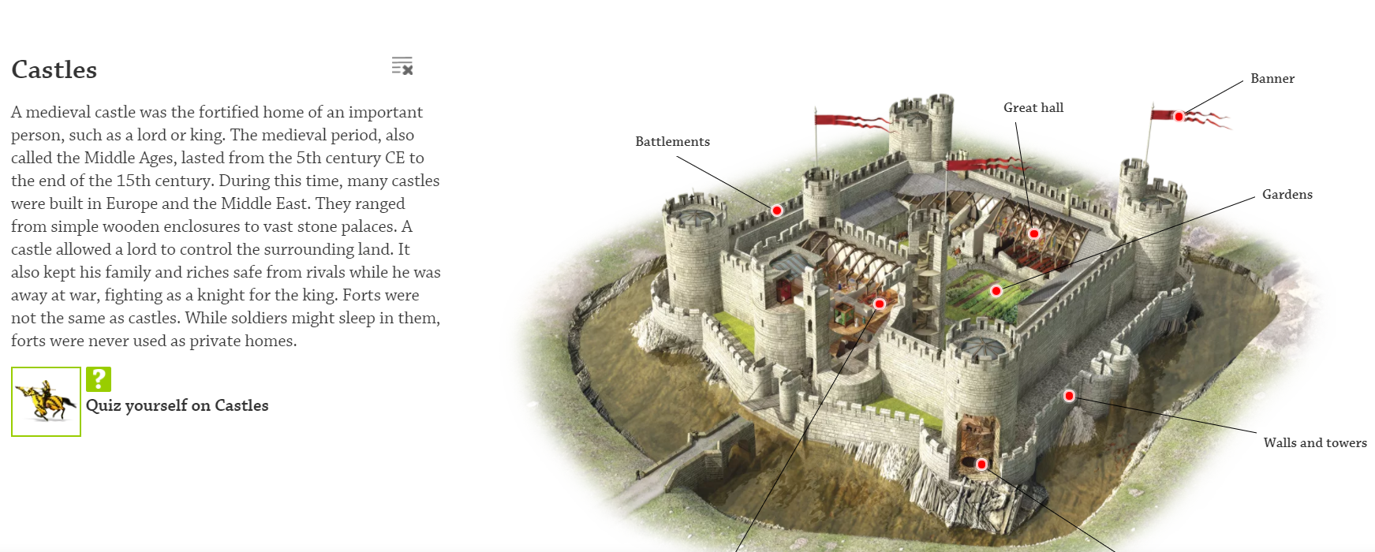
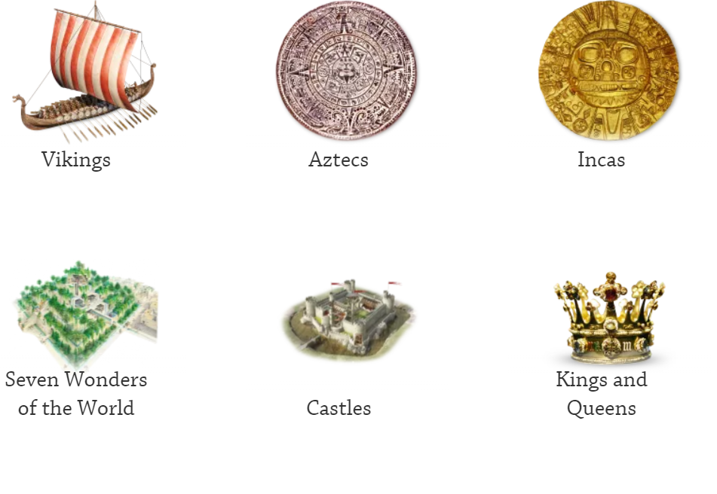
On our class page have a look at DKFindout. In the History section there is a lot of information about castles and the people who used to live in them. I have chosen castle defences and knights.
Click on the red dots to find out more. It is a very interactive site.

