Slide 1

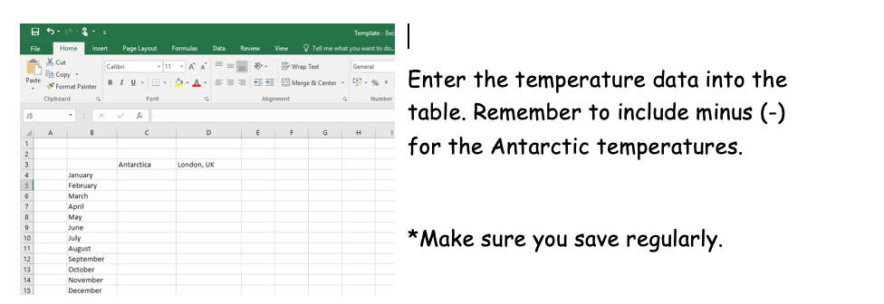
Step 1
The temperature data is uploaded on the online learning page but I have also included it on the next slide for you too.

Slide 2
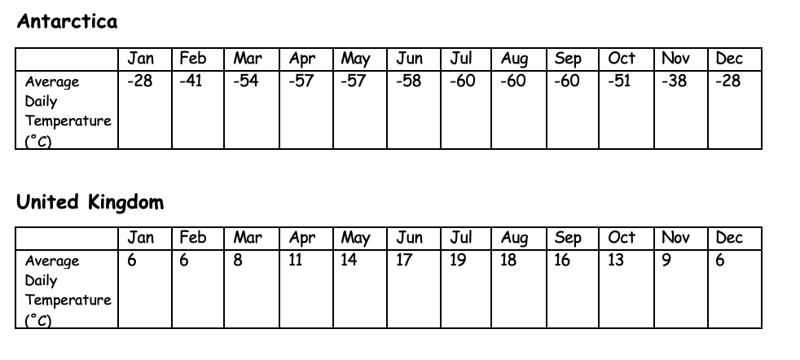
Temperature Data

Slide 3
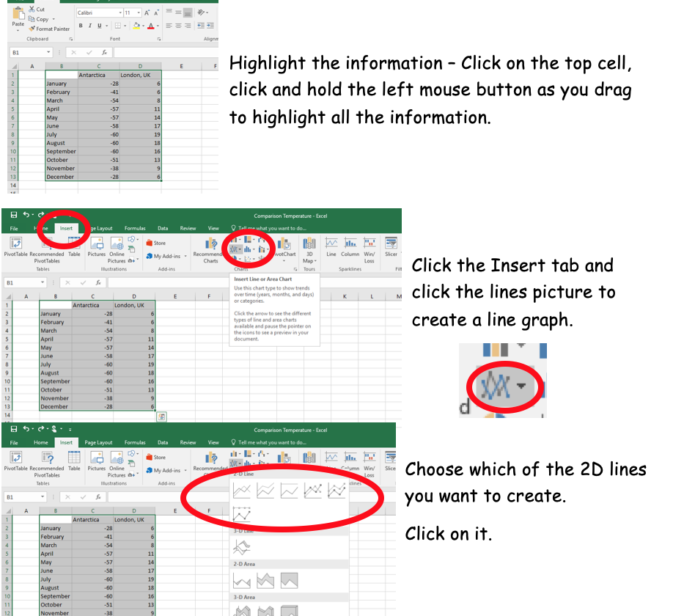
Step 2

Slide 4
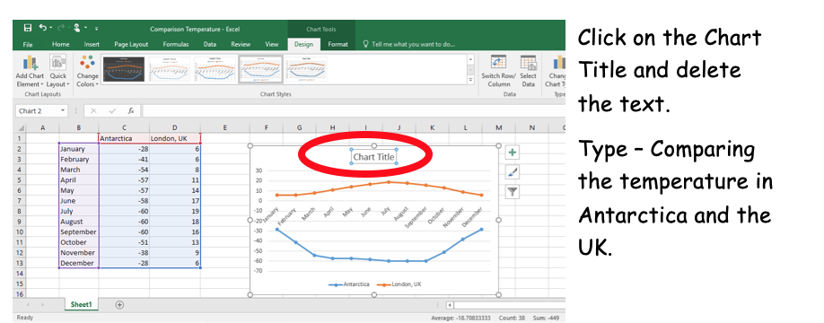
Step 3

Slide 5
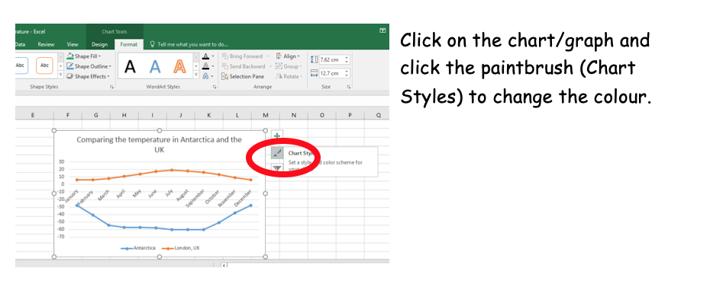
Step 4

