Slide 1

WORLD BOOK DAY
Book QUIZ

Slide 2
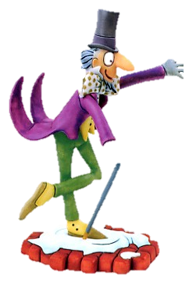
1. Who is this famous book character?

Slide 3
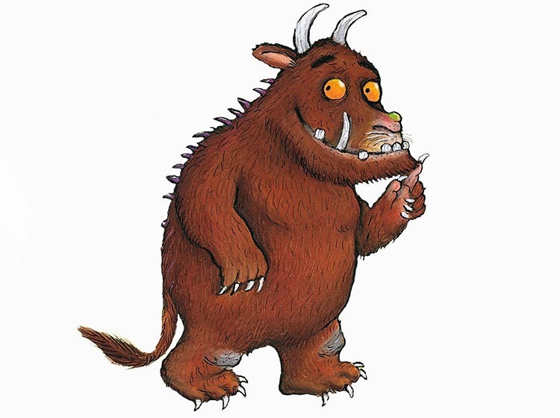
2. Who is this famous book character?

Slide 4
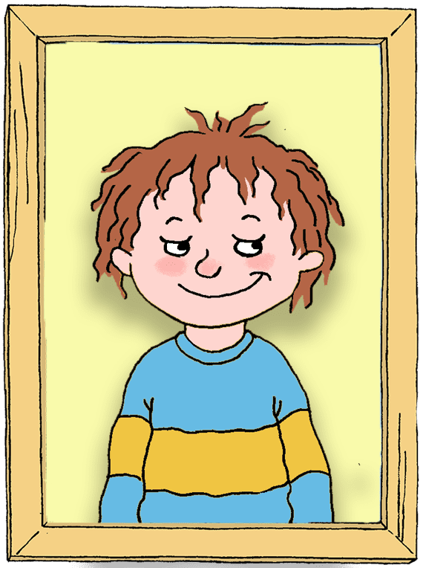
3. Who is this famous book character?

Slide 5
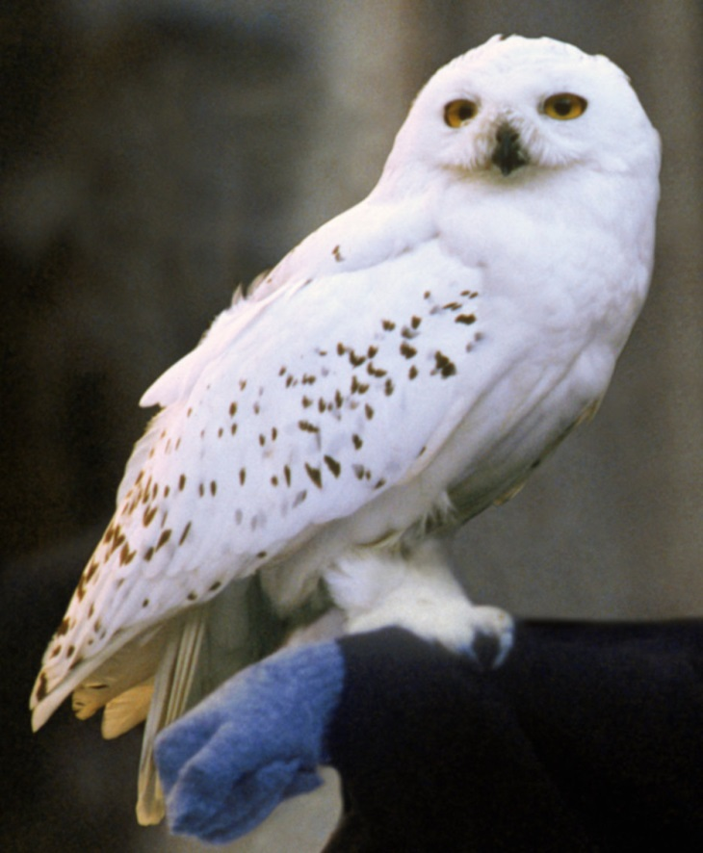
4. What is the name of Harry Potter’s owl?
A. Hagrid
B. Snowy
C. Snape
D. Hedwig

Slide 6
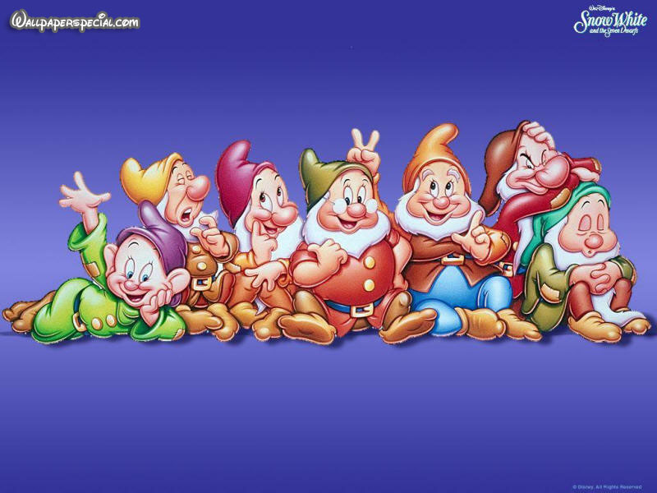
5. Name all of Snow White’s Seven Dwarfs. (One point for each!)

Slide 7

6. Who is this famous author?

Slide 8
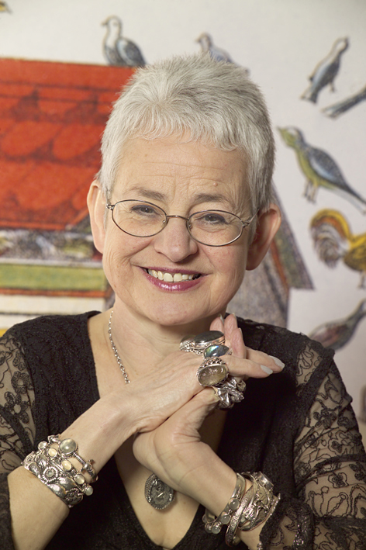
7. Who is this famous children’s author?

Slide 9

8. Before Roald Dahl was an author, what was his job?
A. Doctor
B. Chef
C. Spy
D. Actor

Slide 10
9. Which one of Roald Dahl’s characters is being described here?
The Giant took off his black cloak and hung it against the wall. Sophie saw that under the cloak he was wearing a sort of collarless shirt and a dirty old leather waistcoat that didn’t seem to have any buttons.
“Ha!” shouted the Giant, walking forward and rubbing his hands together, “What has us got here?” His booming voice rolled around the walls of the cave like a burst of thunder.

Slide 11
10. Which magical character is this describing?
‘His eyes were black like Hagrid’s but had none of Hagrid’s warmth. They were cold and empty and made you think of dark tunnels. He spoke in barely more than a whisper but you caught every word. He swept around in his long, black cloak criticising everyone.’

Slide 12

11. This is the front cover of which children’s book?

Slide 13
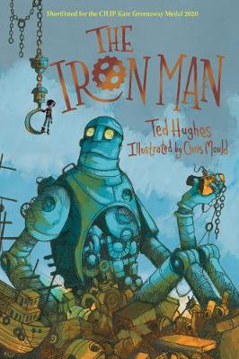
12. This is the front cover of which children’s book?

Slide 14

13. This is the front cover of which children’s book?

Slide 15
14. Look at the pictures and fill in the blanks to find the title of this famous Dr. Seus book.
_ _ _ _ _ _ _ _

Slide 16




15. Can you figure out the name of this famous Dr. Seus book?
fish, fish, fish, fish.

Slide 17
16. What did Jack steal from the giant in ‘Jack and the Beanstalk’?
A. His lunch
B. A Goose that laid golden eggs
C. A golden throne
D. His pet dog

Slide 18
17. Which of the following books has NOT been turned into a film yet?
A. Matilda
B. The Lion the Witch and the Wardrobe
C. Awful Auntie

Slide 19
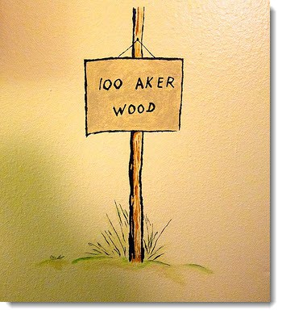
18. Which bear lived in Hundred Acre Wood?
A. Winnie-the-Pooh
B. Rupert
C. Paddington
D. Yogi

Slide 20

19. What did Hansel and Gretel leave as a trail, in order to find their way home?
A. Breadcrumbs
B. Hard boiled sweets
C. Torn paper
D. Leaves

Slide 21
20. In the tale of "Three Billy Goats Gruff", what lives under the bridge the goats must cross?
A. A witch
B. A dragon
C. A goblin
D. A troll

Slide 22

World Book Day Quiz 2021
ANSWERS

Slide 23
1. Who is this famous book character? Willy Wonka

Slide 24
Who is this famous book character? The Gruffalo

Slide 25
3. Who is this famous book character?
Horrid Henry

Slide 26
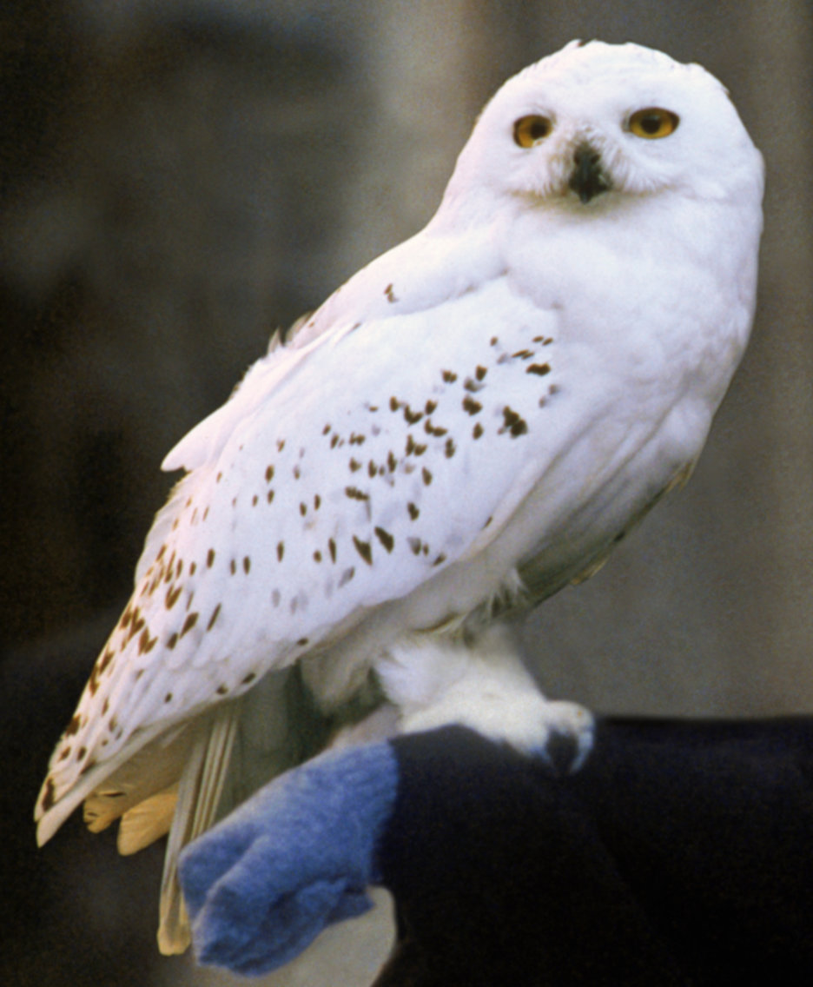
4. What is the name of Harry Potter’s owl?
A. Hagrid
B. Snowy
C. Snape
D. Hedwig

Slide 27
5. Name all of Snow White’s Seven Dwarfs. (One point for each!)
Sleepy, Happy, Grumpy, Sneezy, Bashful, Doc, Dopey.

Slide 28
6. Who is this famous author?
David Walliams

Slide 29
7. Who is this famous children’s author?
Jacqueline Wilson

Slide 30
8. Before Roald Dhal was an author, what was his job?
A. Doctor
B. Chef
C. Spy
D. Actor

Slide 31
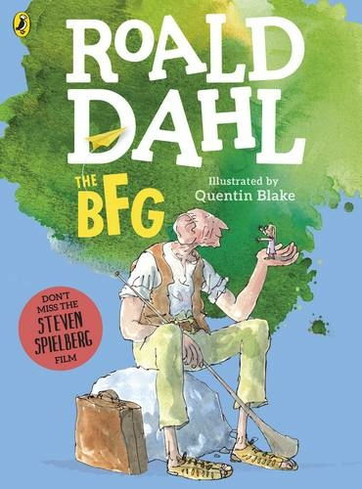
9. Which one of Roald Dahl’s characters is being described here?
The BFG

Slide 32
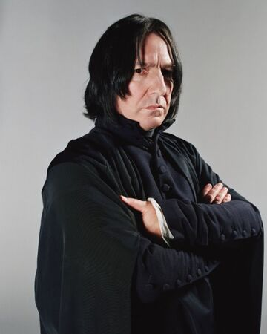
10. Which magical character is this describing?
Professor Snape

Slide 33
11. This is the front cover of which children’s book?
Gangta Granny

Slide 34
12. This is the front cover of which children’s book?
The Iron Man

Slide 35
13. This is the front cover of which children’s book?
Stick Man

Slide 36

14. Look at the pictures and fill in the blanks to find the title of this famous Dr. Seus book.
The cat in the hat

Slide 37
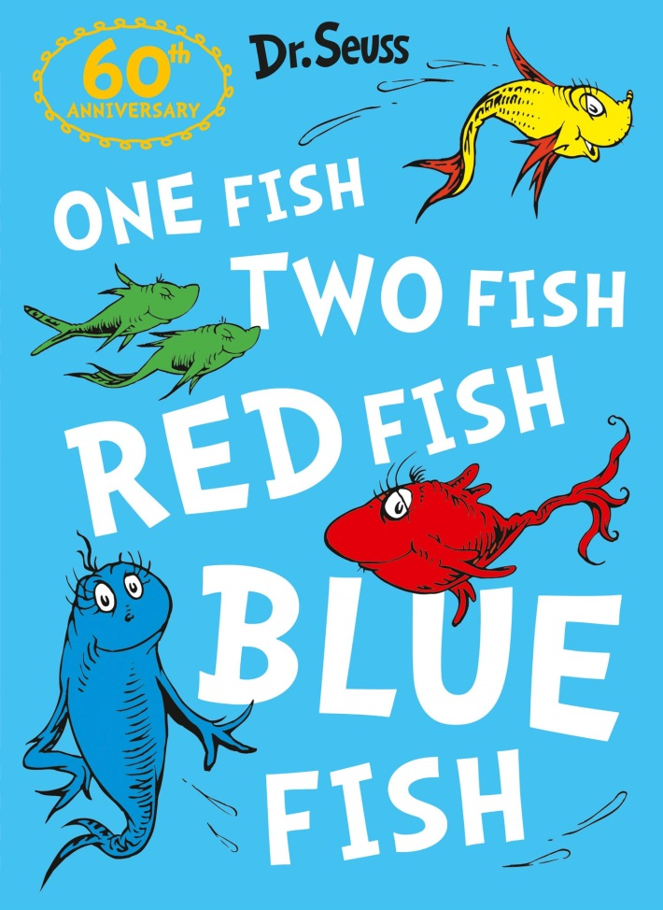
15. Can you figure out the name of this famous Dr. Seus book?
One fish, two fish, red fish,
blue fish.

Slide 38
16. What did Jack steal from the giant in ‘Jack and the Beanstalk’?
A. His lunch
B. A Goose that laid golden eggs
C. A golden throne
D. His pet dog

Slide 39
17. Which of the following books has NOT been turned into a film yet?
A. Matilda
B. The Lion the Witch and the Wardrobe
C. Awful Auntie

Slide 40
18. Which bear lived in Hundred Acre Wood?
A. Winnie-the-Pooh
B. Rupert
C. Paddington
D. Yogi

Slide 41
19. What did Hansel and Gretel leave as a trail, in order to find their way home?
A. Breadcrumbs
B. Hard boiled sweets
C. Torn paper
D. Leaves

Slide 42
20. In the tale of "Three Billy Goats Gruff", what lives under the bridge the goats must cross?
A. A witch
B. A dragon
C. A troll
D. A goblin

