Slide 1
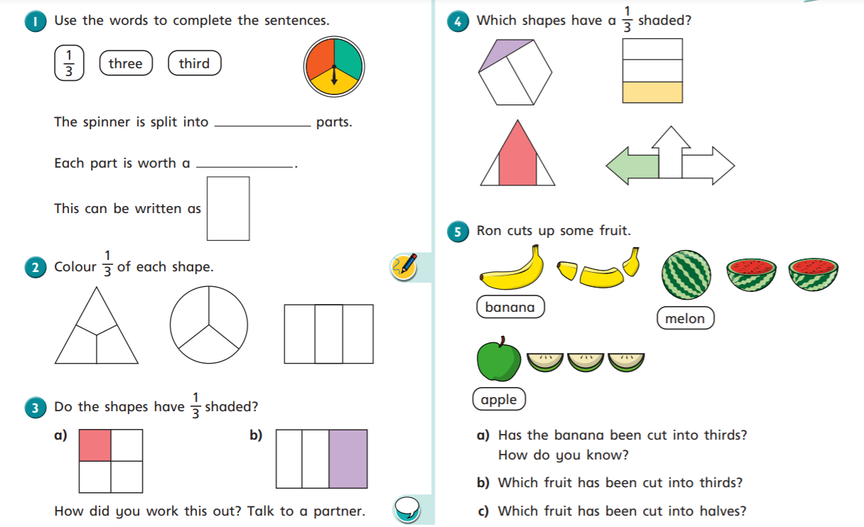

Slide 2
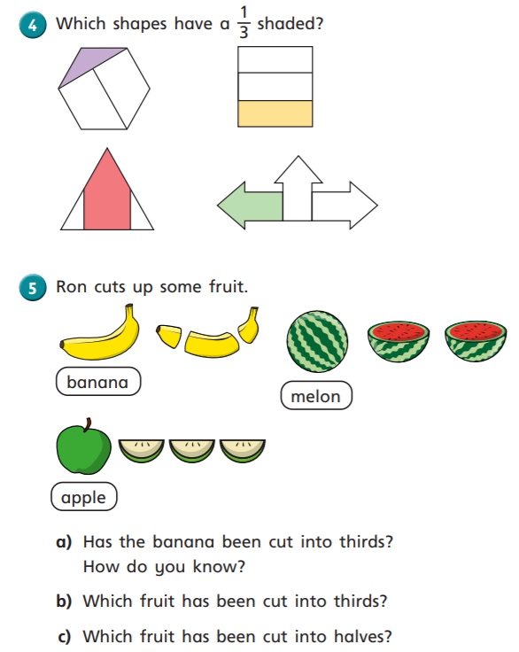
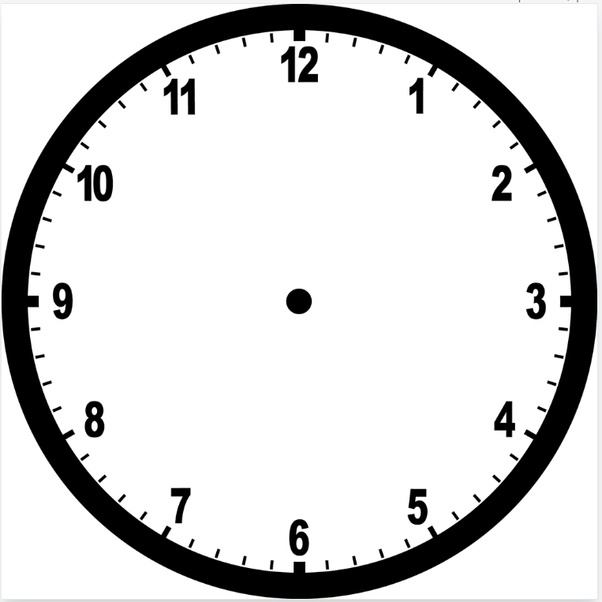
Look at a clock. From the centre, which numbers would you draw a line to, to show thirds?
Is there more than one solution?
If you peel a banana, then squeeze it, it breaks into thirds.
Try it.
Delicious banana fractions.

Slide 3
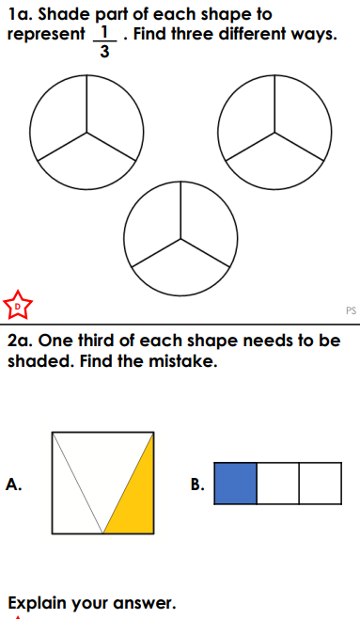
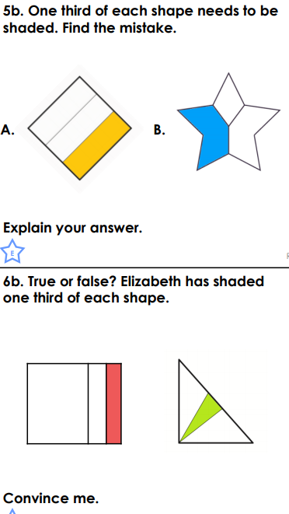
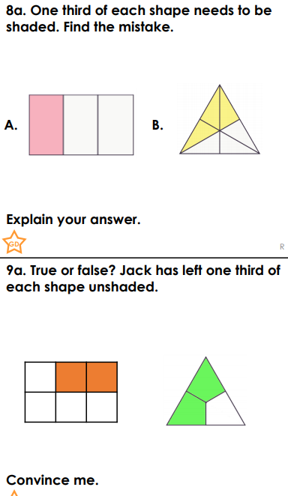
*
**
***
Choose a question to answer.

