Slide 1


Slide 3


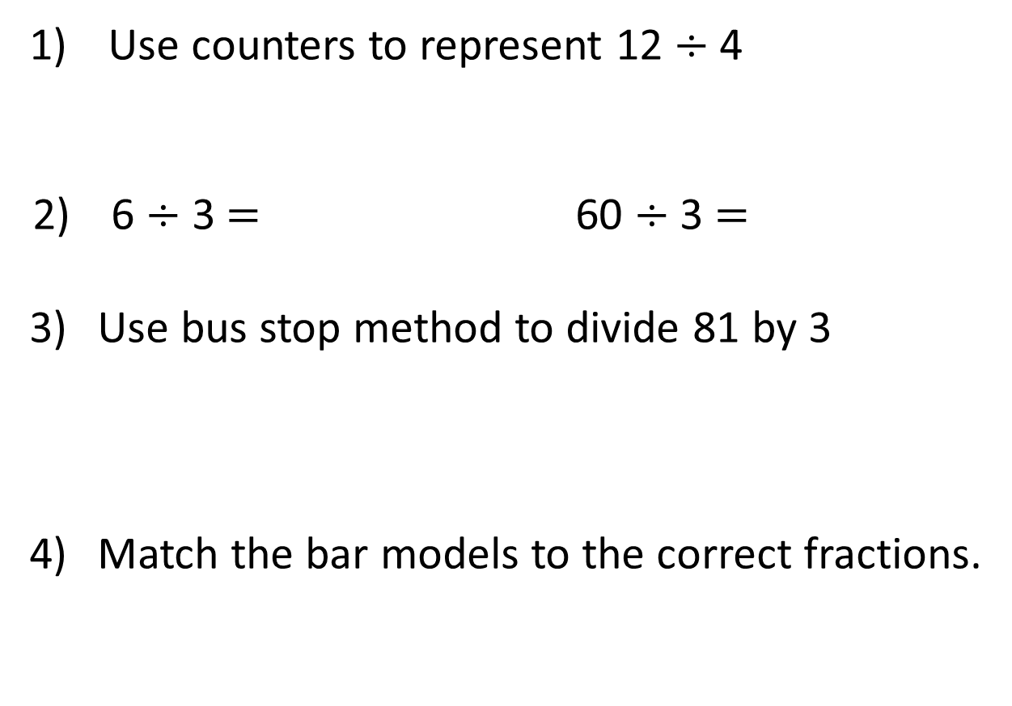


Use counters to represent 12 $÷$ 4
6 $÷$ 3 $=$ 60 $÷$ 3 $=$
Use bus stop method to divide 81 by 3
Match the bar models to the correct fractions.
$\frac{\text{1}}{\text{3}}$
$\frac{\text{1}}{\text{4}}$
$\frac{\text{1}}{\text{2}}$
$\frac{\text{1}}{\text{6}}$

Slide 4




Use counters to represent 12 $÷$ 4
6 $÷$ 3 $=$ 60 $÷$ 3 $=$
Use bus stop method to divide 81 by 3
Match the bar models to the correct fractions.
2
20
27
2 7
3
8 ²1
$\frac{\text{1}}{\text{3}}$
$\frac{\text{1}}{\text{4}}$
$\frac{\text{1}}{\text{2}}$
$\frac{\text{1}}{\text{6}}$

Slide 6

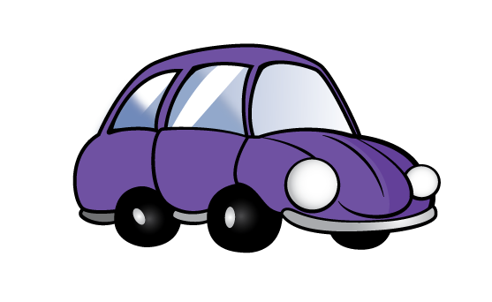
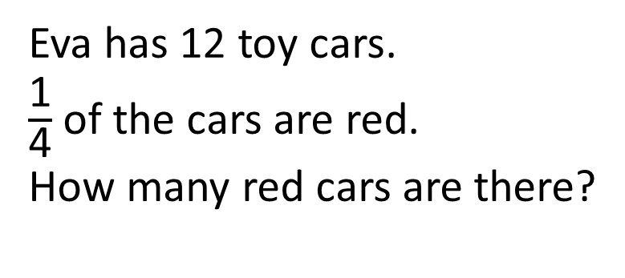
Eva has 12 toy cars.
$\frac{\text{1}}{\text{4}}$ of the cars are red.
How many red cars are there?
There are 3 red cars.

Slide 7
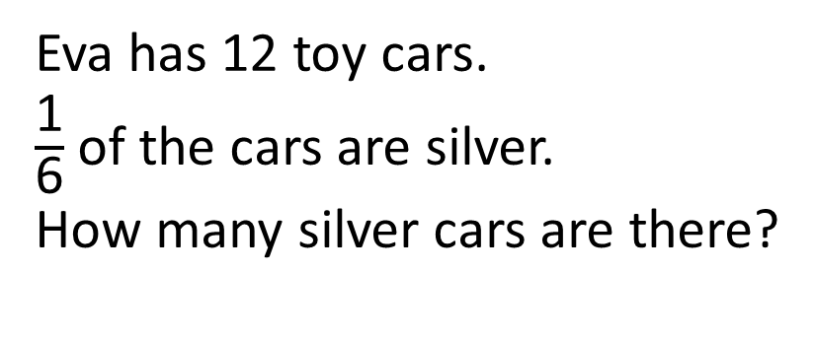
Eva has 12 toy cars.
$\frac{\text{1}}{\text{6}}$ of the cars are silver.
How many silver cars are there?
12
2
2
2
2
2
2
There are 2 silver cars.

Slide 8


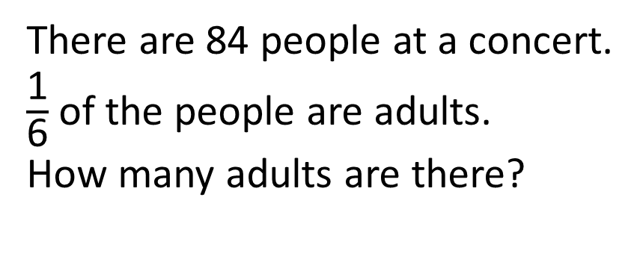
There are 84 people at a concert.
$\frac{\text{1}}{\text{6}}$ of the people are adults.
How many adults are there?
There are 14 adults.
84
14
14
14
14
14
14

Slide 9
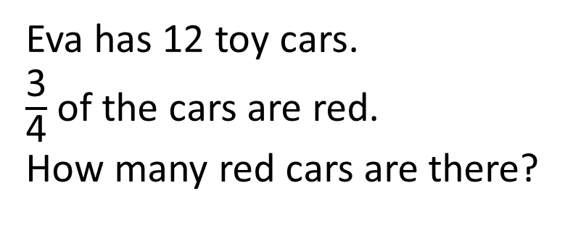
Eva has 12 toy cars.
$\frac{\text{3}}{\text{4}}$ of the cars are red.
How many red cars are there?
There are 9 red cars.

Slide 10



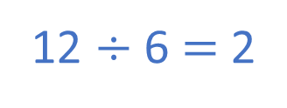

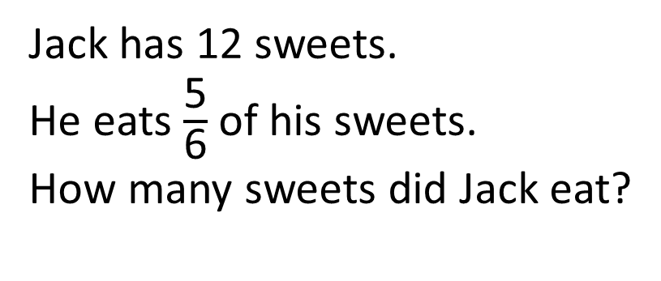
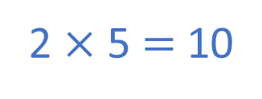
Jack has 12 sweets.
He eats $\frac{\text{5}}{\text{6}}$ of his sweets.
How many sweets did Jack eat?
How many sweets does Jack have left?
What fraction are left?
2
$\frac{\text{1}}{\text{6}}$
Have a think
12
2
2
2
2
2
2
12 $÷$ 6 $=$ 2
2 $×$ 5 $=$ 10
Jack eats 10 sweets.

Slide 11
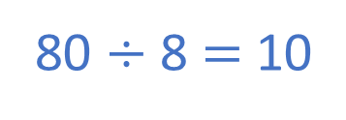
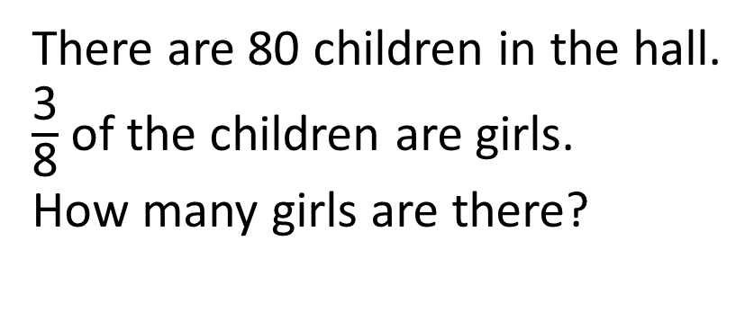
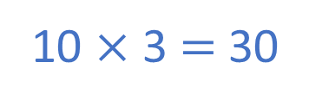
There are 80 children in the hall.
$\frac{\text{3}}{\text{8}}$ of the children are girls.
How many girls are there?
Have a think
80 $÷$ 8 $=$ 10
10 $×$ 3 $=$ 30
There are 30 girls.
80
10
10
10
10
10
10
10
10

Slide 12
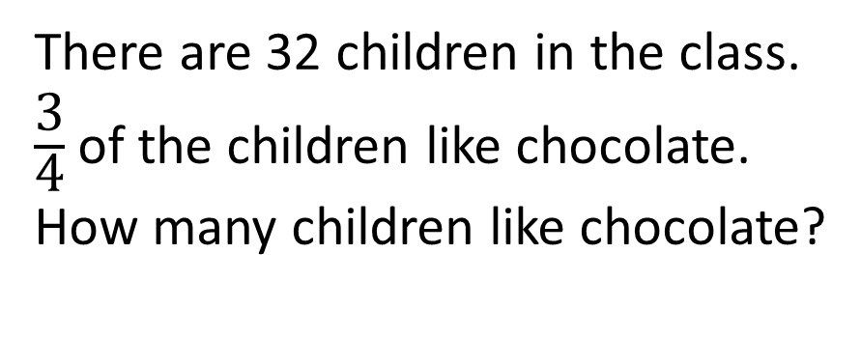
There are 32 children in the class.
$\frac{\text{3}}{\text{4}}$ of the children like chocolate.
How many children like chocolate?
32
8 | 8 | 8 | 8
To do:
Split into the groups (denominator)
32 ÷ 4 = 8 in each group
How many lots of these groups do we need to look at? (numerator)
8 x 3 = 24
So… the golden rule is…
Divide by the bottom, then times by the top!

Slide 13
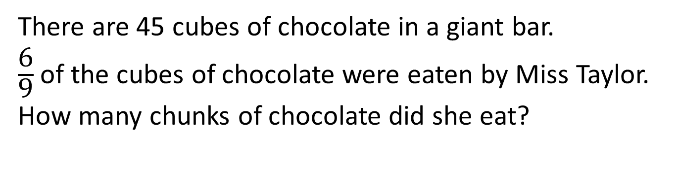
There are 45 cubes of chocolate in a giant bar.
$\frac{\text{6}}{\text{9}}$ of the cubes of chocolate were eaten by Miss Taylor.
How many chunks of chocolate did she eat?
45
5 | 5 | 5
To do:
Split into the groups (denominator)
45 ÷ 9 = 5 in each group
How many lots of these groups do we need to look at? (numerator)
5 x 6 = 30
The golden rule…
Divide by the bottom, then times by the top!

Slide 14
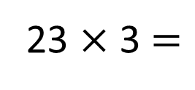
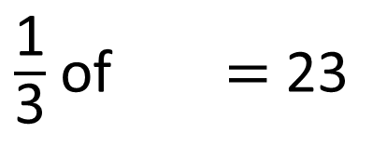
$\frac{\text{1}}{\text{3}}$ of $=$ 23
69
Have a think
69
?
23
23
23
23 $×$ 3 $=$

Slide 15
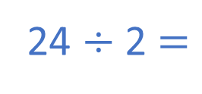
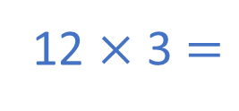
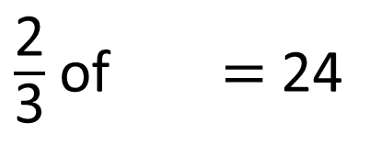
$\frac{\text{2}}{\text{3}}$ of $=$ 24
36
Have a think
36
?
12
12
12
24
24 $÷$ 2 $=$
12
12 $×$ 3 $=$
36

