Slide 1
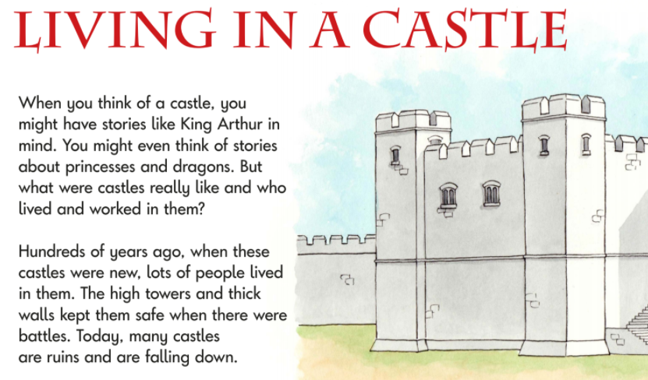
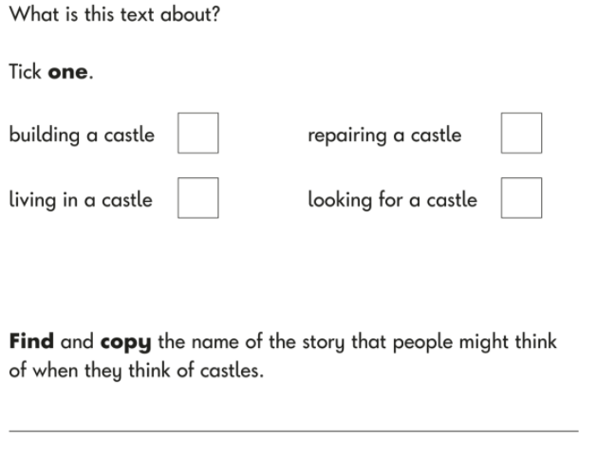
English Monday 1 March
This week we are going to write an information about castles. But first we need to know who lived in a castle, who worked in a castle and what it was like living in a castle.
Task 1
Complete the reading comprehension questions about living in a castle.

Slide 2
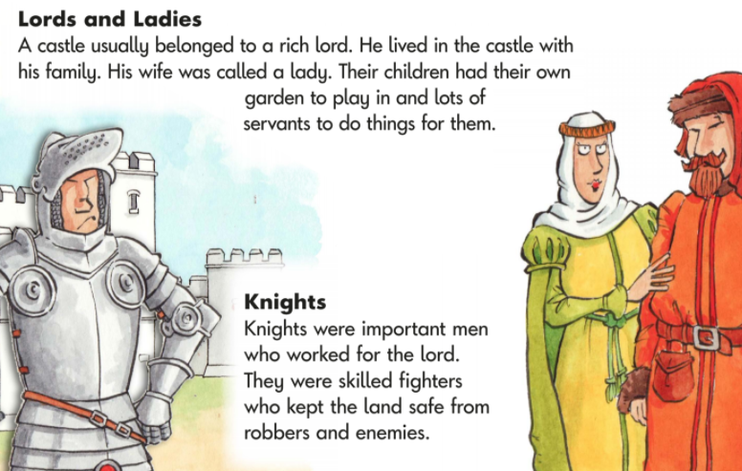
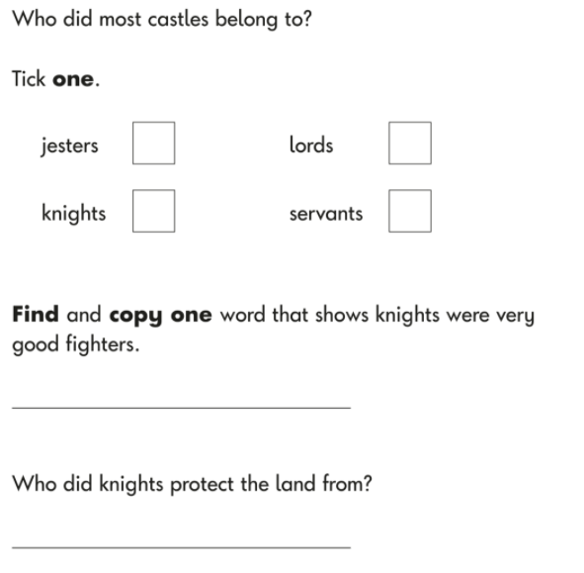

Slide 3
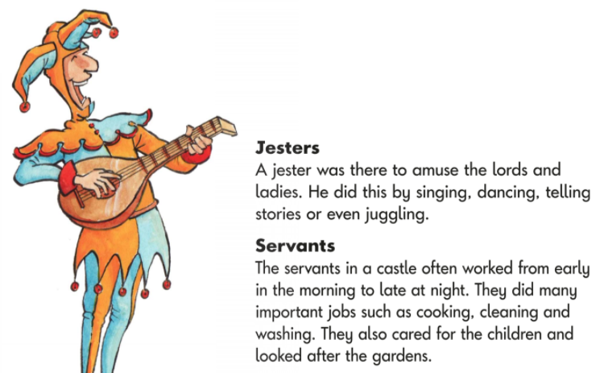
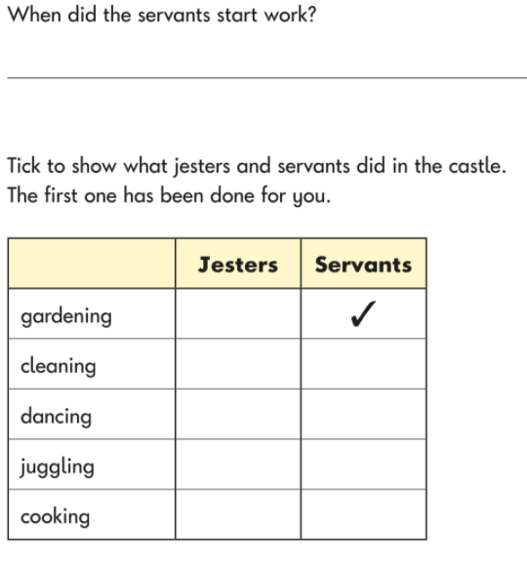

Slide 4
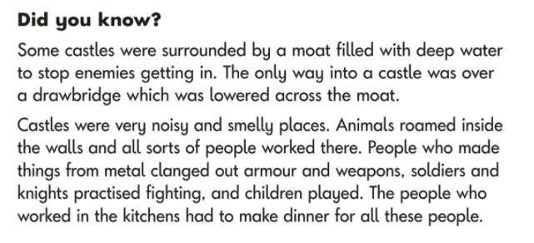
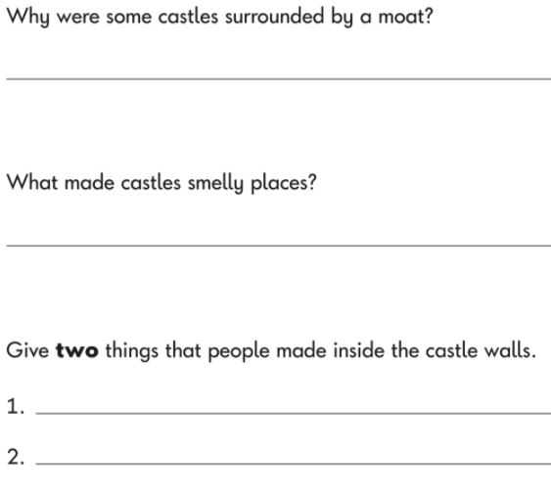
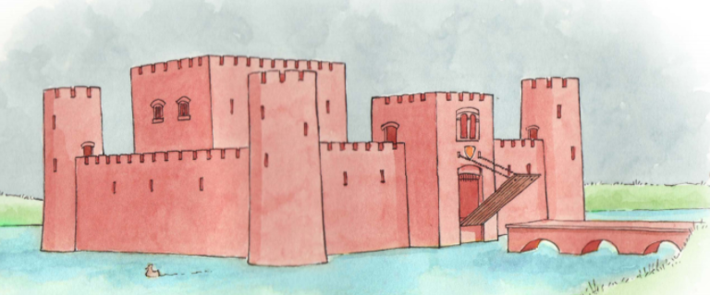

Slide 5
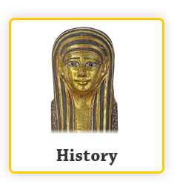
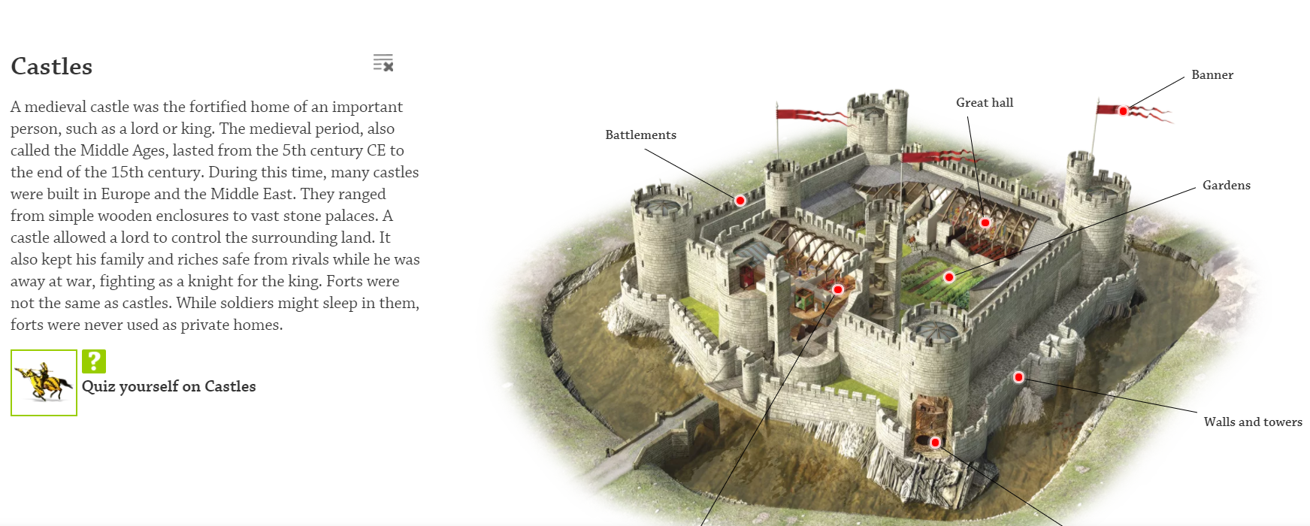
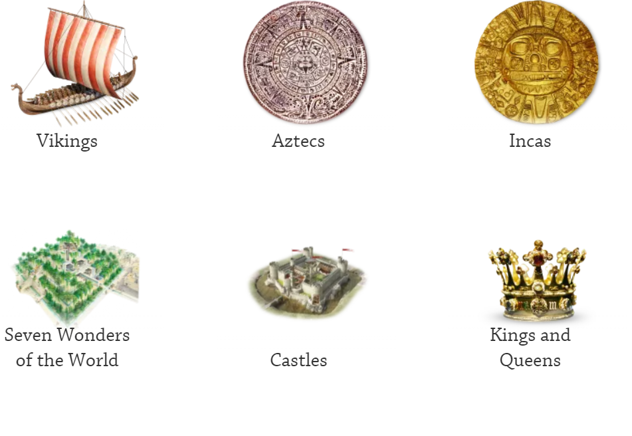
Task 2
On our class page have a look at DKFindout. In the History section there is a lot of information about castles and the people who used to live in them. Enjoy finding out about castles and decide what interests you.
Click on the red dots to find out more. It is a very interactive site.

