Slide 1


Year 3 – Spring Block 4 – Length and Perimeter
Step 1: Measure Length
© Classroom Secrets Limited 2019

Slide 2
Introduction
Put these measurements in order of length, shortest to longest.
15 metres
60 centimetres
100 millimetres
3 metres
© Classroom Secrets Limited 2019

Slide 3
Introduction
Put these measurements in order of length, shortest to longest.
100 millimetres
60 centimetres
3 metres
15 metres
© Classroom Secrets Limited 2019

Slide 4
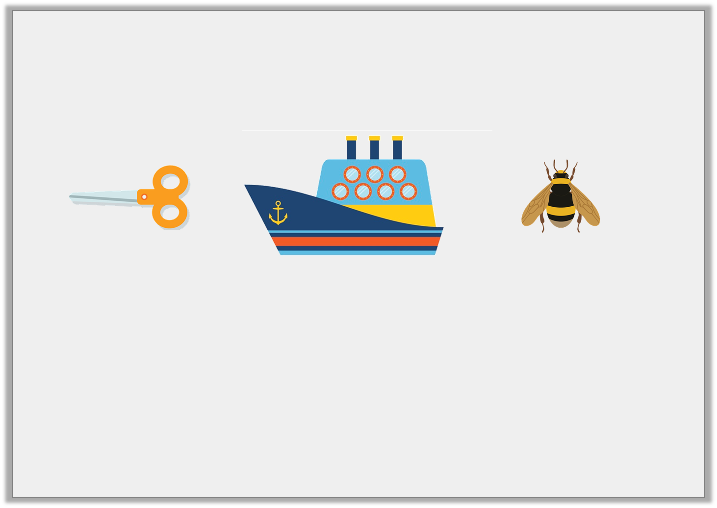
Varied Fluency 2
Imagine these objects are their usual size and match them to the most suitable length measurement.
scissors
cruise ship
bee
15cm
9mm
250m
© Classroom Secrets Limited 2019

Slide 5
Varied Fluency 2
Imagine these objects are their usual size and match them to the most suitable length measurement.
scissors
cruise ship
bee
15cm
9mm
250m
© Classroom Secrets Limited 2019

Slide 6

Varied Fluency 3
Tick the length of the sweet.
Not drawn to scale
5 | 6 | 7 | 8 | 9 | 10 | 11 | 12 | 13 | 14
3cm and 5mm |  |  | 5cm
© Classroom Secrets Limited 2019

Slide 7
Varied Fluency 3
Tick the length of the sweet.
Not drawn to scale
5 | 6 | 7 | 8 | 9 | 10 | 11 | 12 | 13 | 14
3cm and 5mm | ✓ |  | 5cm
© Classroom Secrets Limited 2019

