Slide 1


Science
Animals Including Humans
Year One
Science | Year 3 | Animals Including Humans | Types of Skeletons | Lesson 2

Slide 2


Slide 3
Aim
I can sort animals based on their skeletons.
Success Criteria
I can name the three different types of skeletons.
I can explain the pros and cons of different types of skeletons.

Slide 4

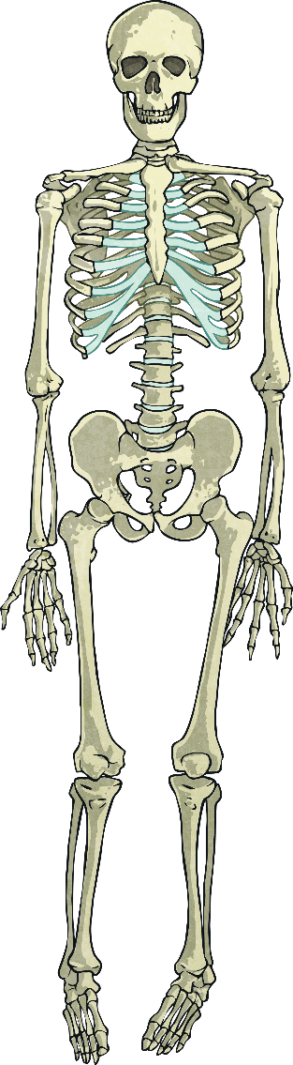
Skeleton
What do you associate with the word skeleton?

Slide 5
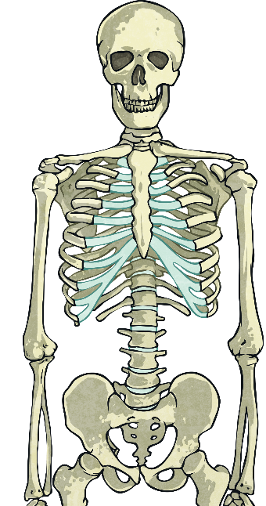
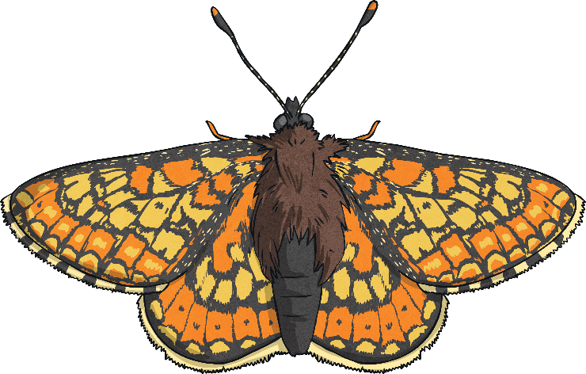
Vertebrates and Invertebrates
The difference between vertebrates and invertebrates is simple!
Vertebrates have a backbone (spine)…
…and invertebrates don’t
Backbone
(spine)
vertebrate
invertebrate
Now let’s see if you can categorise animals as vertebrates or invertebrates.

Slide 6

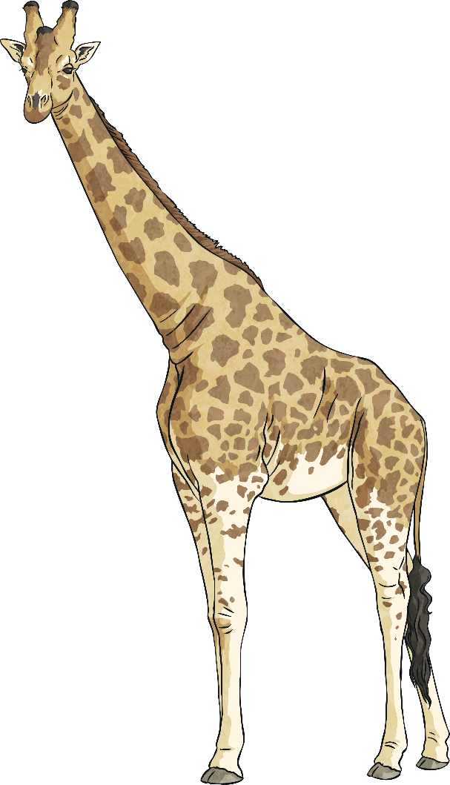
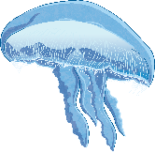
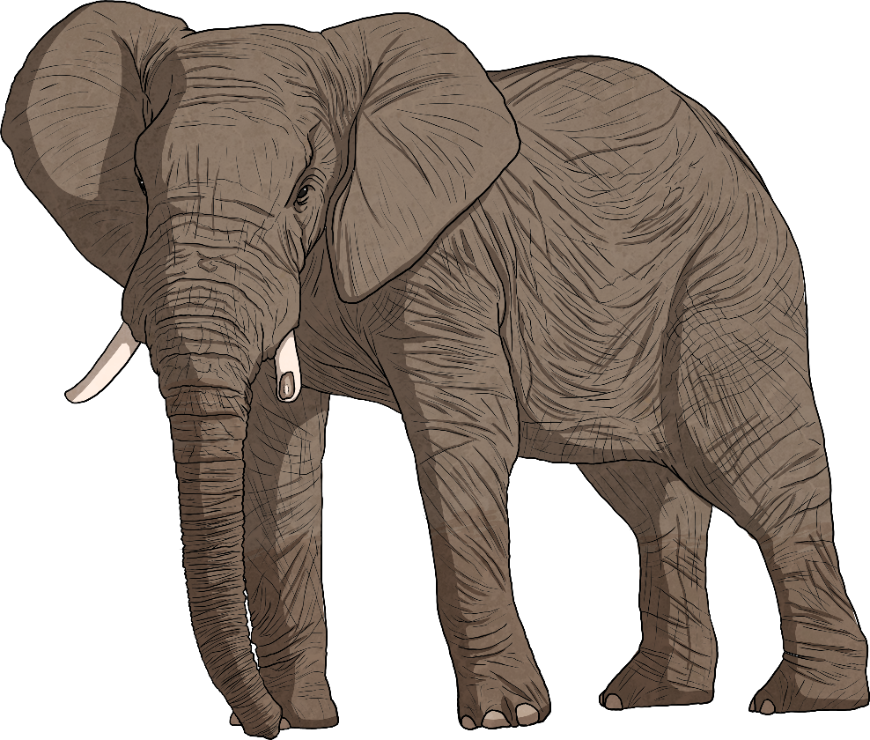

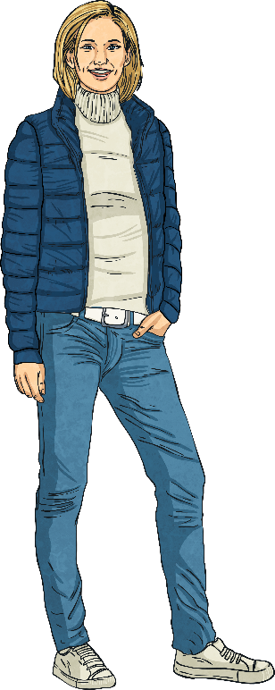
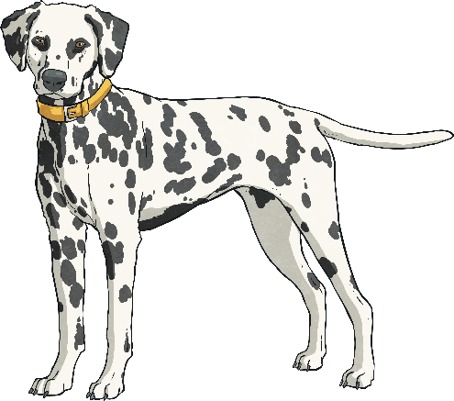
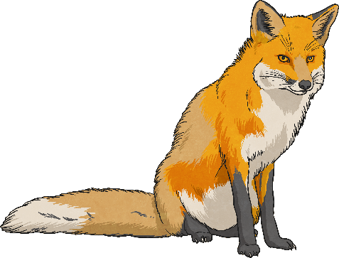
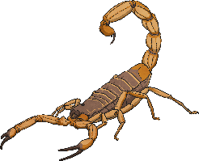

Vertebrate or Invertebrate
Quiz!

Slide 7



Dog
Invertebrate
Vertebrate
Invertebrate
Vertebrate
or

Slide 8
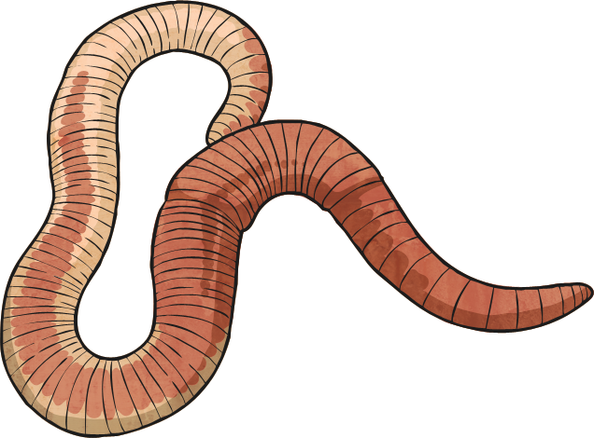
Worm
Invertebrate
Vertebrate
Invertebrate
Vertebrate
or

Slide 9
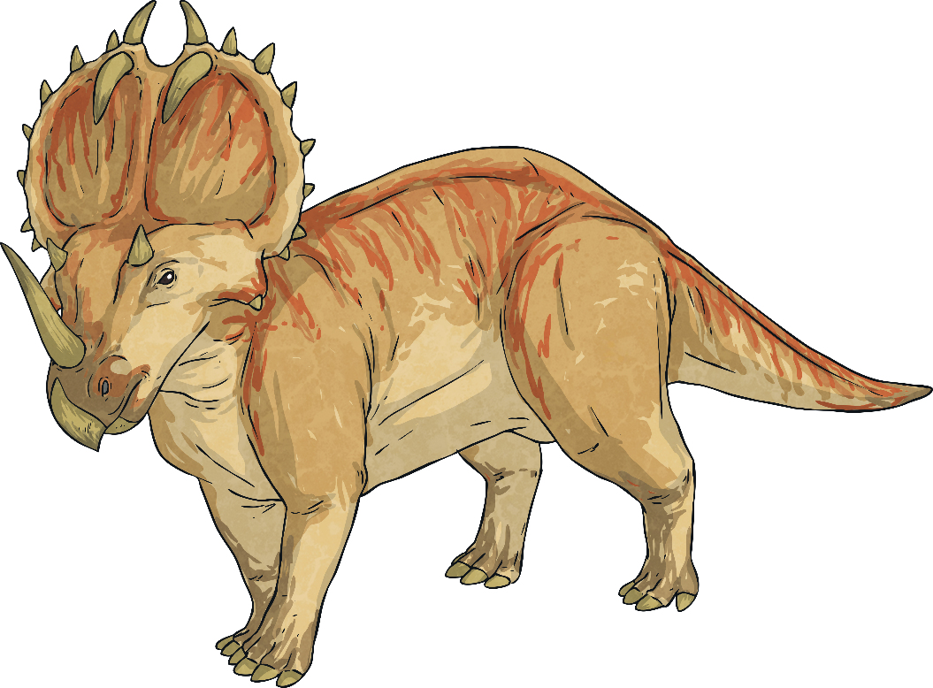
Dinosaur
Invertebrate
Vertebrate
Invertebrate
Vertebrate
or

Slide 10

Human
Invertebrate
Vertebrate
Invertebrate
Vertebrate
or

Slide 11
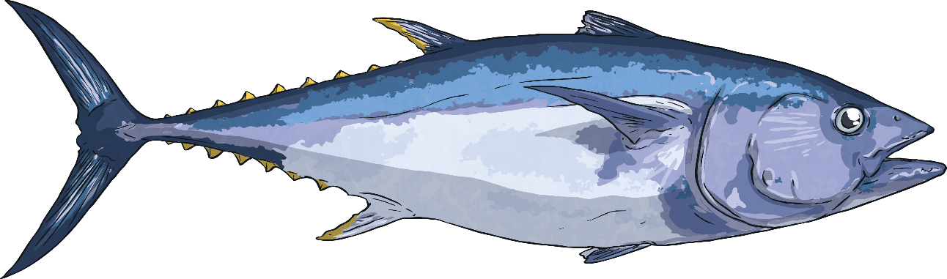
Fish
Invertebrate
Vertebrate
Invertebrate
Vertebrate
or

Slide 12

Jellyfish
Invertebrate
Vertebrate
Invertebrate
Vertebrate
or

Slide 13
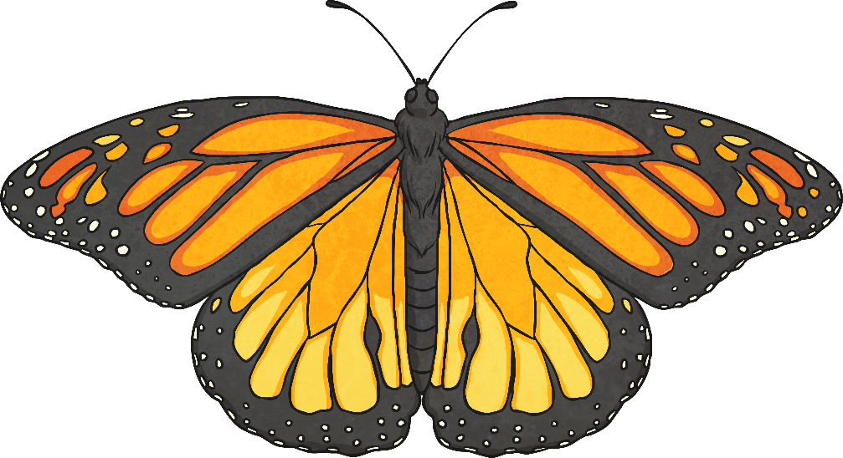
Butterfly
Invertebrate
Vertebrate
Invertebrate
Vertebrate
or

Slide 14



Types of Skeletons
A further classification of skeletons comes from if an animal has a skeleton and where it is.
All vertebrates have an endoskeleton. However invertebrates can be divided again between those with an exoskeleton and those with a hydrostatic skeleton.
vertebrate
invertebrate
endoskeleton
exoskeleton
hydrostatic skeleton
What do you think the words endoskeleton, exoskeleton and hydrostatic skeleton mean?

Slide 15


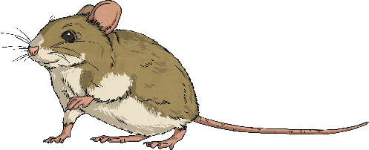
Endoskeletons
Animals with endoskeletons have skeletons on the inside of their bodies.
Endoskeletons are lighter than exoskeletons.
As the animal grows so does their skeleton.

Slide 16
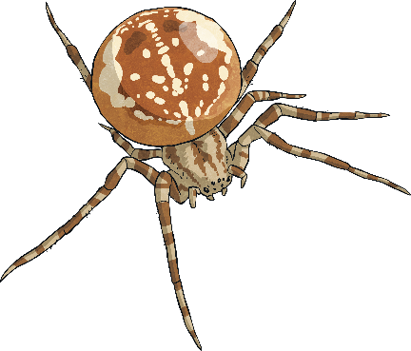
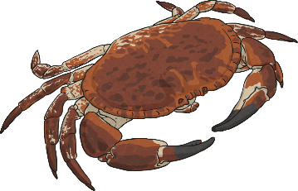

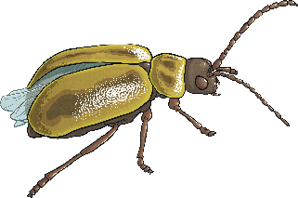
Exoskeletons
Animals with exoskeletons have
their skeletons on
the outside!
Watch the following
clip to see how they shed their skeletons
(clip the crab below).
Exoskeletons do not grow with the animal. Therefore the animal has to shed its skeleton and produce a
new one!

Slide 17
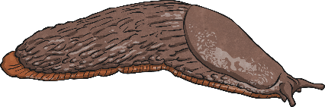

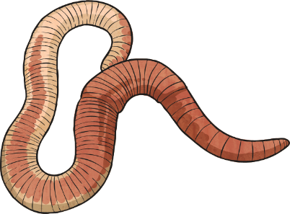
Hydrostatic Skeletons
Animals with hydrostatic skeletons don’t actually have
any bones!
All animals with hydro-static skeletons are invertebrates.
Instead these animals have a fluid-filled compartment in their body called a coelom.

Slide 18


Skeleton Types
endoskeleton
exoskeleton
hydrostatic skeleton
Can you think of an example of an animal with an exoskeleton, endoskeleton or hydrostatic skeleton?

Slide 19




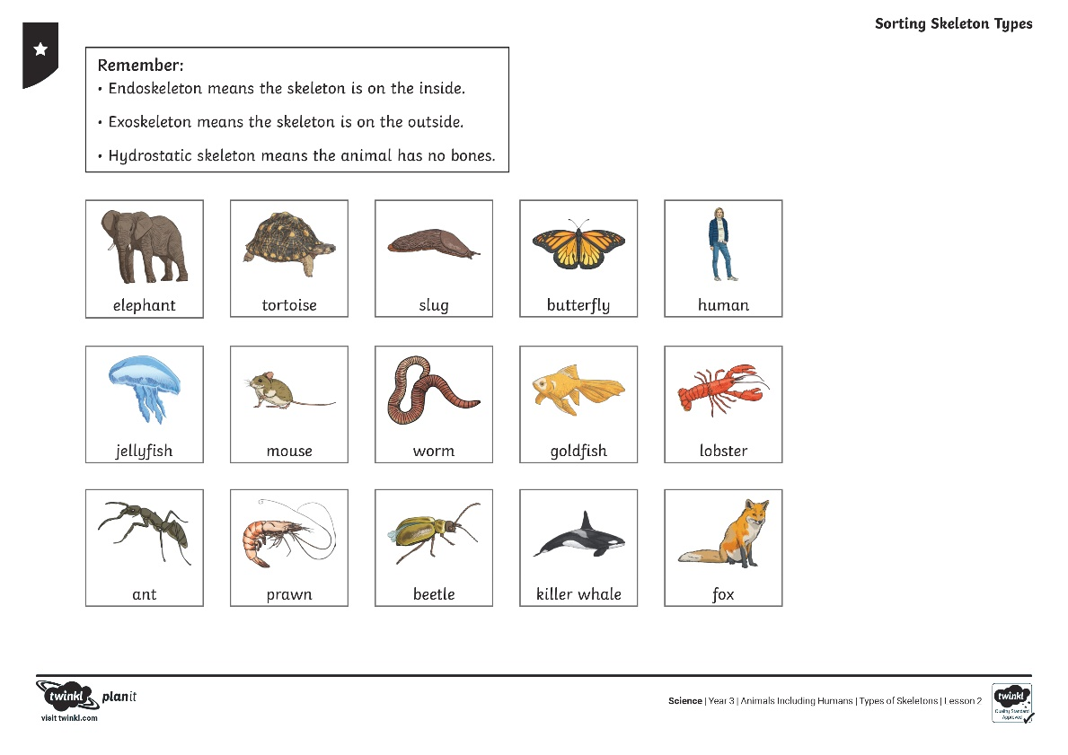
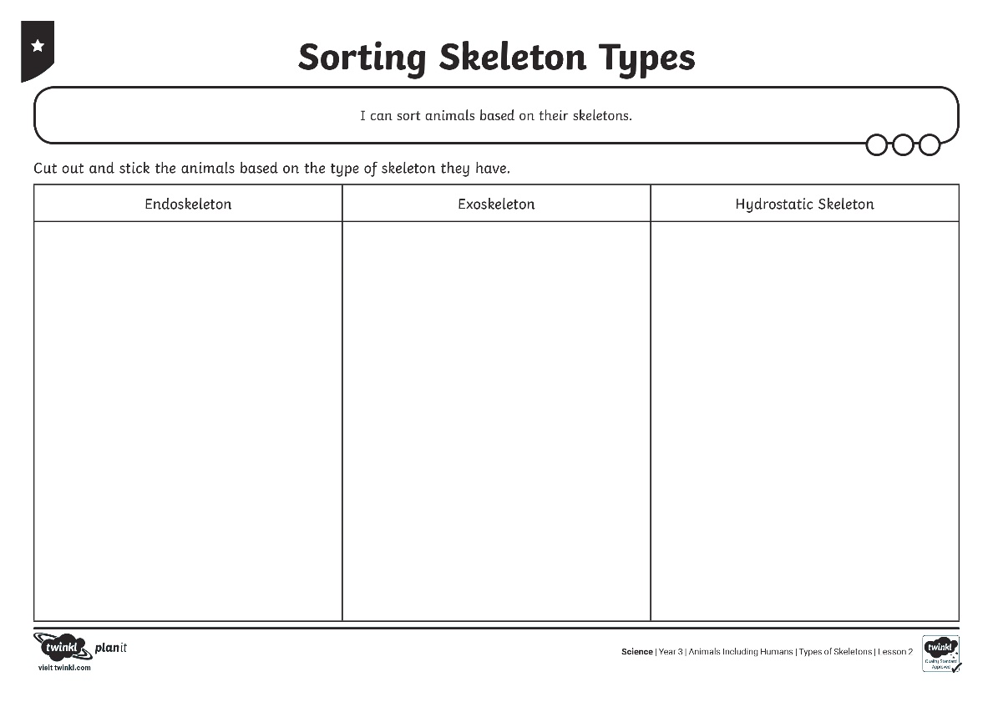



Sorting Skeleton Types

