Slide 1
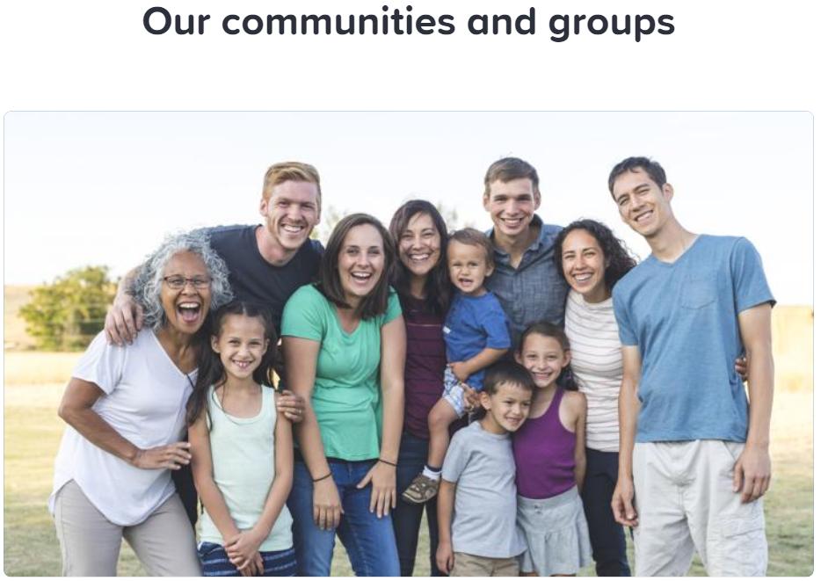
Caring and Responsibility Lesson 3

Slide 2
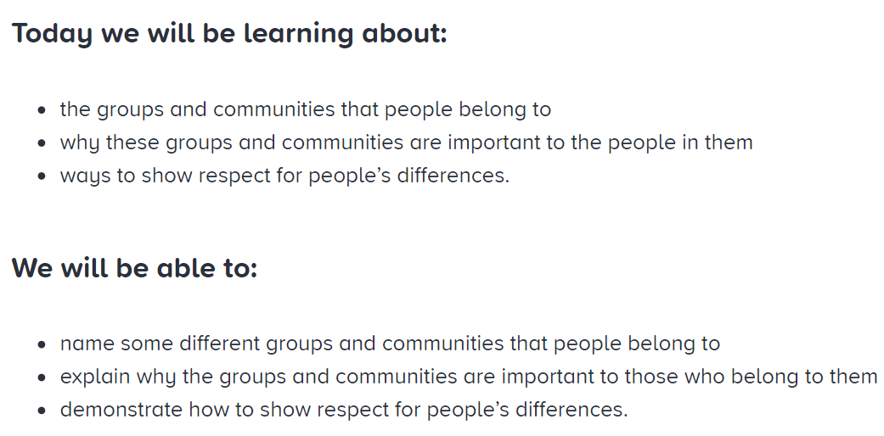
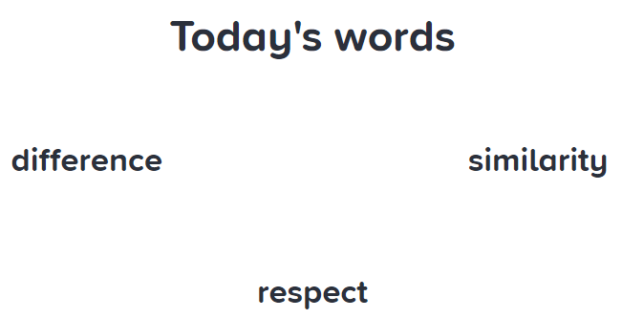

Slide 3
For some people, the groups and communities they belong to can be essential frothier wellbeing. How might joining a group help the following people?
An elderly person who doesn’t live near their family
A parent with a new baby
Someone who has just moved to a new area and doesn’t know anybody.
How might it feel to be someone who is not part of a group or community?
How can joining a new group or community help someone feel good?

Slide 4
Which groups and communities are you and your friends at school part of?
Make a list.
Which groups and communities are we all part of?
Are there any groups and communities that you did not know about?
Are there any you would like to find out more about?
Can people belong to different groups and communities and still get along with one another?

Slide 5
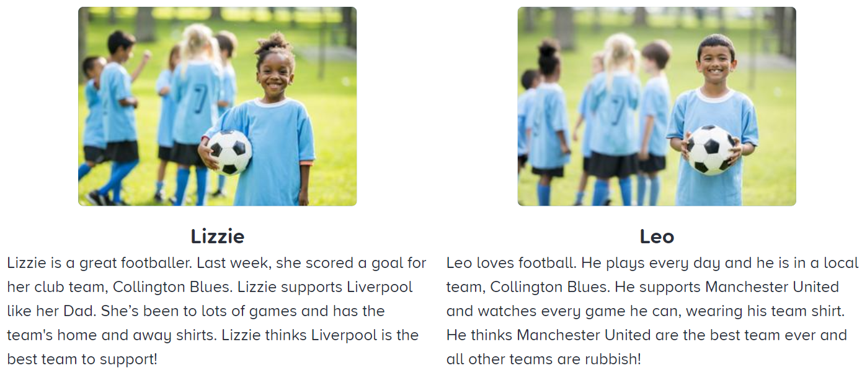
Meet Lizzie and Leo.
How are they the same? How are they different?

Slide 6
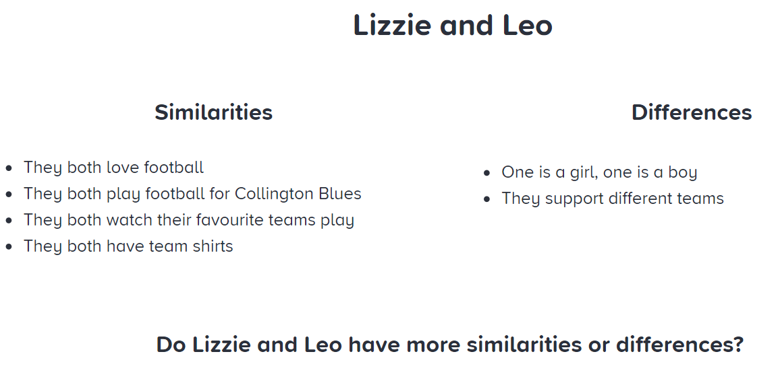

Slide 7
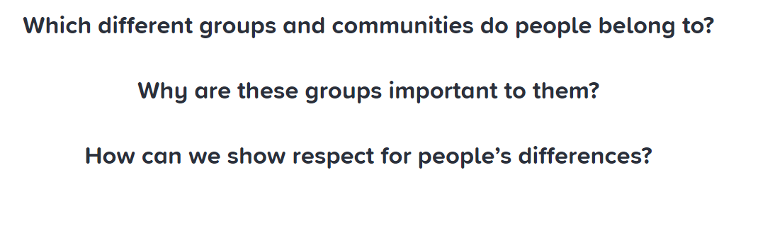
What might Lizzie and Leo say or do to show respect for their differences?

